Slide 1
Control System Studio Training
-
Archive System
Kay Kasemir
ORNL/SNS
kasemirk@ornl.gov
Jan. 2013

Slide 2
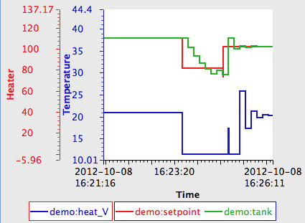
Archive System Interactions
End User
  Look at PVs
  in Data Browser
Administrator
  Setup Data Store
  Create Configuration
  Run Archive Engine(s)

Slide 3
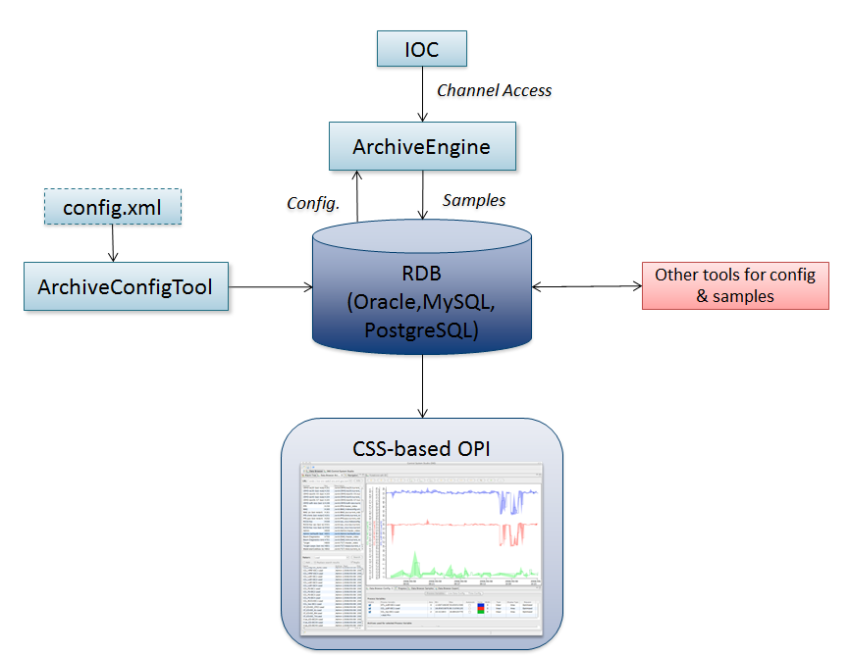
Archive System Overview

Slide 4
RDB Alternatives
Data Browser
  read from old Channel Archiver’s ArchiveDataServer.cgi
  use your own site-specific ‘reader’ plugins
Archive Engine
  Pluggable Configuration
  Pluggable ‘Write’ support

Slide 5


Which one to use?
Channel Archiver
  Fast
  Can’t be maintained
RDB
  Slow
  Super easy to maintain
Worth a look: SLAC Archive ‘Appliance’

Slide 6
CSS Data Browser Configuration
Can be done via preference GUI
Better: plugin_customization.ini of CSS product:
# Read-only(!) archive access
org.csstudio.archive.rdb/url=jdbc:mysql://localhost/archive
org.csstudio.archive.rdb/user=report
org.csstudio.archive.rdb/password=$report
org.csstudio.archive.rdb/schema=
# URLs for archive search
org.csstudio.trends.databrowser2/urls=jdbc:mysql://localhost/archive
# Default data sources for newly added channels
# Format: <name>|<key>|<url>
org.csstudio.trends.databrowser2/archives=RDB|1|jdbc:mysql://localhost/archive

Slide 7
View Archive Data in CSS Data Browser
Open Data Browser Plot
Add PV
  If default archive setup lists data source with historic data for the PV, it will be displayed

Slide 8
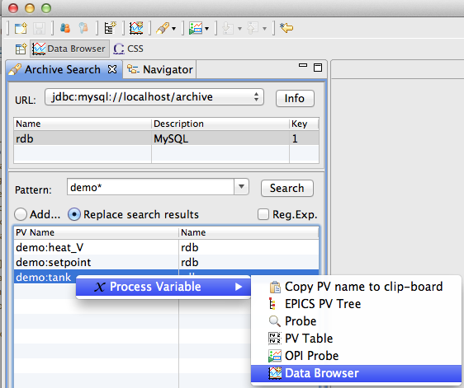
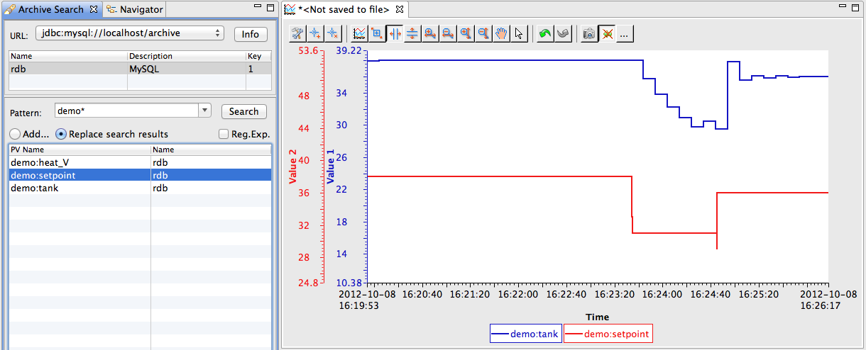
Searching for PVs in Archive
Open Archive Search View
  Data Browser Perspective,
  or Plot’s context menu
Search for channels
via pattern
Send to new Data Browser
  Via context menu
Send to
existing Plot
  Via drag
  & drop

Slide 9
That’s it!
Look at data in Data Browser, no matter if “live” or “archived” data
.. unless you also setup and maintain the infrastructure ..

