Slide 1
Control System Studio Training
-
Alarm System Use
Kay Kasemir
ORNL/SNS
kasemirk@ornl.gov
Jan. 2013

Slide 2
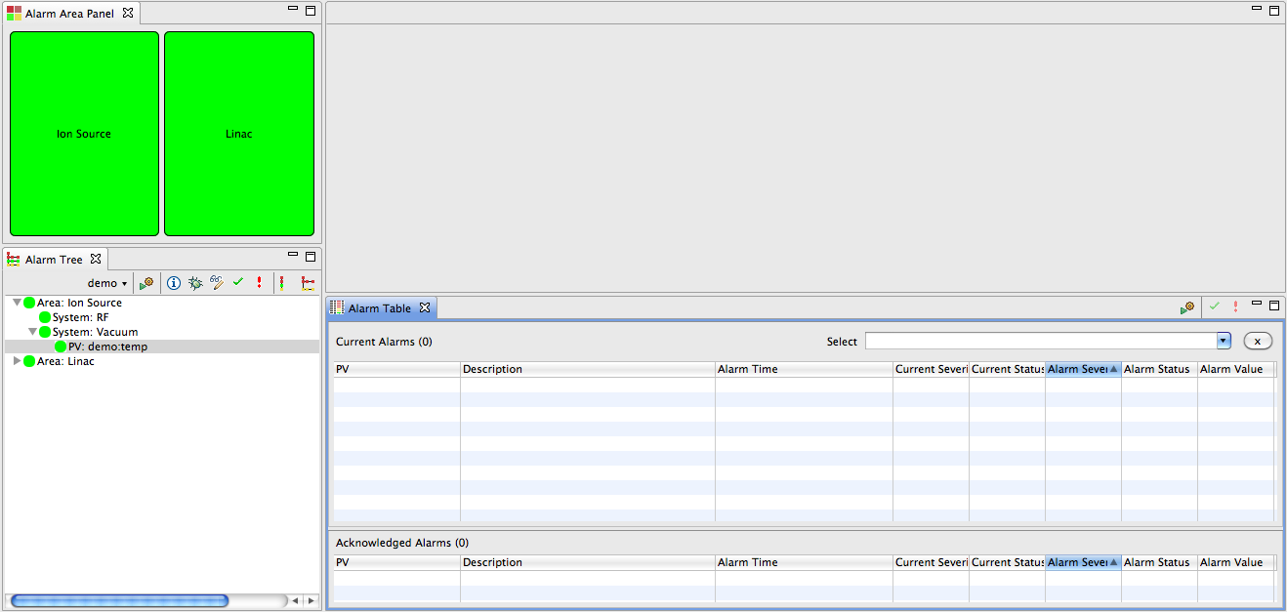
Operator Using the Alarm System
Menu CSS, Alarm, Alarm Table
Ideally: no alarms

Slide 3
Operator Looking at Alarm User Interface
Other Alarm Views (Context Menu Alarm Perspective)
  Alarm Tree: Displays all items monitored by the alarm server (with or without current alarm)
  Area Panel: Overview of areas
Still, all OK

Slide 4
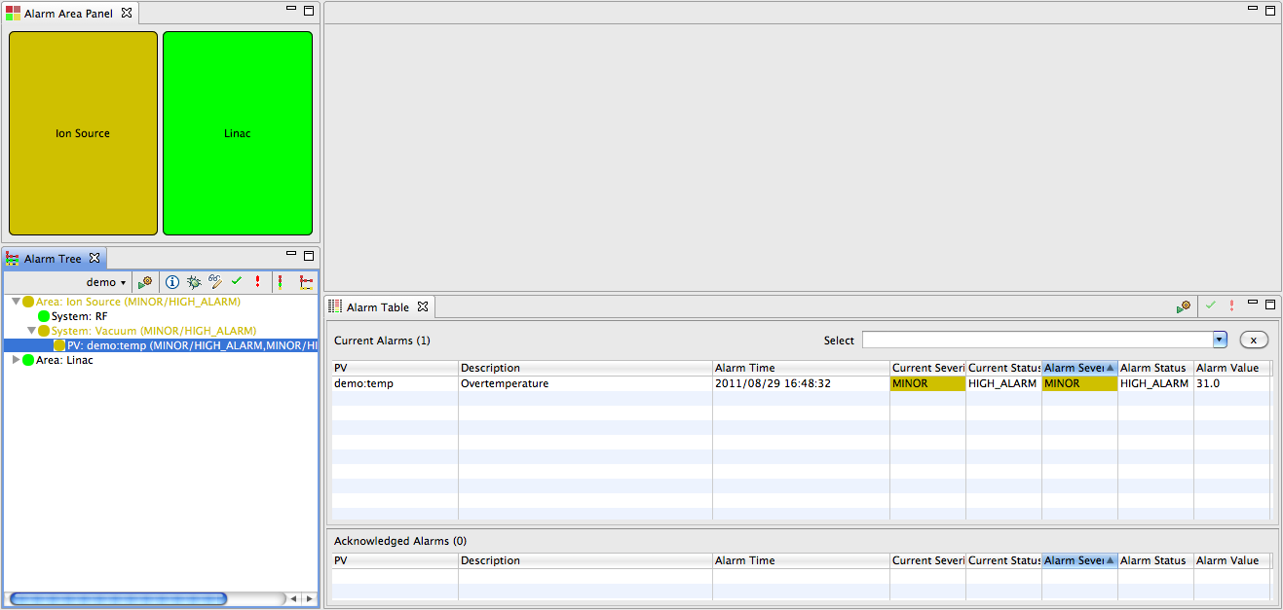
An Alarm Triggers!
Table shows what, when, …
Annunciator would say:
“Minor alarm: Overtemperature”

Slide 5
An Alarm Triggers…
Some operators prefer just the Alarm Table, others also like to look at Area Panel or Tree View
So there is a problem in the Ion Source Vacuum…

Slide 6
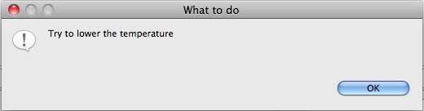
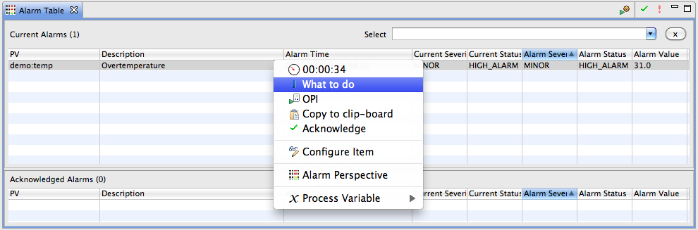
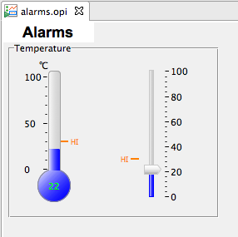
Context menu of Alarm
Guidance
Links to related OPIs

Slide 7
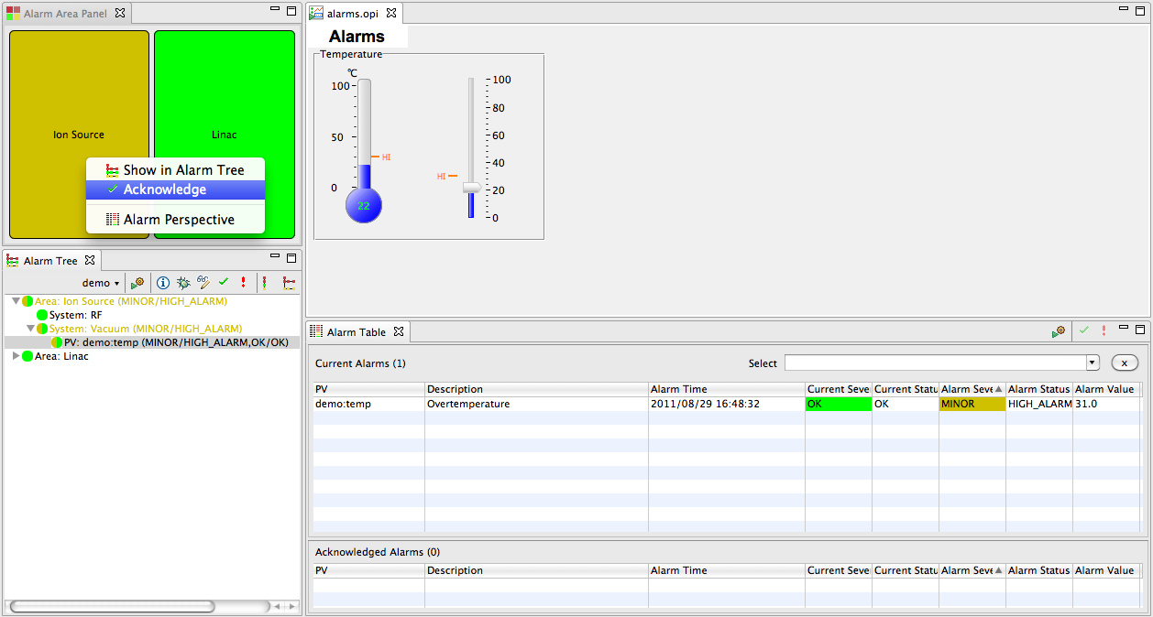
The Problem is fixed, Alarm clears
By default, the alarm system latches alarms
  “Current” severity of PV is OK, but MINOR alarm is remembered until alarm is ✔ Acknowledged

Slide 8
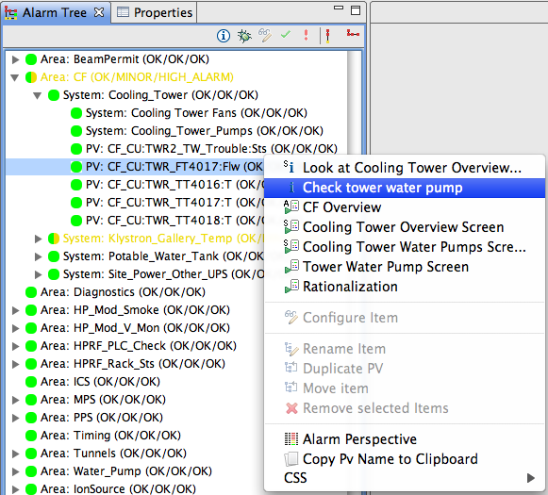
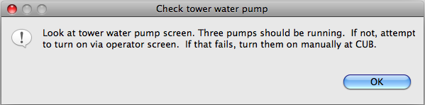
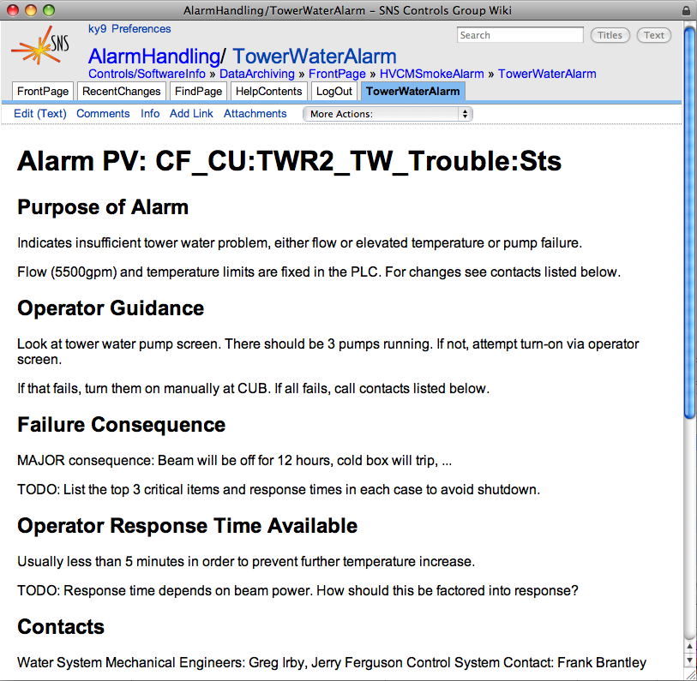
Guidance, Related Displays, Commands
Basic Text
Open EDM/OPI screen
Open web page
Run ext. command
Hierarchical:
Including info of parent entries
Merges Guidance etc. from all selected alarms

Slide 9
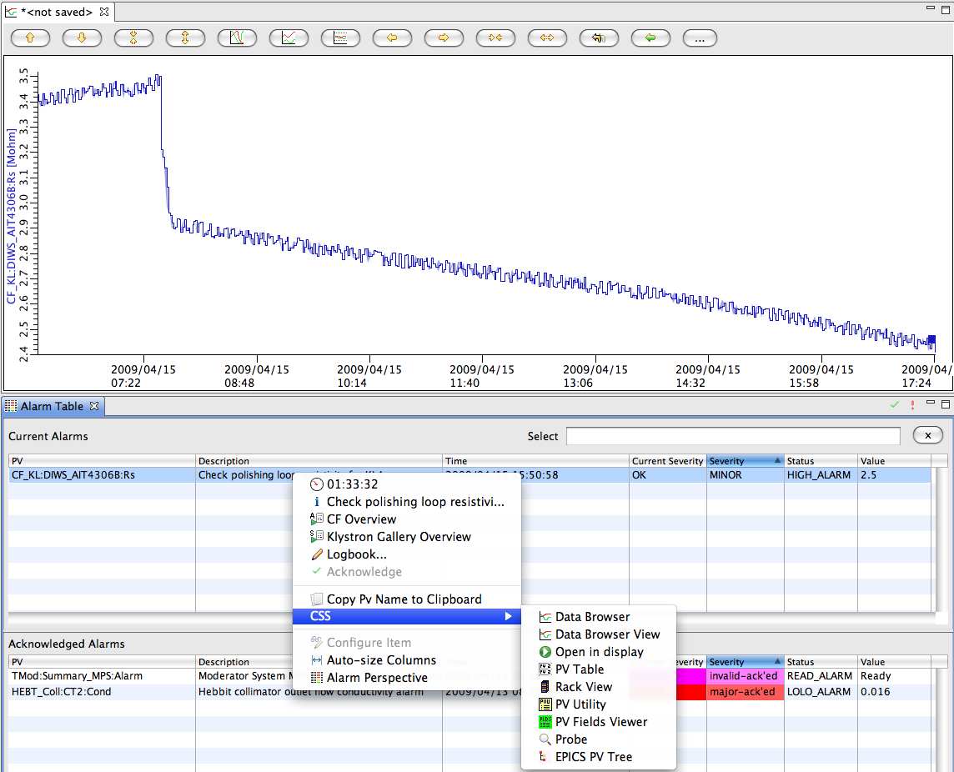
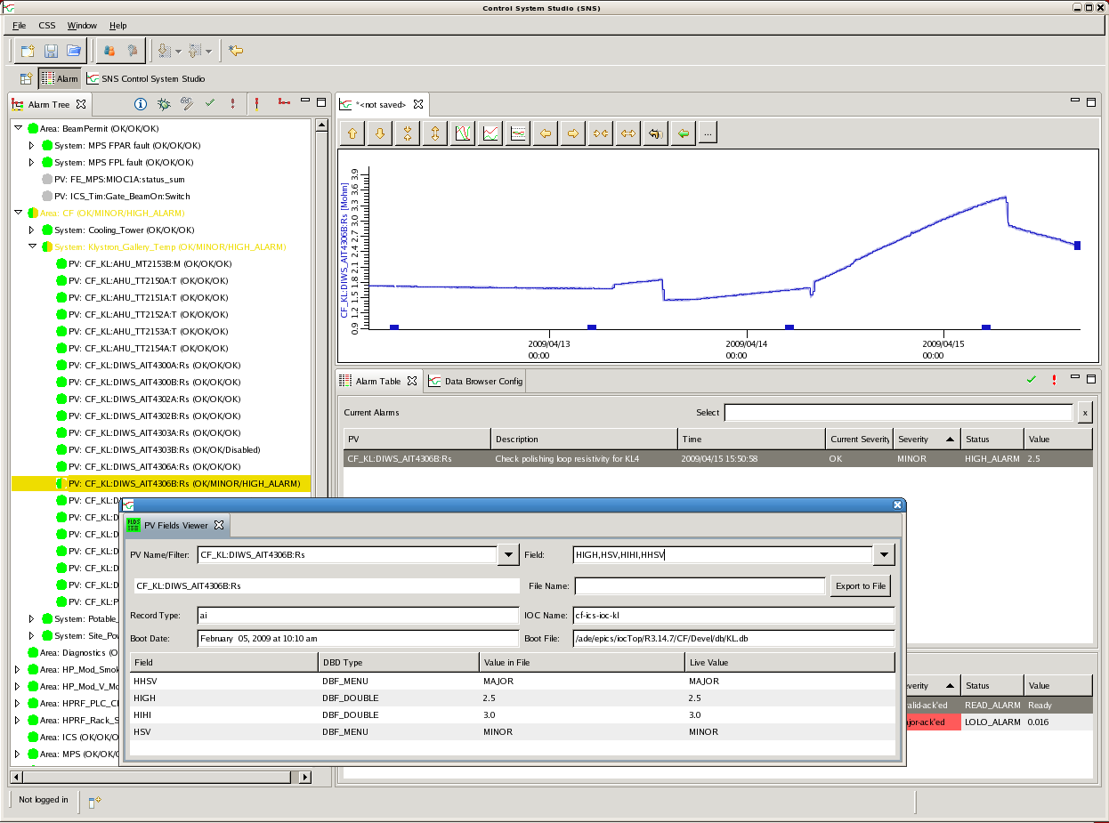
Context Menus Connect the Tools
Send alarm
PV to any
other CSS
PV tool

Slide 10
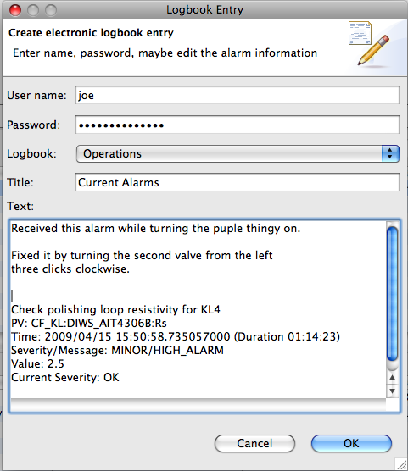
E-Log Entries
“Logbook”
from context menu
creates text w/
basic info about
selected alarms.
Edit, submit.
Pluggable implementation
Similar: EMail

Slide 11
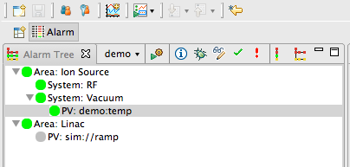
Configuring the Alarm System
Open Alarm Tree
  Menu CSS/Alarm/Alarm Tree
  Use Alarm Perspective
Select alarm configuration
Select Alarm Configuration
Select Perspective
Alarm Configuration
(would be empty for new configuration)
Alarm Tree View

Slide 12
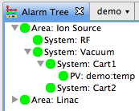
Alarm Configuration Hierarchy
Root
Root
  Name of the alarm configuration
Area
  Top-level elements
System
  Anything below ‘Area’
  Can have (Sub-)System below other System
PV
  Alarm trigger PV
  Can be below Area or System
Areas
(Sub-) System
PV

Slide 13
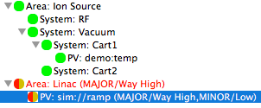
Why Hierarchy?
Organization
  Easier to maintain than plain list of PVs
Help Operators Locate Alarm
  Especially when there are many alarms, if can be useful to know where they are
  Use physical “Areas”, i.e. location along the machine!
Guidance, Related Displays
  Guidance for an Area or System will be displayed for all Subsystems and PVs below that point in the alarm configuration tree
  Examples:
    General Ion Source contact information (phone numbers, …)
    Linac Overview display link

Slide 14
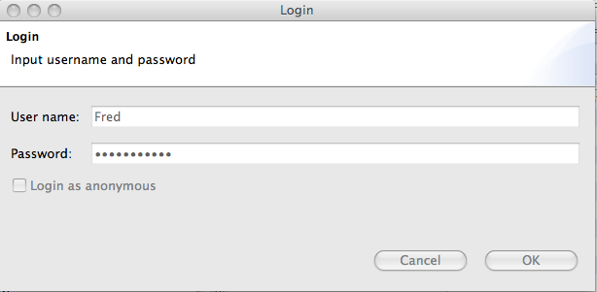
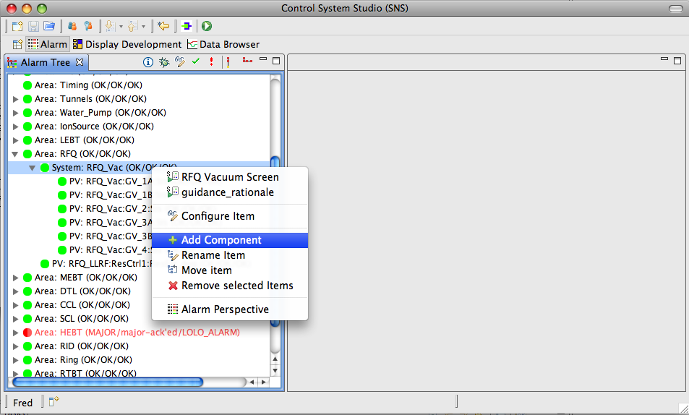
Editing the Alarm Configuration
Open Alarm Tree
Log in
Use Context Menu to add, edit, remove, ...
Add a new Area, System, or PV

Slide 15
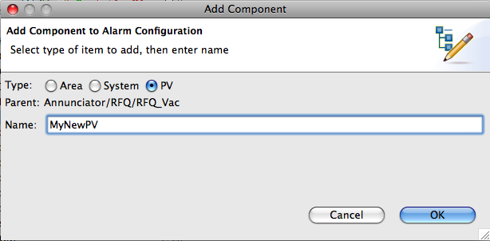
Add PV or Subsystem
Right-click on ‘parent’
“Add …”
Check either Area, System or PV
Enter name
Online. No search for config files, no restarts.

Slide 16
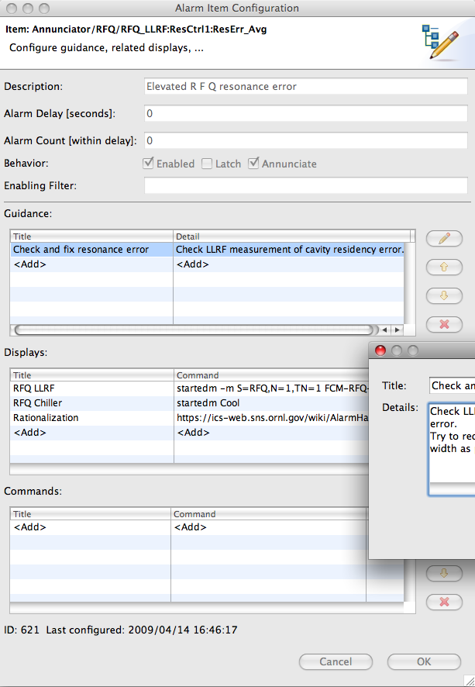
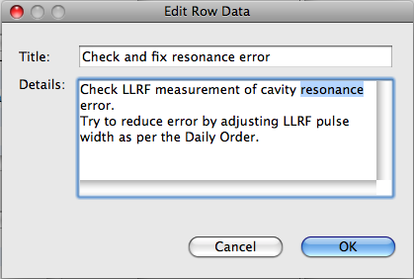
Configure PV
Again online
Especially useful
for operators to
update guidance
and related
screens.

Slide 17
PV Configuration
Full Path to PV in Alarm Tree
Description:
Also used for Annunciation
Guidance:
Simple Title & Detail that should help operators handle the alarm
Display Link Options:
/CSS/path/to/display.opi
http://www.google.com
https://some.host.org
scriptname arg1 arg2
See online help for more details

Slide 18
Exercise: Edit Alarm Configuration
Open Alarm Tree View
Select the Alarm Configuration (‘root’) assigned to your team
Add areas like “Front End”, “Linac”, “Target”
Add Systems like “Vacuum”, “Cooling”
Create simple BOY display that shows alarm trigger PVs and allows you to control them
Add alarm trigger PVs to alarm configuration
  Add some simple guidance like “Fix it”
  Use path to your BOY *.opi as Display Link

Slide 19
Exercise: Use Alarm Configuration
Switch to the Alarm Perspective
  Can do that from context menu of alarm tree
Use the display to trigger an alarm
See how alarm is indicated in the table, tree, area panel
  Open the guidance, related display
  Cause the alarm PV to stop alarming
  Acknowledge the alarm

Slide 20
General Alarm Server Behavior
Latch highest severity, or non-latching
  like ALH “ack. transient”
Annunciate
Chatter filter ala ALH
  Alarm only if severity persists some minimum time
  .. or alarm happens >=N times within period
Optional formula-based alarm enablement:
  Enable if “(pv_x > 5 && pv_y < 7) || pv_z==1”
  … but we prefer to move that logic into IOC
When acknowledging MAJOR alarm, subsequent MINOR alarms not annunciated
  ALH would again blink/require ack’

