Slide 1
Control System Studio Training
-
Alarm System Guidelines
Kay Kasemir
ORNL/SNS
kasemirk@ornl.gov
Jan. 2013

Slide 2

Alarm System Components
User Interface
Configuration
Alarm Server, …
Control System

Slide 3
Levels Of Complexity
Easy
Use the Alarm System
  Control Room operator
Configure the Alarm System
  Certain operators, IOC engineers
Alarm System Setup
  CSS maintainer for site
Coming up with a good configuration
  Everybody
Hard

Slide 4
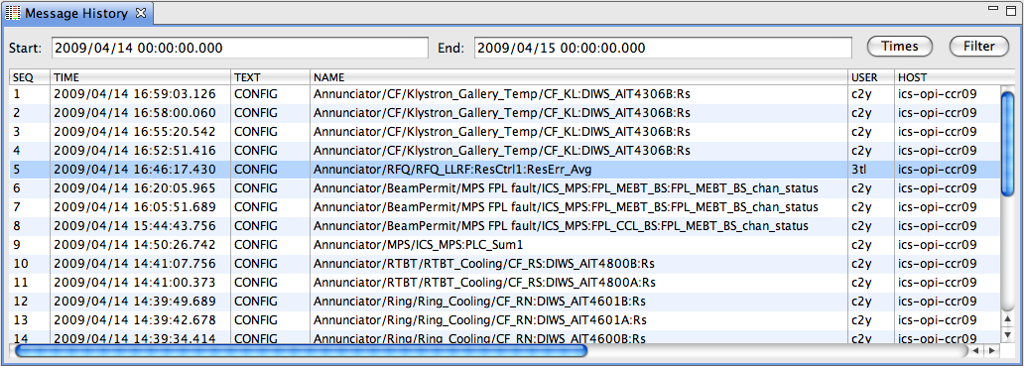
Logging
..into generic CSS log also used for error/warn/info/debug messages
Alarm Server: State transitions, Annunciations
Alarm GUI: Ack/Un-Ack requests, Config changes
Generic Message History Viewer
  Example w/ Filter on TEXT=CONFIG

Slide 5
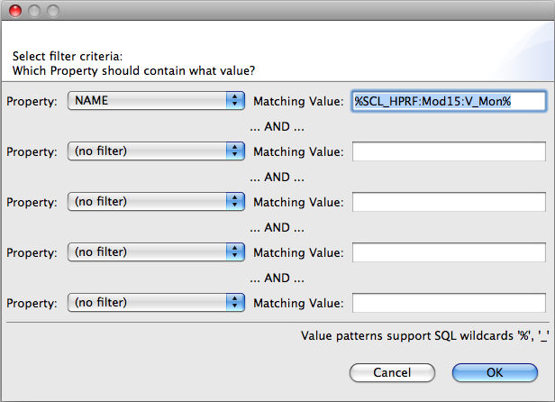
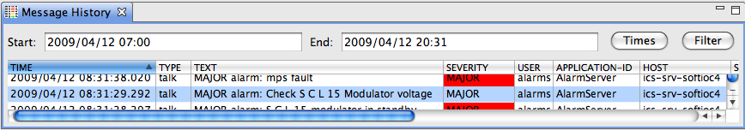
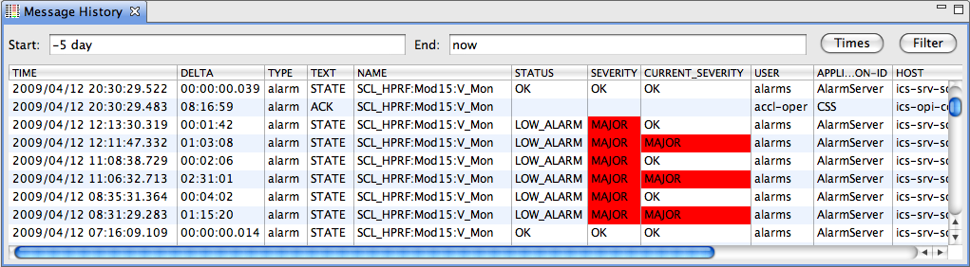
Logging: Get timeline
Example: Filter on TYPE, PV
6. All OK
4. Problem fixed
5. Ack’ed by operator
3. Alarm Server annunciates
1. PV triggers,
clears, triggers again
2. Alarm Server latches alarm

Slide 6
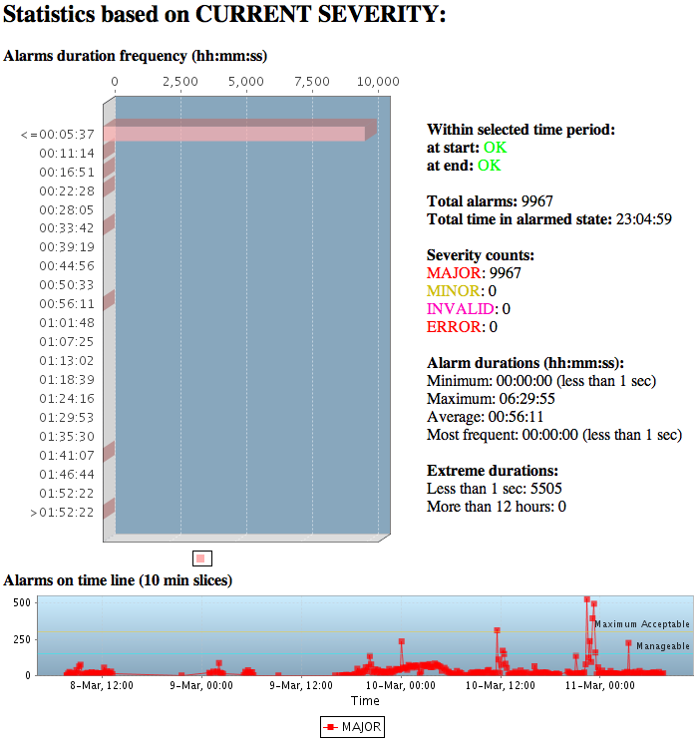
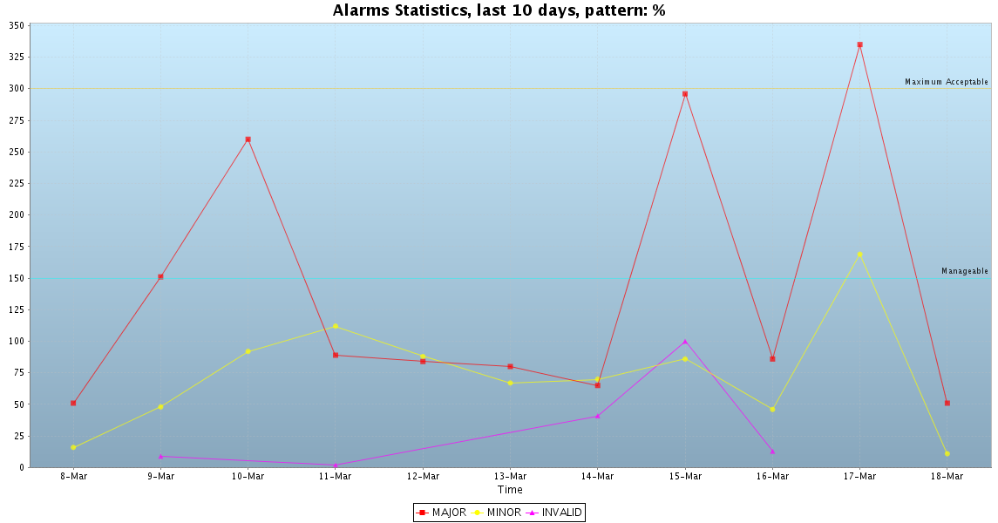
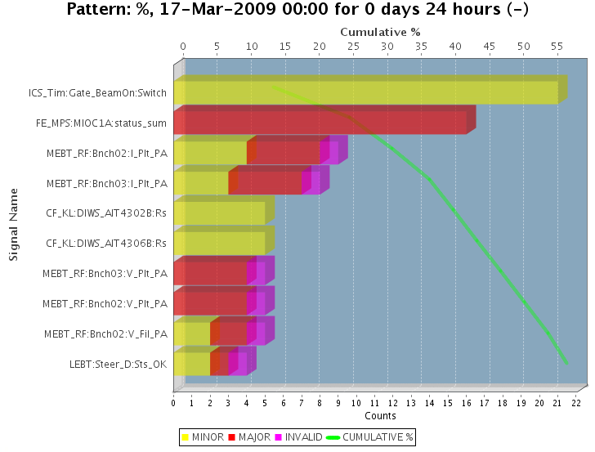
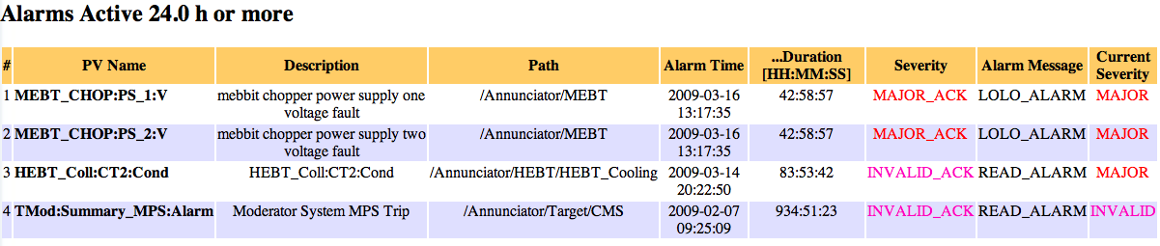
Web Report Examples
Anything is possible
Examples from SNS
  Code would need some rework to port to other sites

Slide 7

Creating a good Alarm Configuration
Hard
B. Hollifield, E. Habibi,
"Alarm Management:
Seven Effective Methods
for Optimum Performance", ISA, 2007

Slide 8
Alarm Philosophy
Goal:
Help operators take correct actions
  Alarms with guidance, related displays
  Manageable alarm rate (<150/day)
  Operators will respond to every alarm
  (corollary to manageable rate)

Slide 9
What’s a valid alarm?
DOES IT REQUIRE IMMEDIATE OPERATOR ACTION?
  What action? Alarm guidance!
    Not “make elog entry”, “tell next shift”, …
  Consequence of not reacting?
  How much time to react?

Slide 10
How are alarms added?
Alarm triggers: PVs on IOCs
  But more than just setting HIGH, HIHI, HSV, HHSV
  HYST is good idea
  Dynamic limits, enable based on machine state,...
  Requires thought, communication, documentation
Added to alarm server with
  Guidance: How to respond
  Related screen: Reason for alarm (limits, …), link to screens mentioned in guidance
  Link to rationalization info (wiki)

Slide 11
Example: Elevated Temp/Press/Res.Err./…
Immediate action required?
  Do something to prevent interlock trip
Impact, Consequence?
  Beam off: Reset & OK, 5 minutes?
  Cryo cold box trip: Off for a day?
Time to respond?
  10 minutes to prevent interlock?
               ⬇
MINOR? MAJOR?
Guidance: “Open Valve 47 a bit, …”
Related Displays: Screen that shows Temp, Valve, …

Slide 12
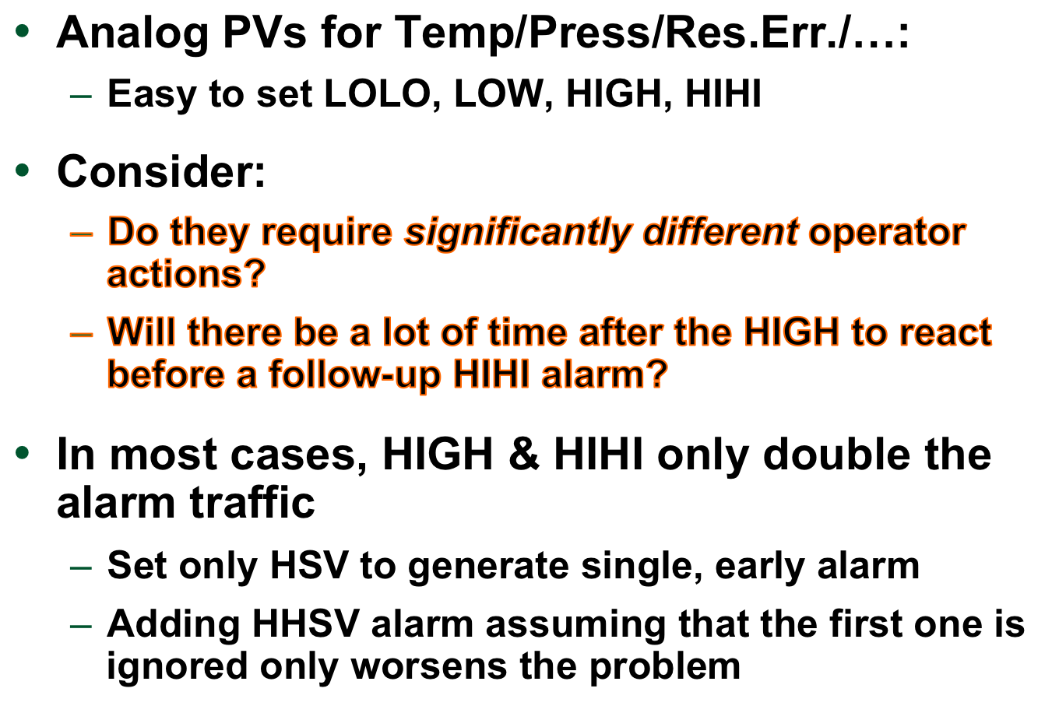
Avoid Multiple Alarm Levels

Slide 13
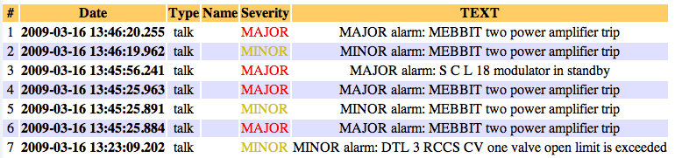

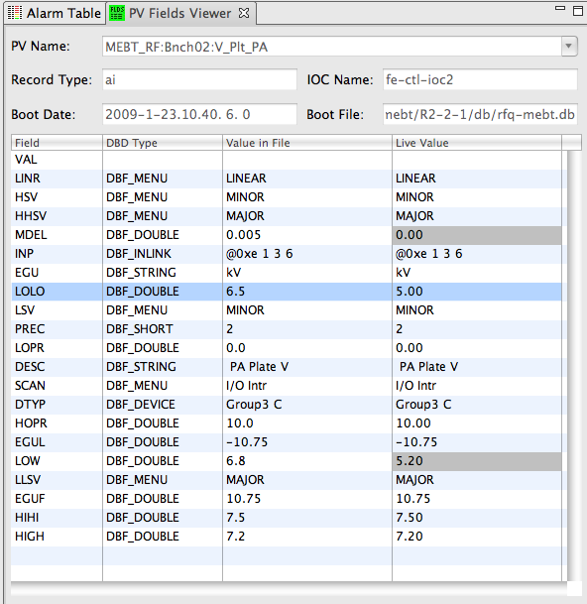
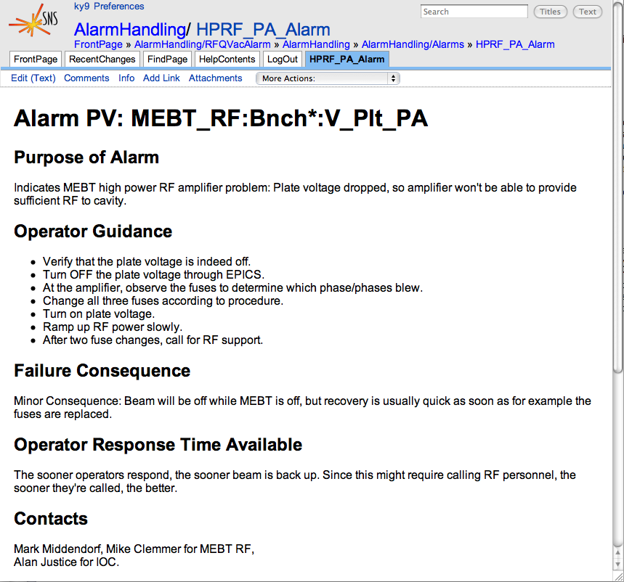
Bad Example: Old SNS ‘MEBT’ Alarms
Each amplifier trip:
≥ 3 ~identical
alarms, no guidance
Rethought w/ subsystem
engineer, IOC programmer
and operators: 1 better alarm

Slide 14
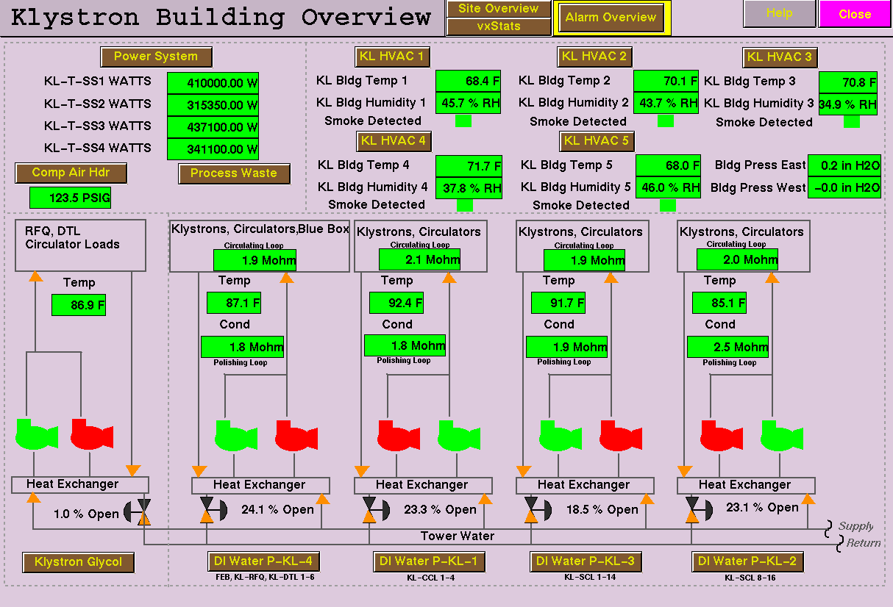
Alarms for Redundant Pumps

Slide 15
Alarm Generation: Redundant Pumps the wrong way
Control System
  Pump1 on/off status
  Pump2 on/off status
Simple Config setting: Pump Off => Alarm:
  It’s normal for the ‘backup’ to be off
  Both running is usually bad as well
    Except during tests or switchover
  During maintenance, both can be off

Slide 16
Redundant Pumps
Required Pumps:
1
Control System
  Pump1 on/off status
  Pump2 on/off status
  Number of running pumps
  Configurable number of desired pumps
Alarm System: Running == Desired?
  … with delay to handle tests, switchover
Same applies to devices that are only needed on-demand

Slide 17
Weekly Review: How Many? Top 10?

Slide 18
Summary
Easy to use
  Check alarms in Table, Tree, Panel
  Fix it: Read Guidance, use Display Links
  ✔Acknowledge
Configuration
  Can be changed online
  Operators can update guidance or add better display links
Alarm System Setup
  Somewhat Involved, but only once
Coming up with a good configuration
  Hard
Easy
Hard

