Slide 1
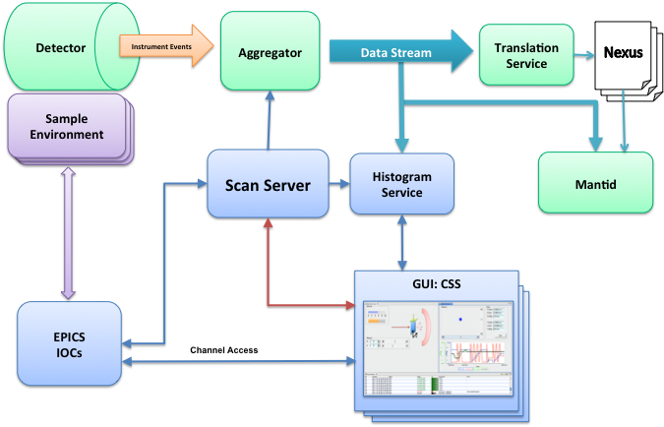
Scan System
Kay Kasemir,
Xihui Chen
Jan. 2013

Slide 2


Automated Experiment Control
“Scan” should be easy
Graphical:
… or script:
Robust execution
Monitor, pause, resume, abort
Open Shutter
Set motor X = 0
Wait for certain beam charge to accumulate
Step motor
X += 1
Yes
X < 10 ?
No
Close Shutter

Slide 3
EPICS Sequencer?
Excellent for “permanent” automation, not for changing scan scenarios
Compile, link, …
No GUI
No progress, pause, resume
Can do anything

Slide 4
Scripts (Python, Jython, Scala, …)
“Works”, but…
No progress, pause, resume
Can do most anything

Slide 5
Allow Anything = Robust
set(setpoint, 30); # Assume OK after 10 seconds wait(10.0);
set(nonexisting_channel, 42);
while (readback < 10) { /* busy loop */ }
set(setpoint, 30); # Wait for readback to match waitForValue(readback, 30);
if (notConnected(…)) reportError(); while (readback < 10) { sleep(1); if (timeout_exceeded) reportError(); }

Slide 6
APS “Scan Engine”
Claude Saunders, Mitch McCuiston, Brian Tieman, Tim Mooney
“Scan Engine” executes submitted scans
Scan = List of robust commands
“Loop” command
Pause, Resume
Eclipse RCP instead of Spring
Eclipse build instead of Maven
CSS PV instead of new PV layer
Tight CSS GUI integration AND basic script access

Slide 7
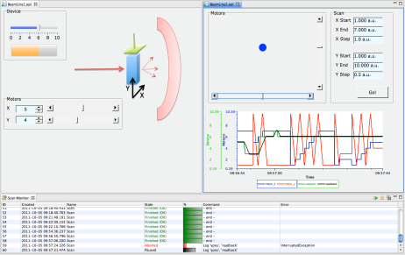
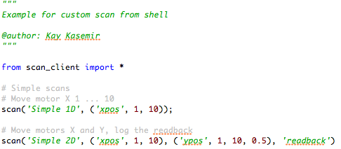
Experiment Control for EPICS
Sample Environment Equipment
Sample Environment Equipments
Sample Environment Equipments
GUI: CSS
Jython, Matlab, …
Scan Server
EPICS IOCs
Channel Access

Slide 8
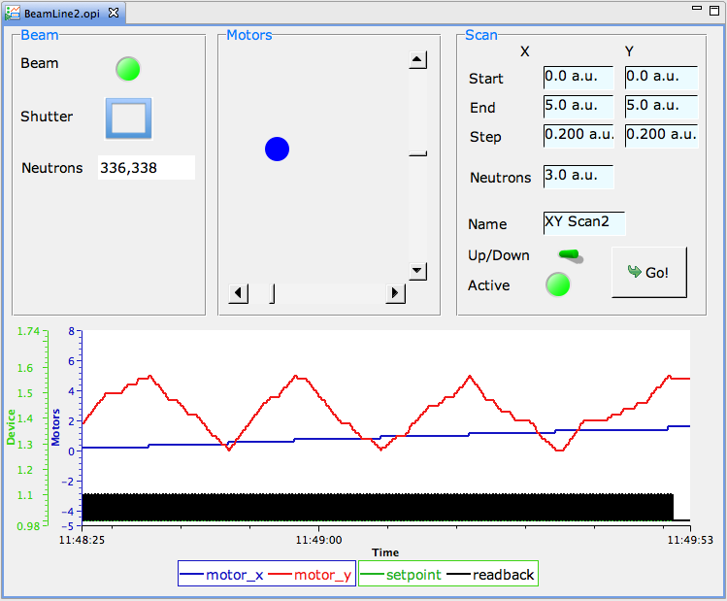
BOY Example
1. Configure
2. Start
3. Monitor

Slide 9
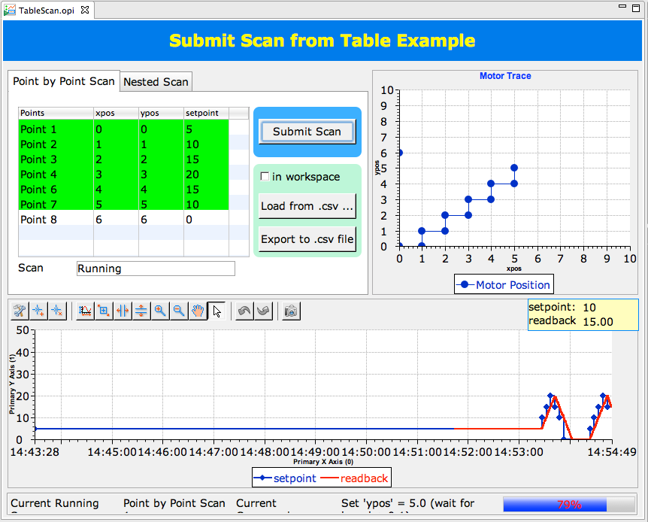
Tabular OPI

Slide 10
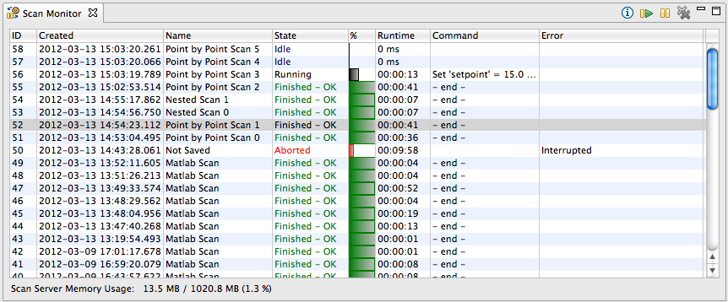
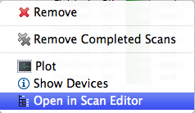
Scan Monitor
List Scans on Server
Idle: To be executed next
Running: With progress report
Finished, Failed: Past runs

Slide 11
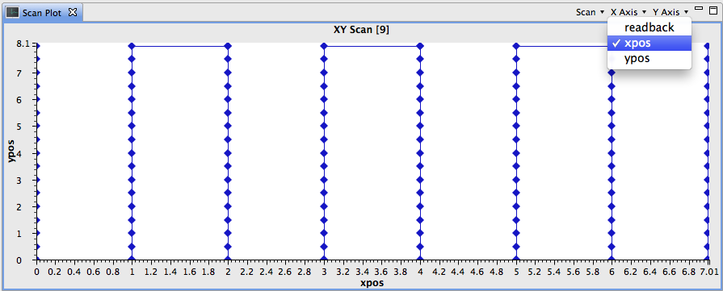
Scan Plot
Plot variables used by scan
Get data from Running or Finished scans

Slide 12
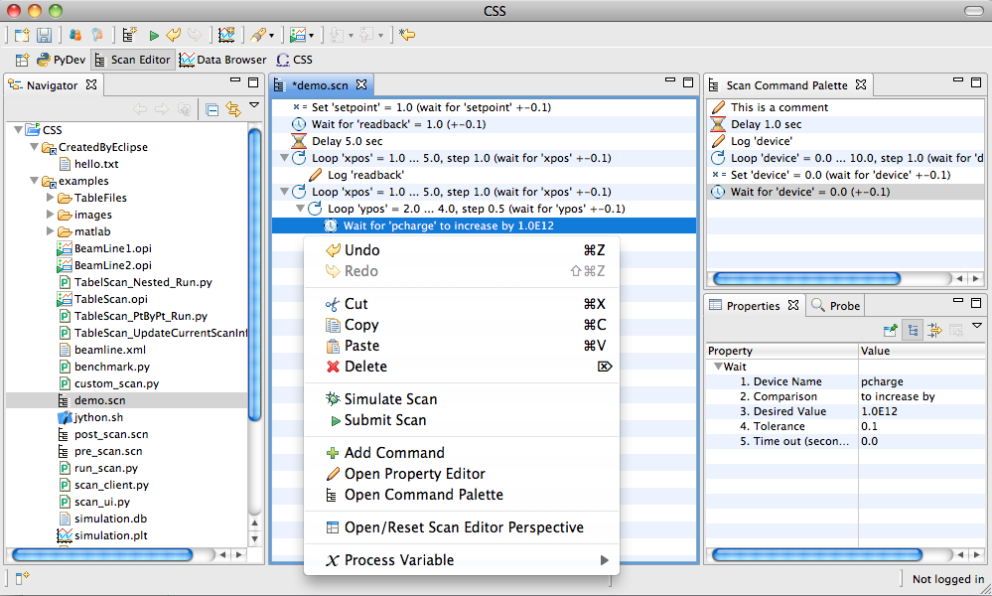
Scan Editor
Add commands
Open, save
Set parameters
“Undo”
Drag/drop commands or PV names (also as XML text)
Device PVs (or alias) can be picked from beamline-specific configuration

Slide 13
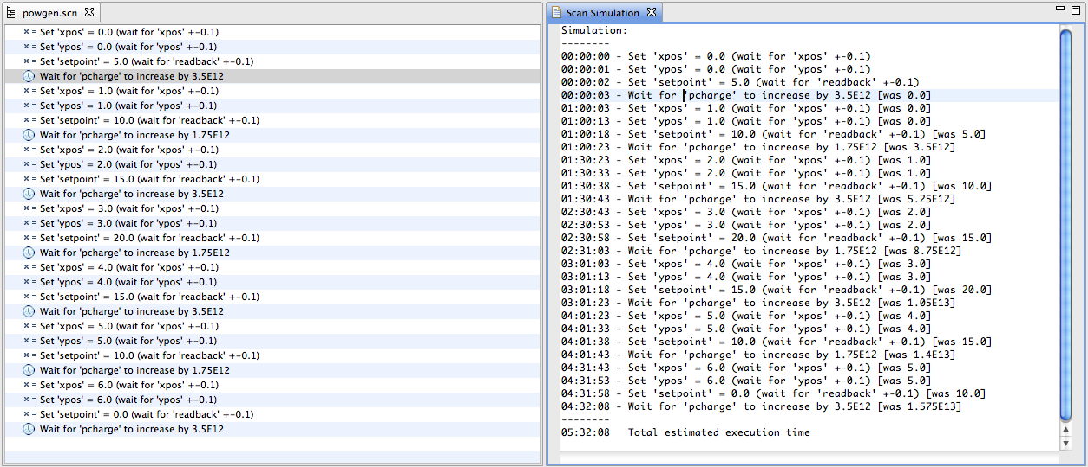
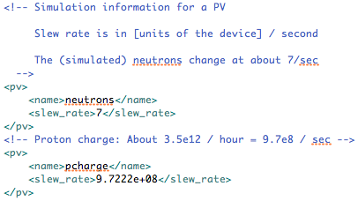
Simulation Mode
Simulated PV changes
Estimates times

Slide 14
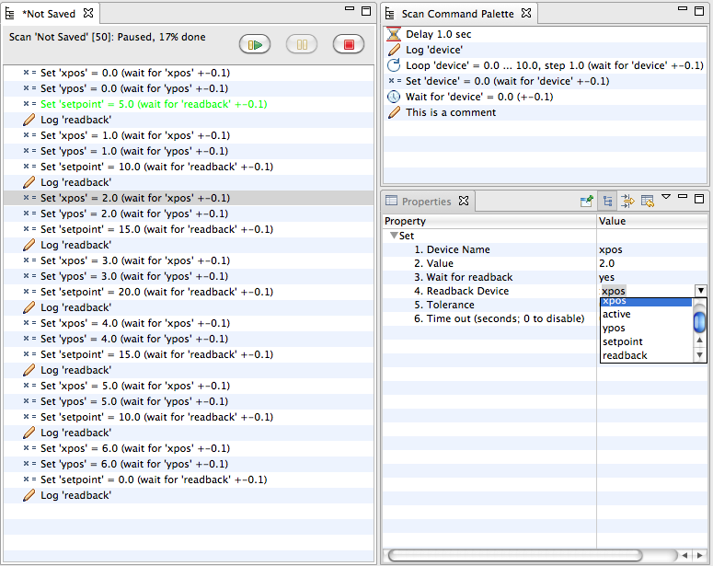
Monitor, Adjust Live Scan
Scan Info
Active Command
Adjust properties
of live scan

Slide 15
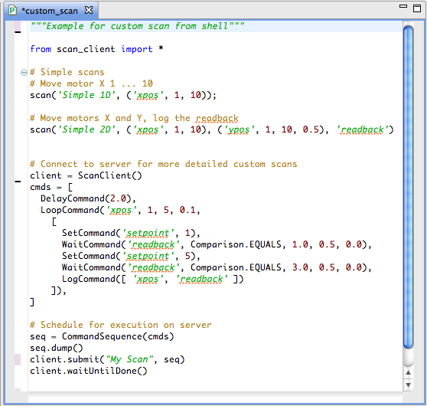
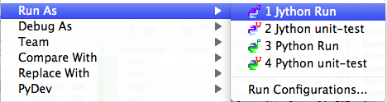
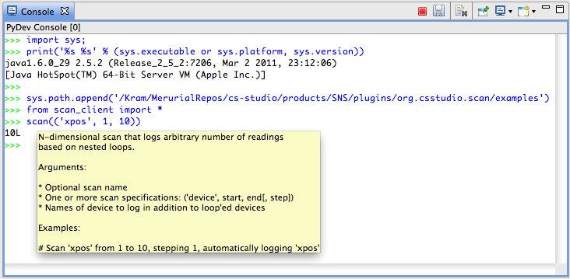
Scripted Scan
Jython editor, debugger
Jython console
… or use ‘vi’, shell

Slide 16
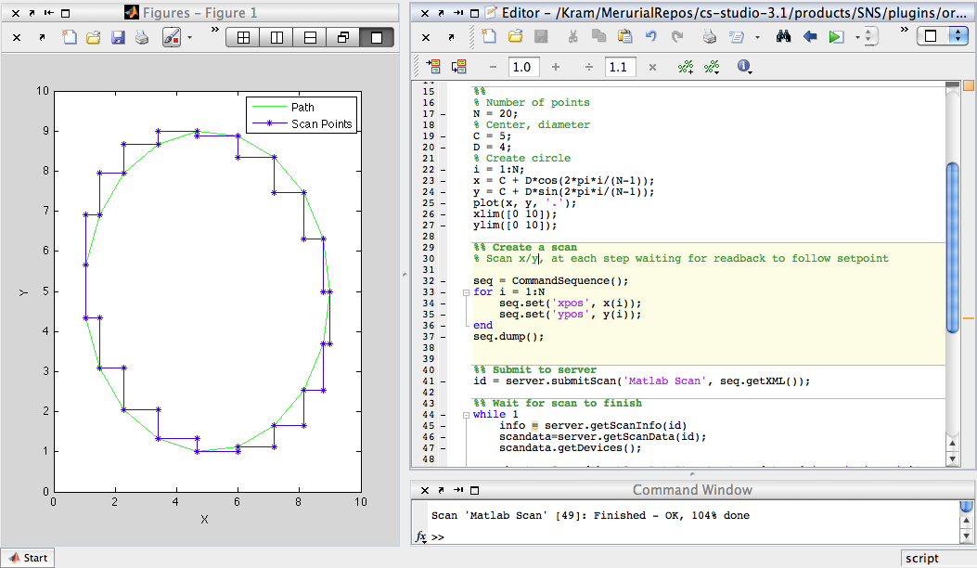
Matlab
Create Scan
Monitor
Analyze
(maybe submit follow-up scan)

Slide 17
Scan Commands
Set
Set device (PV) to a value.
Optional wait for read-back, same or other PV, with timeout.
Wait
Wait until a device (PV) reaches a certain value. Support condition: >, <, ==, >=, <=, increment-by, decrease-by. Optional timeout.
Loop
Command that performs a loop, optional read-back and timeout.
Log
Log data for plot in addition to variables used by Set, Wait, Loop
Delay
Delay for a certain time. Discouraged. Use Wait.
Script
Execute jython code. Use with care.
Custom commands can be added via Eclipse extension points.

Slide 18
Performance
Command Execution
80000 commands/second: Delay 0 sec, Set w/o read-back
4500 commands/second: Set w/ read-back, Loop
Download scan into Editor
10000 commands: 1 second
50000 commands: 15 seconds

Slide 19
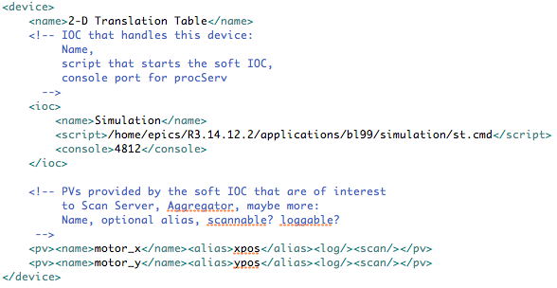
Beam Line Configuration
Required (soft) IOCs
Used by separate tools to start/stop as required
Scan System Aliases
Available within scans
Simulation Info
Slew rates
DAQ info
Which channels to log with neutron data?

Slide 20
Overall Picture for SNS
Detector
Aggregator
Instrument Events
Translation Service
Nexus
Data Stream
Nexus
Nexus
Sample Environment
Sample Environment Equipments
Sample Environment Equipments
Scan Server
Histogram
Service
Mantid
GUI: CSS
GUI: CSS
EPICS IOCs
GUI: CSS
Channel Access

Slide 21
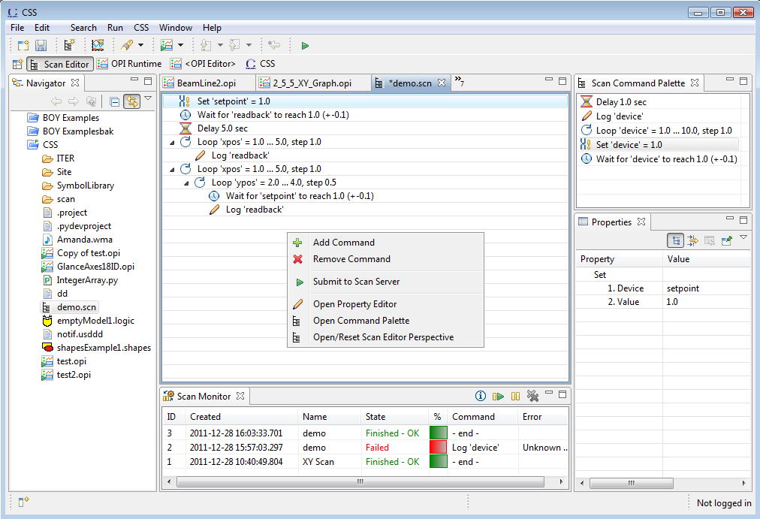
Summary
Scan Server: Experiment Automation
BOY Panels, Scan Editor, Scripts
Monitor, Pause, Resume, even adjust

Slide 22
Scan Server
Submitted scans are queued for execution
Pre- and Post-Scan commands: open/close shutter, …
CSS/Eclipse ‘headless’ application
‘PV’: EPICS, simulated
Alias names for PVs as well as plain PV names
Telnet interface: Status, pause, resume, …
Java RMI interface: Submit, status, pause, resume, get data, …
Scans transferred in XML format
RMI = Java, Jython, Matlab, Scala, JRuby, …

Slide 23
Plans, Ideas
RESTful web interface
Submit scan
Monitor scans
Abort scan
Allows non-Java tools to ‘close the loop’

