Slide 1
Control System Studio Training
-
Development Setup
Kay Kasemir
ORNL/SNS
kasemirk@ornl.gov
Jan. 2013

Slide 2
Getting CSS to run from source code
Get Java, Eclipse, CSS Sources
Start Eclipse
“Import” Sources into Workspace
Open CSS *.product file, Launch

Slide 3
Java
Check: Is java available?
  java -version
  Need Sun/Oracle Java 1.6, 1.7;
  Not GCJ, OpenJDK

Slide 4
Eclipse Version
Eclipse just went from 3.x to 4.x
Most CSS Sources would ‘work’ with 4.x
  Except BOY
→ Need Eclipse 3.7.2
  Can use Eclipse 4.x as the IDE, but “Target Platform” must be 3.7.2

Slide 5
Start Eclipse
Run
  eclipse/eclipse
  “Workspace”:
  use CSS/Workspace in your home directory
Suggest to check Preferences:
  Java, Installed JREs: Is it the one you want?
    Eclipse may automatically find a JRE, but you want the JDK for source-level debugging
  Usage Data Collector: Disable capture?
  Add (older) version of Eclipse as “Target Platform”?

Slide 6
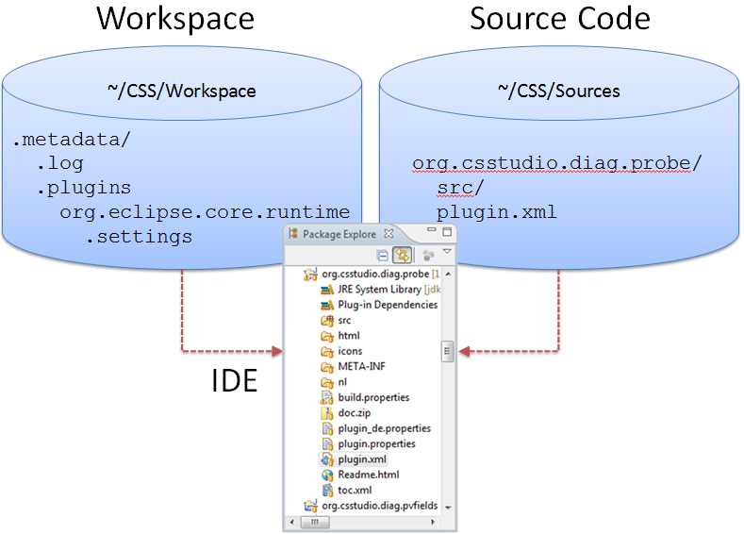
Source Code vs. Eclipse Workspace
Source Code:
  Where the sources are
Workspace:
Directory with
“.metadata”
subdir.
  Tracks currently
  open window, …
To avoid confusion: Keep Separate!
  Example: Use CSS/Sources, CSS/Workspace

Slide 7
Eclipse Workspace
“Import” Sources
into Workspace:
  File/Import…,
  General,
  Existing Projects
  into Workspace
  Select “root” directory,
  import all projects found
  Do not
  “Copy projects into Workspace”
Note: Need to “Import” even if sources are already located in workspace directory

Slide 8
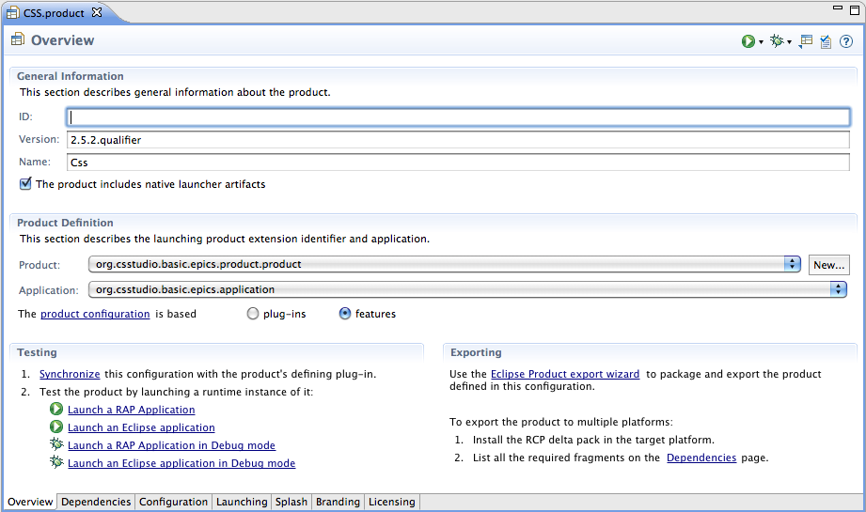
Run Product
Open org.csstudio.basic.epics.product/*.product
Press
  Synchronize
  Launch an Eclipse application
  Later, re-run via the Run button in toolbar

Slide 9
Fundamentally, that’s it
Product:
  List of plugins
  *.product file to run the product
  IDE can also ‘export’ product binary
Feature:
  Logical group of plugins
  Allows online ‘install’, automated ‘update’

Slide 10
“Headless Build”
Command-line process to turn *.product or *.feature into binary
Can be scripted, launched from Hudson, …
Sadly, somewhat in parallel to IDE:
  Specific directory layout
    Need to copy sources into plugins/ and features/ folders
  Additional build.properties file
    Target platform, Java object code level, ..

Slide 11
“Update Site”
Fundamentally, just a build option to create “P2 Metadata Repository” for products and features
Published on web site
Products can then
  Install features from repository
  Automatically update to latest version
Requires careful setting of dependencies and version numbers

