Slide 1
Control System Studio Training
-
Archive System Setup
Kay Kasemir
ORNL/SNS
kasemirk@ornl.gov
Jan. 2013

Slide 2
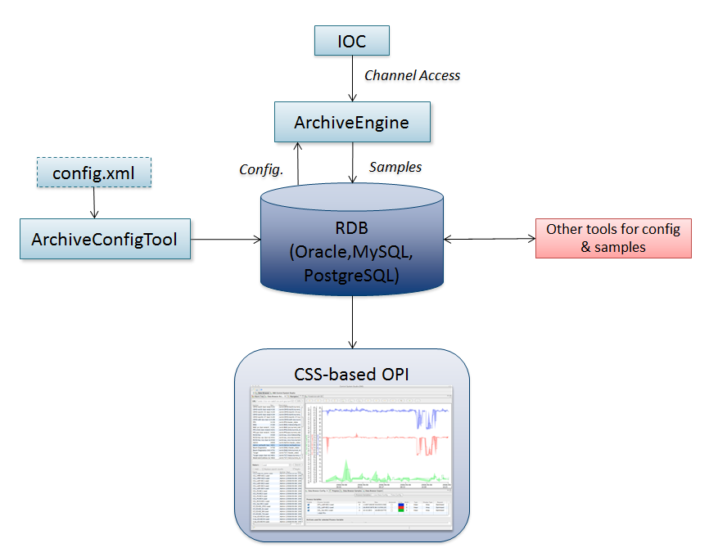
Archive System Overview

Slide 3
Setup Steps
Prepare RDB
Create & Import initial configuration
Run Archive Engine

Slide 4
Prepare RDB
Plugin org.csstudio.archive.rdb,
folder dbd/:
Copy/paste the commands for the following from mysql_schema.txt into a mysql shell:
  Create “archive” user with password “$archive”
  Create “report” user with password “$report”
  Create “archive” data base
  Create tables, insert some demo data

Slide 5
Create & import initial configuration
Directly manipulate tables in RDB?
Use ArchiveConfigTool to import XML file
Same format as Channel Archiver:
    <engineconfig>
    <group>
    <name>Cooling</name>
    <channel><name>demo:tank</name>
    <period>1.0</period><monitor/>
    </channel>
    </group>
    </engineconfig>
  Import:
  ArchiveConfigTool –pluginCustomization /path/to/settings.ini \
  –import –engine demo –config demo.xml

Slide 6
settings.ini
Prepare file settings.ini, starting like this:
# Archive RDB (Config Tool, Archive Engine)
org.csstudio.archive.rdb/url=jdbc:mysql://localhost/archive
org.csstudio.archive.rdb/user=archive
org.csstudio.archive.rdb/password=$archive
org.csstudio.archive.rdb/schema=
# Channel Access (Archive Engine)
org.csstudio.platform.libs.epics/addr_list=127.0.0.1
org.csstudio.platform.libs.epics/use_pure_java=true

Slide 7
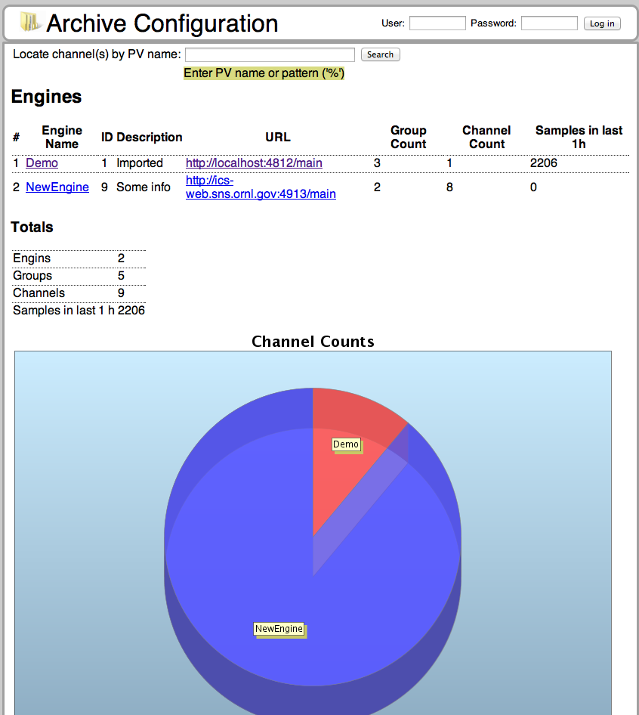
Online Configuration Editor
Ongoing development…
Add web.archive.war to Tomcat
Add to conf/catalina.properties:
  web.archive.settings=
  /path/to/archive.properties
Example archive.properties:
  # Database server URL
  rdb_url=jdbc:mysql://localhost/archive
  # Schema prefix to use. Must include trailing ".".
  schema=
  # User for read-only access
  anonymous_user=reports
  # Password for read-only access
  anonymous_password=secret

Slide 8
Run Archive Engine
Start:
ArchiveEngine –pluginCustomization /path/to/settings.ini \
–engine demo
Monitor:
  http://localhost:4812/main
  Check start time, number of channels
  Look at groups, individual channels
  Values received and written for each channel
Stop:
  http://localhost:4812/stop

Slide 9
Multiple Archive Engines
On each host, need unique port numbers
(default: 4812)
ArchiveConfigTool … -port 4813
ArchiveEngine … –port 4813
Web access via http://localhost:4813/main
Consistency check: Engine compares its port with the number in the configuration.
RDB configuration for engine also contains host:
  EngineConfigImport … -host some_host
  In principle, on could create a tool that automatically starts archive engines on a host based on RDB info. Not implemented.

