Slide 1
Control System Studio Training
-
Alarm System Setup
Kay Kasemir
ORNL/SNS
kasemirk@ornl.gov
Jan. 2013

Slide 2
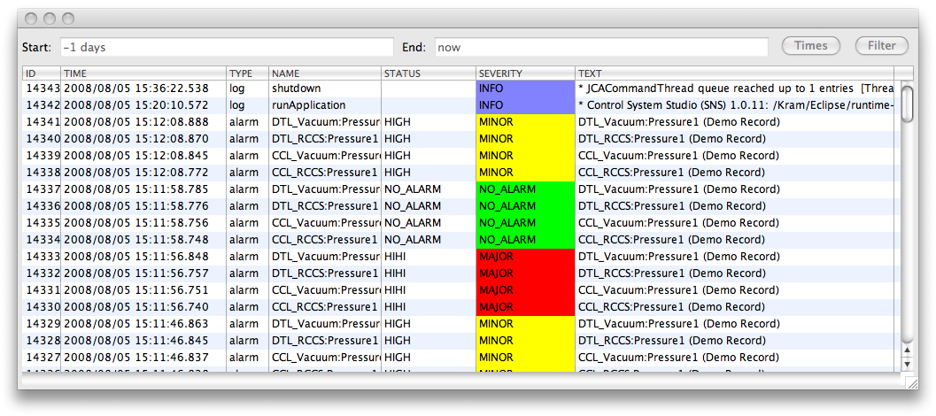
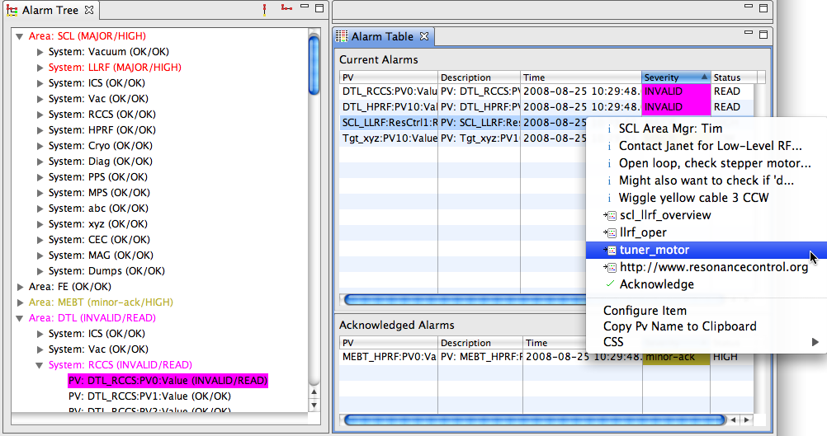
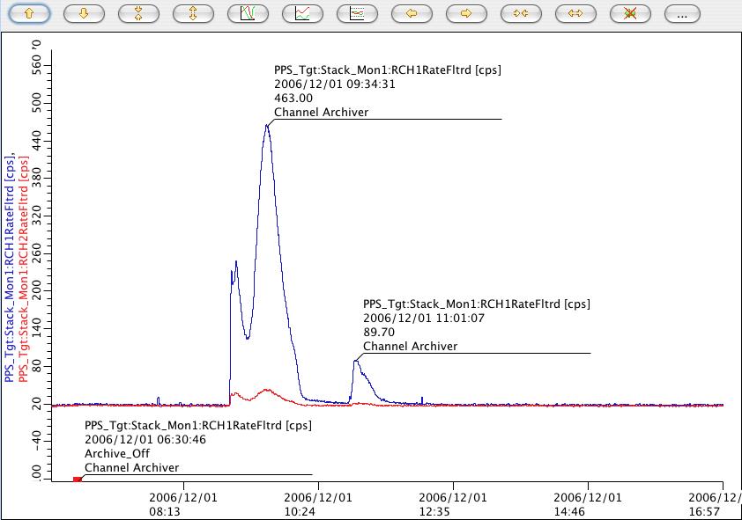
Alarm System Overview
IOCs
PV Updates (Channel Access, …)
Alarm Server
Current Alarms: Acknowledged? Transient? Annunciated?
Tomcat
Reports
Log Messages
Annunciations
Alarm Updates
Ack’; Config Updates
JMS
Alarm Cfg & State
RDB
LOG
alarm_TALK
alarm_SERVER
alarm_CLIENT
JMS
2
RDB
Annunciator
Alarm Client GUI
Message
RDB
CSS Applications

Slide 3
Initial Setup similar to archive system
Prepare RDB
Start JMS Server
Create and import initial configuration
Run Alarm Server
View in CSS Alarm Tree, Alarm Table

Slide 4
Prepare RDB
Plugin org.csstudio.alarm.beast,
folder dbd/:
Copy/paste the commands for the following from MYSQL_USER.sql and ALARM_MYSQL.sql into a mysql shell:
  Create “alarm” user with password “$alarm”
  Allow “report” user to read alarm tables
  Create “alarm” data base
  Create tables, insert some demo data

Slide 5
Create initial configuration
Minimum XML File
<config name=”Demo">
</config>
More elaborate Example
<config name=”Demo">
<component name="Simulated">
<pv name="sim://ramp">
<description>Ramp</description>
<latching>true</latching>
<annunciating>true</annunciating>
</pv>
</component>
<component name="Heater Demo">
<pv name="demo1:heat_V">
<description>Heater at maximum</description>
<latching>false</latching>
<annunciating>true</annunciating>
</pv>
</component>
</config>
Either one can then be edited from CSS GUI

Slide 6
settings.ini for alarm tools
Add to settings.ini:
# Alarm RDB (Config Tool, Alarm Server)
org.csstudio.alarm.beast/rdb_url=jdbc:mysql://localhost/alarm
org.csstudio.alarm.beast/rdb_user=alarm
org.csstudio.alarm.beast/rdb_password=$alarm
org.csstudio.alarm.beast/rdb_schema=
# JMS Connection
org.csstudio.alarm.beast/jms_url=failover:(tcp://localhost:61616)
# Specify alarm configuration (root element)
org.csstudio.alarm.beast/root_component=Demo
# Annunciator
org.csstudio.alarm.beast.annunciator/jms_url=failover:(tcp://localhost:61616)
org.csstudio.alarm.beast.annunciator/jms_topic=demo_TALK
# Channel Access (Alarm Server and Archive Engine)
org.csstudio.platform.libs.epics/addr_list=127.0.0.1

Slide 7
Import XML Configuration
Alarm Config Tool:
AlarmConfigTool –pluginCustomization /path/to/settings.ini \
–root Demo –file /path/demo.xml -import
‘root’:
Database can contain multiple alarm configuration trees, identified by name of root element
Consistency check:
Name of <config name=“Demo”> and command-line argument –root Demo must match

Slide 8
Run Alarm Server
Start:
AlarmServer –pluginCustomization /path/to/settings.ini \
–root Demo
Monitor:
Primarily just use CSS Alarm GUI
Console output
Send ‘debug’ message from CSS Alarm Tree
org.csstudio.debugging.jmsmonitor
Stop:
Kill the process (Ctrl-C)

Slide 9
Add Alarm GUI to CSS
Add alarm GUI plugins to CSS product
  org.csstudio.alarm.beast
  org.csstudio.alarm.beast.annunciator
  org.csstudio.alarm.beast.ui
  org.csstudio.alarm.beast.ui.alarmtable
  org.csstudio.alarm.beast.ui.alarmtree
  org.csstudio.alarm.beast.ui.areapanel
  org.csstudio.utility.speech
The above also combined in alarm.feature
plugin_customization.ini of CSS product:
  Same org.csstudio.alarm.beast/* settings as used by Alarm Server (settings.ini)
To hear alarms
Most important
Nice

