Slide 1
Control System Studio Training
-
Authentication,
Authorization
Kay Kasemir
ORNL/SNS
kasemirk@ornl.gov
Jan. 2013

Slide 2
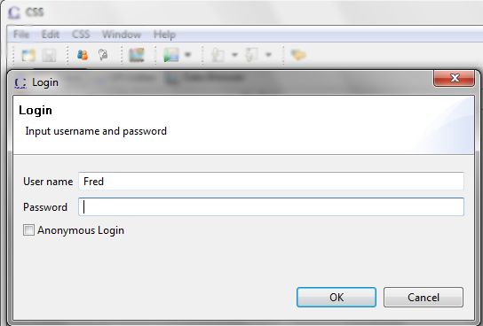
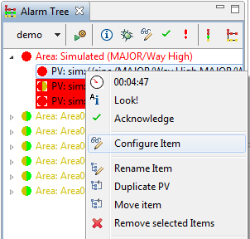
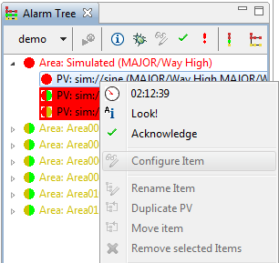
Example: Alarm System
!
☺
☹
Only authorized users can change the configuration

Slide 3
Auth & Auth
Authentication: Confirm a user's identity
  Check password
Authorization: Is user permitted to do something?
  Requires authenticated user
  Some database: User “Fred” may configure alarm

Slide 4
Auth & Auth in CSS
API:
org.csstudio.auth
Implementations:
Authentication
  org.csstudio.platform.jaasAuthentication
Authorization
  org.csstudio.platform.ldapAuthorization
  org.csstudio.sns.dummyAuthorization
  org.csstudio.sns.ldapAuthorization

Slide 5
Can’t we just ignore this?
No.
If you don’t configure auth & auth,
nobody can do anything
What follows is the simple “anybody can do anything” setup.

Slide 6
Dummy Authentication
  Include plugins in CSS product: org.csstudio.platform.jaasAuthentication
  org.csstudio.platform.jaasAuthentication.ui
Configure like this in plugin_customization.ini of CSS product:
# Select 'Dummy' JAAS Authentication
org.csstudio.platform.jaasAuthentication/jaas_config_source=File
org.csstudio.platform.jaasAuthentication/jaas_config_file_entry=Dummy
Now any user and password will work
  Except user name “fail”, which can be used for tests

Slide 7
Dummy Authorization
  Include plugin in CSS product: org.csstudio.sns.dummyAuthorization
Now any user and password will work
  Still needs to log on, though, but any user name and password will be accepted

Slide 8
For Operational Setups
Authentication
  org.csstudio.platform.jaasAuthentication
  Kerberous, LDAP
Authorization
  org.csstudio.platform.ldapAuthorization
  org.csstudio.sns.ldapAuthorization
  Similar, different LDAP schemata

