Slide 1
Control System Studio Training
-
More about “Products”
Kay Kasemir
ORNL/SNS
kasemirk@ornl.gov
Jan. 2013

Slide 2
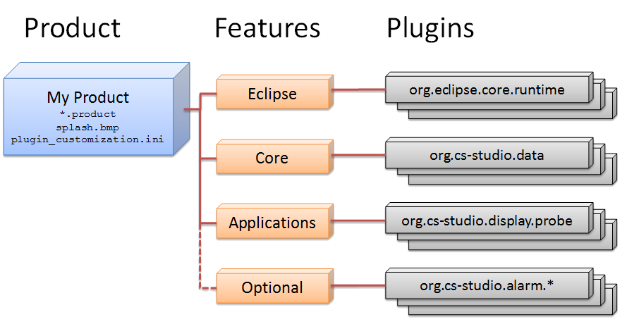
Product: Composition of Plugins

Slide 3
Feature-Based Products
org.cstudio.basic.epics.product/CSS.product
  Based on “Features”
org.csstudio.sns.feature.applications
  org.csstudio.diag.probe
  org.csstudio.diag.epics.pvtree
  …
  and features …opibuilder, …databrowser
Features:
  “Group” plugins to better organize them
  Features can be installed & updated from update sites
    Individual plugins can’t

Slide 4
Smaller Products without Features
org.csstudio.archive.engine/ArchiveEngine.product
org.csstudio.archive.config.rdb/ArchiveConfigTool.product
org.csstudio.alarm.beast.server/AlarmServer.product
org.csstudio.alarm.beast.configtool/AlarmConfigTool.produc
It’s OK to not use features
Easier to start that way.
But: Less organized,
no install & update possible.

Slide 5
Dependencies
org.csstudio.diag.probe
  MANIFEST.MF, plugin.xml
  Dependency on ..utility.pv
org.csstudio.utility.pv*
Products that include probe must also include utility.pv.
Otherwise obvious error about missing dependency at startup, or no product at all.
Similar: Databrowser depends on org.csstudio.archive.reader,
org.csstudio.logbook
* Apology for the bad example.
We’re just now replacing *.utility.pv.* with *.pvmanager.*…

Slide 6
Extension Points
org.csstudio.utility.pv
  Extension point pvfactory
  “How to get live data”
org.csstudio.utility.pv.simu
  Implements that ext. point for “loc”, “sim”, …
org.csstudio.utility.pv.epics
  Implements that ext. point for “ca”
  Depends on ..libs.epics
You may include utility.pv.epics, or pv.simu, or both.
Not enforced by Eclipse.
No error message on startup.
But probe may not display any data.
Similar:
org.csstudio.logbook.* - Need 0 or 1
org.csstudio.archive.reader.* - Need 0 or more

Slide 7
To build a custom product:
You pick what you want
  Probe, Data Browser, BOY, …
Add dependencies, Eclipse helps
  Logbook, pv, archive, …
Determine what you may also need
  pv.epics, logbook.mysite, archive.reader.*
Test within Eclipse IDE (Run Configurations…)
  Then update your *product, *feature
  Read http://cs-studio.sourceforge.net/docbook/

