Slide 1
Control System Studio Training
-
Extension Points:
Logbook Example
Kay Kasemir
ORNL/SNS
kasemirk@ornl.gov
Jan. 2013

Slide 2
Extension points
Eclipse:
  menus, online help, preferences, views, editors, toolbar buttons, …
CSS:
  live data, archived data, logbook, …
Dummy Logbook: Example for basic mechanism

Slide 3
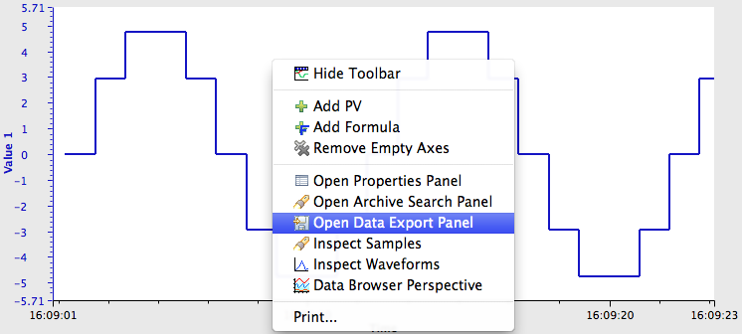
Example CSS Product
No “Logbook”.
Why?
In principle, BOY displays and Data Browser support the Logbook …

Slide 4
The only constant is Change…
Examples refer to a “logbookfactory”, an API for writing simple log entries.
BNL/FRIB right now triggering update to a more elaborate “logclientfactory” API for reading and writing more elaborate log entries.
The following will soon be outdated, it’s meant as a simple example.

Slide 5
Terms
Plugins that try to access the logbook
opibuilder
databrowser
alarm gui
Defines Extension Point “logbookfactory”.
Can query Eclipse Registry for available implementations.
org.csstudio.logbook
logbookfactory
mylogbookfactory
….logbook.mysite
Plugs into point “logbookfactory”.
Implements logbook access for my site.

Slide 6
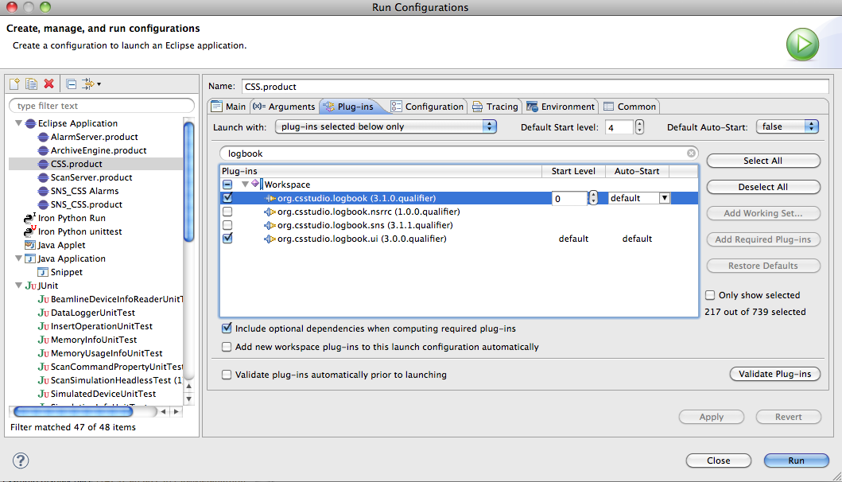
No Logbook Implementation!
There’s one for ..sns, but not YourSite

Slide 7
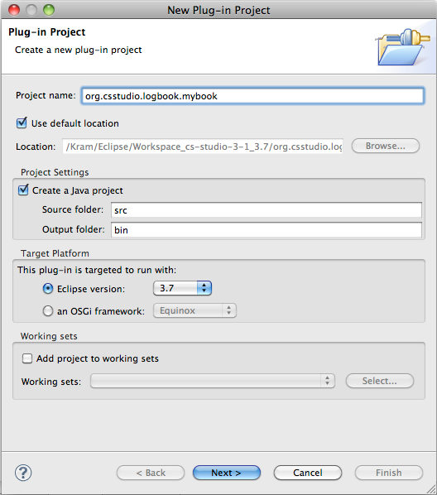
Create org.csstudio.logbook.mybook
File, New,
Plug-In Project
  Enter name
  Next, … Finish

Slide 8
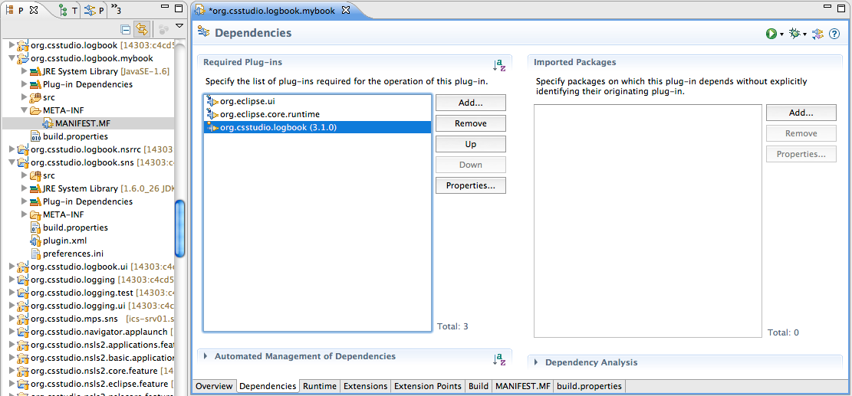
Configure org.csstudio.logbook.mybook
MANIFEST.MF editor should open
  On the “Overview”, check “This plug-in is a singleton”
  Select “Dependencies”
  Add org.csstudio.logbook

Slide 9
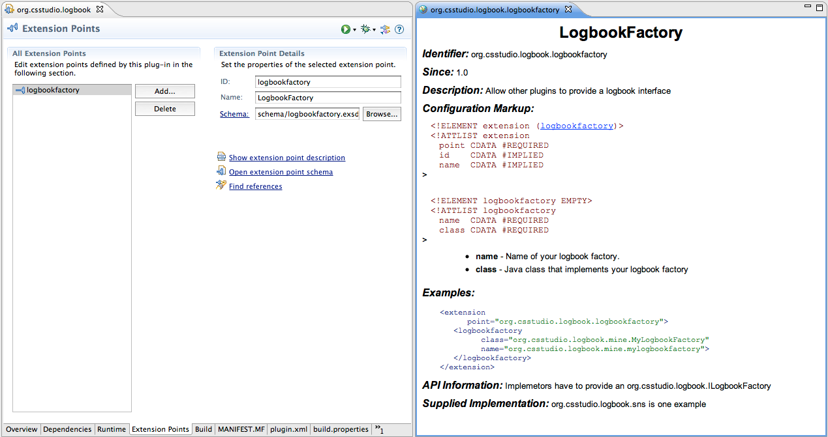
About “Logbookfactory” Extension Point
We could
  Open org.csstudio.logbook/ plugin.xml
  In the “Extension Points” tab, locate the “logbookfactory” and read its description
  Study the ILogbookFactory interface
  Study one of the supplied implementations
Or:
Just Do It
  And let
  Eclipse
  help on
  the
  way

Slide 10
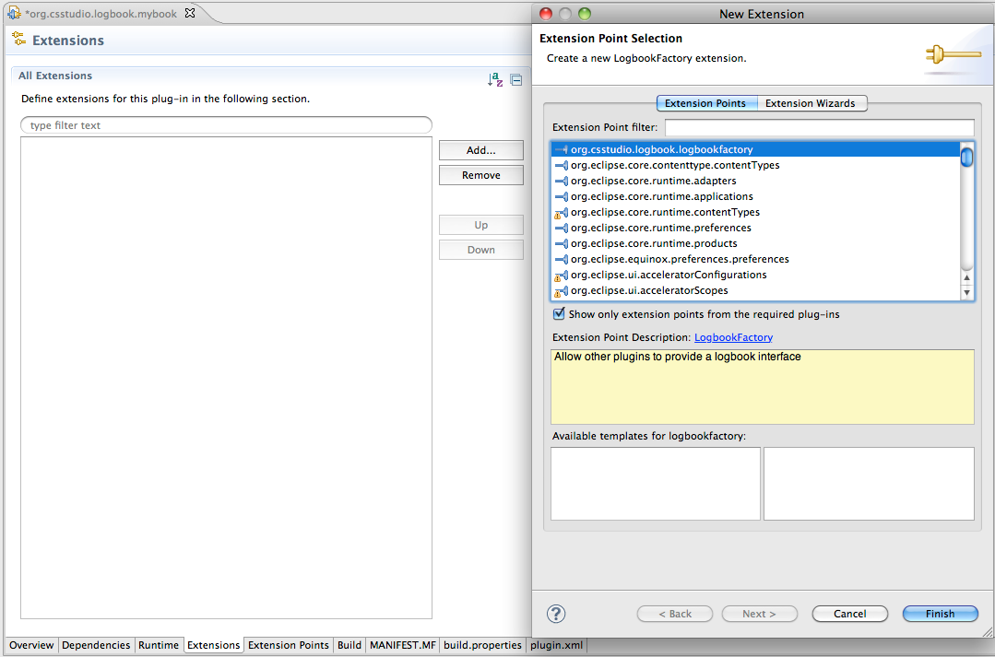
Make ..mybook extend logbookfactory
In editor for ..mylogbook/MANIFEST.MF
  Select “Extensions”
  Pick ..logbookfactory
  Finish

Slide 11
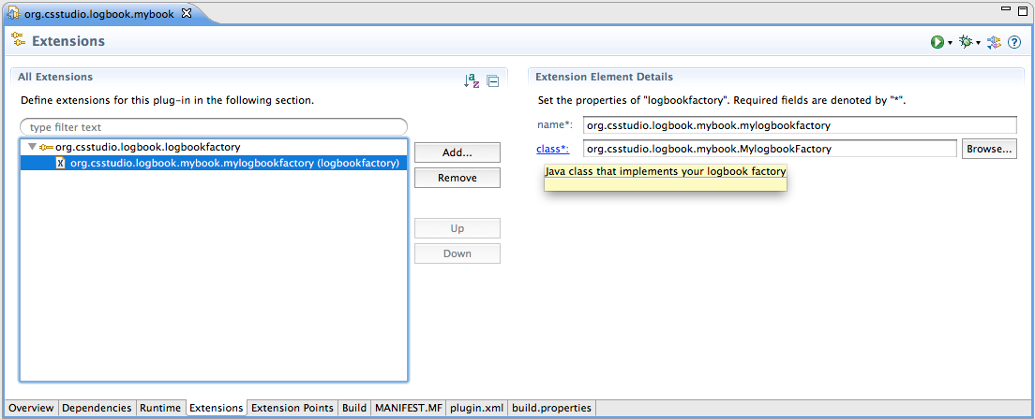
Configure your logbookfactory
If we had read the extension point description, we would know that we need an
  ID
  Name of our Java class
The extensions editor helps us to provide these.
Finally, click on the “class*:” link

Slide 12
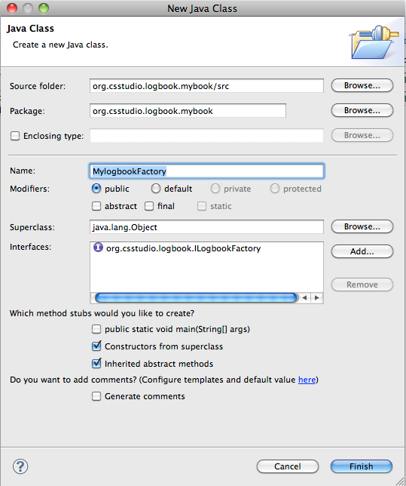
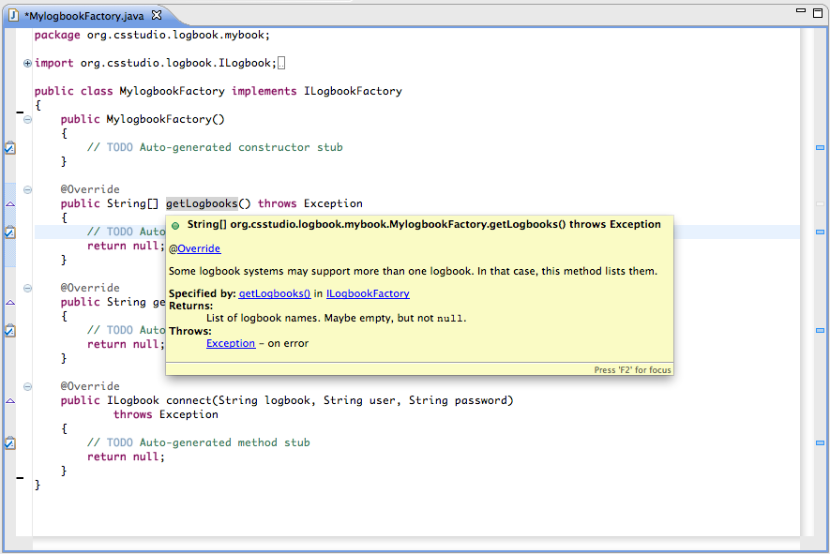
Implement LogbookFactory
Eclipse
  suggests required Java Interface
  Provides skeleton
  JavaDoc

Slide 13
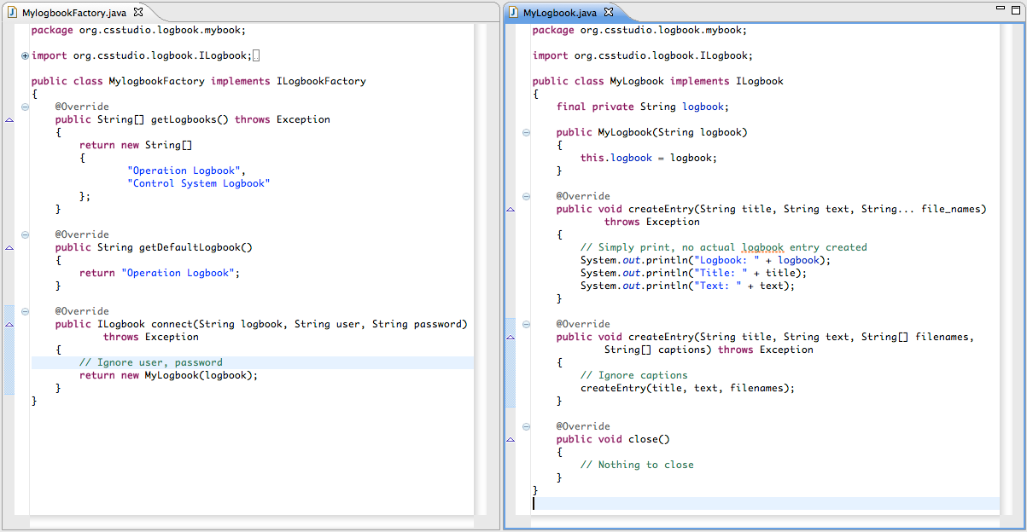
Finally: Do need to write code

Slide 14
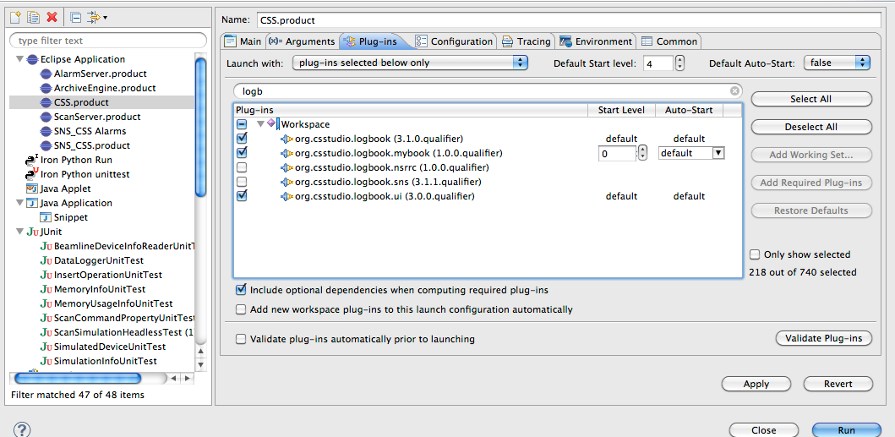
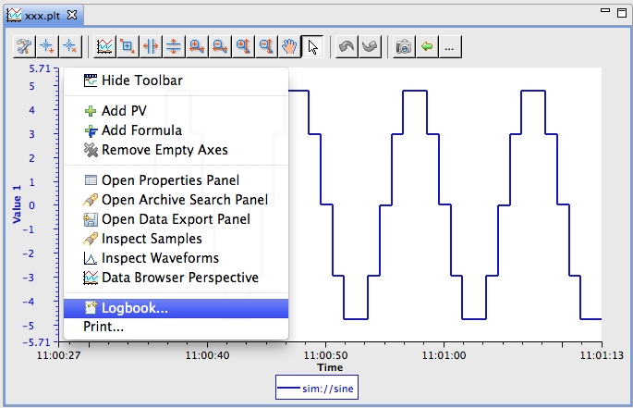
Try it
Include in run configuration
There it is!

Slide 15
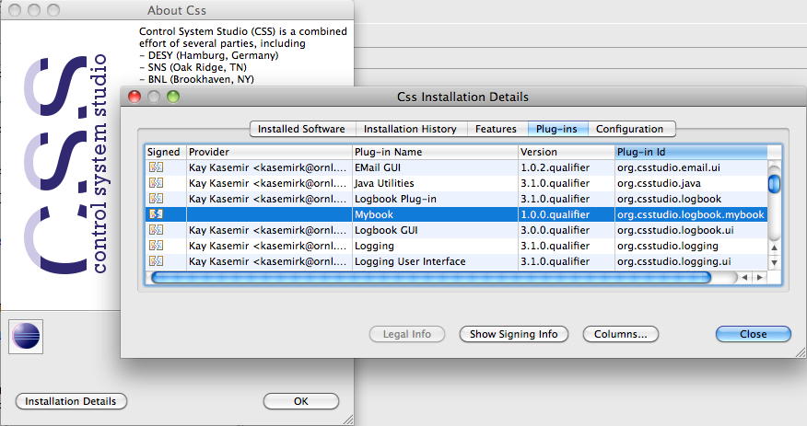
Troubleshooting
Was the plugin included in the run configuration?
In product, check Help, About, Installation Details, Plug-Ins
  Is it really loaded?

Slide 16
Extension Points
There are many!
  Read Eclipse RCP Books
  See Eclipse IDE online help
  http://cs-studio.sourceforge.net/docbook/
  Study CSS Sources
Code is nicely decoupled and “packaged”

