Slide 1
IBEX migration to Eclipse 4

Slide 2
What is Eclipse
Eclipse is a user-interface framework for Java applications
The current version of the IBEX user interface is built using Eclipse 3
…but in September, IBEX will be running on Eclipse 4!

Slide 3
Why is the migration needed
The current user interface is built on eclipse 3, but…
  Eclipse 3 is becoming increasingly outdated
  Several of our dependencies are dropping support for eclipse 3 – this means we no longer get access to the latest bug fixes
Eclipse 4 lets us implement some functionality which was impossible in 3
Notes:
- Flexibility in creating custom layouts

Slide 4
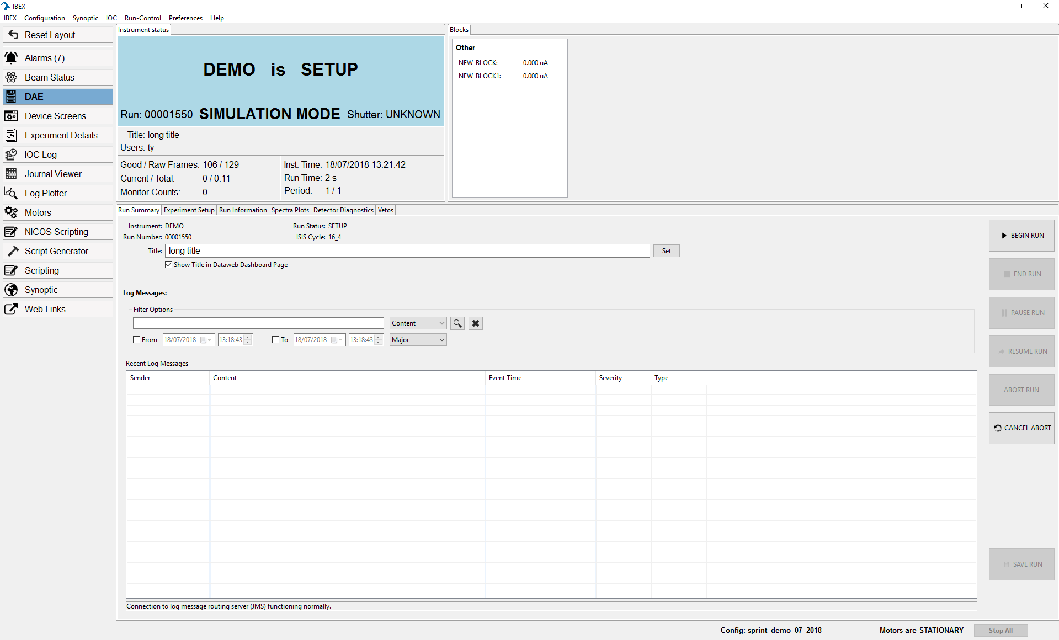
Most of the user interface has not changed

Slide 5
The IBEX server has not changed because of Eclipse 4
There are no changes to the communication layer(s) of any devices due to the Eclipse 4 migration

Slide 6
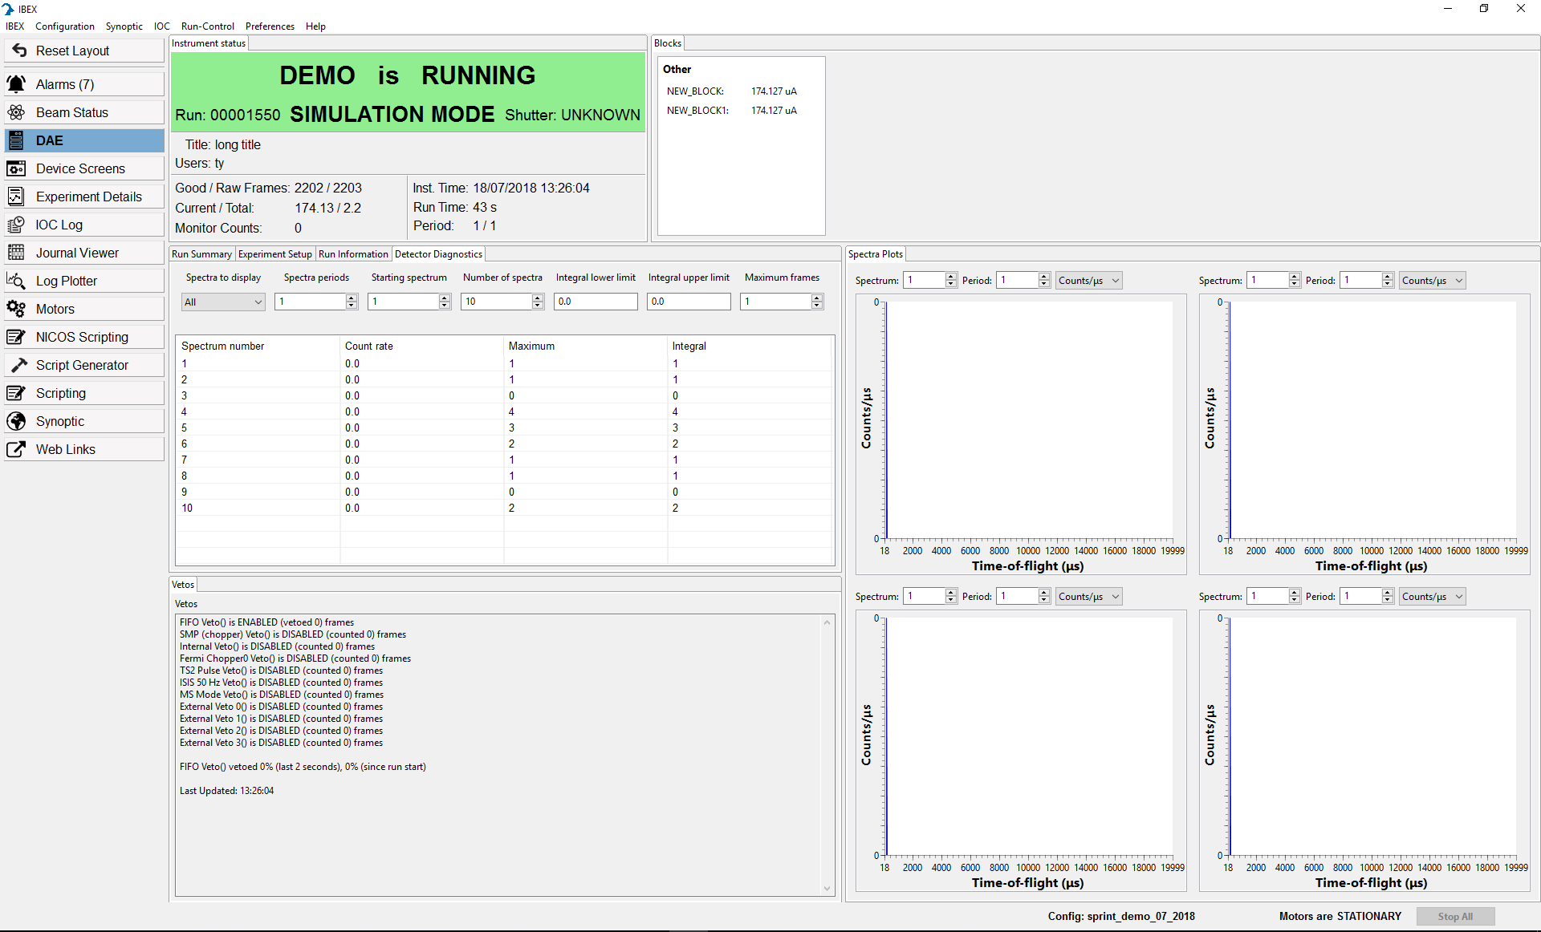
Biggest change: views are resizable & moveable
Notes:
This allows us to define custom views – e.g. detector diagnostics at the same time as spectra plots and vetos.
In future we will allow instrument scientists to save their “favourite” layout of views
Emphasise the “reset layout” button in case things go wrong!

Slide 7
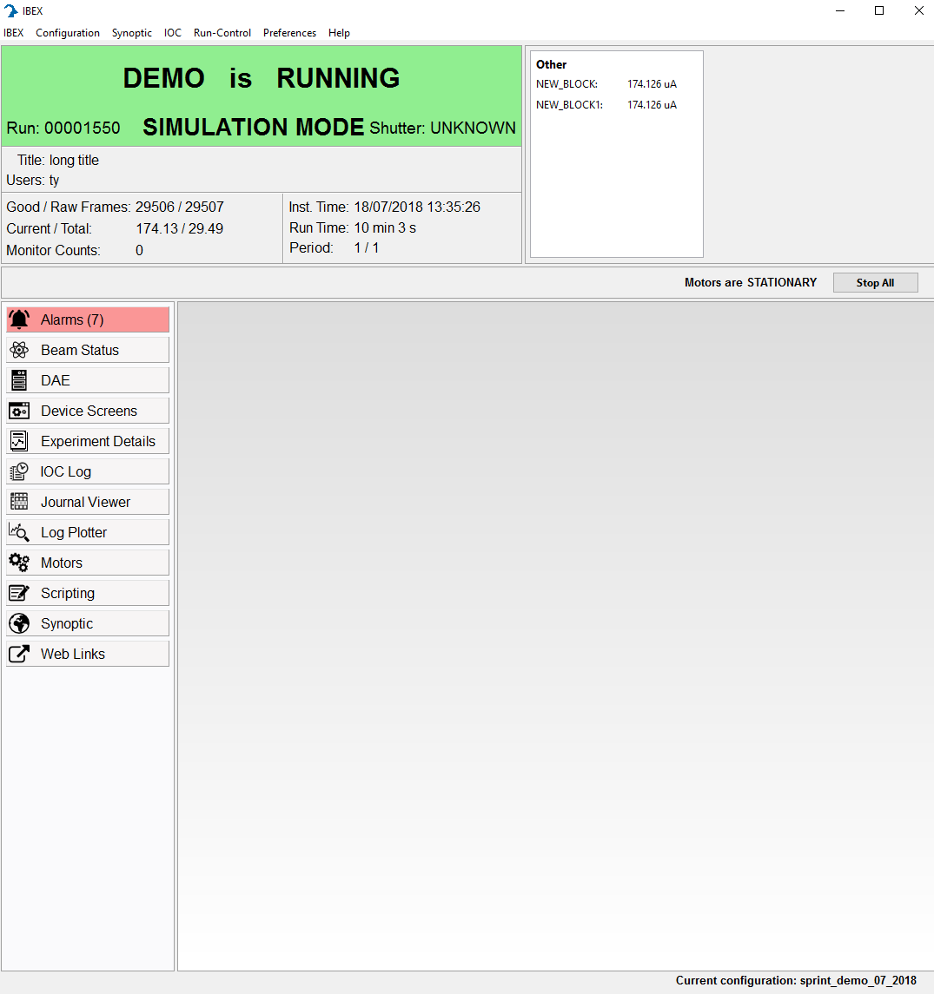
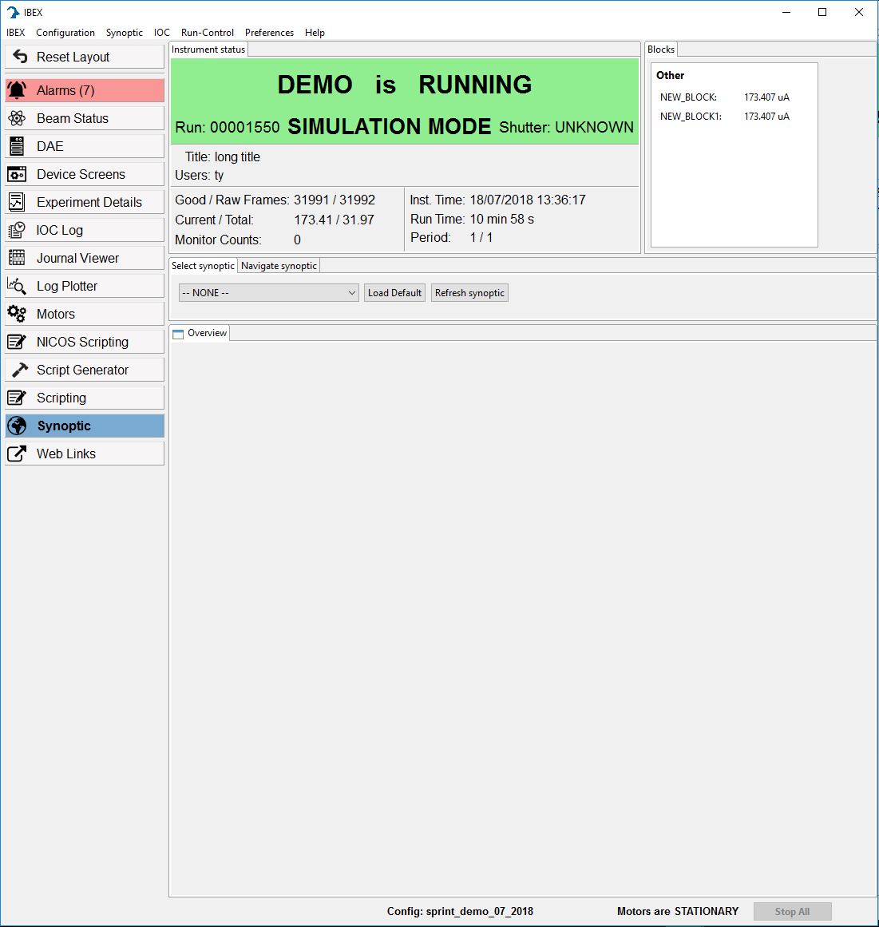
Banner
Eclipse 3
Eclipse 4
Notes:
Less wasted space in centre of screen

Slide 8
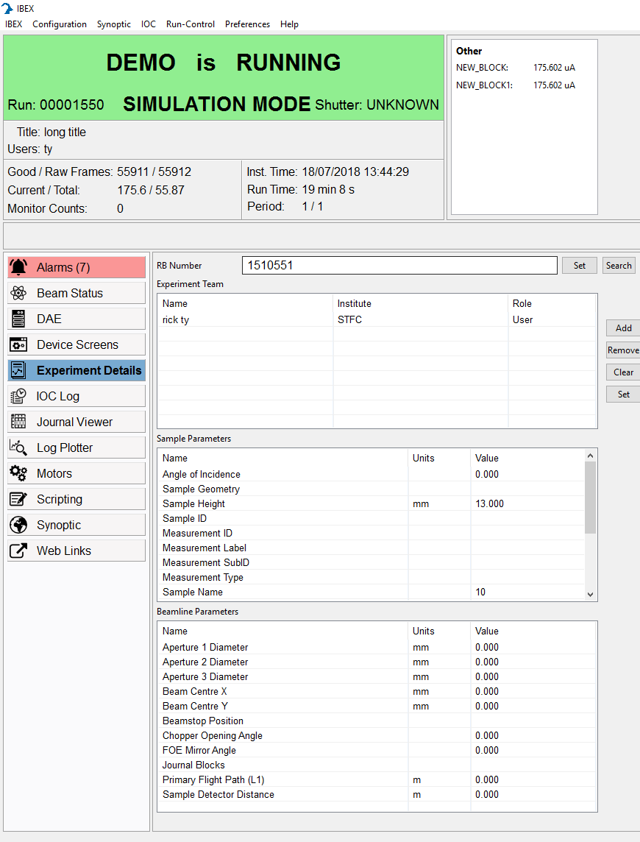
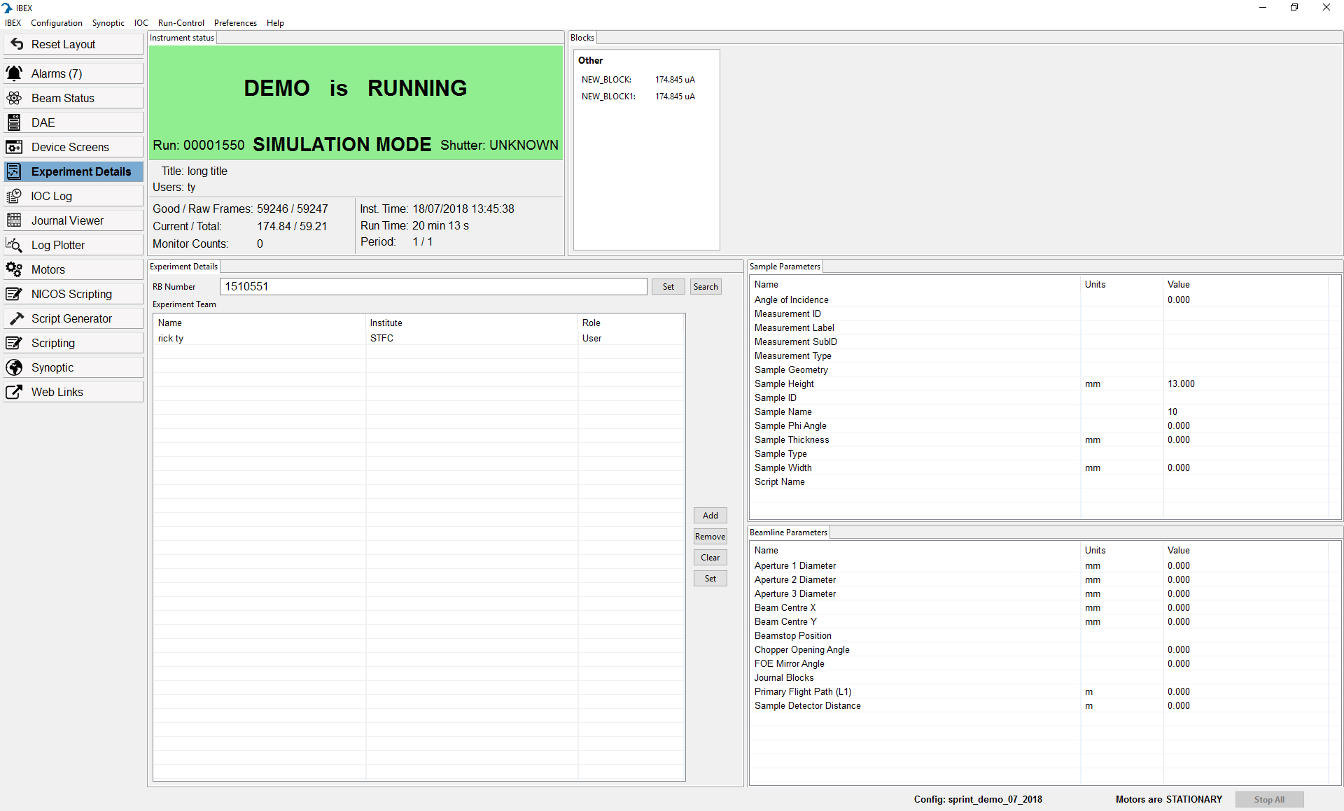
Experiment details
Eclipse 3
Eclipse 4
Notes:
Emphasise better use of space – no scrolling required to see all experimental parameters

Slide 9
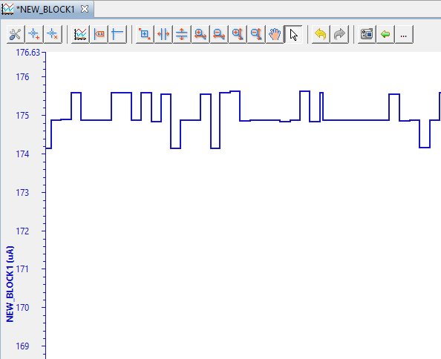
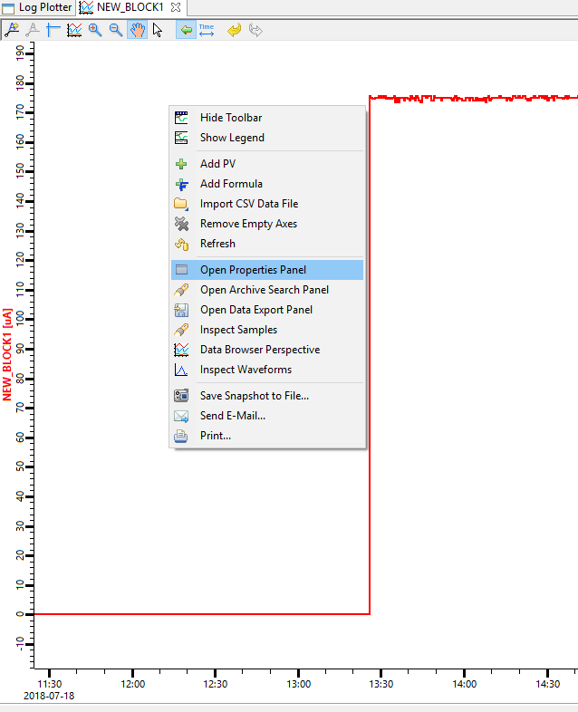
Log Plotter
Most options now moved to “properties” pane accessible via right-click context menu
Eclipse 3
Eclipse 4
Notes:
Emphasise that properties are still accessible – just from a different menu.
We have disabled autoscale by default on the log plotter, per request from multiple instruments

Slide 10
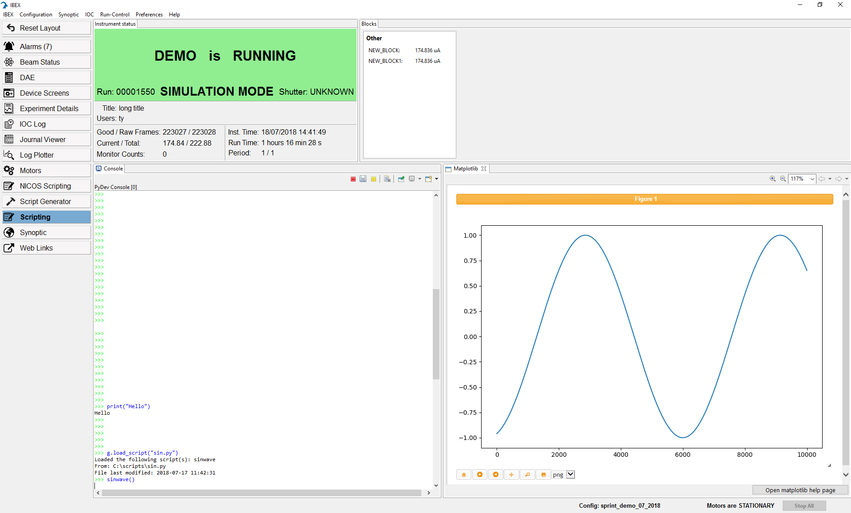
E4 features: matplotlib
Eclipse 4 can capture the output from matplotlib
Notes:
Asked for explicitly by LSS and Reflectometers, muons also had some interest in potentially complex graphs.

Slide 11
E4 features: live view
The IBEX user interface will have support for displaying a live view of the detectors, provided that:
  The instrument is running in event mode
  There is a sensible square arrangement of detectors that can be used to draw the image
For details, talk to Freddie Akeroyd
Notes:
Asked for by SANS instruments. Could potentially be useful for others too.

Slide 12
E4 features: script server
There is a separate presentation about the script server
Ability to fully separate client/server
In time, this means that remote desktop / VNC to instrument machines will no longer be necessary.
Instead, can submit scripts directly from allowed PCs (e.g. cabin PC, offices, …)
Scripting console will work as before.
Notes:
See separate NICOS presentation.

Slide 13
Deployment
I am used to the Eclipse 3 user interface. Can I keep using it?
  No. We will no longer be supporting the eclipse 3 user interface. If there are specific issues in the eclipse 4 interface, please raise them.
  However, for one cycle only, we will provide a fall back option of the eclipse 3 user interface.
When will an eclipse 4 user interface be released?
  In time for the September cycle.

Slide 14
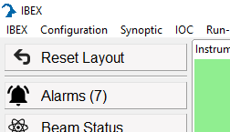
Layouts
What happens if my user accidentally loses a window?
  There is a reset layout button in an easily accessible location. This will bring back the default layout.
Can I define and save my own custom layout?
  Right now: No
  In the future: Possibly. Would this be a useful feature?

Slide 15
Demo / Questions

