Slide 1

genie_python and Ibex Experimental Controls Team ISIS

Slide 2
Contents
Getting started
Common commands
Scripting
Converting from OpenGENIE
Notes:
Welcome to this introductory course on genie_python, a Python module that enables instrument control using Genie commands with Python.
We’ll learn how to: Start and stop runs, get and set block information, ipdate experiment details, call specialised instrument and user scripts, convert our old OpenGENIE scripts to genie_python
At each stage, the course aims to assist learning with exercises and worked examples.
We will assume a basic working knowledge of Python.
genie_python does not cover data analysis. If you want to do analysis that can't be achieved with basic Python, we recommend the Mantid with Python training course.

Slide 3
Contents
Format
Information in black
Tasks in green
You are in control
Ask questions
Choose the order and depth
If you want to spend more or less time on a section please just let us know
Notes:
- Prepared some slides with info on (in black) and tasks to try (to green)
- You are in control this is to help you so can ignore slides. Ask questions whenever and you can choose the order
- Today’s session is scheduled to last for 3 hours

Slide 4
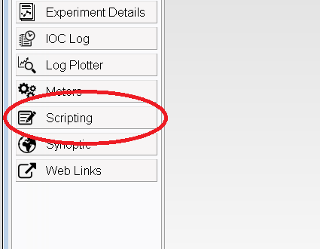
Getting started
Open a scripting window in Ibex
Output "Hello, world!" to the console
Output the square of all the integers between 1 and 10
Notes:
The best way to run genie_python commands is from the scripting perspective of the Ibex client.
To open a scripting window:
Start the Ibex client
Open the scripting perspective
The exercise is mostly a warm up to make sure:
People are comfortable with their PC setup
Their server is running
They have prerequisite Python knowledge

Slide 5
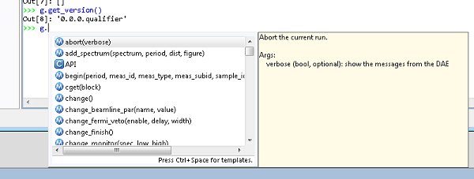
Common commands: Calling functions
Access functions via the ‘g’ namespace.
For example: ‘g.get_version()’
Autocomplete will suggest available functions:
Notes:
Functions accessed via the ``g`` namespace
You should have noticed immediately after you typed ``g.`` that an auto-complete window appeared:
The window lists the available commands, and the arguments they take, in brackets.
A description of the highlighted functions and its arguments is also given.
The list will be refined as you type more characters.

Slide 6
Common commands: Arguments
Arguments are passed to functions using standard Python syntax. For example:
g.add_spectrum(1, 2)
g.add_spectrum(spectrum=1, period=2)
g.add_spectrum(1, period=2)
g.add_spectrum(period=2, spectrum=1)
Why is g.add_spectrum(2, spectrum=1) invalid?
What are two equivalent ways of writing g.begin(False)? Can you think of why you might choose each one?
Notes:
This should all be review of how arguments are passed to functions. They should know this.
Arguments are passed to functions as a comma-separated list within brackets. For example ``g.add_spectrum(1, 2)``
Arguments may be named or not. For example ``g.add_spectrum(spectrum=1, period=2)``
Named and un-named arguments can be mixed but the named arguments must appear last. For example ``g.add_spectrum(1, period=2)``
Named arguments will be interpreted in the order of the function definition. Un-named arguments can be in any order. So ``g.add_spectrum(period=2, spectrum=1)`` would be valid but ``g.add_spectrum(2, spectrum=1)`` would not.
Some arguments may be defaulted in which case they do not need to be included in the argument list. For example ``g.add_spectrum(1)`` is equivalent to ``g.add_spectrum(1, 1)``.
The following three calls are all equivalent
g.begin()
g.begin(False)
g.begin(verbose=False)
I would pick the first if I never want verbose output, I would choose the latter if I sometimes wanted verbose output and wanted to make my choice explicit. I would use the final syntax if the script was being read/modified by a novice user unfamiliar with what the argument is likely to mean

Slide 7
Common commands: Arguments
Arguments are passed to functions using standard Python syntax. For example:
g.add_spectrum(1, 2)
g.add_spectrum(spectrum=1, period=2)
g.add_spectrum(1, period=2)
g.add_spectrum(period=2, spectrum=1)
Why is g.add_spectrum(2, spectrum=1) invalid?
What are two equivalent ways of writing g.begin(False)? Can you think of why you might choose each one?
Notes:
This should all be review of how arguments are passed to functions. They should know this.
Arguments are passed to functions as a comma-separated list within brackets. For example ``g.add_spectrum(1, 2)``
Arguments may be named or not. For example ``g.add_spectrum(spectrum=1, period=2)``
Named and un-named arguments can be mixed but the named arguments must appear last. For example ``g.add_spectrum(1, period=2)``
Un-named arguments will be interpreted in the order of the function definition. Named arguments can be in any order. So ``g.add_spectrum(period=2, spectrum=1)`` would be valid but ``g.add_spectrum(2, spectrum=1)`` would not.
Some arguments may be defaulted in which case they do not need to be included in the argument list. For example ``g.add_spectrum(1)`` is equivalent to ``g.add_spectrum(1, 1)``.
The following three calls are all equivalent
g.begin()
g.begin(False)
g.begin(verbose=False)
I would pick the first if I never want verbose output, I would choose the latter if I sometimes wanted verbose output and wanted to make my choice explicit. I would use the final syntax if the script was being read/modified by a novice user unfamiliar with what the argument is likely to mean

Slide 8
Common commands: Switching run states
begin: Begins a new run
pause: Pauses the current run
resume: Resumes the current run
end: Ends the current run
abort: Aborts the current run
get_runstate: Gets the state of the current run
Notes:
Run through the basic run state commands
Warn users not to assume the resultant state when using these commands. For example, you may run ``g.begin()`` and then expect the instrument to be running. That may be true, but it could also be waiting, vetoing, or still setup. It's a good idea to put checks into your scripts that you've reached the expected state.

Slide 9
Common commands: Waiting
Wait for a specific event before continuing. Use a “waitfor_...” function:
What do you think the following commands do?
g.waitfor_time(seconds=10)
g.waitfor_time(minutes=10)
g.waitfor_uamps(10)
g.waitfor_block("MY_BLOCK", lowlimit=10)
G.waitfor_move()
Use autocomplete to bring up a list of available waitfor functions
Notes:
``g.waitfor_time(seconds=10)``. Wait for 10 seconds
``g.waitfor_time(minutes=10)``. Wait for 10 minutes
``g.waitfor_uamps(10)``. Wait for the total received current to reach 10 uamps
``g.waitfor_block(block="MY_BLOCK", lowlimit=10)``. Wait for the block "MY_BLOCK" to be greater than or equal to 10

Slide 10
Common commands: Update and store
You can update and store DAE results using:
update: Load the data from the DAE into memory
store: Write the updated DAE information to disk
updatestore: Load the data from the DAE into memory and store it to disk

Slide 11
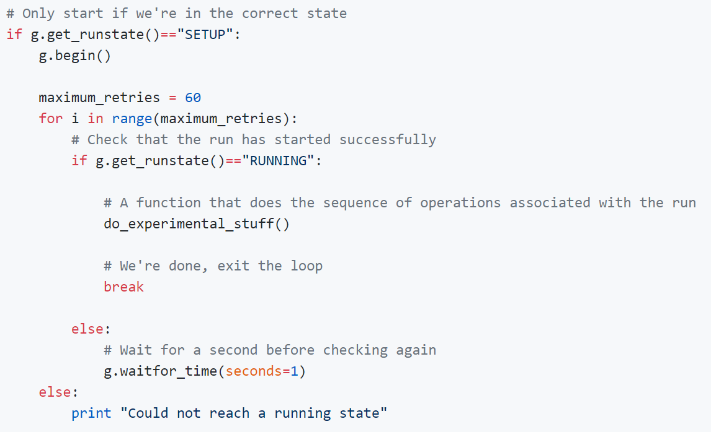
Common commands: Worked example
Notes:
Get the attendees to put the script in via the terminal
They’ll need to put something token in place of do_experimental_stuff()

Slide 12
Common commands: Blocks
get_blocks: Gets a list of the currently available blocks
cshow: Shows the properties of a named block/all blocks
If given a name (e.g. MY_BLOCK) it will return a string containing properties of the block
If called without arguments, it will show the same information for all blocks, with each block on a new line
cget: Gets properties of a named block as a dictionary of values
Unlike cshow, a block name must be specified
Properties can be accessed as standard Python
cset: Sets the value for a particular block
Assumes that either a setpoint exists for the underlying value or the block itself points at a setpoint
Can be called with block names as named arguments. This is useful for setting multiple blocks
E.g. g.cset(MY_BLOCK=1, MY_OTHER_BLOCK=2)
The block can also be passed in by name. This is useful when setting advanced block properties
E.g. g.cset("MY_BLOCK", lowlimit=1, highlimit=10, runcontrol=True)
Try using the above commands to get and set the value of the blocks in the current configuration

Slide 13
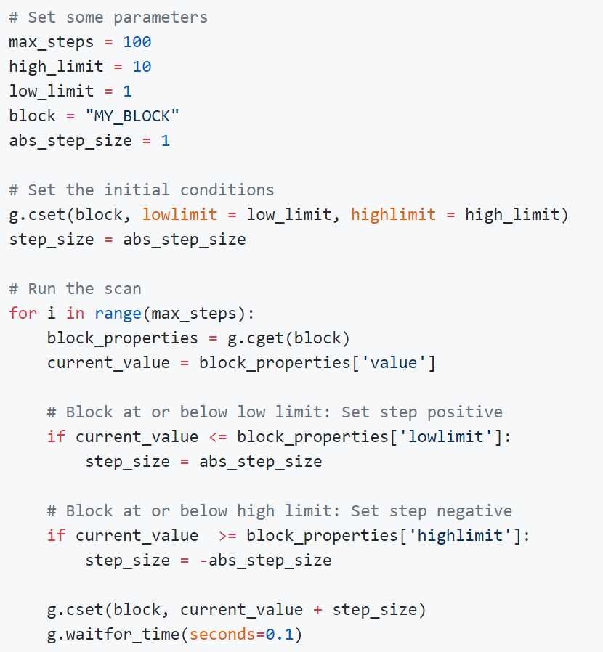
Common commands: Worked example
Notes:
Get the attendees to put the script in via the terminal
They’ll need to put something token in place of do_experimental_stuff()

Slide 14
Common commands: Experiment setup
You can change various elements of the experiment setup using genie_python. For example:
change_tcb: Change the time channel binning
change_tables: Change the wiring, spectra and detector table locations
change_monitor: Change the monitor to a specified spectrum and range
If you use the following commands, you can stop a run from starting while you’re still applying changes:
change_start: Marks the start of a change
change_finish: Marks that the current set of changes is complete.

Slide 15
Common commands: Experiment details
You can change various experiment details with one of the “change_...” functions:
g.change_title("New title")
g.change_user(“Adrian and John")
g.change_rb(10)
What other “change” commands are there?
You can get properties using the equivalent “get_...” command:
g.get_title()
g.get_user()
g.get_rb()
Notes:
Use auto-complete or genie_python reference manual to look up change commands

Slide 16
Common commands: Exercise
Change the title of the run to Exercise 2
Start a run
Wait for 1 uamps (maximum wait 10 seconds) before pausing
Set the value of MY_BLOCK to 5, with a high limit of 10, a low limit of 1 and put it under run control
Resume the run
Set the value of MY_BLOCK to 20 and confirm (using genie_python) that the instrument has entered a waiting state
Decrease the value of MY_BLOCK down in steps of 1 until it reaches 10. Wait for 1 second between steps. Notice how the run state changes back to running when the block value drops below 10.
End the run
Notes:
g.change_title("Exercise 2")
g.begin()
g.waitfor(uamps=1, max_wait=10)
g.pause()
g.cset("MY_BLOCK", 5, lowlimit=1, highlimit=10, runcontrol=True)
g.resume()
g.cset(MY_BLOCK=20)
print "The instrument {0} waiting“.format(“is” if g.get_runstate()=="WAITING“ else “is not”)
for i in range(int(g.cget("MY_BLOCK")['value']), 4, -1):
g.cset(MY_BLOCK=i)
g.waitfor(seconds=1)
g.end()

Slide 17
Scripting Create
Python scripts have the extension .py.
Many editors available. We like Notepad++
Two types of script:
Instrument scripts. Aimed at instrument scientists, or an instrument-specific functions that multiple users may wish to access.
User scripts. Specific users need for particular experiments.
Ibex puts all Instrument scripts under version control.
Instrument scripts are in:
C:\Instrument\Settings\config\NDX[Instrument name]\Python\inst
User scripts are in:
C:\scripts
Create two empty scripts:
An instrument script called set_up_instrument.py
A user script called run_my_experiment.py
Notes:
Explain what it means for scripts to be under version control. Why is that good?
After creating the files, you should have one new file in C:\scripts and another in C:\Instrument\Settings\config\[Instrument name]\Python\inst

Slide 18
Scripting Write
Scripts can use any Python and genie_python functionality that you've already learnt.
We recommend all executable code within a script should be contained within functions and classes. For example:
Update your instrument script, set_up_instrument.py, so that it contains a single function
The function should be called "set_up_instrument"
It should set the title to "My experiment"
It should set the username to your name
Update your user script, run_my_experiment.py which contains a function that does the following
Begins the run
Prints the current uamps for the current period over 10 seconds at 1 second intervals
Ends the run
Notes:
def set_up_instrument():
g.change(title="My experiment", user="Adrian")
def get_uamps_run():
g.begin()
period = g.get_period()
for i in range(10):
print "Total current after {0}s: {1}.format(i+1, g.get_uamps(period))
g.end()

Slide 19
Scripting Load
Instrument scripts are loaded automatically when you open the scripting perspective
User scripts can be loaded by using the load_script function, e.g. g.load_script('C:\script\my_script.py')
Load your user script run_my_experiment.py
Notes:
IMPORTANT: When a script is loaded, Python runs all the commands contained within. We strongly recommend keeping all executable code within functions, so that it runs when you call it rather than executing immediately.
Loading the scripts should be easy but it’s when the most problems are likely to become apparent

Slide 20
Scripting Run
Instrument script functions can be called with inst.[function_name](args), for example:
inst.my_method("MY_BLOCK")
The Ibex scripting perspective will provide auto-completion for instrument methods so you can see what is available
Run the instrument function you wrote earlier
Notes:
- Again, running should be easy but most likely where they will run into problems. Check the scripting window startup for signs of issues loading inst scripts

Slide 21

Scripting Run
Functions loaded from user scripts using g.load_script(...) will be available to call like any other function. For example:
Run the user function you wrote earlier
Notes:
- Again, running should be easy but most likely where they will run into problems. Check the scripting window startup for signs of issues loading inst scripts

Slide 22
Scripting Modify
Every new scripting perspective will be a clean slate.
Sometimes you might want to change a script and update it without having to change scripting terminal.
Instrument scripts: Run the command reload(inst)
User scripts: Rerun g.load_script(…)
Modify your instrument script to output the current at 0.1 second intervals
Reload the script
Run it again and confirm the behaviour has changed

Slide 23
Scripting Importing modules
You may want to call a function from one file in another file.
Calling an instrument function from a different instrument script
Use the import command:
from counts import vanadium
def calibration():
for i in range(5):
vanadium()
Calling an instrument function from a user script
Use inst. prefix
Calling a user function from an instrument script
Not a good idea
Calling a user function from a different user script
Same as calling a function from one instrument script in another

Slide 24
Scripting Exercise
Create a new instrument script containing a function
The function sets the title to "Ramping [block name] from [initial value] to [final value]"
The method begins a run and then changes the value of the block incrementally in steps of size 1
Once the target is reached, the method ends the run
Put a line at the top of your instrument script outside the function definition that prints the current title
Create a new user script containing a function
The function runs the new instrument script on two different blocks
Load and run your new user-script function
Where was the print statement at the top of your instrument script executed?
Notes:
See https://github.com/ISISComputingGroup/ibex_user_manual/wiki/genie_python-and-Ibex-%28Exercise-solutions%29

Slide 25
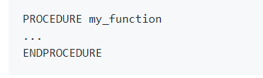

Converting from OpenGENIE Procedures vs. functions
Notes:
No ENDPROCEDURE needed in Python, indentation makes it implicit

Slide 26
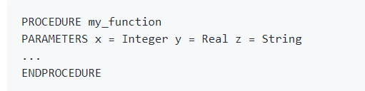

Converting from OpenGENIE Procedures vs. functions
Notes:
Arguments don’t need typing in Python

Slide 27


Converting from OpenGENIE Loops
Notes:
The endpoint of Python’s range function is not inclusive
No ENDLOOP needed in python

Slide 28
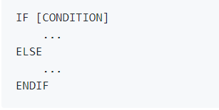
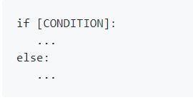
Converting from OpenGENIE Conditionals
Notes:
No ENDIF needed in python

Slide 29
Converting from OpenGENIE Commands
The majority of OpenGENIE commands have a very close equivalent in genie_python:
BEGIN becomes g.begin()
CHANGE TITLE=‘New title’ becomes g.change_title(“New title”)
Similarly, most arguments will be very similar between OpenGENIE and genie_python:
CSET/CONTROL TEMP1=5 LOWLIMIT=1 HIGHLIMIT=10 becomes g.cset(TEMP1=5, runcontrol=True, lowlimit=1, highlimit=10)
Notes:
NOTE Python is case sensitive and the arguments, apart from the block name, are in lower case

Slide 30
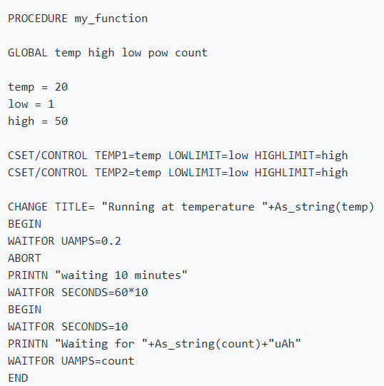
Converting from OpenGENIE Worked example
Notes:
Go through this step-by step with the attendees so they’re happy with the conversion process:
https://github.com/ISISComputingGroup/ibex_user_manual/wiki/genie_python-and-Ibex-%28Converting-from-OpenGENIE%29

Slide 31
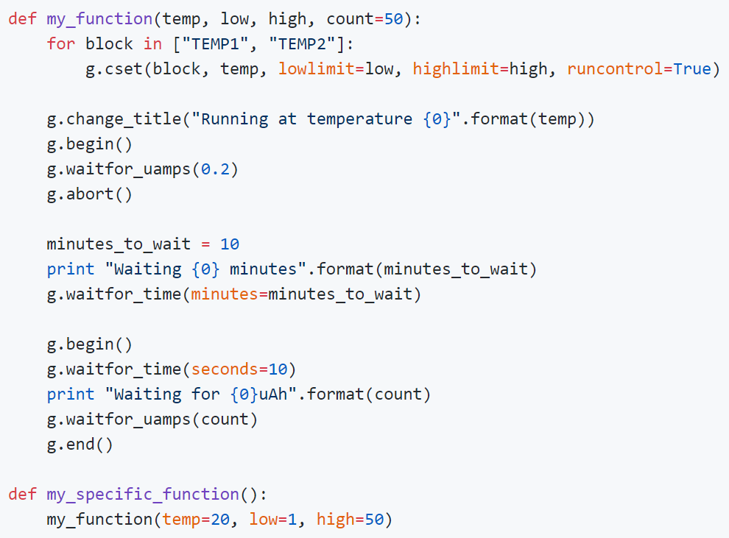
Converting from OpenGENIE Worked example
Notes:
Rather than use the value 10 for the number of minutes to wait, we've set it as a variable. That means if we change the value, we only need to change it in one place.
We've used the minutes argument in waitfor_time rather than having to apply the conversion factor between minutes and seconds ourselves.
We've used the syntax "...".format(arg1, arg2) to build our output strings. There are lots of ways to build strings in Python. Alternatively you can just use "..." + str(arg1) + "..." + str(arg2) + "..." but we like this way because it makes it easier to read and you don't have to remember to use str(...) to convert the types
Full conversion steps at: https://github.com/ISISComputingGroup/ibex_user_manual/wiki/genie_python-and-Ibex-%28Converting-from-OpenGENIE%29

Slide 32
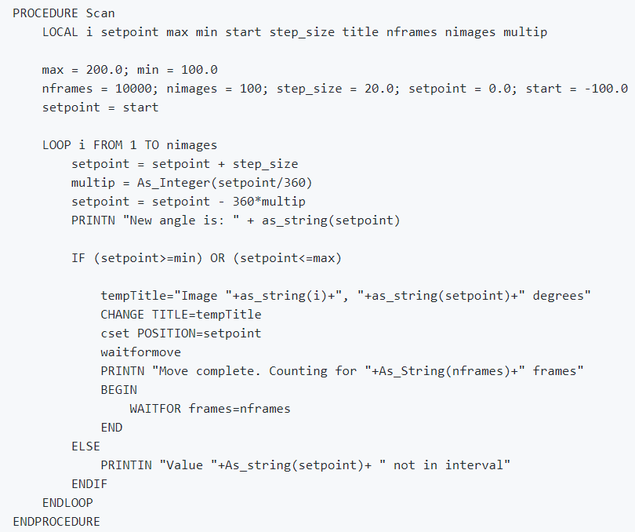
Converting from OpenGENIE Exercise: Translate to genie_python
Notes:
https://github.com/ISISComputingGroup/ibex_user_manual/wiki/genie_python-and-Ibex-%28Exercise-solutions%29
Should be quite straightforward. Note the simplification “setpoint = (start + i*step_size) % 360” to avoid needing to increment step size and do modulo in one step

Slide 33
References
User Manual
http://shadow.nd.rl.ac.uk/ibex_user_manual/Home
Course notes
http://shadow.nd.rl.ac.uk/ibex_user_manual/genie_python-and-Ibex-(Introduction)
Genie Python Manual
http://shadow.nd.rl.ac.uk/genie_python/sphinx/genie_python.html
Notes:
User manual and genie python manual

