Slide 1
Script server

Slide 2
What is a script server?
Currently, instrument control scripts run inside the IBEX client and genie_python windows
The script server runs Python Scripts in the IBEX-server
Authorised clients submit scripts to the script server

Slide 3



What is a script server?
Commands
Scipting console:
Client
NDX
Script
Script Server:
Results
Client
NDX

Slide 4
Script server functionality
The script server can currently:
  Execute a queue of scripts on the server
  Display which line a script is currently on
  Pause and resume scripts interactively
Note: the script server is optional. The existing scripting perspective will work as before.
Notes:
Might also choose to mention that scripts can now be submitted from any (authorised) computer – means that the IBEX client can be run on any office or cabin PC and not need VNC

Slide 5
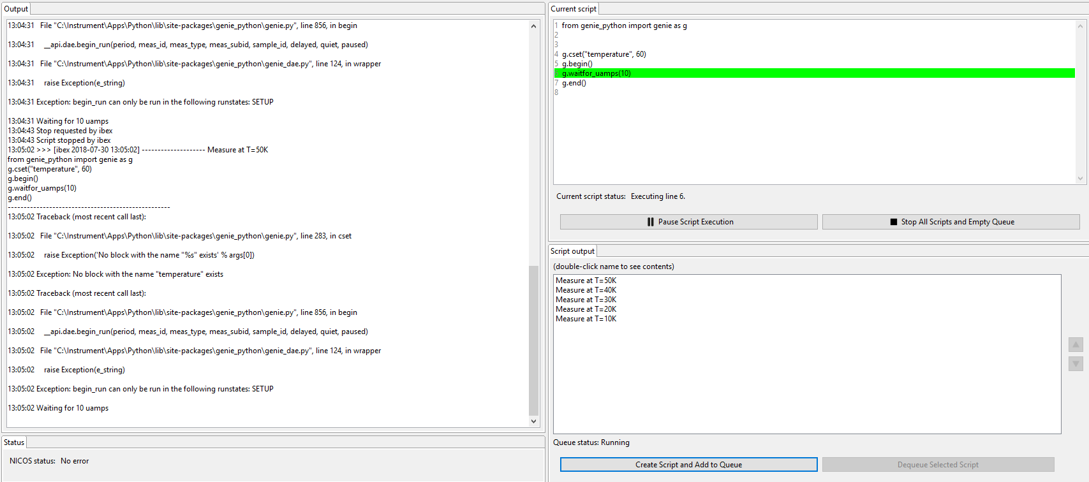
Script server functionality
Notes:
Talk about the different parts of the view – output, current script, queue

Slide 6
Future development
Syntax highlighting/suggestions
  Similar to existing scripting window
Time estimation?
Dry runs of scripts?
Python 3
  At the same time as mantid
Stepping through scripts one line at a time
Editing a script on the fly

Slide 7
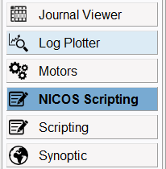


How to use the script server
Select the NICOS scripting perspective in IBEX
Add a script to the queue
Look at the output in the “output” window
Notes:
May be worth explaining that we can’t load scripts from file (yet) – you have to type them in
Emphasise that this is a first release, and it is likely we’ll be able to implement more features on it.

Slide 8
Demo / questions
Notes:
Add a script to the queue. Pause it. Resume it. Remove a script from the queue.

