Slide 1
Nicos script server

Slide 2
What is a script server?
Currently, instrument control scripts run inside the IBEX user interface
A script server is a server-side process that executes Python scripts
On an (authorised) client, can submit scripts to be run on the script server

Slide 3
Script server advantages
Allows scripts to be queued – errors in earlier scripts will not prevent later scripts from executing
Prevents multiple scripting sessions from fighting each other
Interactivity – e.g. displaying which line the script is on, pause/resume, …
In future: Dry runs? Time estimation?
Notes:
Might also choose to mention that scripts can now be submitted from any (authorised) computer – means that the IBEX client can be run on any office or cabin PC and not need VNC

Slide 4
Script server functionality
The script server can currently:
  Execute a queue of scripts on the server
  Display which line a script is currently on
  Pause and resume scripts
Note: the script server is optional. The existing scripting perspective will work as before.

Slide 5
Future development
Syntax highlighting/suggestions
  Similar to existing scripting window
Time estimation?
Dry runs of scripts?
Python 3
  Probably at a similar time to Mantid
Stepping through scripts one line at a time
Editing a script on the fly

Slide 6
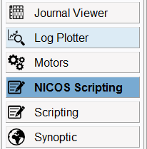


How to use the script server
Select the NICOS scripting perspective in IBEX
Add a script to the queue
Look at the output in the “output” window

Slide 7
Demo / questions

