Slide 1

genie_python and IBEX
Introduction for LSS Experimental Controls Team ISIS

Slide 2
Contents
Getting started
Common commands
Scripting
Converting from Open GENIE
Notes:
Welcome to this introductory course on genie_python, a Python module that enables instrument control using Genie commands with Python.
We’ll learn how to: Start and stop runs, get and set block information, ipdate experiment details, call specialised instrument and user scripts, convert our old Open GENIE scripts to genie_python
At each stage, the course aims to assist learning with exercises and worked examples.
We will assume a basic working knowledge of Python.
genie_python does not cover data analysis. If you want to do analysis that can't be achieved with basic Python, we recommend the Mantid with Python training course.

Slide 3
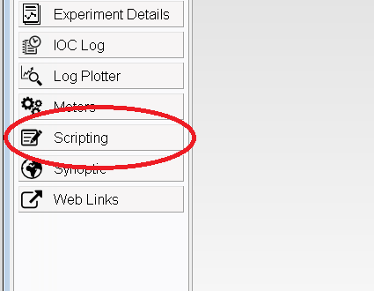
Getting started
Notes:
The best way to run genie_python commands is from the scripting perspective of the IBEX client.
To open a scripting window:
Start the IBEX client
Open the scripting perspective
The exercise is mostly a warm up to make sure:
People are comfortable with their PC setup
Their server is running
They have prerequisite Python knowledge

Slide 4
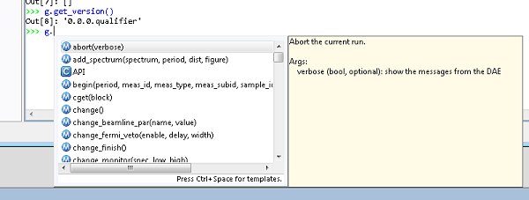
Common commands: Calling functions
Access functions via the ‘g’ namespace.
For example: g.get_version()
Autocomplete will suggest available functions:
Notes:
Functions accessed via the ``g`` namespace
You should have noticed immediately after you typed ``g.`` that an auto-complete window appeared:
The window lists the available commands, and the arguments they take, in brackets.
A description of the highlighted functions and its arguments is also given.
The list will be refined as you type more characters.

Slide 5
Common commands: Switching run states
begin: Begins a new run
pause: Pauses the current run
resume: Resumes the current run
end: Ends the current run
abort: Aborts the current run
get_runstate: Gets the state of the current run
Notes:
Run through the basic run state commands
Warn users not to assume the resultant state when using these commands. For example, you may run ``g.begin()`` and then expect the instrument to be running. That may be true, but it could also be waiting, vetoing, or still setup. It's a good idea to put checks into your scripts that you've reached the expected state.

Slide 6
Common commands: Waiting
Wait for a specific event before continuing. Use a “waitfor_...” function:
What do you think the following commands do?
g.waitfor_time(seconds=10)
g.waitfor_time(minutes=10)
g.waitfor_uamps(10)
g.waitfor_block("MY_BLOCK", lowlimit=10)
g.waitfor_move()
g.waitfor_runstate(“Running”, 60)
Notes:
``g.waitfor_time(seconds=10)``. Wait for 10 seconds
``g.waitfor_time(minutes=10)``. Wait for 10 minutes
``g.waitfor_uamps(10)``. Wait for the total received current to reach 10 uamps
``g.waitfor_block(block="MY_BLOCK", lowlimit=10)``. Wait for the block "MY_BLOCK" to be greater than or equal to 10

Slide 7
Common commands: Update and store
You can update and store DAE results using:
update: Load the data from the DAE into memory
store: Write the updated DAE information to disk
updatestore: Load the data from the DAE into memory and store it to disk

Slide 8
Common commands: Blocks
get_blocks: Gets a list of the currently available blocks
cshow: Shows the properties of a named block/all blocks
If given a name (e.g. MY_BLOCK) it will return a string containing properties of the block
If called without arguments, it will show the same information for all blocks, with each block on a new line
cget: Gets properties of a named block as a dictionary of values
Unlike cshow, a block name must be specified
Properties can be accessed as standard Python
cset: Sets the value for a particular block
Assumes that either a setpoint exists for the underlying value or the block itself points at a setpoint
Can be called with block names as named arguments. This is useful for setting multiple blocks
g.cset(MY_BLOCK=1, MY_OTHER_BLOCK=2)
The block can also be passed in by name. This is useful when setting advanced block properties
g.cset("MY_BLOCK", lowlimit=1, highlimit=10, runcontrol=True)

Slide 9
Common commands: Experiment details
You can change various experiment details with one of the “change_...” functions:
g.change_title("New title")
g.change_user(“Adrian and John")
g.change_rb(10)
You can get properties using the equivalent “get_...” command:
g.get_title()
g.get_user()
g.get_rb()
Notes:
Use auto-complete or genie_python reference manual to look up change commands

Slide 10
Common commands: Experiment setup
You can change various elements of the experiment setup using genie_python. For example:
change_tcb: Change the time channel binning
change_tables: Change the wiring, spectra and detector table locations
change_monitor: Change the monitor to a specified spectrum and range
If you use the following commands, you can stop a run from starting while you’re still applying changes:
change_start: Marks the start of a change
change_finish: Marks that the current set of changes is complete.

Slide 11
Scripting Create
Python scripts have the extension .py.
Many editors available. We like Notepad++
Two types of script:
Instrument scripts. Aimed at instrument scientists, or an instrument-specific functions that multiple users may wish to access.
User scripts. Specific users need for particular experiments.
IBEX puts all Instrument scripts under version control.
Instrument scripts are in:
C:\Instrument\Settings\config\NDX[Instrument name]\Python\inst
User scripts are in:
C:\scripts
Notes:
Explain what it means for scripts to be under version control. Why is that good?
After creating the files, you should have one new file in C:\scripts and another in C:\Instrument\Settings\config\[Instrument name]\Python\inst

Slide 12
Scripting Write
Scripts can use any Python and genie_python functionality that you've already learnt.
We recommend all executable code within a script should be contained within functions and classes. For example:
Notes:
def set_up_instrument():
g.change(title="My experiment", user="Adrian")
def get_uamps_run():
g.begin()
period = g.get_period()
for i in range(10):
print "Total current after {0}s: {1}.format(i+1, g.get_uamps(period))
g.end()

Slide 13
Scripting Load
Instrument scripts are loaded automatically when you open the scripting perspective
User scripts can be loaded by using the load_script function, e.g. g.load_script('C:\script\my_script.py')
Notes:
IMPORTANT: When a script is loaded, Python runs all the commands contained within. We strongly recommend keeping all executable code within functions, so that it runs when you call it rather than executing immediately.
Loading the scripts should be easy but it’s when the most problems are likely to become apparent

Slide 14
Scripting Run
Instrument script functions can be called with inst.[function_name](args), for example:
inst.my_method("MY_BLOCK")
The IBEX scripting perspective will provide auto-completion for instrument methods so you can see what is available
Notes:
- Again, running should be easy but most likely where they will run into problems. Check the scripting window startup for signs of issues loading inst scripts

Slide 15

Scripting Run
Functions loaded from user scripts using g.load_script(...) will be available to call like any other function. For example:
Notes:
- Again, running should be easy but most likely where they will run into problems. Check the scripting window startup for signs of issues loading inst scripts

Slide 16
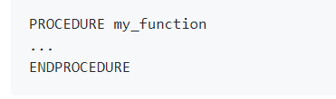

Converting from Open GENIE Procedures vs. functions
Notes:
No ENDPROCEDURE needed in Python, indentation makes it implicit

Slide 17
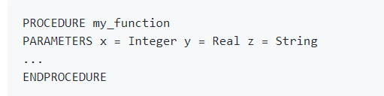

Converting from Open GENIE Procedures vs. functions
Notes:
Arguments don’t need typing in Python

Slide 18


Converting from Open GENIE Loops
Notes:
The endpoint of Python’s range function is not inclusive
No ENDLOOP needed in python

Slide 19
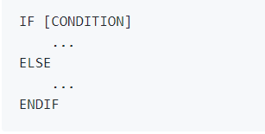
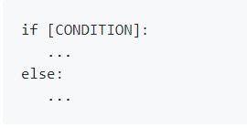
Converting from Open GENIE Conditionals
Notes:
No ENDIF needed in python

Slide 20
Converting from Open GENIE Commands
The majority of Open GENIE commands have a very close equivalent in genie_python:
BEGIN becomes g.begin()
CHANGE TITLE=‘New title’ becomes g.change_title(“New title”)
Similarly, most arguments will be very similar between Open GENIE and genie_python:
CSET/CONTROL TEMP1=5 LOWLIMIT=1 HIGHLIMIT=10 becomes g.cset(TEMP1=5, runcontrol=True, lowlimit=1, highlimit=10)
Notes:
NOTE Python is case sensitive and the arguments, apart from the block name, are in lower case

Slide 21
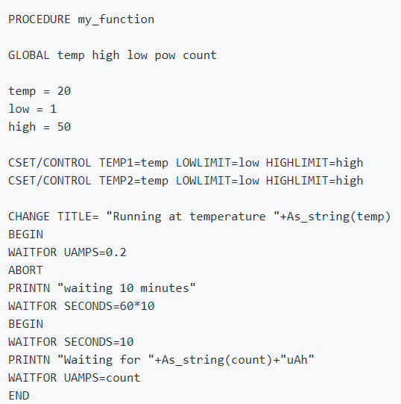
Converting from Open GENIE Worked example
Notes:
Go through this step-by step with the attendees so they’re happy with the conversion process:
https://github.com/ISISComputingGroup/IBEX_user_manual/wiki/genie_python-and-IBEX-%28Converting-from- Open GENIE%29

Slide 22
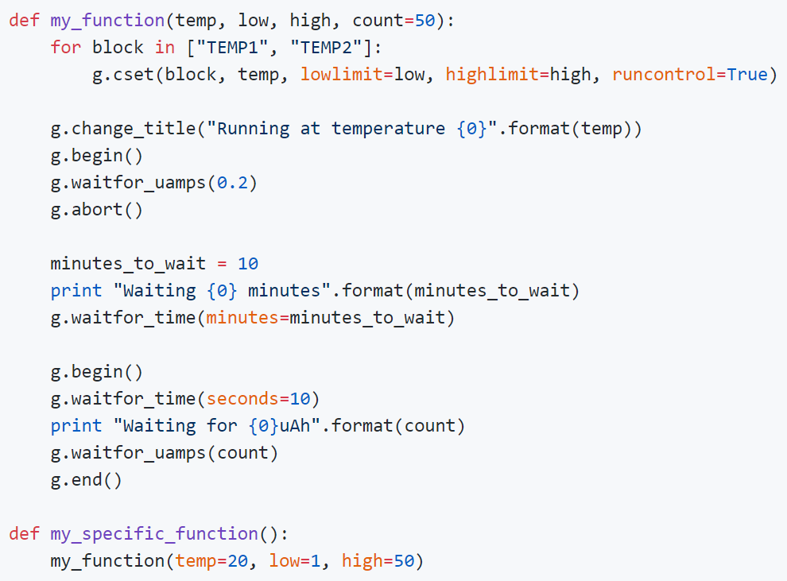
Converting from Open GENIE Worked example
Notes:
Rather than use the value 10 for the number of minutes to wait, we've set it as a variable. That means if we change the value, we only need to change it in one place.
We've used the minutes argument in waitfor_time rather than having to apply the conversion factor between minutes and seconds ourselves.
We've used the syntax "...".format(arg1, arg2) to build our output strings. There are lots of ways to build strings in Python. Alternatively you can just use "..." + str(arg1) + "..." + str(arg2) + "..." but we like this way because it makes it easier to read and you don't have to remember to use str(...) to convert the types
Full conversion steps at: https://github.com/ISISComputingGroup/IBEX_user_manual/wiki/genie_python-and-IBEX-%28Converting-from- Open GENIE%29

Slide 23
References
User Manual
http://shadow.nd.rl.ac.uk/IBEX_user_manual/Home
Course notes
http://shadow.nd.rl.ac.uk/IBEX_user_manual/genie_python-and-IBEX-(Introduction)
Genie Python Manual
http://shadow.nd.rl.ac.uk/genie_python/sphinx/genie_python.html
Notes:
User manual and genie python manual

