Slide 1
IBEX Client
Migration to Eclipse 4

Slide 2
What is Eclipse
Eclipse is a user-interface framework for Java applications
The current version of the IBEX user interface is built using Eclipse 3
…but in September, IBEX will be running on Eclipse 4!

Slide 3
Why is the migration needed
The current user interface is built on Eclipse 3, but…
  Eclipse 3 is becoming increasingly outdated
  Several of our dependencies are dropping support for Eclipse 3 – this means we no longer get access to the latest bug fixes
Eclipse 4 lets us implement some functionality which was impossible in 3
Notes:
Flexibility in creating custom layouts
Dependencies
CSS
Java8
Site security says can’t run out dated software e.g. Java
Java is moving to a 6-month release cycle. If we do not keep up to date we will find it increasingly difficult to get support. Especially for Java, they are moving towards a more regular release cycle, meaning we have to stay on top of versions as they are released to avoid becoming outdated.

Slide 4
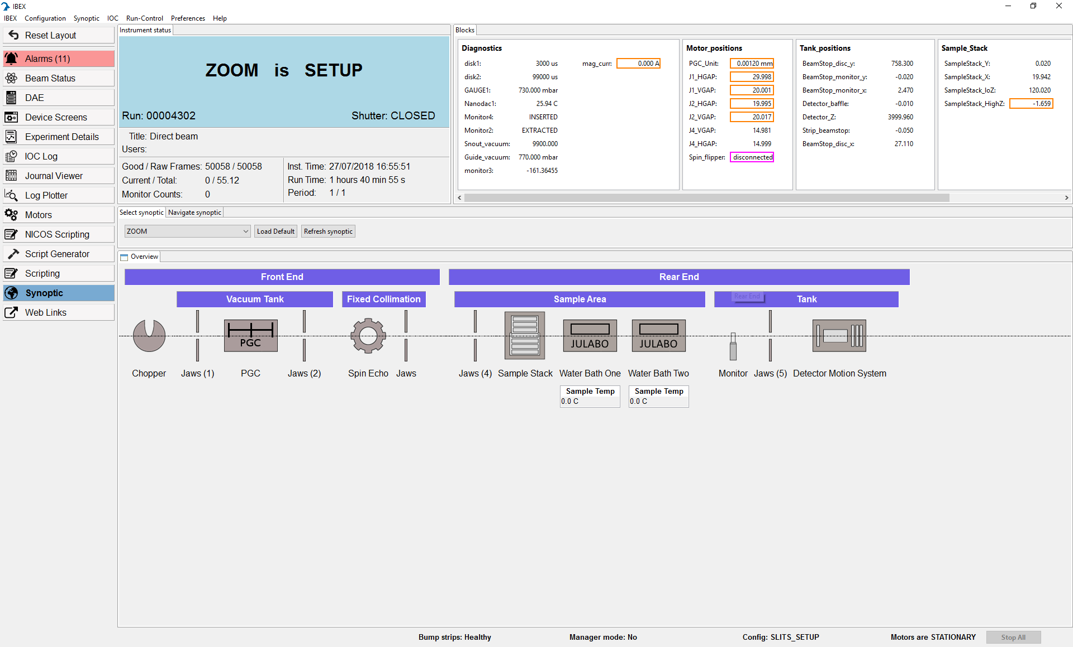
Most of the user interface has not changed

Slide 5
The IBEX server has not changed because of Eclipse 4
There is no risk of IOCs (IBEX device drivers) having broken due to Eclipse 4 migration
All genie_python scripting is the same
An Eclipse 3 user interface will be available for one more cycle
  We won’t be able to keep the Eclipse 3 client up to date in the long term.

Slide 6
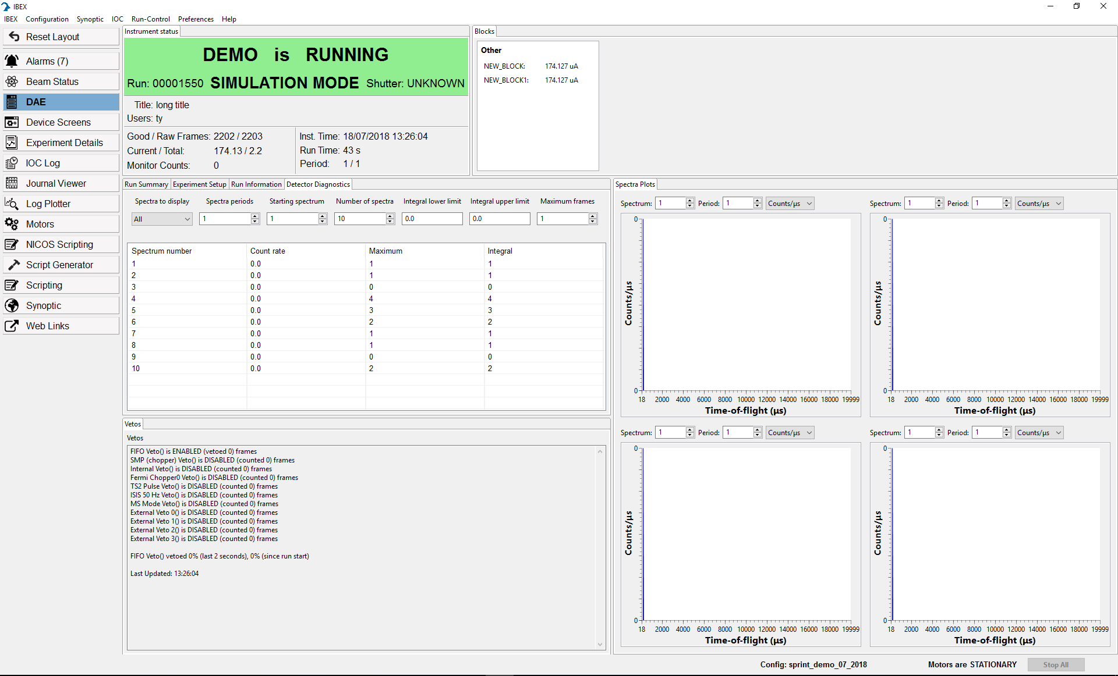
Biggest change: views are resizable & moveable
Notes:
This allows us to define custom views – e.g. detector diagnostics at the same time as spectra plots and vetos.
Emphasise the “reset layout” button in case things go wrong!
If we have implemented the ticket to tell when the layout has changed then let the scientists know here.

Slide 7
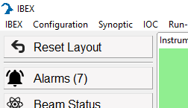
Layouts
What happens if my user accidentally loses a window?
  There is a reset layout button in an easily accessible location. This will bring back the default layout.
Can I define and save my own custom layout?
  Right now: No
  In the future: Possibly. Would this be a useful feature?

Slide 8
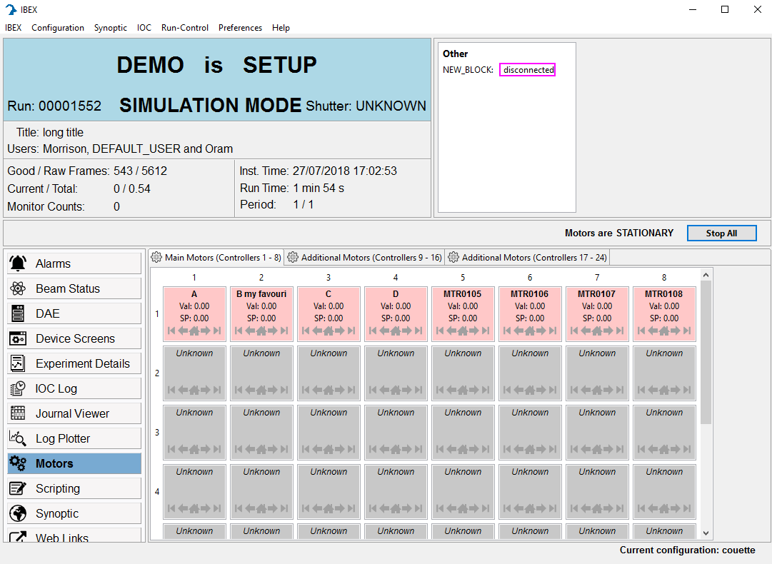
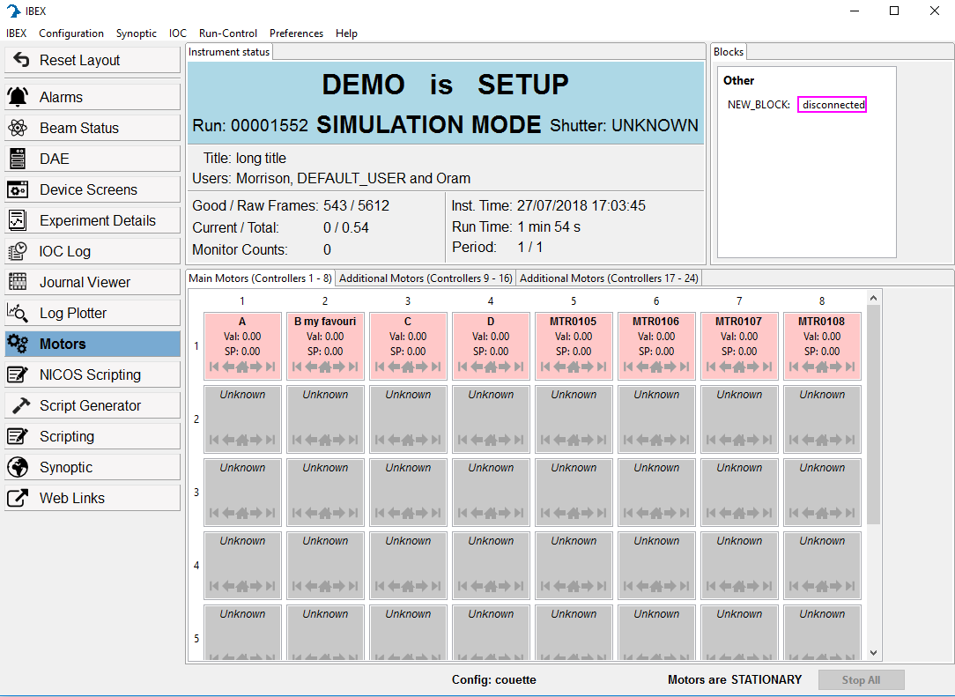
Banner
Eclipse 3
Eclipse 4
Notes:
Less wasted space in centre of screen

Slide 9
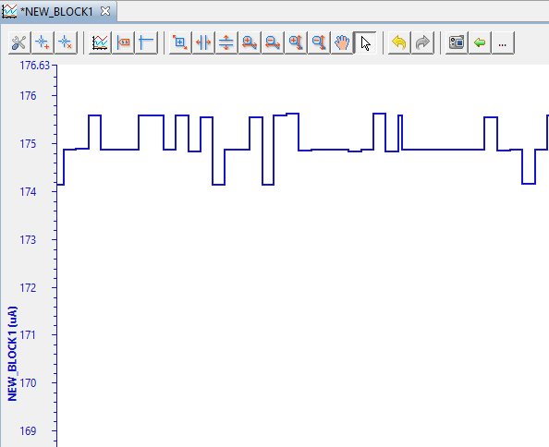
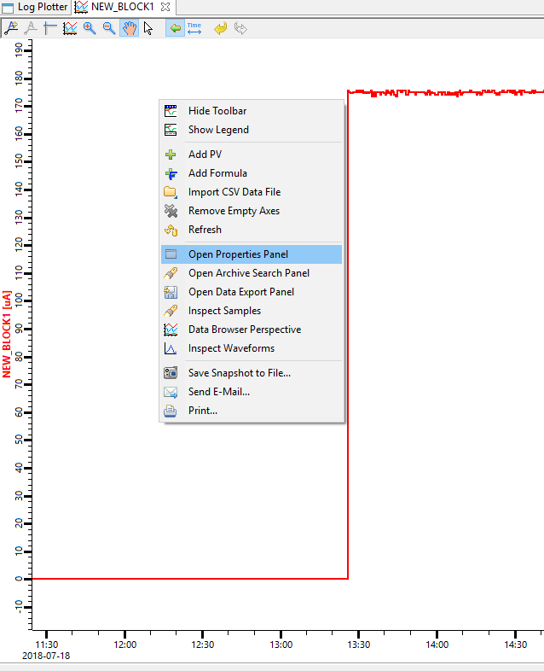
Log Plotter
Most options now moved to “properties” pane accessible via right-click context menu
Eclipse 3
Eclipse 4
Notes:
Emphasise that properties are still accessible – just from a different menu.
We have disabled autoscale by default on the log plotter, per request from multiple instruments
TODO: Check Mention that the “save” dialog has been supressed as there is no current functionality to save plots.

Slide 10
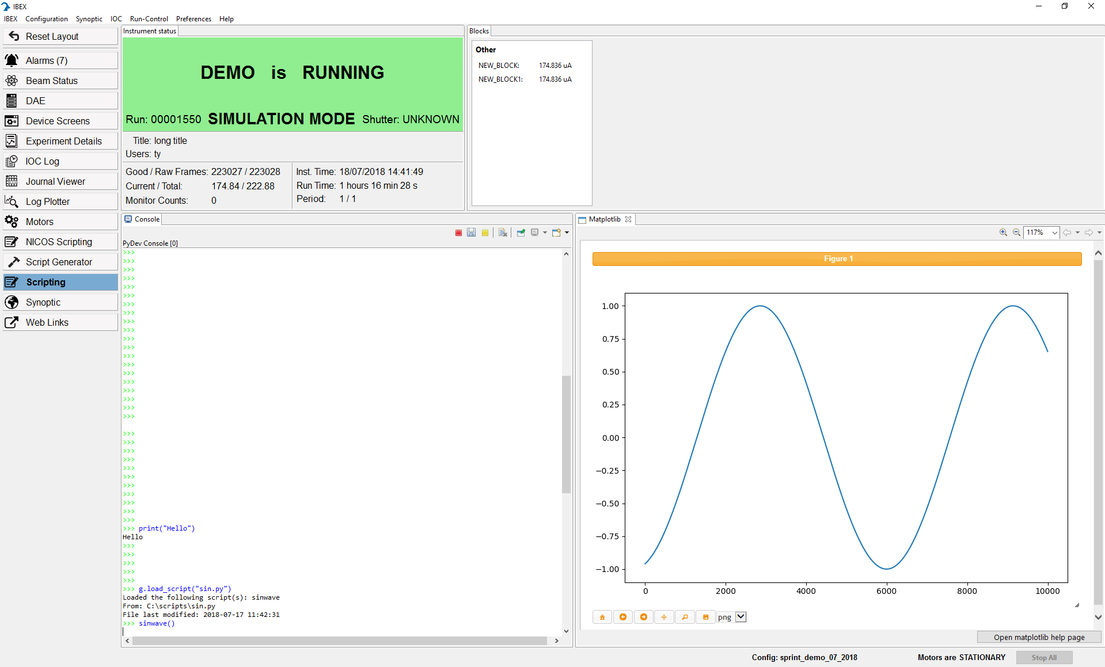
E4 features: Python plotting
IBEX client can show matplotlib graphs
  Allows complex graphs displayed within the GUI
These plots can be updated on the fly
Notes:
Asked for explicitly by LSS and Reflectometers, muons also had some interest in potentially complex graphs.
Demo some matplotlib features: a couple of example matplotlib scripts are located at: https://github.com/ISISComputingGroup/ibex_user_manual/wiki/Matplotlib

Slide 11
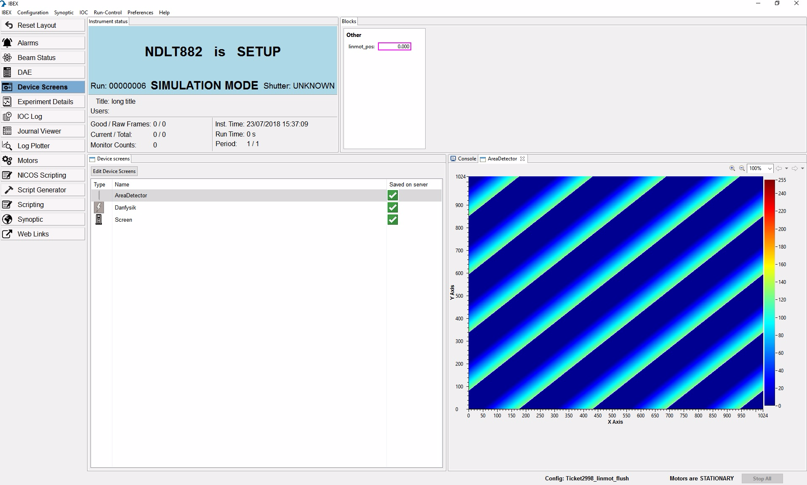
E4 features: live view
Notes:
This is a 2D area detector view, NOT a mantid view
Asked for by SANS instruments. Could potentially be useful for others too.

Slide 12
E4 features: script server
There is a separate presentation about the script server
Gives a view of which line the script is currently on
Allows queuing scripts – an error in one script will not prevent the next one from running
Scripting console will continue to work as before
Notes:
See separate NICOS presentation.

Slide 13
Deployment
We are aware that Eclipse 4 contains some significant changes
  We will leave an old version of the user interface on the machines for one cycle
If you find specific issues in the user interface after the change please raise them.
It will be released for the September cycle.

Slide 14
Demo / Questions
Notes:
Rearrange windows
Reset layout

