Slide 1
Reactive Programming
A modern (sane) approach to asynchronous propagation of change
Brandon Hewer

Slide 2
Imperative Arithmetic
y = f (10)
x := y + 2
y = 5
t0 = 0
t1 := t0 + 1.2
b := t1 > t0
t0 = 2
x = ?
b = ?

Slide 3
Imperative Arithmetic
y = f (10)
x := y + 2
y = 5
t0 = 0
t1 := t0 + 1.2
b := t1 > t0
t0 = 2
x = f (10) + 2
b = ?

Slide 4
Imperative Arithmetic
y = f (10)
x := y + 2
y = 5
t0 = 0
t1 := t0 + 1.2
b := t1 > t0
t0 = 2
x = f (10) + 2
b = true

Slide 5
Reactive Arithmetic
y = f (10)
x := y + 2
y = 5
t0 = 0
t1 := t0 + 1.2
b := t1 > t0
t0 = 2
x = ?
b = ?

Slide 6
Reactive Arithmetic
y = f (10)
x := y + 2
y = 5
t0 = 0
t1 := t0 + 1.2
b := t1 > t0
t0 = 2
x = 7
b = ?

Slide 7
Reactive Arithmetic
y = f (10)
x := y + 2
y = 5
t0 = 0
t1 := t0 + 1.2
b := t1 > t0
t0 = 2
x = 7
b = true

Slide 8
Data Streams
Everything is a stream!
Time

Slide 9
Return types in time and space
Single
Multiple
T
vector<T>
Synchronous
Asynchronous
future<T>
observable<T>

Slide 10
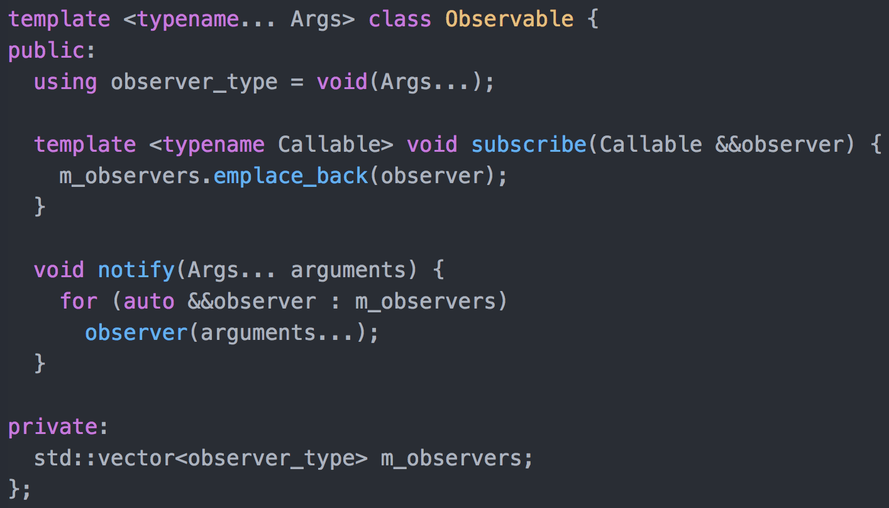
Observable Pattern

Slide 11
Proactive vs Reactive
Reactive observables (also known as ‘cold’ or ‘lazy’ observables) only begin to emit their sequence on being subscribed.
Proactive observables (also known as ‘hot’ or ‘strict’ observables) emit their sequence regardless of whether they’re being observed. This models most real-world phenomenon, e.g. mouse clicks.

Slide 12

Enemy of the state
Object-Oriented
Inheritance
Abstraction
Polymorphism
Encapsulation

Slide 13
Enemy of the state
Object-Oriented
Inheritance
Abstraction
Polymorphism
Encapsulation

Slide 14
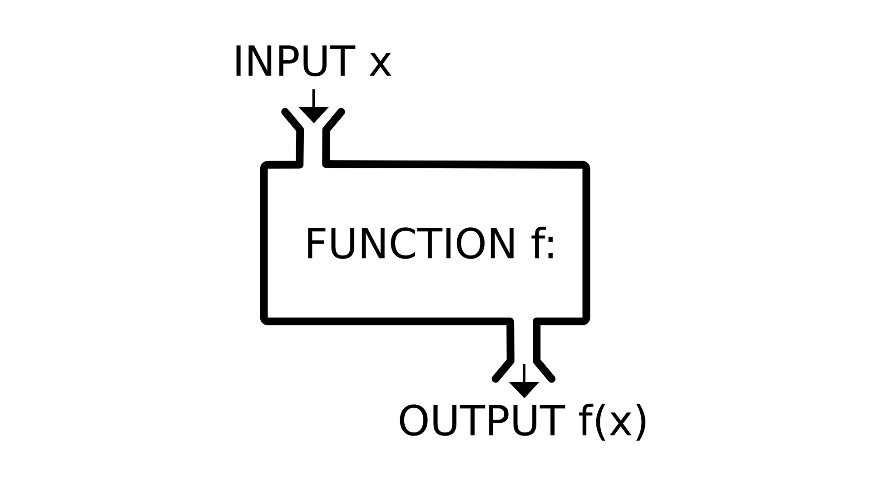
Enemy of the state
Object-Oriented
Functional
Inheritance
Abstraction
Polymorphism
Encapsulation

Slide 15
Enemy of the state
Benefits of pure functions
Referentially Transparent
Predictable
No concurrency issues
Can be memoized
Composable
Easy to test

Slide 16
Enemy of the state
Benefits of pure functions
Benefits of impurity
Referentially Transparent
Predictable
No concurrency issues
Can be memoized
Composable
Easy to test
?
A necessary evil; required for computation to interface with the real world.
Performance (context matters)

Slide 17
Higher-order functions
A higher-order function is a function whose type signature includes that of another function.
This simply means the function either takes a function as a parameter or returns a function.
Examples
map
filter
fold/reduce
compose
curry/uncurry

Slide 18
Stream Transformation
map ::

Slide 19
Stream Composition - Concatenation

Slide 20
Stream Composition – Merging/Interleaving

Slide 21
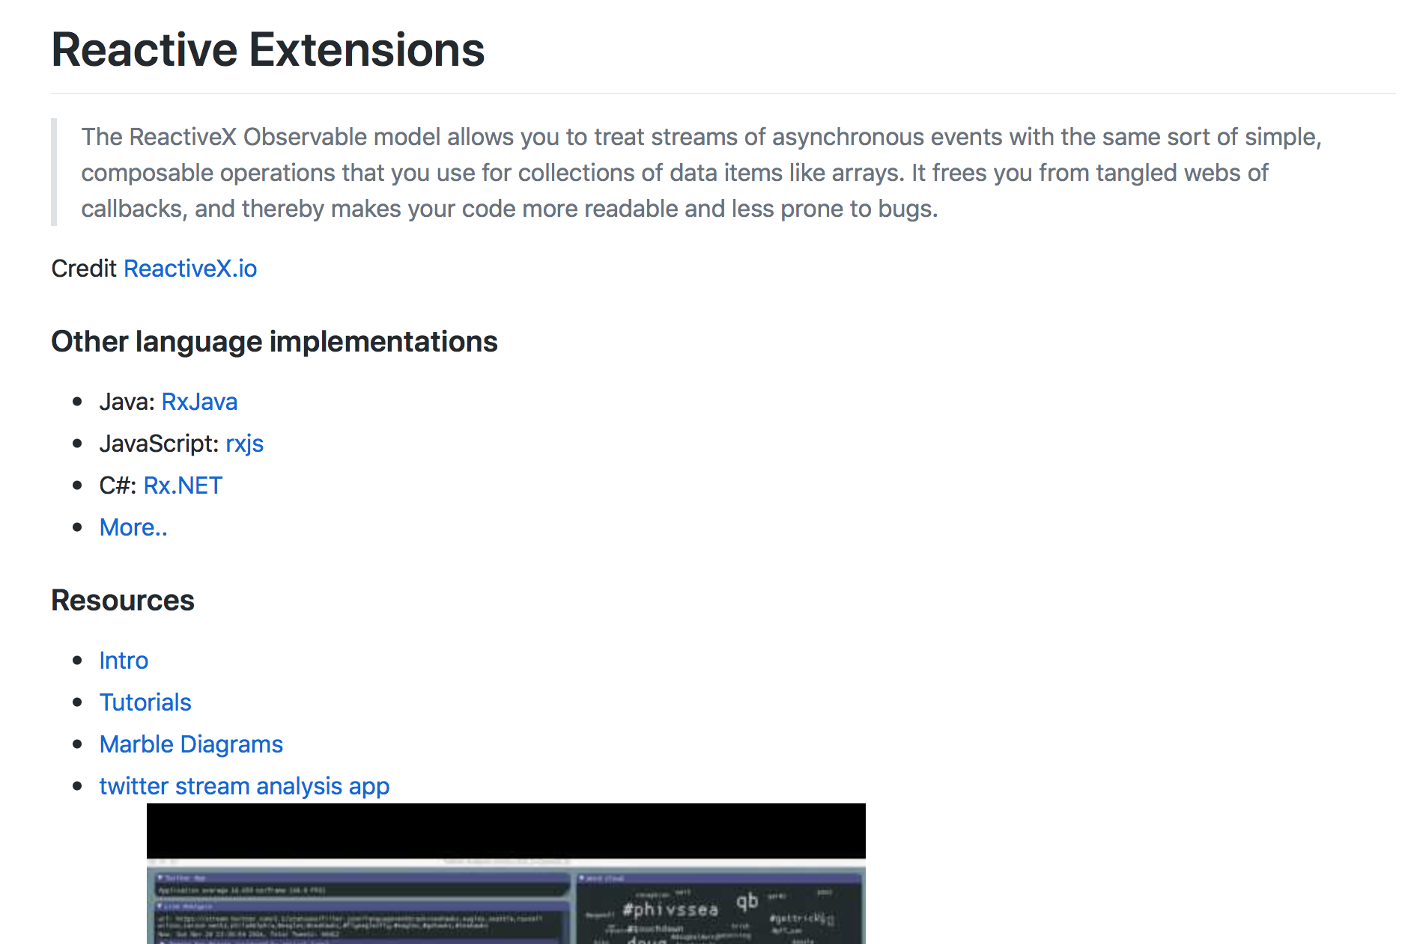
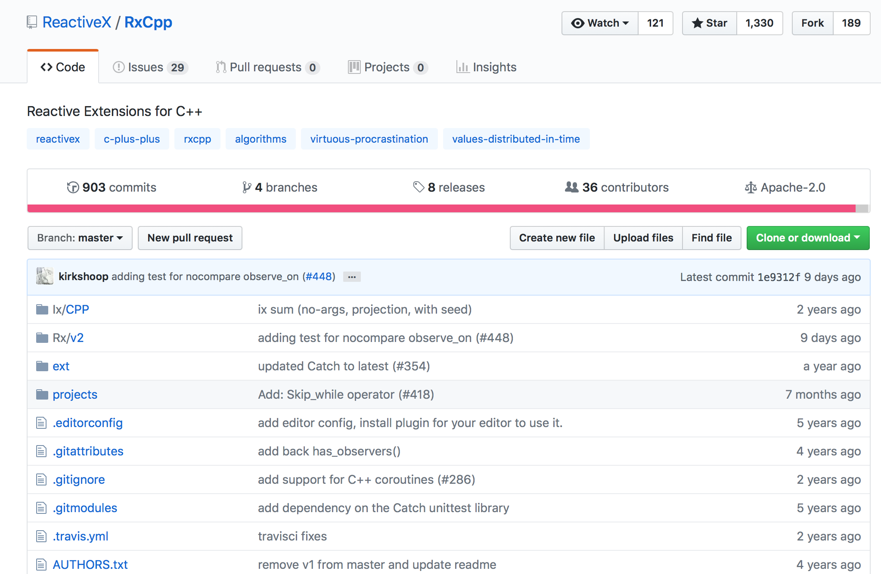
Rxcpp – Reactive extensions for C++

Slide 22
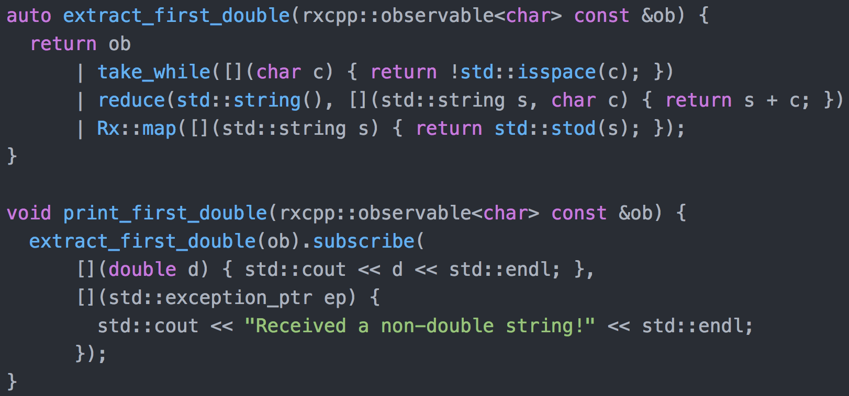
An introduction to RxCpp

Slide 23
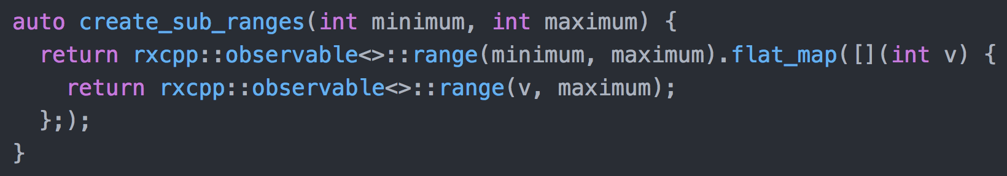
flat_map
flat_map takes a function which maps each element in the source observable to a new observable. The observables which are mapped to are subsequently merged.

Slide 24
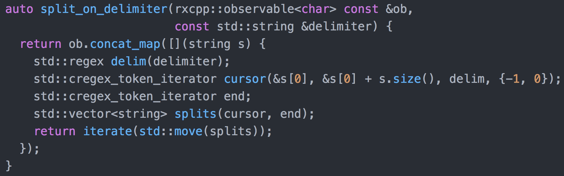
concat_map
concat_map takes a function which maps each element in the source observable to a new observable. The observables which are mapped to are subsequently concatenated.

Slide 25
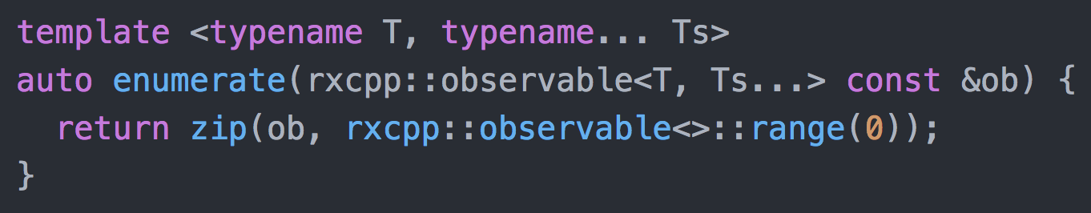
zip
zip takes any number of observables and combines them into an observable of tuples containing one item from each observable. Has an optional aggregation function parameter.

Slide 26
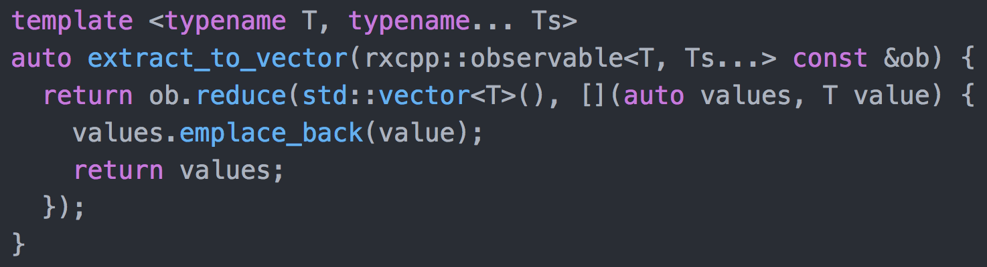
reduce
reduce takes a starting value for an accumulator, an aggregation function (which takes the accumulator and a value from the source observable) and produces an observer containing one value, from the source observable.

Slide 27
Sources and Scheduling
Streams (observables) are not restricted to any particular source. The source may be simply from user-input or from across a network. Every source can be treated equally.
Multi-threading can be introduced simply by using different schedulers for observables (most Rxcpp observable operations have overloads which take an optional scheduler parameter).

Slide 28
What is reactive programming?
Asynchronous data streams, which are continuous in time but emit discrete signals.
Functional operators are applied to transform these streams (this is known as functional reactive programming).
Streams can be merged, concatenated, forked (divided into smaller streams).
(Almost) everything is a stream!

Slide 29
The drawbacks to a reactive approach
Less intuitive; overhead associated to learning a new paradigm.
Bad habits from impure code (e.g. large, indivisible data structures) can produce poor performance if translated directly into a pure setting.
Some languages do not provide sensible facilities for using higher-order functions.

Slide 30
The benefits of a reactive approach
Modular code, with loose coupling between functions and routines used for transforming reactive streams.
Promotes the use of small, composable components.
Organized approach to handling asynchronous propagation of change.
State is pushed out to the boundary of the problem domain.

Slide 31
Questions and Discussion

Slide 32
Useful Resources
RxCpp on Github: https://github.com/ReactiveX/RxCpp
Introduction to reactive programming: https://gist.github.com/staltz/868e7e9bc2a7b8c1f754
Introduction to functional reactive programming: https://blog.danlew.net/2017/07/27/an-introduction-to-functional-reactive-programming/
Talk on FRP in C++: https://www.youtube.com/watch?v=a2MmURgc6cU

