Slide 1

Django Web Framework

Slide 2
Aims to ease creation of complex database-driven websites
Emphasis on reusability & “pluggability” of components

Slide 3
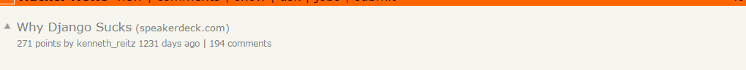
Bunch of sites use it…
Mozilla
Bitbucket
Disqus
Chess.com
Autoreduction!

Slide 4
installing
Use pip & virtualenv for easy changing between projects
And dependency handling
sudo yum install python-pip
sudo pip install virtualenv
Cd into dir
virtualenv newenv
source newenv/bin/activate
pip install django (no sudo!)
deactivate
So clean!

Slide 5

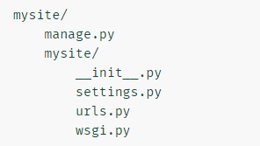
Container for project
Command line utility
Actual python package for project – name matters
Table of contents
Entry point for WSGI-compatible web servers
to serve your project

Slide 6
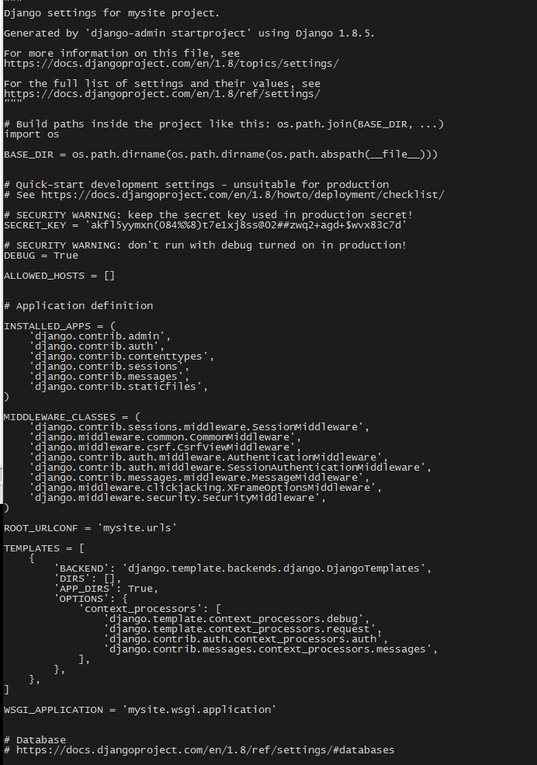
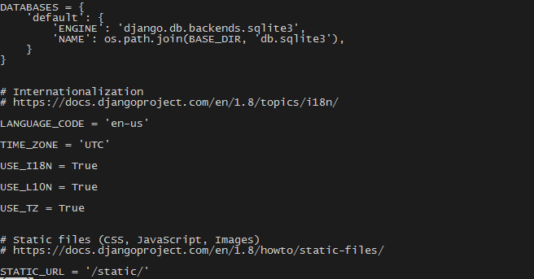
Mysite/settings.py
All names of apps activated in current instance
Apps are modular & pluggable
Can be packaged and distributed
Notes:
Options available inc databases, check out able ot change databases etc
Apps – can see there’s default admin site set, along with an authentication framwork etc

Slide 7
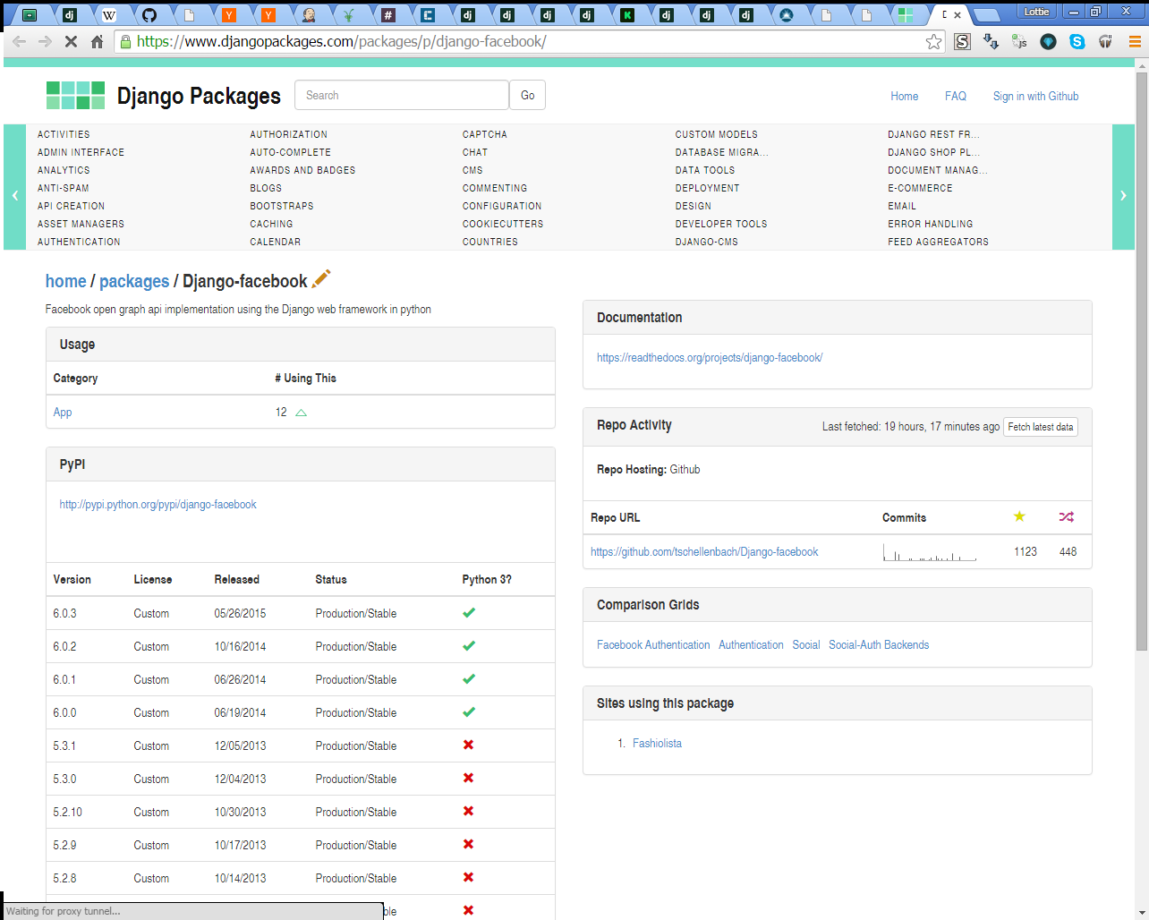

Slide 8
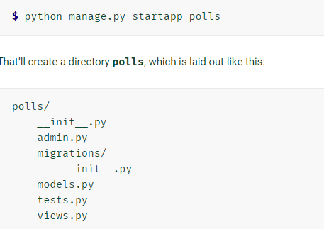

Slide 9
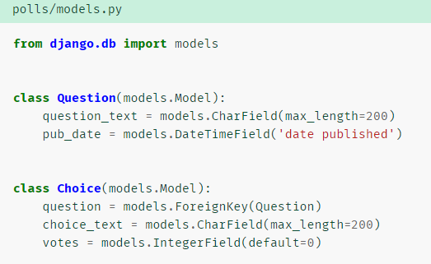
Object-relational mapper
Define data models entirely in python!
(can still do sql if needed)
Then add into install_apps in settings.py
And migrate!

Slide 10
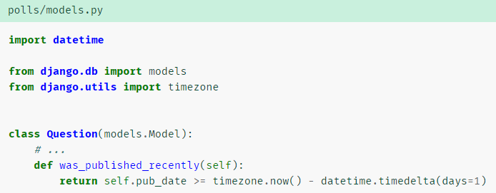
Models.py
Can add custom methods

Slide 11
Models.py
Definitive source of data about your data
Where the ‘business logic’ lives
The M in MVC (model-view-controller) (-ish)
The Object Relational Mapper for Django (-ish)
Each model is a python subclass of django.db.models.Model
Each attribute of the model represents a database field
So django makes the database for you!

Slide 12
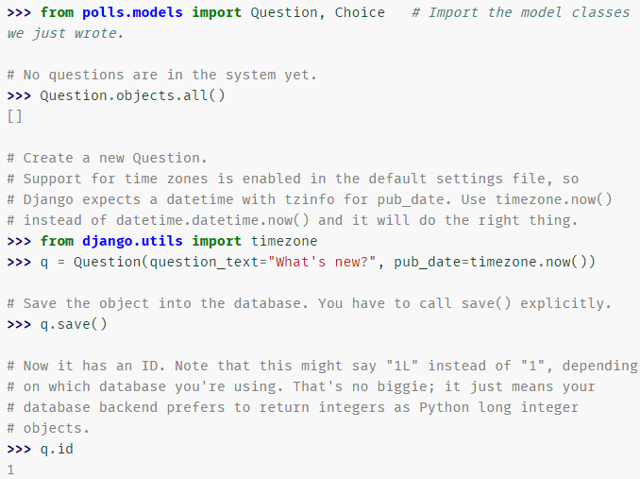
Manage.py
Interactive python shell!
Query sql db and add things!
(Post-migration)

Slide 13
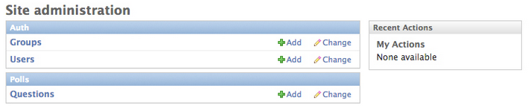
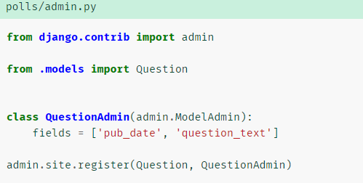
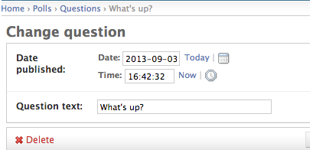
Admin console
Can add change delete content … nearly a cms, but only allows editing of database (users/objects in db)
Reads metadata in model to automatically provide prod. Ready interface
Customise with admin.py

Slide 14
Mysite/settings.py
Add dirs for templates to search
Notes:
Options available inc databases, check out able ot change databases etc
Apps – can see there’s default admin site set, along with an authentication framwork etc

Slide 15

templates
View says what is on a page, a template arranges it (hopefully) nicely
Django not MVC, is MTV (model-view-template) (Controller partially in the model, but also the rest of the framework)
Template language designed mostly for front-end dev
Templates are optional

Slide 16
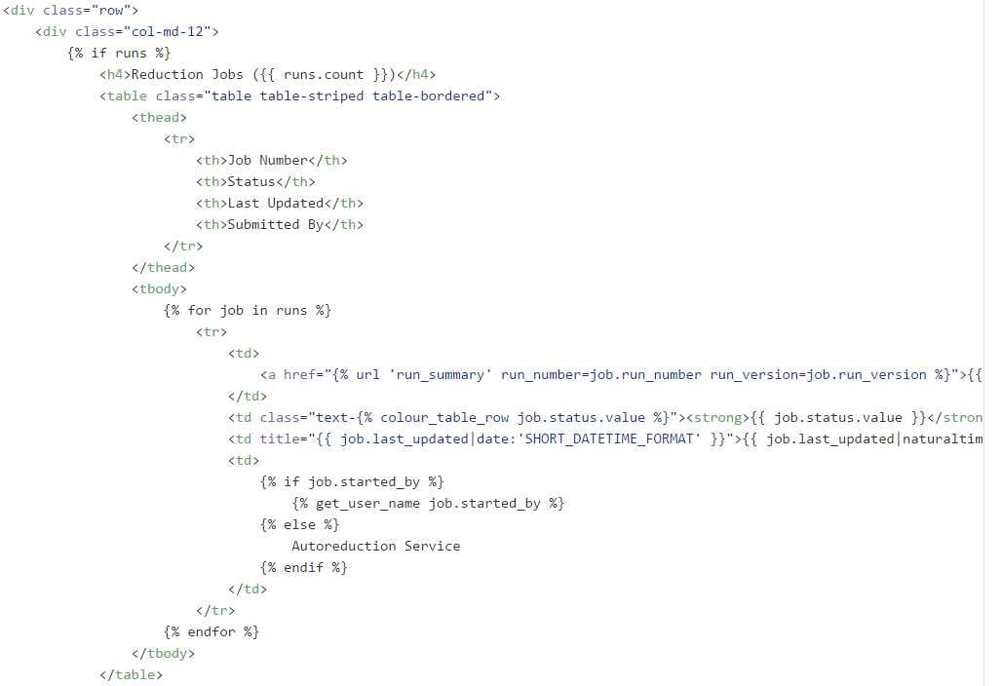
file

Slide 17
Views
‘type’ of web page in your application – the home page, the index, or a single blog post
Not the MVC view b/c views have the logic for a page but don’t specify the visual presentation for it
Views are most customisable bit.

Slide 18
Urls.py
Designing URLS is explicit part of application design so URLs are part of the UI of web application
Each project has a URLconf – ‘table of contents’
Incoming URLs matched against a regex then dispatched to a view function
Maps application URLs to application views
Means you can decouple business logic with URLs… change URL later on without changing code!

Slide 19
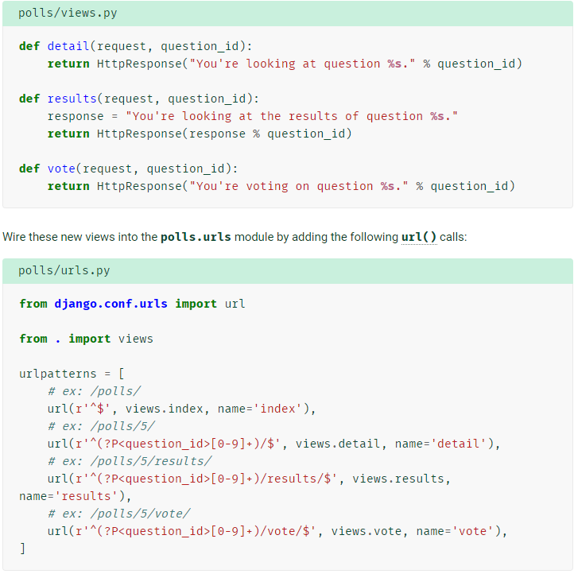
Urls.py
So if looking at /polls/34/, runs detail() method and displays whatever ID provided in URL
Same situation for /polls/34/results and /polls/34/vote

Slide 20
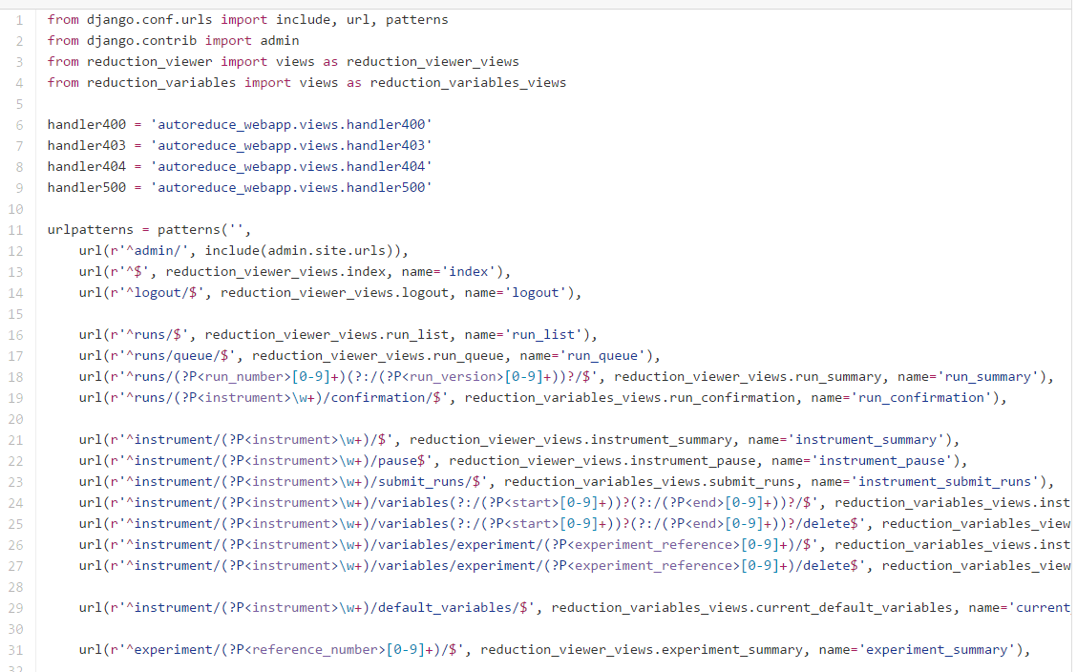
Urls.py - autoreduction
file

Slide 21
Negatives
Django is too monolithic, and so…
it encourages big, tightly-coupled apps.
Everything depends on the Django ORM, whether it’s front-end stuff like sessions or back-end stuff like data persistence.
Broad knowledge of the system is required.
All components get deployed together
And reusing others peoples apps isn’t always a positive experience

Slide 22
So, Autoreduction
Settings.py https://github.com/mantidproject/autoreduce/blob/master/WebApp/ISIS/autoreduce_webapp/autoreduce_webapp/settings.py

