Slide 1
Black Magic Algorithms – Bayesian Inference
Anthony Lim

Slide 2
Why Is It Black Magic?
Parameters
Model
Data
Random Numbers

Slide 3
Contents
A bit of Maths
A simple example
Walkers
Evolution
Probability
Results?!

Slide 4
Monte Hall Problem
Got 3 doors, the player picks 1 door. One door has a prize (a goat).
The host then shows that one door (not picked by the player) is empty.
The player is asked if they would like to change their answer.

Slide 5
Monte Hall Problem
Initially probability is 1/3.

Slide 6
Monte Hall Problem
Host open door 3.

Slide 7

Bayes’ Theorem

Slide 8

Monte Hall Problem
Prize is not behind 2 or 3

Slide 9

Monte Hall Problem
Picked 1 so cannot open it and cannot open 2 as it has the prize

Slide 10

Monte Hall Problem

Slide 11


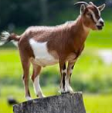
Monte Hall Problem

Slide 12

A Simple Example
The Lennard Jones potential
Can calculate the lattice constant and bulk modulus.
Can measure the lattice constant and bulk modulus of a material.

Slide 13
Walkers
Each walker contains a compete set of parameters (ε, σ).
Has a single probability given all of the data.

Slide 14
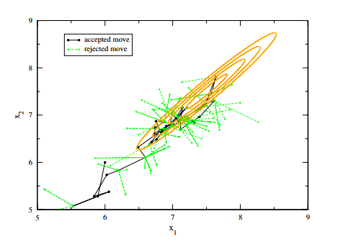
Walkers
https://journals.aps.org/rmp/pdf/10.1103/RevModPhys.83.943

Slide 15
Evolution
How do we determine where to move each walker to?
How do we decide if to accept or reject the move?

Slide 16

Evolution – New Move
Markov chain Monte Carlo.
The parameters are given by θ and the coupling strength by γ.
i≠j≠k

Slide 17
Evolution – accepting
Can make a probability distribution by constructing a histogram of walkers.
There is no normalisation.
P(θ)
θ

Slide 18

Evolution – Accepting
Metropolis Hastings method:
If a uniform random number is greater than the acceptance probability we reject the move.

Slide 19

Probability
How do we get the probability?
Need to pick a distribution (e.g. normal).
Each hypothesis has its own probability.
The probability for a given hypothesis:

Slide 20
Probability
Can have multiple hypotheses in one inference.
The total probability is the product of the probabilities for each of the hypotheses (p_{j}).
If a single hypothesis is rejected then all the move is rejected. Can use this to reduce computational cost.

Slide 21
Results?!
Can get good approximations to the probability distribution of the parameters.
The best we can say is that the true value is in the distribution.
P(θ)
θ
True value

Slide 22
Results?!
The most expensive part of the calculation is usually the “burn in” period.
“Burn in” is the time taken for the simulation to find a good approximation to the probability distribution.

Slide 23
Results?!
Can use parallel tempering to speed up simulations.
Can use PBC to limit the search domain.
There is a lot of research into reducing the “burn in” period.

Slide 24
Results?!
Can also use Bayesian inference to test if a fit is over/under parametrized.
Can be used for image reconstruction.
Calculating parameters for complex models.
Some algorithms only find the peak of distribution (e.g. MaxEnt).

Slide 25
Conclusion
Bayesian inference can be used to get probability distributions for parameters of a model.
Given some data and a suitable model.
Requires a large number of walkers.
May take a long time.

Slide 26
Any questions?
Thank you for listening.

Slide 27
Parallel Tempering
Define multiple inverse temperatures (β) between 0 and 1. The probability is altered according to p^{β}.
Run the same number of walkers at each temperature.
Periodically allow swaps between neighboring temperatures.
Can update beta values based on number of swaps.

Slide 28
PBC
PBC normally require several conditions to be met, such as continuous forces across the boundary.
In this algorithm the evolution only states start and end points.
PBC will therefore not alter the dynamics as the evolution is path independent.

Slide 29
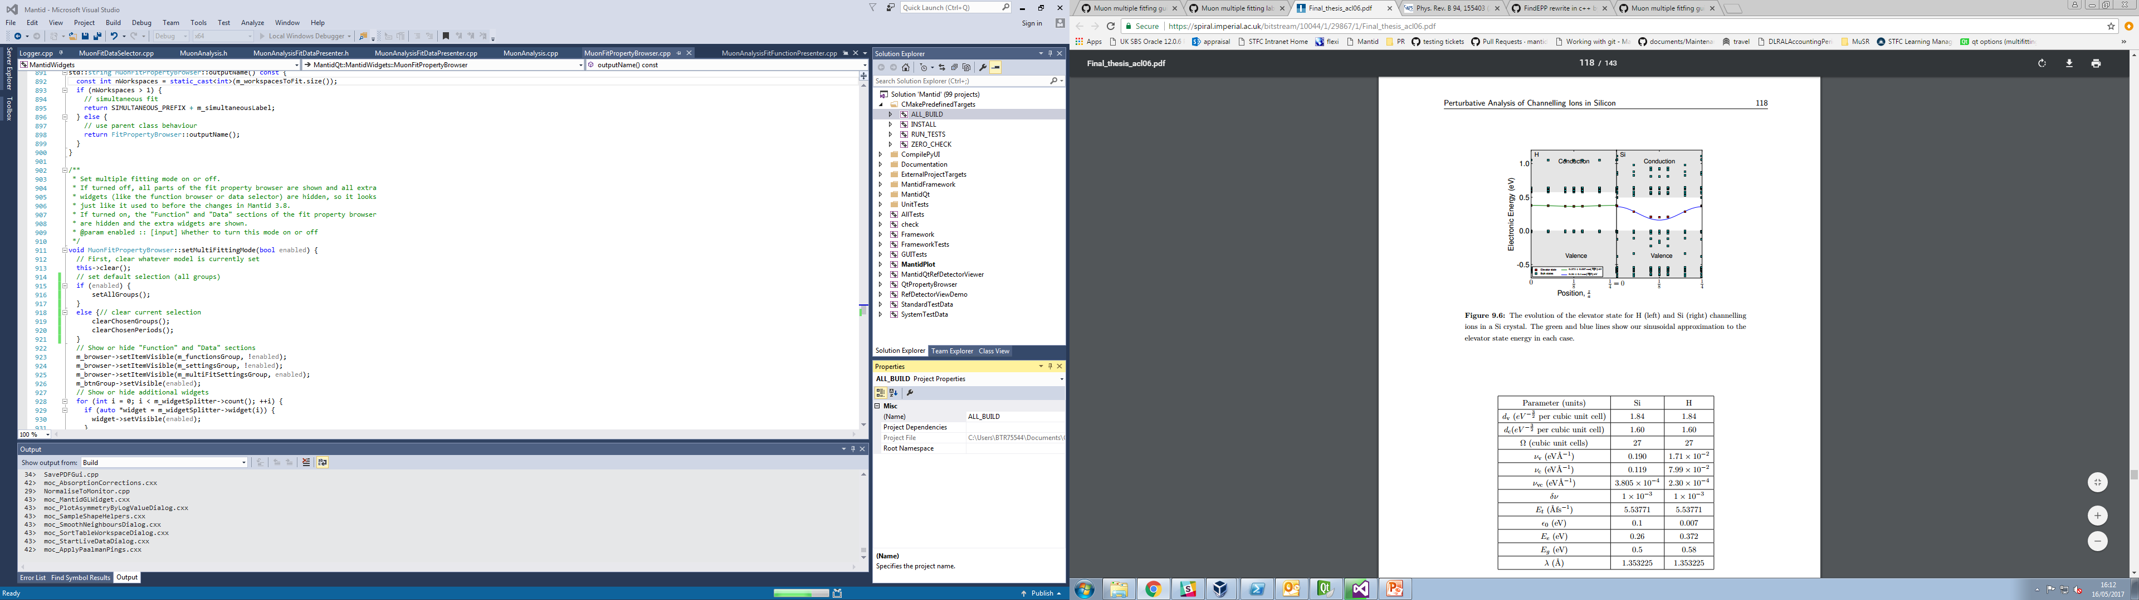
Complex example
Have 3 fitting parameters:
Valence -> conduction
Valence -> elevator (gap) state
Elevator state -> Conduction
https://spiral.imperial.ac.uk/bitstream/10044/1/29867/1/Final_thesis_acl06.pdf

Slide 30

Complex example
Getting the parameters numerically is difficult, but possible (3 simultaneous equations).
Results were very good.

Slide 31
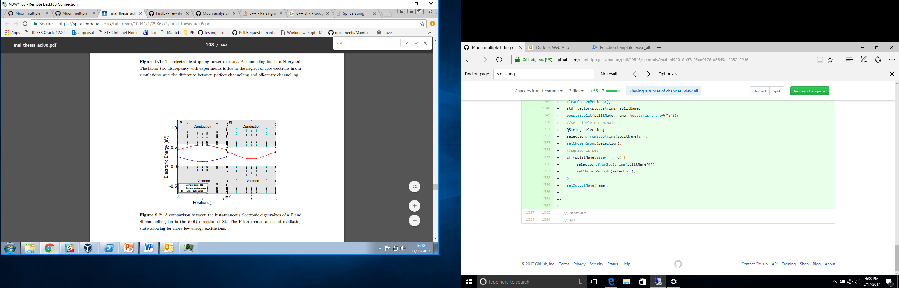
Complex example
There are more difficult cases…
This example requires 7 fitting parameters.
Could use Bayesian inference to get parameters.

