Slide 1
The Open Plan Office and the layout of R14 and G37
Anders Markvardsen
ISIS, Oct 2017

Slide 2
Law and regulations
11 m^3
“Workrooms should have enough free space to allow people to get to and from workstations and to move within the room, with ease”
Fire, health and safety
http://www.hse.gov.uk/contact/faqs/roomspace.htm

Slide 3
History of the Open Plan office
Pros and Cons
The future?
Layout in R14 and G37

Slide 4
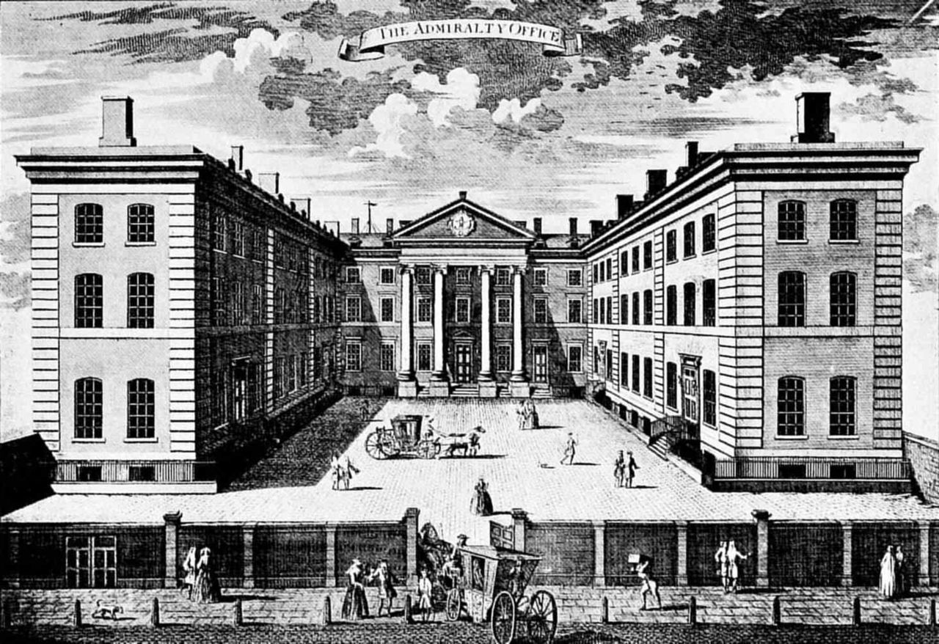
https://en.wikipedia.org/wiki/Admiralty

Slide 5
History: The Open Plan
Introduced mid-20th century
Scandinavian countries were early pioneers of open-plan environments in the 90s - more egalitarian workspace design
In the UK and USA about ~70% some type of open floor plan (according to International Facility Management Association)
https://www.forbes.com/sites/neilhowe/2015/03/31/open-offices-back-in-vogue-thanks-to-millennials/#6a14677db8f9

Slide 6
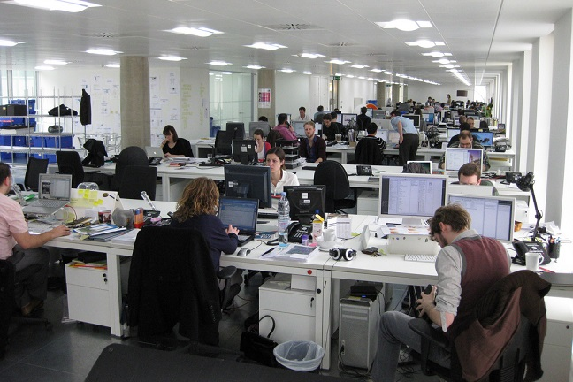
https://www.managementtoday.co.uk/open-plan-office-ruining-business/leadership-lessons/article/1423447

Slide 7
Workspace density
1997: 16.6 m2
2008: 11.8 m2
2013: 10.9 m2
http://www.fmj.co.uk/a-contradiction-in-terms-as-escaping-the-city-crowds-delivers-more-congestion-in-the-workplace/

Slide 8
The Pros
Decreases operational cost (rent etc)
Increase collaboration (agile development)
Creative thinking and innovation
More egalitarian place to work
Easier to change the interior layout
Socialising

Slide 9
The Cons
Uncontrolled interruptions (depending on type of work) Distracted every 3 minutes and 23 minutes to get back into the flow
Noise level (headphones)
Productivity (15%, 20% and 66% quoted). Capacity to concentrate
Lack of privacy
Health (more sick days. Cleanliness? Other factors?)
https://www.callcare247.com/articles/office-workers-are-distracted-every-3-minutes/
http://www.techradar.com/news/audio/how-your-noisy-open-plan-office-is-making-you-66-less-productive-1148580
https://www.theguardian.com/money/work-blog/2014/sep/29/open-plan-office-health-productivity

Slide 10
Future/now
Diversity of cultures
Diversity of generations
Productivity is not location dependent (hardware and asking questions)

Slide 11
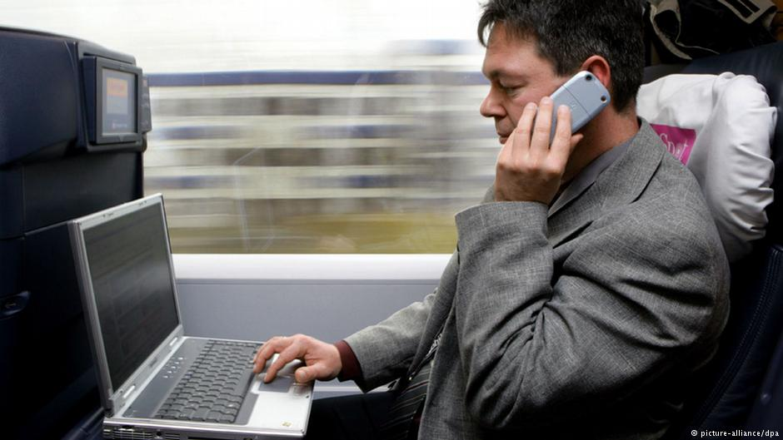
Banning e-mail after work
http://www.dw.com/en/banning-e-mail-after-work/a-17445387

Slide 12
No office desks
Law firm in DC called Clearspire (99% of their attorneys WFH). Do have office but only used for meetings with clients and with other attorneys
http://www.abajournal.com/news/article/legal_entrepreneur_forms_dc_law_firm_that_shuns_office_face_time_and_lawyer/

Slide 13

Activity Based working
https://www.veldhoencompany.com/en/activity-based-working/

Slide 14
Into the flow state
Spaces for quiet work (quiet room, headphones)
Switch phone off
Email: batch your email. Say 4 times a day or Sanebox– because every time you hear a ping you lose concentration: 10 points women, 15 points men

Slide 15
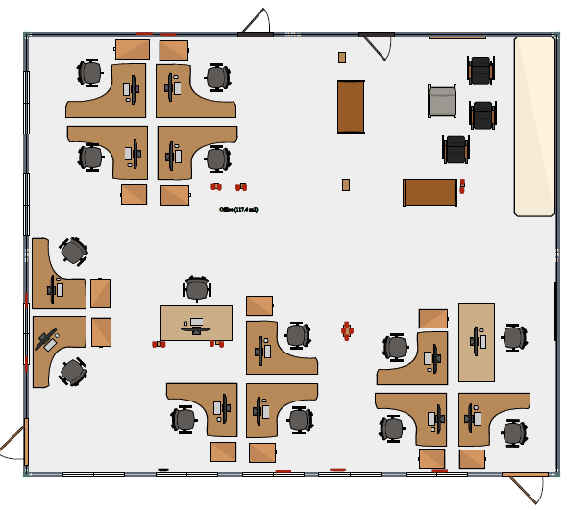
R74

Slide 16
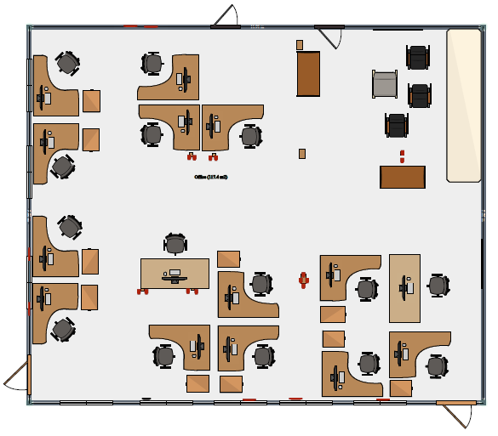
R74

Slide 17
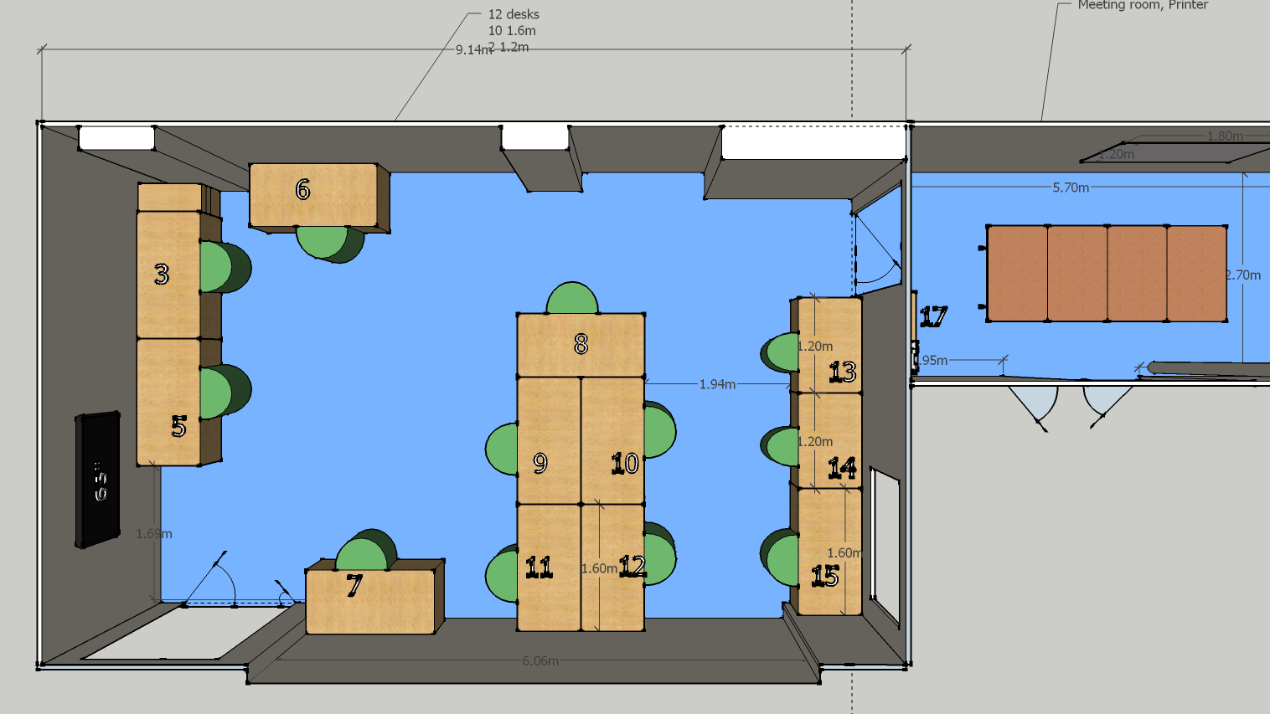
G37

