Slide 1
Video Compression Basics

Slide 2
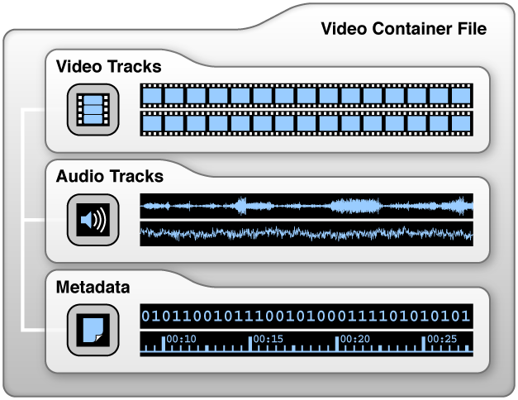
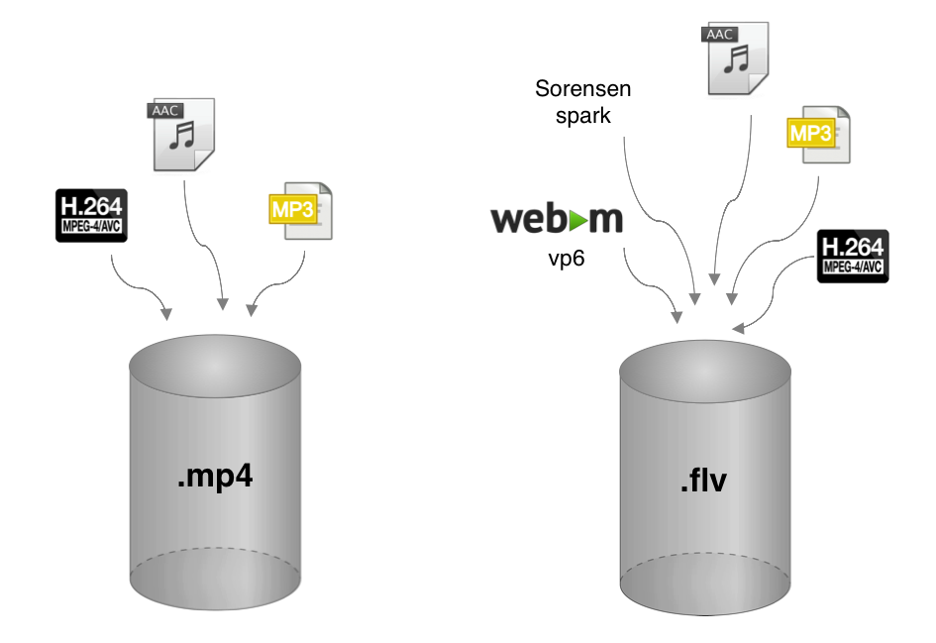
Containers and codecs

Slide 3
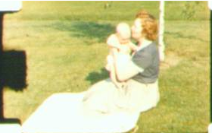
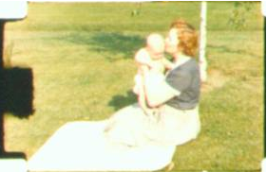



Video Compression Overview
A video comprises of a sequence of frames.
Frame 1
Frame 2
Frame 3
Frame 4
A video, of the duration of 1 second, generated by a TV camera usually contains 24 frames or 30 frames.
Each pixel in a frame is represented by three attributes (each 8 bits long) – One luminance attribute and two chrominance attributes. (i.e. YCbCr)
{Y, Cb, Cr}
Luminance (Y) : Describes the brightness of the pixel.
Chrominance (CbCr) : Describes the color of the pixel.
Frame

Slide 4



The Problem
An uncompressed video data is big in size.
720 Pixels
For example-
A single frame of 720 X 480 (standard definintion TV) will be described by
{Y, Cb, Cr}, {Y, Cb, Cr}, {Y, Cb, Cr}…. {Y, Cb, Cr}
{Y, Cb, Cr}, {Y, Cb, Cr}, {Y, Cb, Cr}…. {Y, Cb, Cr}
………………………………………………………………………………….
………………………………………………………........................
………………………………………………………………………………….
………………………………………………………………………………….
………………………………………………………………………………….
………………………………………………………........................
………………………………………………………………………………….
………………………………………………………………………………….
{Y, Cb, Cr}, {Y, Cb, Cr}, {Y, Cb, Cr}…. {Y, Cb, Cr}
480
Lines
720 X 480 X 8 + 720 X 480 X 8 + 720 X 480 X 8 bits
= 8294400 bits. ~ 1.04 MB.
Frame (720 X 480)
A complete video of 1 second will be described by
(720 X 480 X 8 + 720 X 480 X 8 + 720 X 480 X 8) X 24 frames
= 199,065,600 bits ~ 24.9MB.
For a 2 hr movie this would be
(2 x 60 x 60) x 199Mb ~ 180GB
A 1080p movie of 2 hr would be ~ 1,075 GB
This would take ~ 20 DVD’s or Blu Ray discs respectively,
The number of channels that could be broadcast would be
4
8
30

Slide 5
MPEG
MPEG stands for Motion Picture Experts Group established in 1988 as a working group within ISO/IEC that has defined standards for digital compression of audio & video signals. Such as-
MPEG-1 : It was the very first project of this group and published in 1993 as ISO/IEC 11172 standard.
Was used in CD-i and Video CD systems.
MPEG-2 : is an extension of MPEG-1, published in 1995 as ISO/IEC 13818 standard.
Commonly used in broadcast format, such as – Standard Definition TV (SDT) and High Definition TV (HDT).
MPEG-4 : introduced in 1998 and still in development as ISO/IEC 14496 standard.
Supports 3D rendering, animation graphics, DRM, various types of interactivity etc.
Commonly used in web based streaming media, CD, videophone, DVB, etc .
MPEG-H : introduced in 2013 and still in development as ISO/IEC 23008 standard.
Introduces h.265 or HEVC and supports 3D audio, depth enhanced video.
50 – 60% smaller than MPEG-4 for similar quality
Limited, but growing use:
  4K Ultra HD Blu ray discs
  Amazon Video (Netflix use VP9)
  Apple iOS 11 uses HEVC for videos

Slide 6
VIDEO COMPRESSION
The concept of video compression lies on two main factors-
The data in frames is often redundant in space and time.
For example-
Spatial redundancy
In a frame, adjacent pixels are usually correlated. e.g. - The grass is green in the background of a frame.
Time based redundancy
In a video, adjacent frames are usually correlated. e.g. - The green background is persisting frame after frame.
Frame 1
Frame 2
Frame 3
Frame 4
The human eye better resolve the brightness details than color details. So the way human eye works, it is also possible to delete some data from the frame with almost no noticeable degradation in image quality.

Slide 7
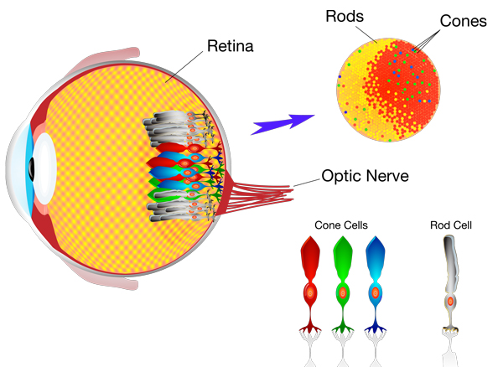
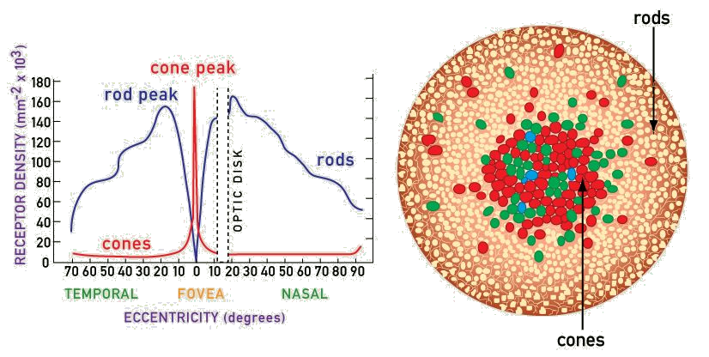
The Human Eye
120 million Rods
- Light sensitive, but no colour
7 million cones
Red (64%)
Green (32%)
Blue (2%)

Slide 8
MPEG-2 VIDEO ENCODING
MPEG-2 video encoding can be broadly categorized into – Intra Frame Encoding and Non-Intra Frame Encoding.
Intra Frame Encoding
Non-Intra Frame Encoding
It takes the advantage of spatial redundancy.
Compression techniques are applied using the data of the current frame only.
It uses combination of various lossless and lossy compression techniques. Such as –
It takes the advantage of time-based redundancy as well as spatial redundancy.
Compression techniques are applied using the data of the current frame as well as preceding and/ or succeeding frames.
It mainly uses lossy compression techniques. Such as –
Video filter
Compress spatial redundancy at chrominance plane.
Forward interpolated prediction
Discrete cosine transform (DCT)
Uses data of previously coded frame.
Convert spatial variation into frequency variation.
Forward & backward interpolated prediction
DCT coefficient quantization
Uses data of previously coded frame & future frame.
Reduces higher frequency DCT coefficients to zero .
Temporal prediction
Run-Length amplitude/ Variable length encoding
Uses motion estimation & vectors to generate predicted frame.
Compression using entropy encoding, run-length encoding & Huffman encoding .
Residual error frame & its coding
It is generated by subtracting predicted frame from its reference frame, which is further spatially coded & transmitted.

Slide 9



INTRA FRAME ENCODING
Bit Rate Control
Video Filter
(Optional)
DCT
Quantization
Run-Length VLC
Bit Stream Buffer
Intra Frame Encoder
Video Filtering
Video filtering is a lossy compression technique and is used to compress the spatial redundancies on macro-block basis within the current frame.
It operates on color space (i.e. YCbCr encoding & CbCr sub-sampling), as Human Visual System is less sensitive to variations in color as compared to variations in brightness.
Video filtering includes-
Macro-block : Macro-blocks are created by dividing raw frame into 8 x 8 pixels blocks. For example-
Raw Frame
Block_1
Block_2
Block_n
8 X 8
Pixels

Slide 10
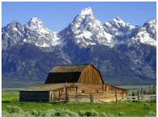
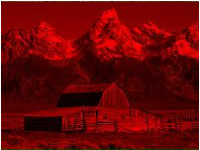
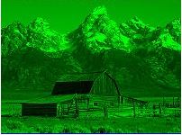
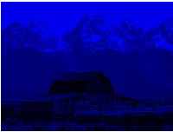
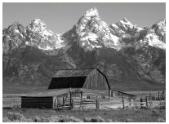


YCbCr Encoding: converts block’s RGB data into YCbCr color space. For example-
A raw frame contains an image in RGB color space.
Raw Frame
R
G
B
RGB color space contains mutual redundancies, so it requires large space for storage and high bandwidth for transmission.
Encoding RGB into YCbCr color space reduces the mutual redundancies
Raw Frame
Y
Cb
Cr
Conversion: Y = + 0.299 * R + 0.587 * G + 0.114 * B
Cb = 128 - 0.168736 * R - 0.331264 * G + 0.5 * B
Cr = 128 + 0.5 * R - 0.418688 * G - 0.081312 * B
Where-
R, G & B values are 8 bits long and lies in {0, 1, 2, ..., 255} range.

Slide 11
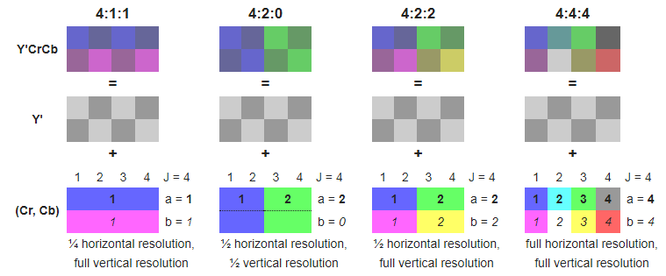
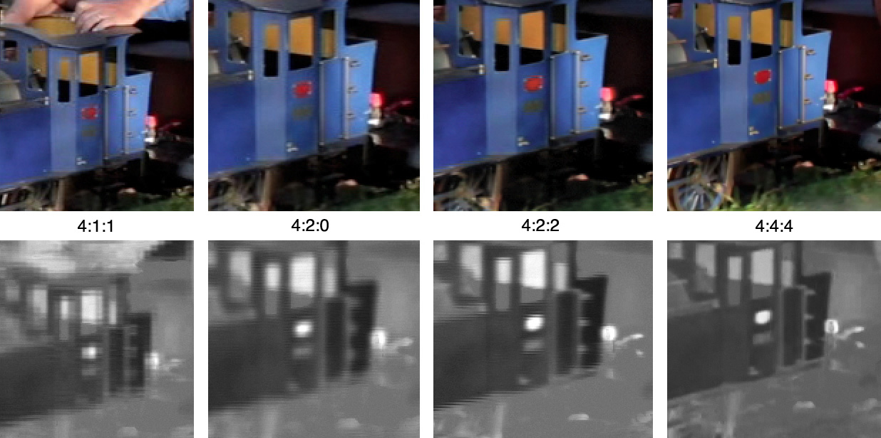
Chrominance (CbCr) Sub-Sampling
Size 50% 50% 66% 100%

Slide 12

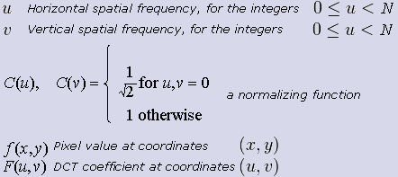
Discrete Cosine Transformation
DCT converts the spatial variations within the macro-block into frequency variations without changing the data.
A two-dimension DCT function can be represented as:
Where-
The output of a DCT function is a DCT coefficient matrix containing the data in frequency domain.
Data in frequency domain can be efficiently processed and compressed.

Slide 13


In DCT, 8x8 data block of Y, Cb and Cr components is converted into frequency domain. For example-
Block_1
Lets assume, 8x8 pixel block of Y component and its corresponding 8x8 data block -
8 X 8
Pixels
8 X 8 Data block
Y
52
55
61
66
70
61
64
73
Subtract 128 from each pixel value.
63
59
55
90
109
85
69
72
62
59
68
113
144
104
66
73
8 X 8 Data block
63
58
71
122
154
106
70
69
-76
-73
-67
-62
-58
-67
-64
-55
67
61
68
104
126
88
68
70
-65
-69
-73
-38
-19
-43
-59
-56
79
65
60
70
77
68
58
75
-66
-69
-60
-15
16
-24
-62
-55
85
71
64
59
55
61
65
83
-65
-70
-57
-6
26
-22
-58
-59
87
79
69
68
65
76
78
94
-61
-67
-60
-24
-2
-40
-60
-58
-49
-63
-68
-58
-51
-60
-70
-53
8 X 8 DCT Coefficient Matrix
-43
-57
-64
-69
-73
-67
-63
-45
-415
-30
-61
27
56
-20
-2
-0
-41
-49
-59
-60
-63
-52
-50
-34
4
-22
-61
10
13
-7
-9
5
DCT
-47
7
77
-25
-29
10
5
-6
DCT
8 X 8
Pixels
-49
12
34
-15
-10
6
2
2
~
12
-7
-13
-4
-2
2
-3
3
Y
-8
3
2
-6
-2
1
4
2
-1
0
0
-2
-1
-3
4
-1
Apply two-dimension DCT to get DCT coefficient matrix.
0
0
-1
-4
-1
0
1
2

Slide 14

Quantization
Quantization reduces the amount of information in higher frequency DCT coefficient components using a default quantization matrix defined by MPEG-2 standard.
16
11
19
16
24
40
51
61
12
12
14
19
26
58
60
55
Default quantization matrix contains constant values.
It is a lossy operation that causes minor degradation in the image quality due to some subtle loss in brightness and colors.
14
13
16
24
40
57
69
56
14
17
22
29
51
87
80
62
18
22
37
56
68
109
103
77
24
35
55
64
81
104
113
92
49
64
78
87
103
121
120
101
72
92
95
98
112
100
103
99
Default Quantization Matrix
Each component in DCT coefficient matrix is divided by its corresponding constant value in default quantization matrix and a quantized DCT coefficient matrix is computed.
A quantization function can be represented as:

Slide 15
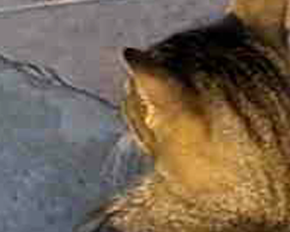
For example-
-415
-30
-61
27
56
-20
-2
-0
16
11
19
16
24
40
51
61
4
-22
-61
10
13
-7
-9
5
12
12
14
19
26
58
60
55
-47
7
77
-25
-29
10
5
-6
14
13
16
24
40
57
69
56
-49
12
34
-15
-10
6
2
2
14
17
22
29
51
87
80
62
12
-7
-13
-4
-2
2
-3
3
18
22
37
56
68
109
103
77
-8
3
2
-6
-2
1
4
2
24
35
55
64
81
104
113
92
-1
0
0
-2
-1
-3
4
-1
49
64
78
87
103
121
120
101
0
0
-1
-4
-1
0
1
2
72
92
95
98
112
100
103
99
8 X 8 DCT Coefficient Matrix
Default Quantization Matrix
Quantization
-26
-3
-6
2
2
-1
0
0
0
-2
-4
1
1
0
0
0
-3
1
5
-1
-1
0
0
0
-4
1
2
-1
0
0
0
0
1
0
0
0
0
0
0
0
0
0
0
0
0
0
0
0
0
0
0
0
0
0
0
0
0
0
0
0
0
0
0
0
Quantized 8 X 8 DCT Coefficient Matrix

Slide 16
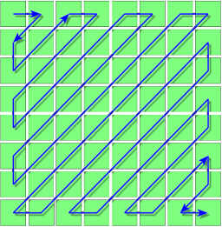
Run Length Amplitude/ Variable Length Encoding
Run length amplitude/ Variable length encoding is a lossless compression techniques that includes entropy encoding, run-length encoding and Huffman encoding.
Entropy Encoding
Entropy Encoding : Components of quantized DCT coefficient matrix is read in zigzag order.
It helps in representing the frequency coefficients (both higher & lower) of quantized DCT coefficient matrix in an efficient manner. For example-
-26
-26
-3
-6
2
2
-1
0
0
-3
0
Entropy Encoding
0
-2
-4
1
1
0
0
0
-3
-2
-6
-3
1
5
-1
-1
0
0
0
2
-4
1
-4
-4
1
2
-1
0
0
0
0
1
1
5
1
2
1
0
0
0
0
0
0
0
-1
1
-1
2
0
0
0
0
0
0
0
0
0
0
0
0
0
-1
-1
0
0
0
0
0
0
0
0
0
0
0
0
0
0
0
0
0
0
0
0
0
0
0
0
0
0
0
0
0
0
0
0
0
Quantized 8 X 8 DCT Coefficient Matrix
0
0
0
0
0
0
0
0
0
0
0
0
Zigzag ordering of quantized 8 X 8 DCT Coefficient Matrix
15
0
0
0
0
-26
-3
0
-3
-2
-6
2
-4
1
-4
1
1
5
1
2
-1
0
0
0
1
-1
2
0
0
0
0
0
-1
-1
0
0
0
0
0
0
0
0
~
0
0
0
0
0
0
0
0
0
0
0
0
0
0
0
0
0
0
0
0
0
0
0
0
0
0
0
0
0
0
0
0
0
48
63

Slide 17
Run Length Encoding : is a lossless data compression technique of a sequence in which same data value occurs in many consecutive data elements.
WWWWWWWWWWWWBWWWWWWWWWWWWBBB
(Sequence)
Here, the runs of data are stored as single data value and count. That is, the above sequence can be represented as 12W1B12W3B.
For example-
0
Zigzag ordering of quantized 8 X 8 DCT Coefficient Matrix
15
-26
-3
0
-3
-2
-6
2
-4
1
-4
1
1
5
1
2
-1
1
-1
2
0
0
0
0
0
-1
-1
0
0
0
0
0
0
0
0
0
0
0
0
0
0
0
0
0
0
0
0
0
0
0
0
0
0
0
0
0
0
0
0
0
0
0
0
0
0
Run Length Encoding
48
63
-26, -3, 0, -3, -2, -6, 2, -4, 1, -4, (two 1s), 5, 1, 2, -1, 1, -1, 2, (5 0s), (two -1s), (thirty eights zeroes)
Run Length Encoded DCT coefficients

Slide 18
Huffman Encoding : is a lossless data compression technique that uses variable length code table for encoding a source symbol.
Variable length code table
Where, Variable length code table is derived based on the estimated probability of occurrence of each possible value of the source symbol.
char
Freq
Code
space
7
111
a
4
010
e
4
000
f
3
1101
h
2
1010
For example- MPEG-2 has special Huffman code word (i.e. EOB) to end the sequence prematurely when the remaining coefficients are zero and then it performs variable length encoding for further compression.
-26, -3, 0, -3, -2, -6, 2, -4, 1, -4, (two 1s), 5, 1, 2, -1, 1, -1, 2, (5 0s), (two -1s), (thirty eights zeroes)
Run Length Encoded DCT coefficients
-26, -3, 0, -3, -2, -6, 2, -4, 1, -4, (two 1s), 5, 1, 2, -1, 1, -1, 2, (5 0s), (two -1s), EOB
DCT coefficients sequence with EOB
Variable Length Encoding
0011101010011011010110001010
Compressed Bit Stream Sequence

Slide 19
NON-INTRA FRAME ENCODING
MPEG-2 compresses a raw frame into three different kind of frames –
Raw Frame
Intra coded frames (I-frames),
Predictive coded frames (P-frames), and
I-Frame
P-Frame
B-Frame
Bi-directionally predictive coded frames (B-frames)
Compression is based on -
Spatial redundancy
Time based redundancy
Compressed frames (I, P & B frames) are organized in a sequence to form Group of Pictures (GOP).
(GOP 1)
Group of pictures
I
B
P
B
P
B
P
B
I
B

Slide 20
MPEG-2 FRAMES
I - Frame
Compressed directly from of a raw (uncompressed) frame.
Compression is based on spatial redundancy in the current raw frame only and inability of human eye to detect certain changes in the image.
Compressed
I
Raw Frame
I-frame is a reference frame and can be used to predict the P-frame immediately following it.
P - Frame
Compression is based on spatial redundancy as well as on time based redundancy.
P-frame can be predicted by referring I-frame or P-frame immediately preceding it. (P-frame is also a reference frame).
Reference
Reference
I
P
P
P
Previous
Next
Previous
Next
P-frame provides better compression than I-frame as it uses the data of previous I- frame or P-frame.

Slide 21
References
P
B
I
B - Frame
Previous
Future
References
Compression is similar to P-frame except that B-frame compression is done by referring previous as well as following I-frame and/ or P frame.
References
I
B
P
Previous
Future
P
B
P
B-frame required frame sequence must be transmitted or stored (I or P frames) out of order, so that future frame is available for reference.
It causes some delay through out the system.
Previous
Future
B-frame provides better compression than P-frame & I-frame, as it uses the data of previous as well as succeeding I- frame and/ or P-frame.
It requires a memory buffer of double in size to store data of two reference/ anchor frames
B-frame is not a reference frame.
Transmission Order
Raw Frames
100
102
99
104
101
106
103
107
105
108
Encoding Order
Encoded Frames
I
P
B
P
B
P
B
I
B
P
Frame Number
100
102
99
104
101
106
103
107
105
108
Display Order
Encoded Frames
B
I
B
P
B
P
B
P
I
P
Frame Number
99
100
101
102
103
104
105
106
107
108
There is no defined limit to the number of consecutive B-frames within a group of pictures. Most application uses two consecutive B-frames as the ideal trade off between compression efficiency and video quality.

Slide 22
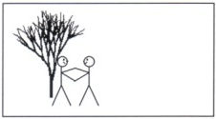
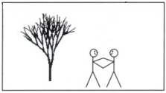
Temporal Prediction
Mostly, consecutive video frames are similar except for the differences induced by the objects moving within the frames. For example-
People moved farther to the right than tree
Tree moved down and to the right
Frame 1
(Current)
Frame 2
(Next)
Temporal prediction uses motion estimation & motion vector techniques to predict these changes in the future frames.
Motion estimation is applied at luminance plane only. (It is not applied at chrominance plane as it is assumed that the color motion can be adequately presented with the same motion information as the luminance.)

Slide 23
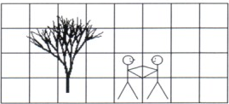
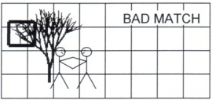

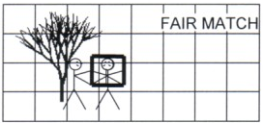
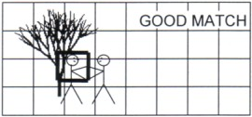
Motion Estimation : It performs a 2-Dimesional spatial search for each luminance macro-blocks within the frame to get the best match. For example-
Macro-block to be searched
Search
Frame 2
Frame 1
Search
Search
Frame 1
Frame 1
If there is no acceptable match, then encoder shall code that particular macro-block as an intra macro-block, even though it may be in a P or B frame.

Slide 24
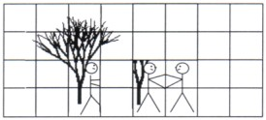
Motion Vector : Assign motion vectors to the resultant macro-blocks to indicate how far the horizontally and vertically the macro-block must be moved so that a predicted frame can be generated For example-
Motion Vectors
Frame 1
Predicted Frame
Since, each forward and backward macro-block contains 2 motion vectors, so a bi-directionally predicted macro-block will contain 4 motion vectors.

Slide 25
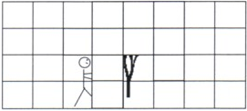
Residual Error Frame
Residual error Frame is generated by subtracting the predicted frame from desired frame. For example-
Desired Frame
Subtract
Frame 2
Predicted Frame
Residual error Frame is less complicated and can be encoded efficiently.
More accurate the motion is estimated & matched, more likely the residual error will approach zero and the coding efficiency shall be highest.
Residual Error Frame
Since, motion vector tends to be highly correlated between macro-blocks – Horizontal & vertical component is compared to the previously valid horizontal & vertical motion vector respectively and difference is calculated.
These differences (i.e. Residual Error Frame) are then coded and variable length code is applied on it for maximum compression efficiency.

Slide 26
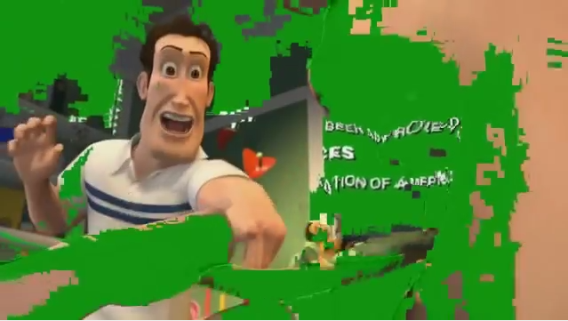
Life without I-Frames

