Slide 1
Benchmarking fit minimizers

Slide 2
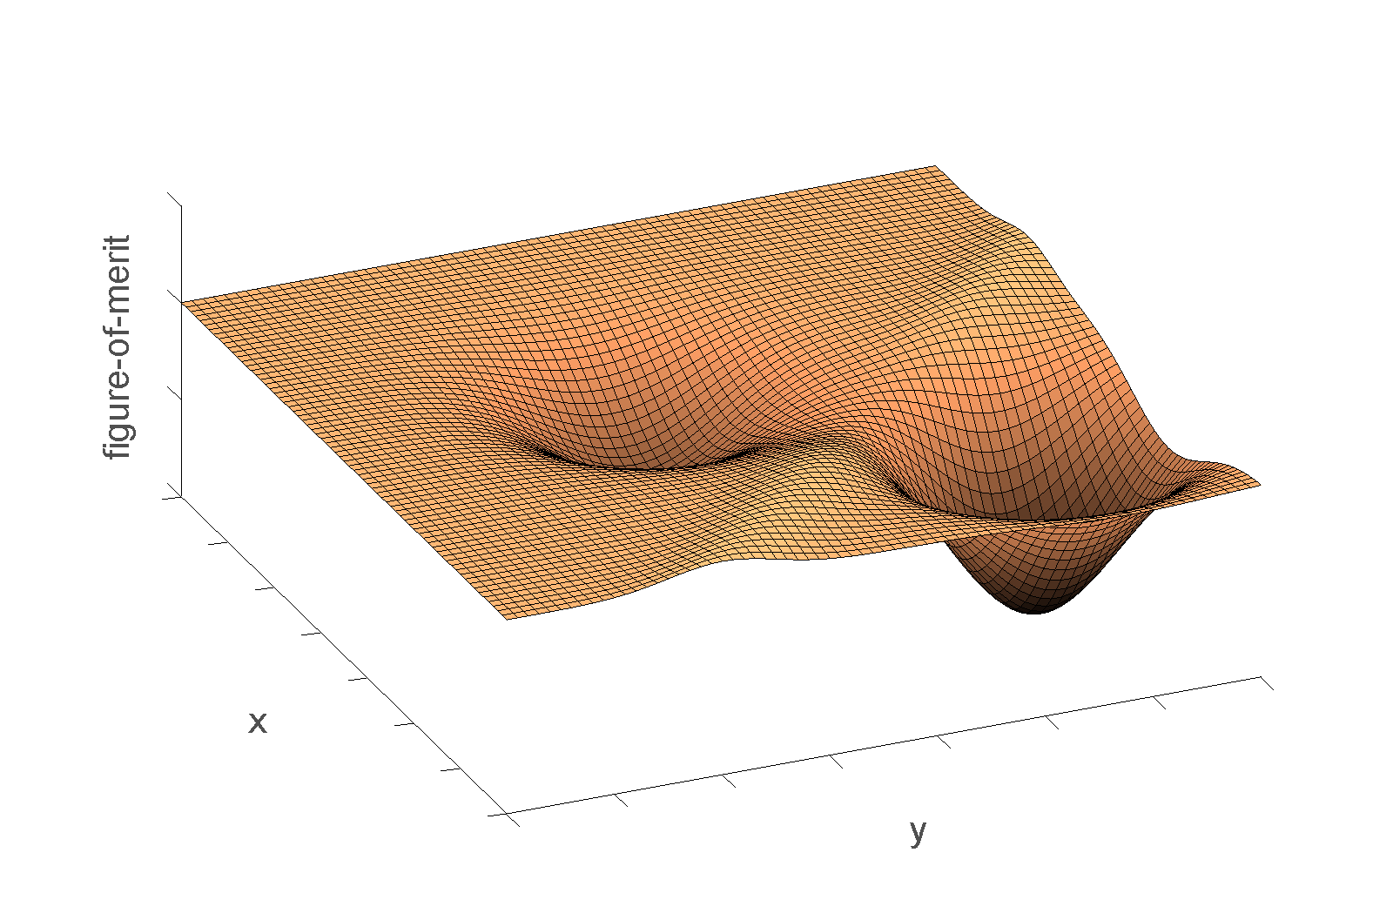
What is global optimisation?

Slide 4
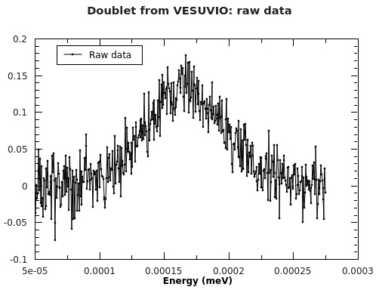
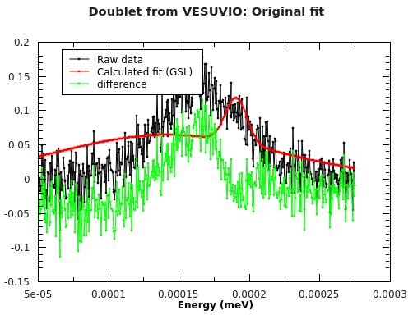
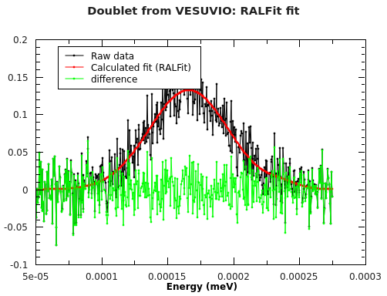
No thanks
Yes please
- and are No Thanks cases recorded?

Slide 5

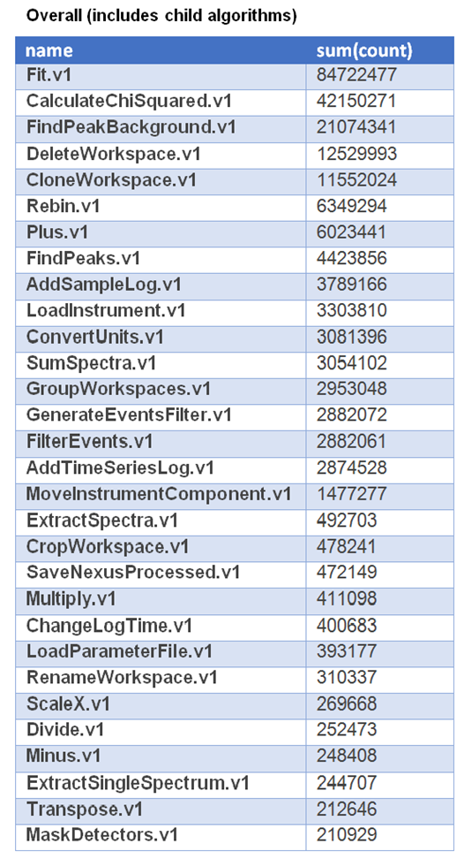
Why do we care?
GSAS/SasView/DASH/TobyFit/Rascal…..
Even Mantid:

Slide 6
Perception
Different minimizers: Powder diffraction software
Mantid – Levenberg-Marquardt

Slide 7
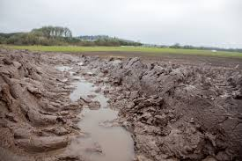


Reality: different types of surfaces

Slide 8
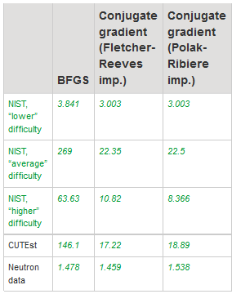

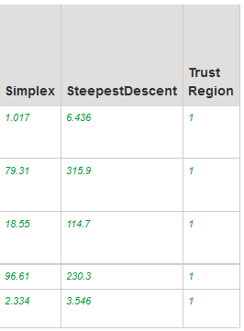
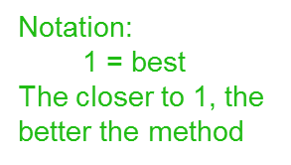
Benchmarking minimizers http://docs.mantidproject.org/nightly/concepts/FittingMinimizers.html
Current
default
SCD
?

Slide 9
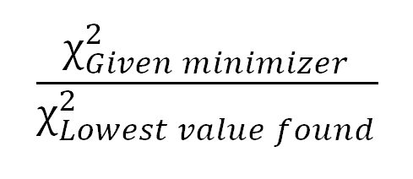
Metrics for comparing minimizers
Stability:
Performance: Time

Slide 10
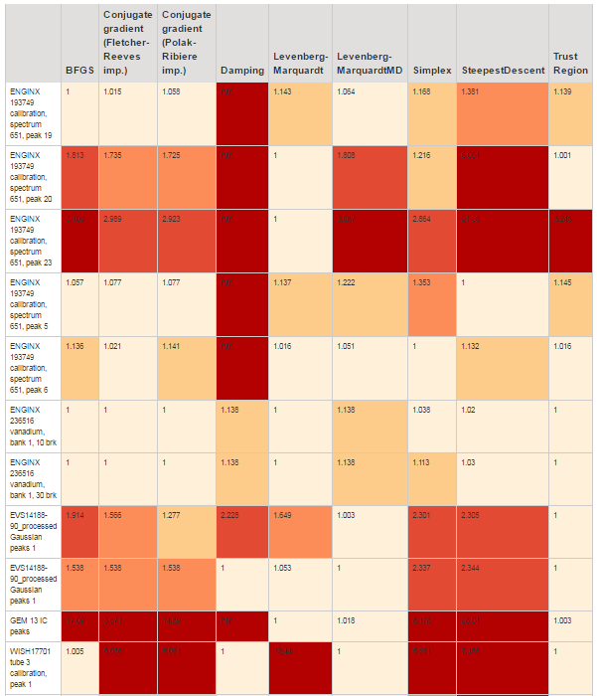
Measure
Stability:

Slide 11
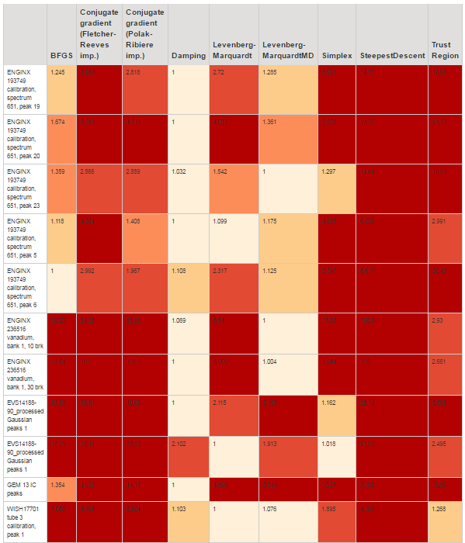
Measure
Performance:

Slide 12
Page to be created
Dear User…… fitting…. Info & recommendations….,
By default Mantid uses Lebenbert-Marquet
We can also recommend Trust Region for general purpose fitting
(future) For constrained problems we recommend …
(also possible future recommendations for other subset of neutron problems)
For Bayesian analysis we currently support only one minimizer, which is Fabada
Please let us know if you have a fitting problem where the (recommended) fit minimizers are not giving you the result you expect.
Maybe separate recommendation for stability and performance?
The above recommendations are based on these benchmarking results: http://docs.mantidproject.org/nightly/concepts/FittingMinimizers.html
Some sentence that benchmarking framework can be used by anyone to test any new ideas for minimizers

Slide 13
Where are the fitting problems
Fitting problems are stored in the FittingTestProblems directory as follows:
CUTEst/
NIST_nonlinear_regression/
Neutron_data/
https://github.com/mantidproject/mantid/tree/15952_pseudo_system_test_fitting_benchmarks_nist/Testing/Data/SystemTest

Slide 14
Defining a fitting problem (take example WISH17701_peak1.txt)
name = 'WISH17701 panel 103 tube 3 calibration, peak 1'
input_file = 'WISH17701_calibration_panel103_tube3.nxs'
function = 'name=LinearBackground,A0=5986,A1=0;name=Gaussian,Height=22701,PeakCentre=58.953,Sigma=1'
fit_parameters = {'StartX': 43.952964774599998, 'EndX': 73.952964774600005} (fit_settings?)
description = '‘

Slide 15
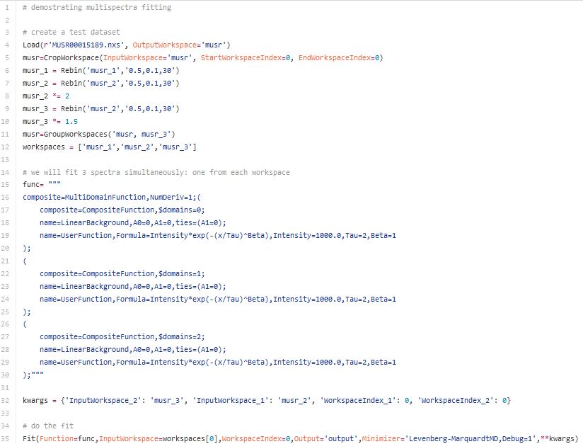
How to deal with e.g.

Slide 16
Where are the scripts
https://github.com/mantidproject/mantid/tree/15952_pseudo_system_test_fitting_benchmarks_nist

Slide 17
FittingBenchmarks systemtest
https://github.com/mantidproject/mantid/pull/17654/files#diff-ec447cd5742fb3f07b35e9434680a401

Slide 18
When tables get updated
For 3.9 manual update: https://github.com/mantidproject/mantid/issues/18151
Automatic update of tables in between releases will not work - I believe
We can’t have recommendations for which minimizer we recommend on a daily basis
Check if subset of problems can form a new table
But straightforward to create manually

Slide 19
How is a new problem added
Email me
Used what I have demoed
Possible reward!

