Slide 1
Efficiency savings at ISIS Facility using machine learning techniques
Anders Markvardsen
ISIS Facility, March 2017

Slide 2
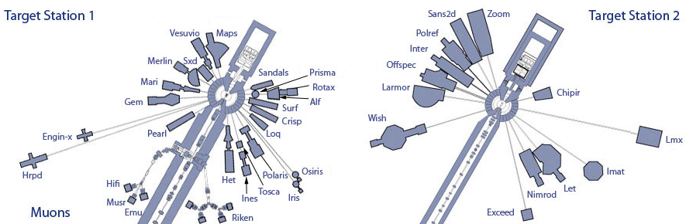

Slide 3
Two ways machine learning can help
More from less
Efficiency savings: less time and/or less manual time required

Slide 4
Manual intensive tasks
Feature finding in data
4D inelastic data
3D elastic data
(1D spectra)
Calibrating instrument
Crystal structure analysis tasks

Slide 5
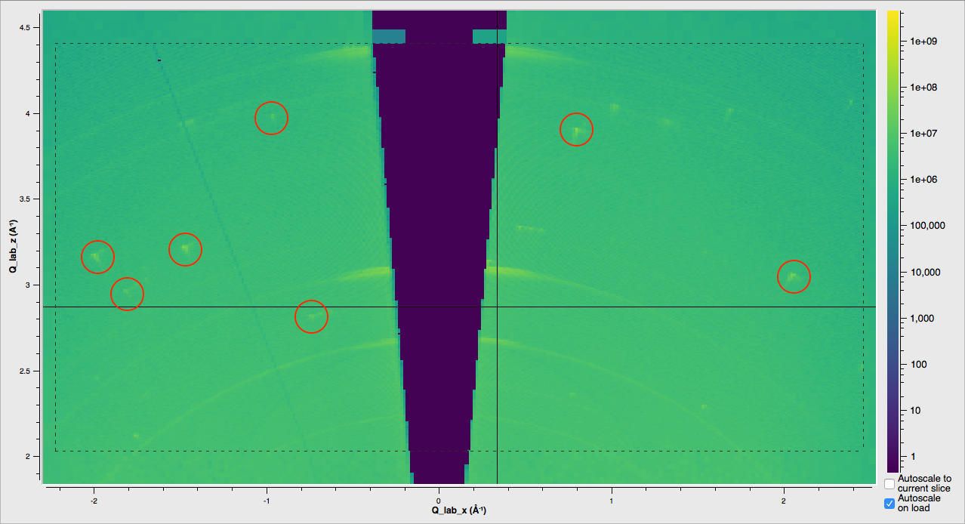
Data processing time wasting on WISH

Slide 6
WISH case in more detail
Runs ~60 SCD experiments a year
Instrument scientists manually adjust output: from a few hours to weeks (on average at least a day). And this does not account for the time the users spend on this.
This is why some experimental data does not get processed
Cost in FEC £ to ISIS per year: ~60 working days ~= 60/(12*20) * 100000 = £25000
Other important costs: fewer scientific publications and cost to users
Hence the total cost to ISIS considerably higher than £25000 per year

Slide 7
WISH feasibility study
~10 working days spread over 3 staff over ~3 months
Samuel Jackson and Michael Hart
Cost ~£6000, where proportion counts towards Samual’s/Michael’s L&D to better understanding ISIS neutron data

Slide 8
What next
Feasibility “approved” and is receiving feedback to it this week
From next week to start implement in 3-month stages with evaluation points, where 1st stage at the same resource level
In parallel continue to seek further input

Slide 9
Data acquisition, understanding and preparation
Raw data
~1GB on disk per dataset
x
Transfer to Q-space
Q-space file
~100MB on disk
Ground truth
Feature list in Q-space:
x y z , good yes/no? shape? etc
x
Non machine learning alg. +
Instrument scientist pain
HKL file
CIF file
(new science)

Slide 10
CIF file
Raw file
Verification
Q-space file
Ground truth
Feature list file

Slide 11
Q-space file
Non ML alg.
Non ML
Feature list file
Trained
ML alg.
Trained
ML alg.
ML
Feature list file

Slide 12
Strategy
Bottom up approach
Since there is a risk that machine learning will not work

Slide 13
I currently believe machine learning can provide huge savings at ISIS
Acknowledgements: Samuel Jackson
Michael Hart

Slide 14
Simulated data:
Loop over a set of crystal structures:
Convolute predicted peak positions with sample resolution to get first output in q-space
Add instrument resolution and instrument view of q-space
Add noise (counting statistics)
Loop over sample environment:
Add artefact for each sample container environment

