Slide 1
Finding Single Crystal Peaks

Slide 2
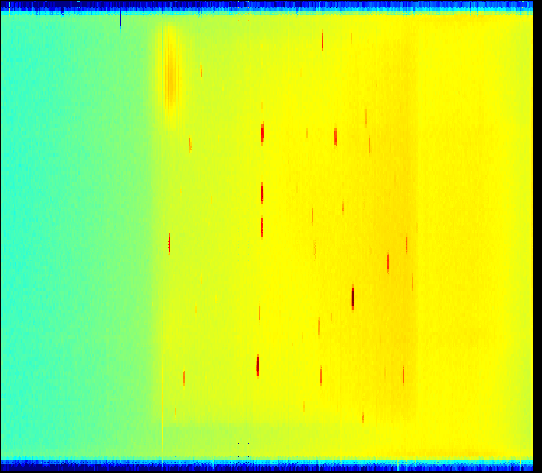
WISH Clear Peaks

Slide 3
Description of Problem
A lot of Instrument Scientist time is spent identifying or correcting peaks
Current density-based algorithm too unreliable when heavy noise is involved
For a human, the process is easy but tedious and wasteful
Could machine learning be used to better identify peaks in the presence of noise?

Slide 4
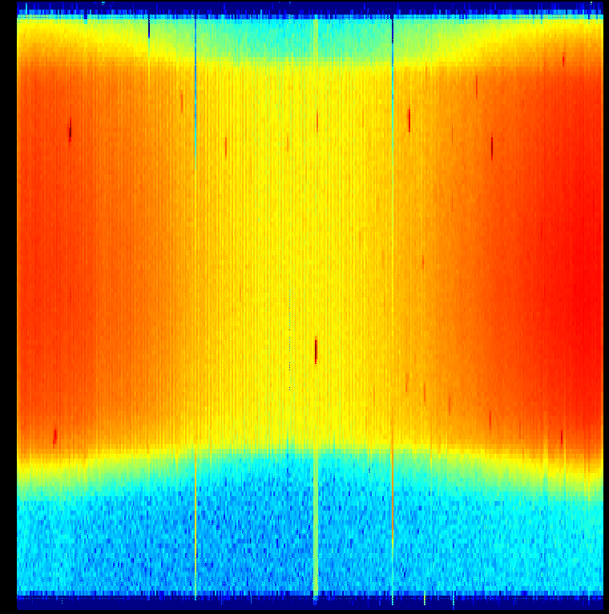
WISH Noisy Peaks

Slide 5
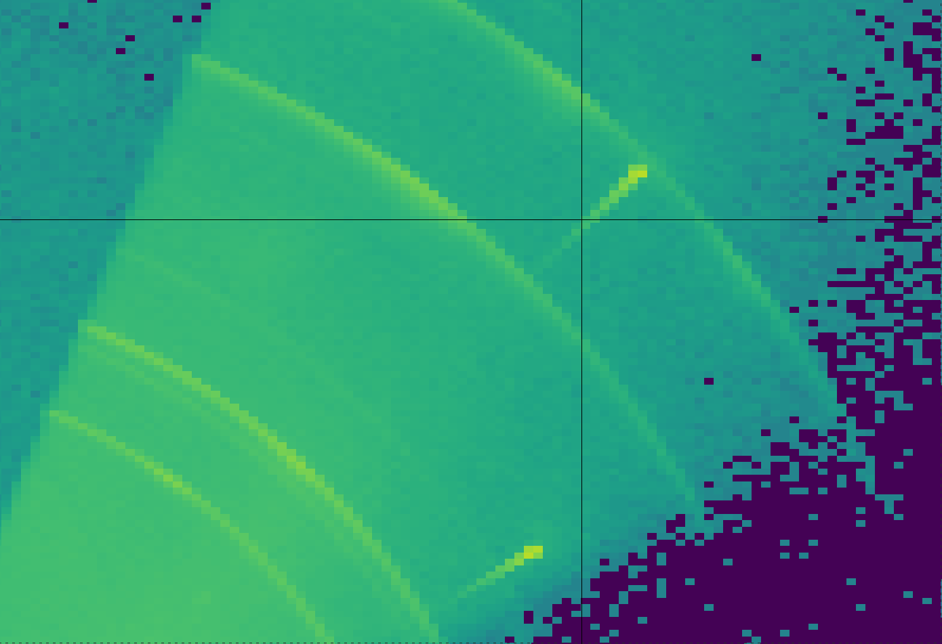
Peaks and Rings

Slide 6

Noise

Slide 7

Weak Peaks

Slide 8
Goals
Ideally, we want:
  Automatic identification with minimal error
  Confidence estimate
  Classification by shape and size
  Continuous learning based on corrections

Slide 9
Thoughts and Challenges
Considering:
  Hand-crafted ROI + SVM or Random Forest
  Neural Network(s) for ROI and classification
Data is 3-dimensional
  To slice or not to slice
Data can be huge (~10GB+ in memory)
Lack of correctly identified data for training
  Considering simulated data as substitute

Slide 10
Plan Going Forward
Next steps to find a solution
  Generate simulated training data set
    Much faster than trying to gather enough manually labelled real data
  Evaluate performance of current algorithm against simulated data set
  Develop prototype(s) using new approach
  Evaluate performance of prototype(s) against simulated data set

Slide 11
Questions We Have
Feasibility of Problem
  Is this something ML can solve?
Most Appropriate Models
Do the next steps we plan to take make sense?
How best to measure effectiveness of model & simulated data?

