Slide 1
Temple Services Portal Prototype
-Book Marathon Feature
Roles:
1. Book Distribution Devotee – BDD
2. Circle Leader – CL
3. BBT Manager – BBTM
4. BBT Operator - BBTO
ICC IT Team
15-Nov-2017

Slide 2
Temple Services Portal Prototype
-Book Marathon Feature
Role:
Book Distribution Devotee – BDD

Slide 3
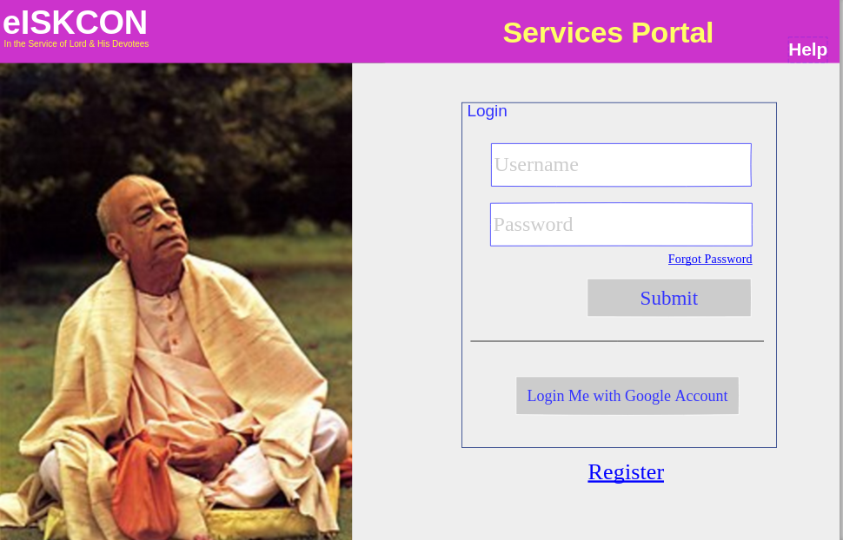
Book Distribution Devotee – BDD

Slide 4
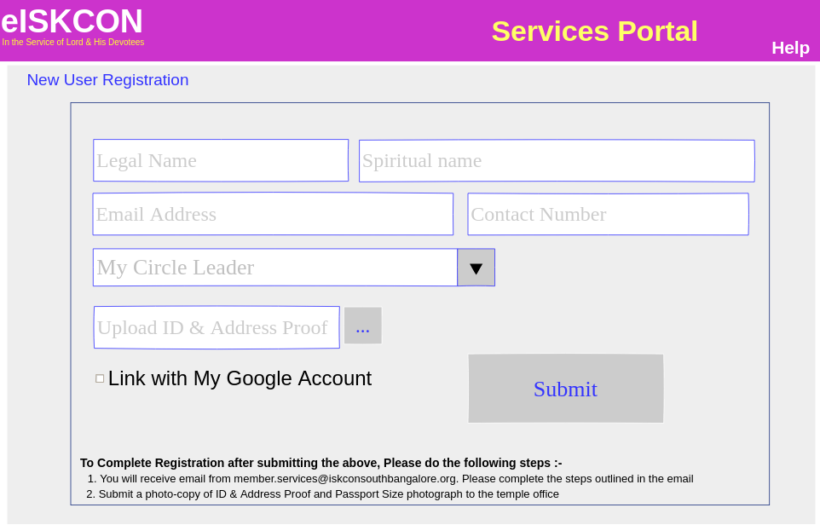
Book Distribution Devotee – BDD

Slide 5
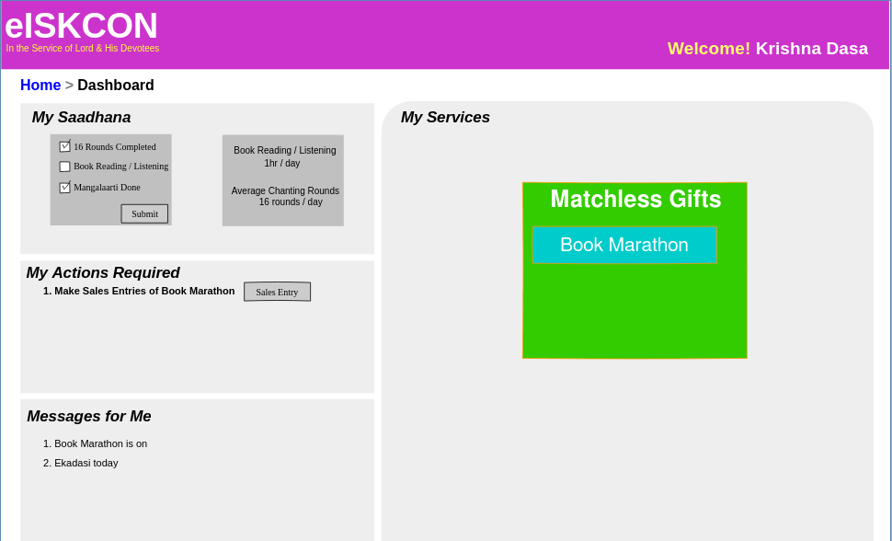
Book Distribution Devotee – BDD

Slide 6
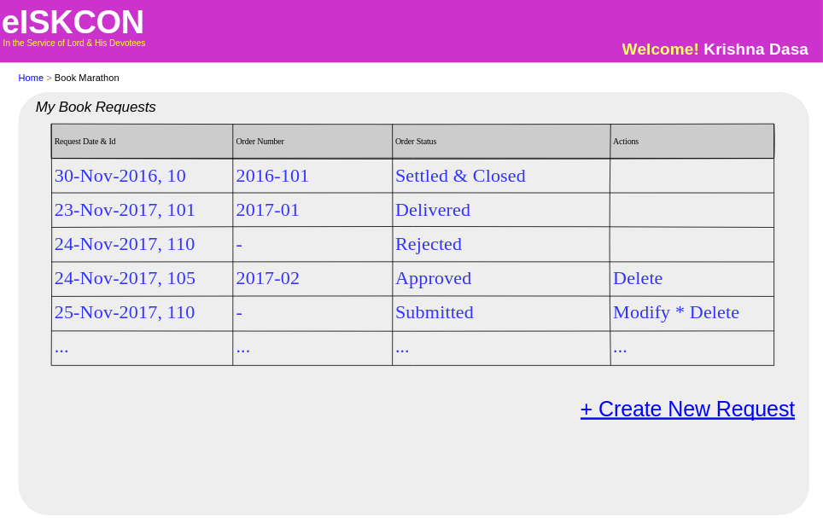
Book Distribution Devotee – BDD

Slide 7
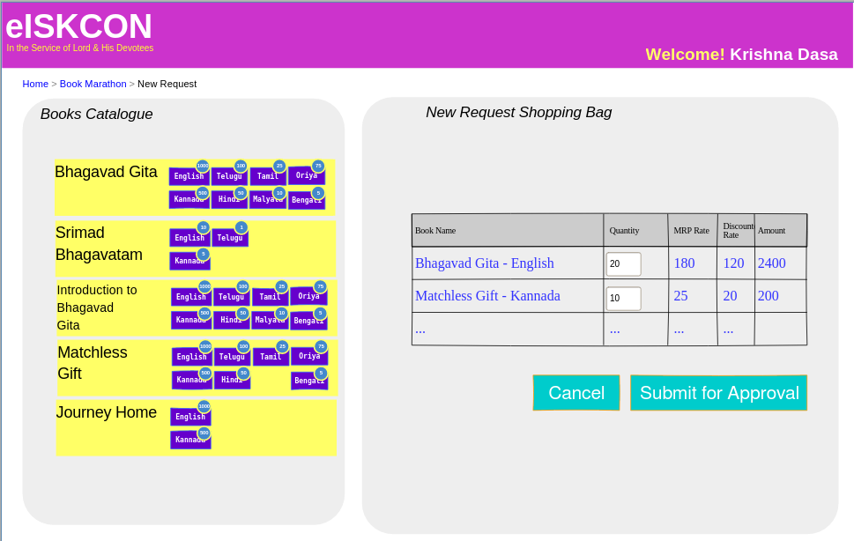
Book Distribution Devotee – BDD

Slide 8
Services Portal Prototype
-Book Marathon Feature
Role:
Circle Leader – CL

Slide 9
Circle Leader – CL

Slide 10
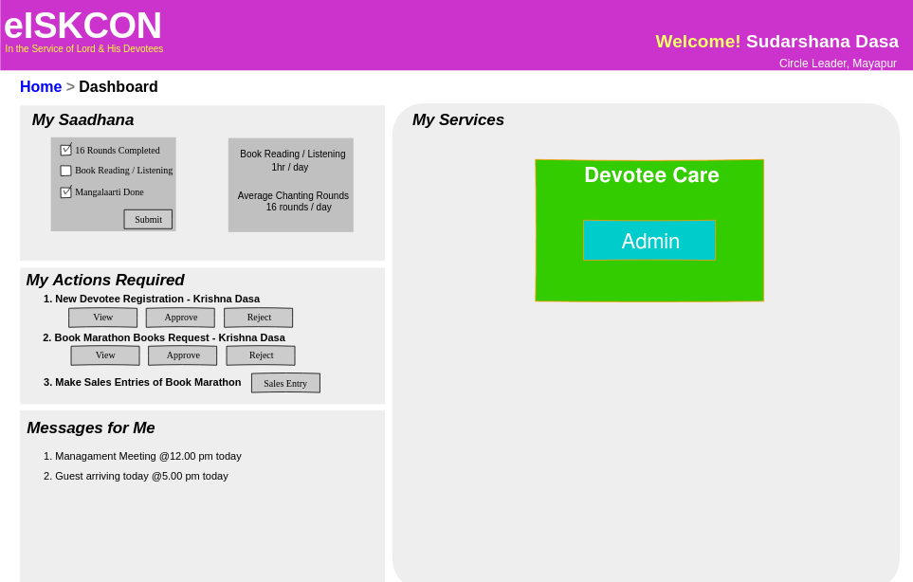
Circle Leader – CL

Slide 11
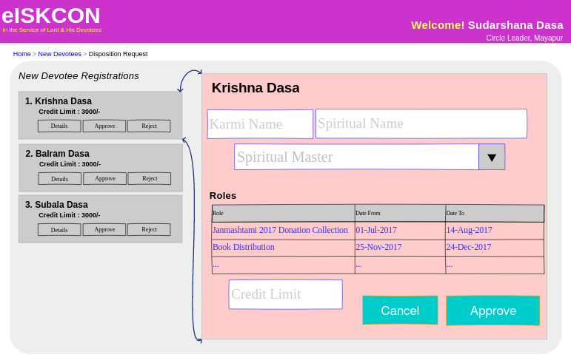
Circle Leader – CL

Slide 12
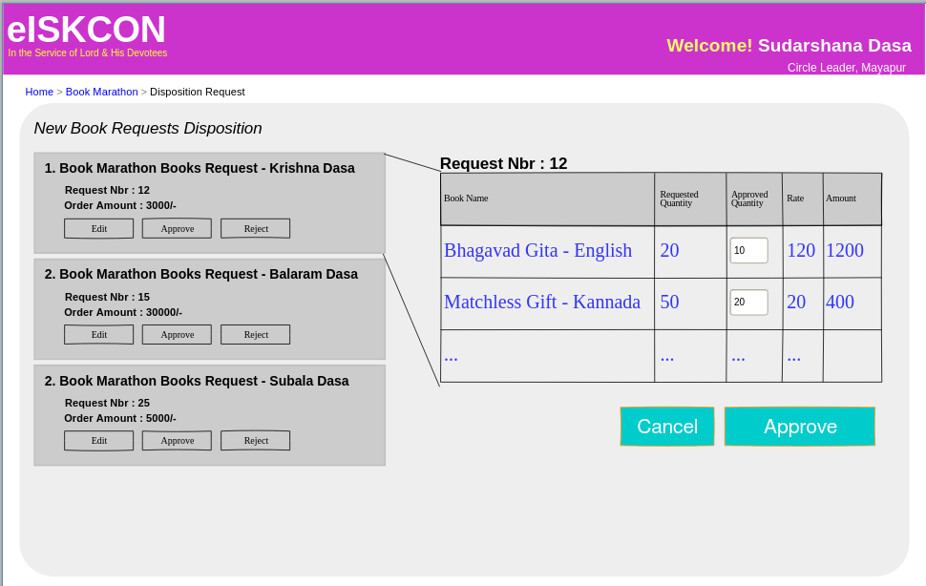
Circle Leader – CL

Slide 13
Services Portal Prototype
-Book Marathon Feature
Role:
BBT Manager – BBTM

Slide 14
BBT Manager – BBTM

Slide 15
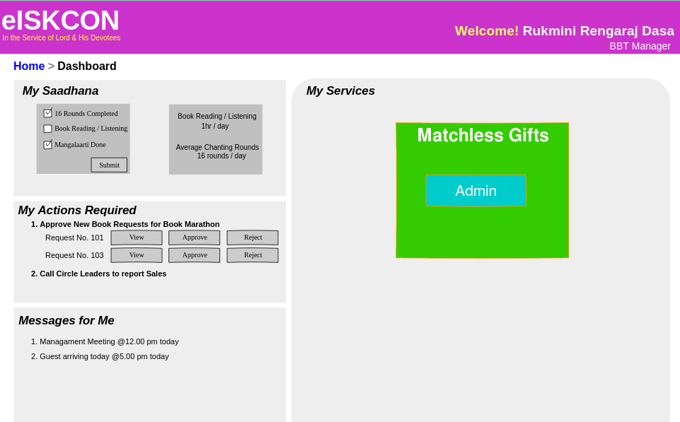
BBT Manager – BBTM

Slide 16
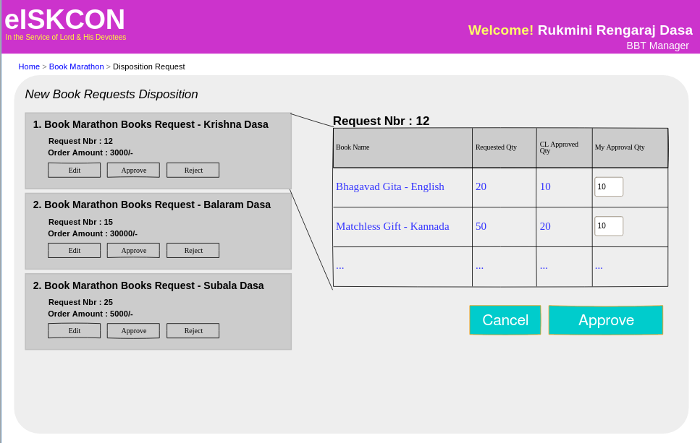
BBT Manager – BBTM

Slide 17
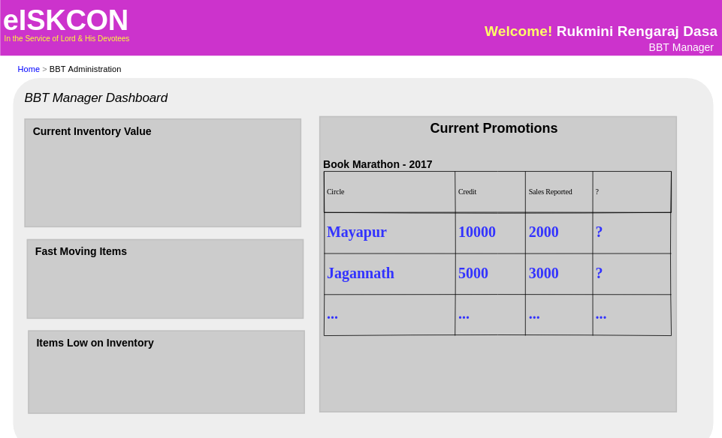
BBT Manager – BBTM

Slide 18
Services Portal Prototype
-Book Marathon Feature
Role:
BBT Operator - BBTO

Slide 19
BBT Operator - BBTO

Slide 20
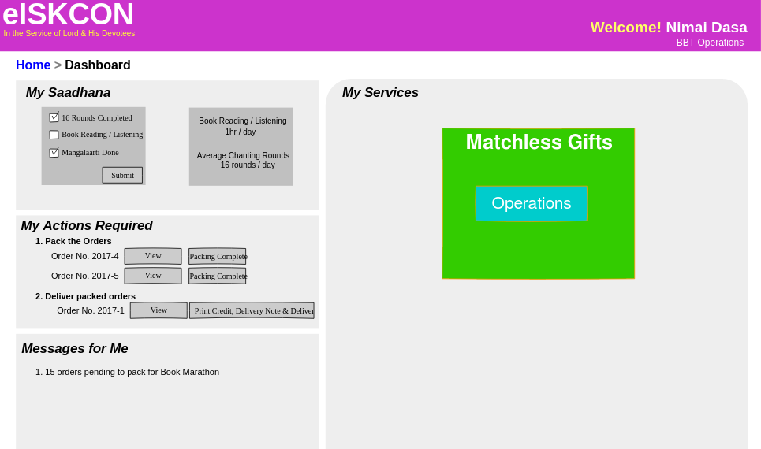
BBT Operator - BBTO

Slide 21
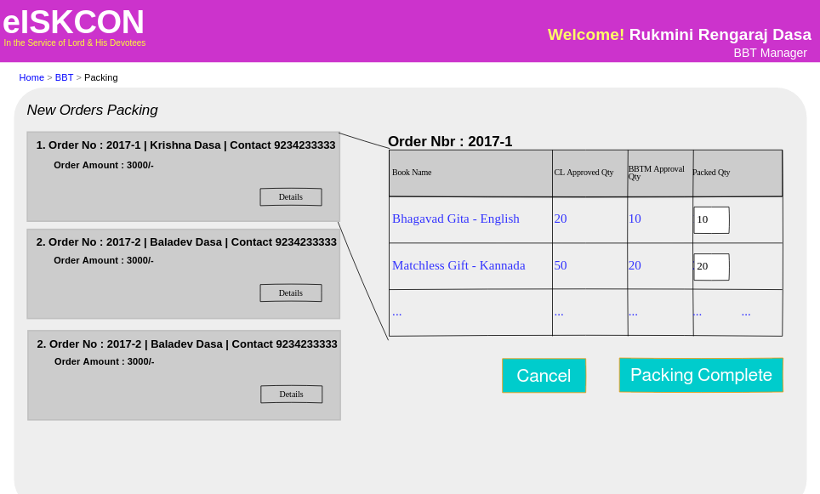
BBT Operator - BBTO

Slide 22
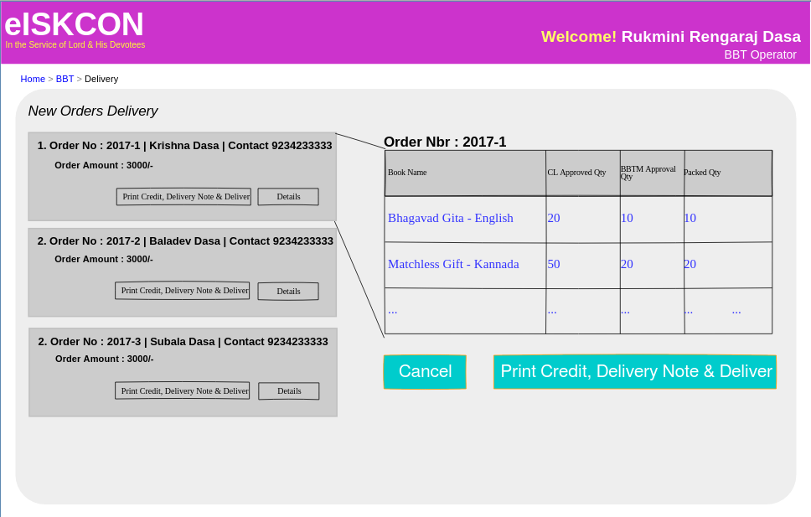
BBT Operator - BBTO

Slide 23
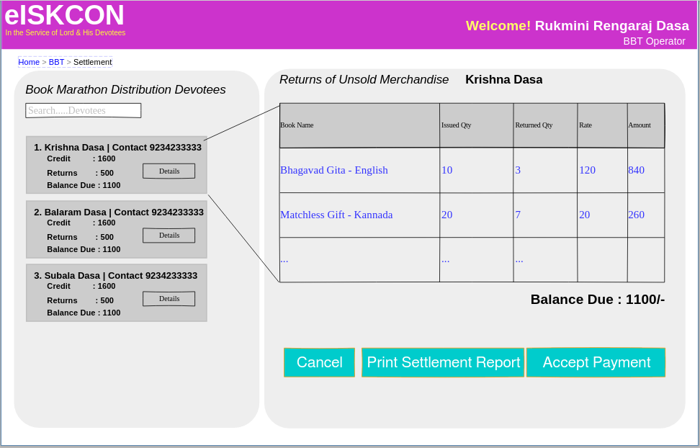
BBT Operator - BBTO

Slide 24
BBT Operator - BBTO

Slide 25
Temple Services Portal Prototype
-Book Marathon Feature
HariBol
Your Review Comments are Welcome

