Slide 1
Introduction to Statistical Learning with Applications
TD3: Questions from previous exams
Pedro L. C. Rodrigues

Slide 2
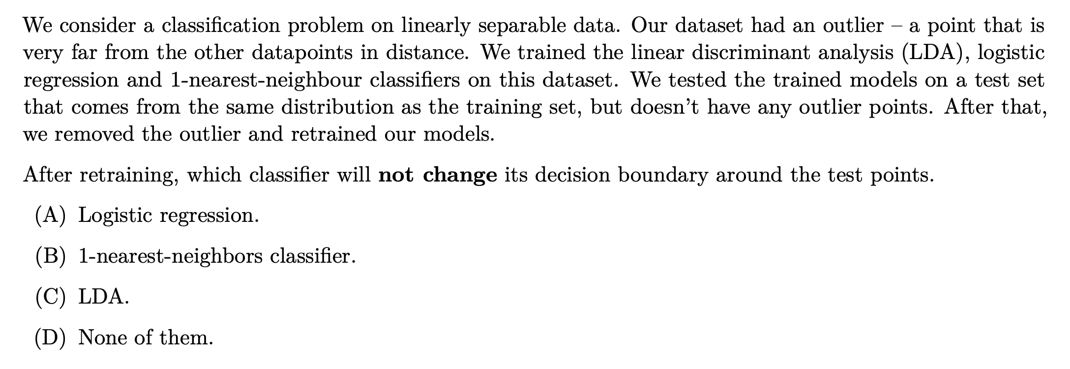
Exercise 1
Notes:
The r

Slide 3
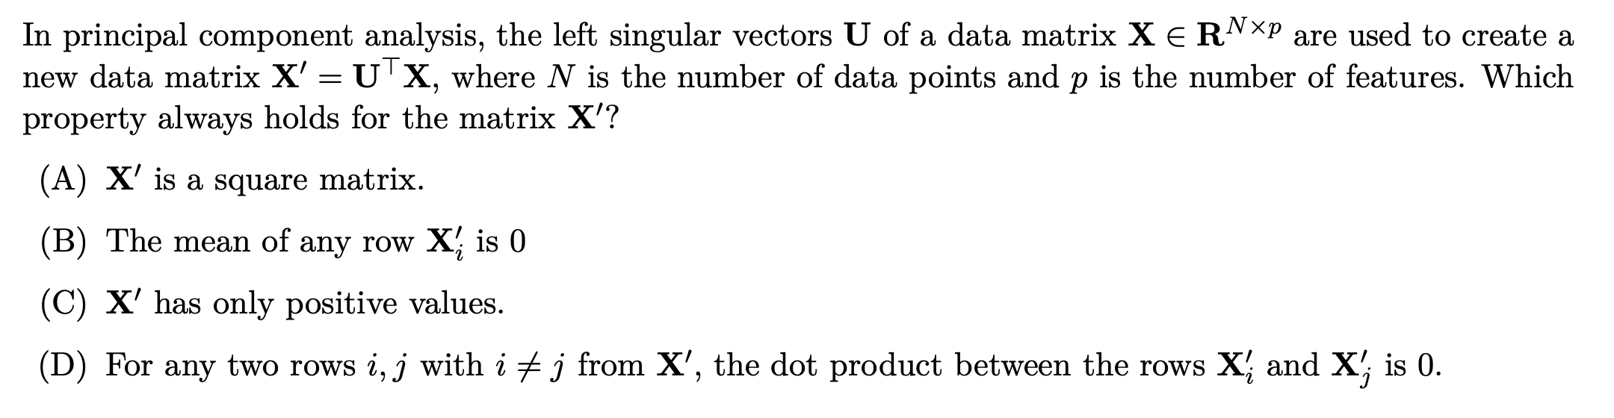
Exercise 2
Notes:
The r

Slide 4
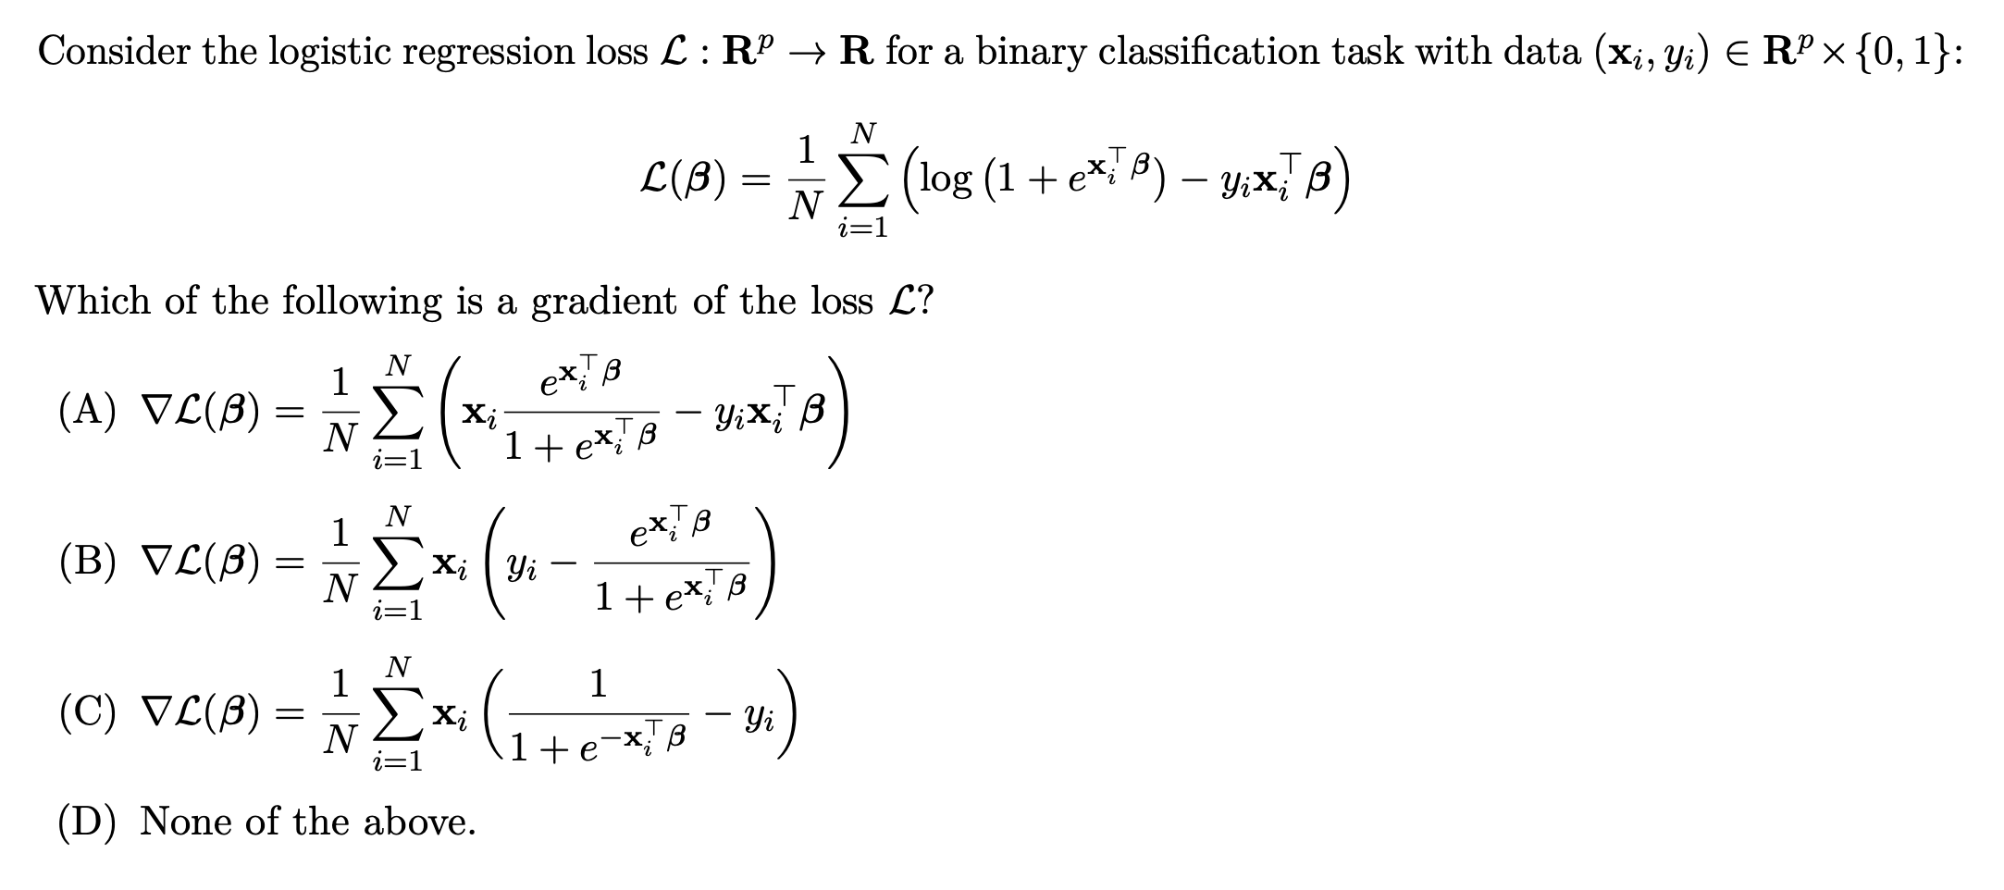
Exercise 3
Notes:
The r

Slide 5
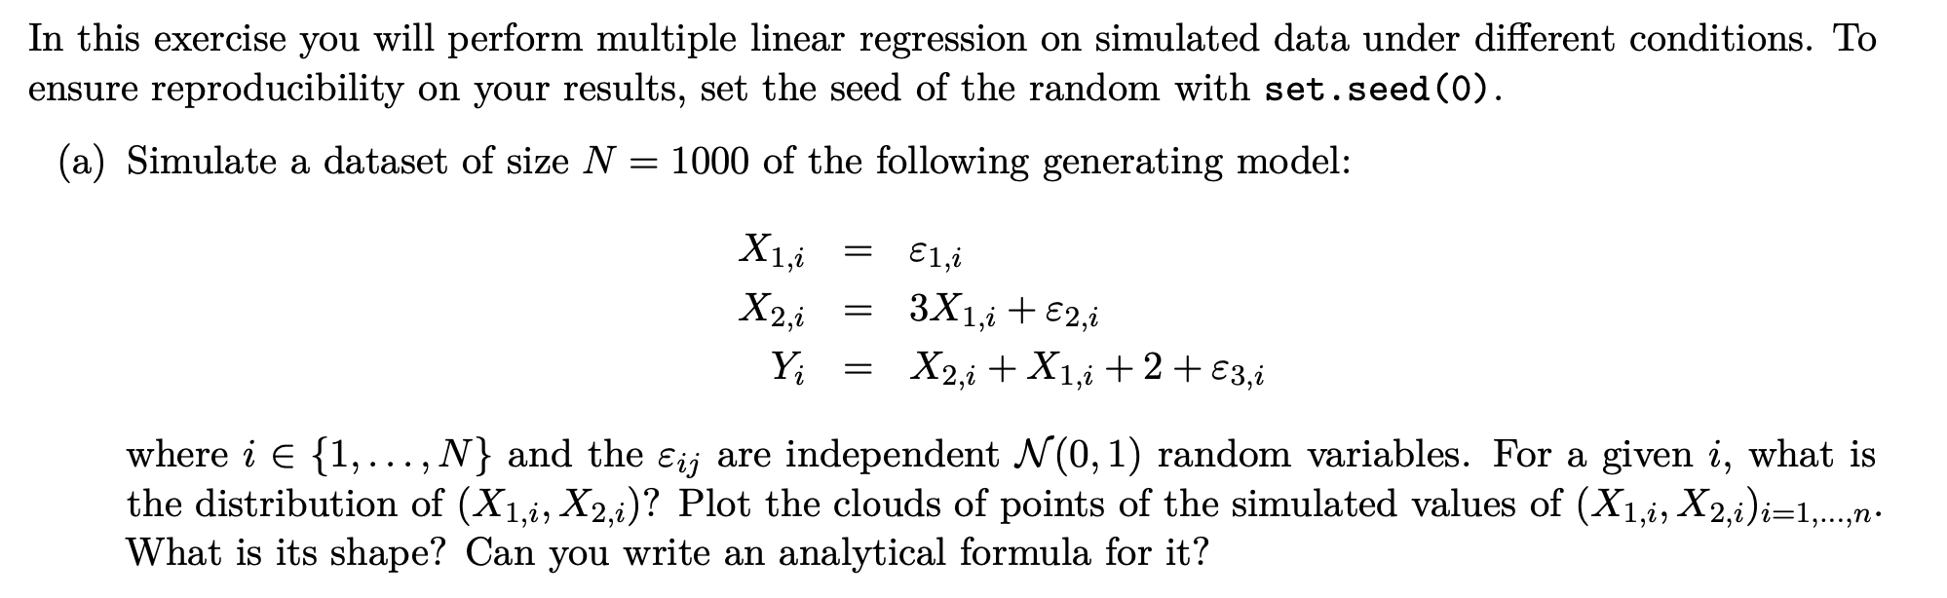
Exercise 4
Notes:
The r

Slide 6
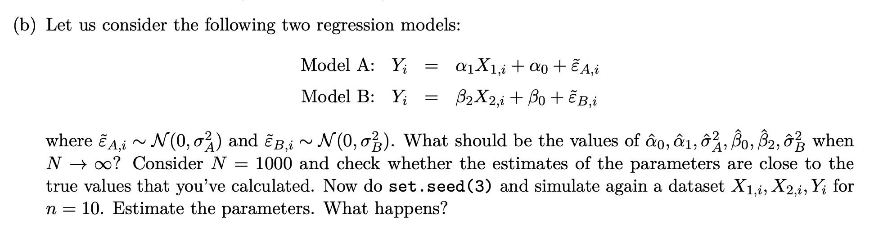
Exercise 4
Notes:
The r

Slide 7
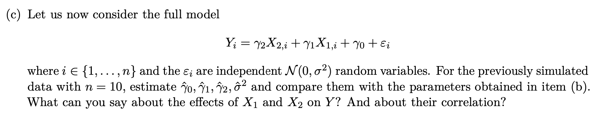
Exercise 4
Notes:
The r

Slide 8
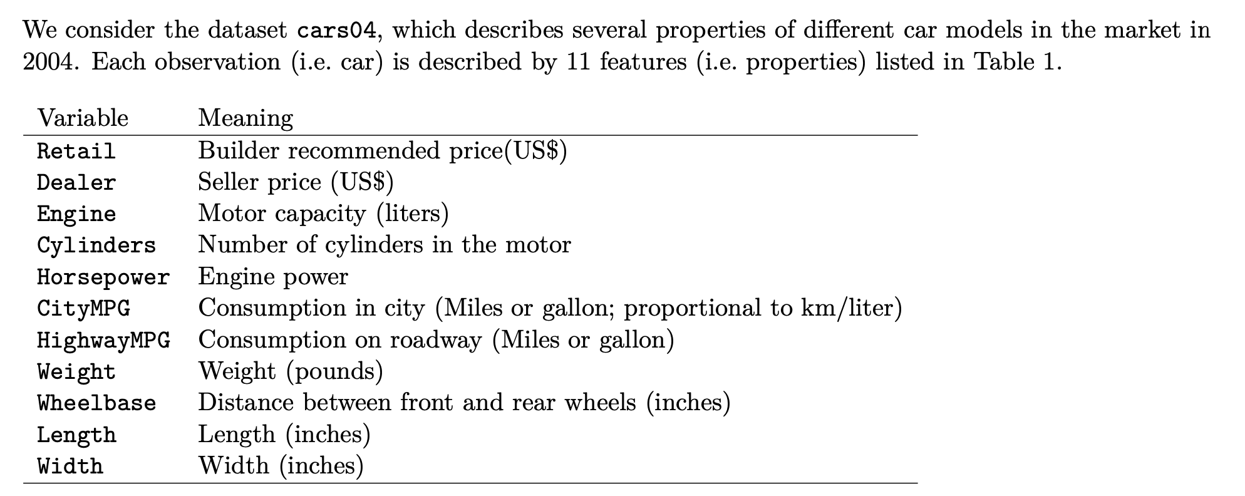
Exercise 5
Notes:
The r

Slide 9
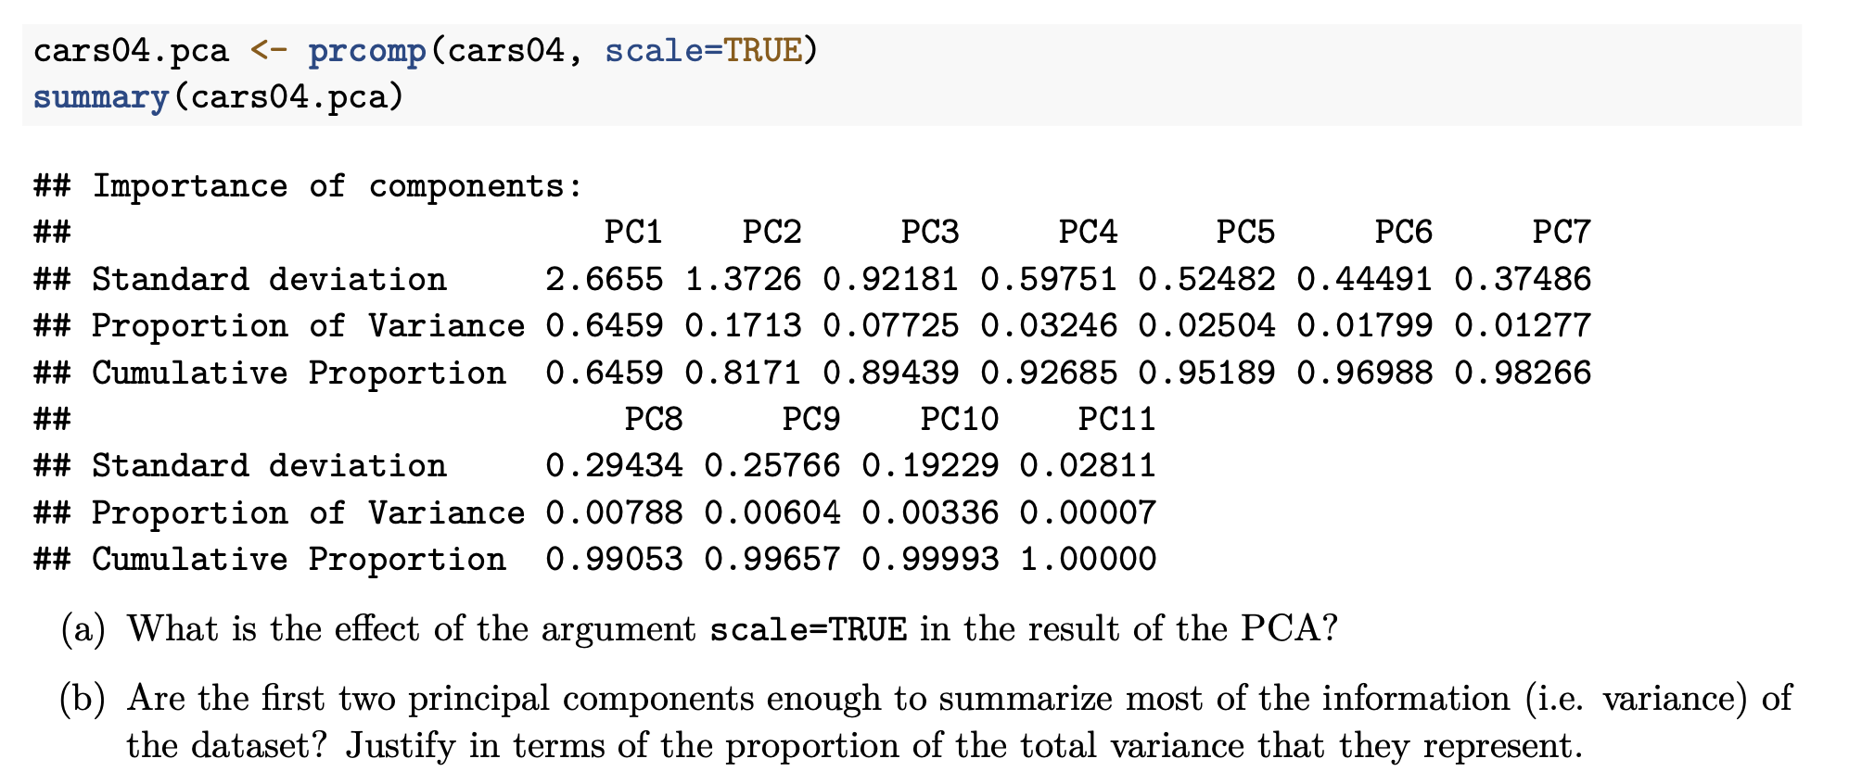
Exercise 5
Notes:
The r

Slide 10
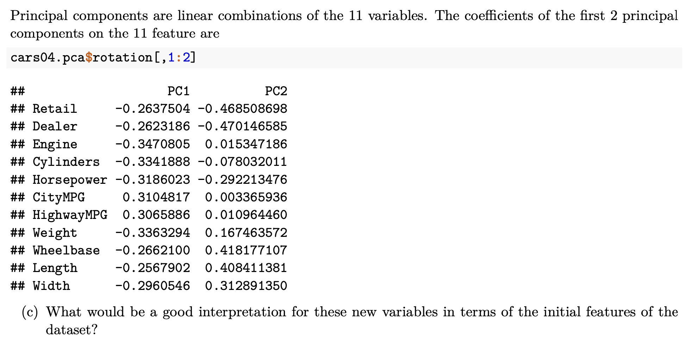
Exercise 5
Notes:
The r

Slide 11
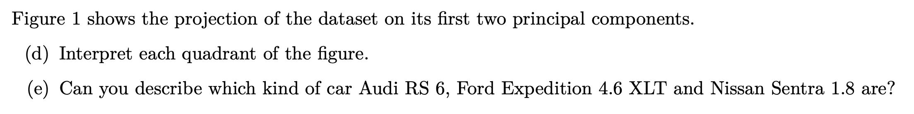
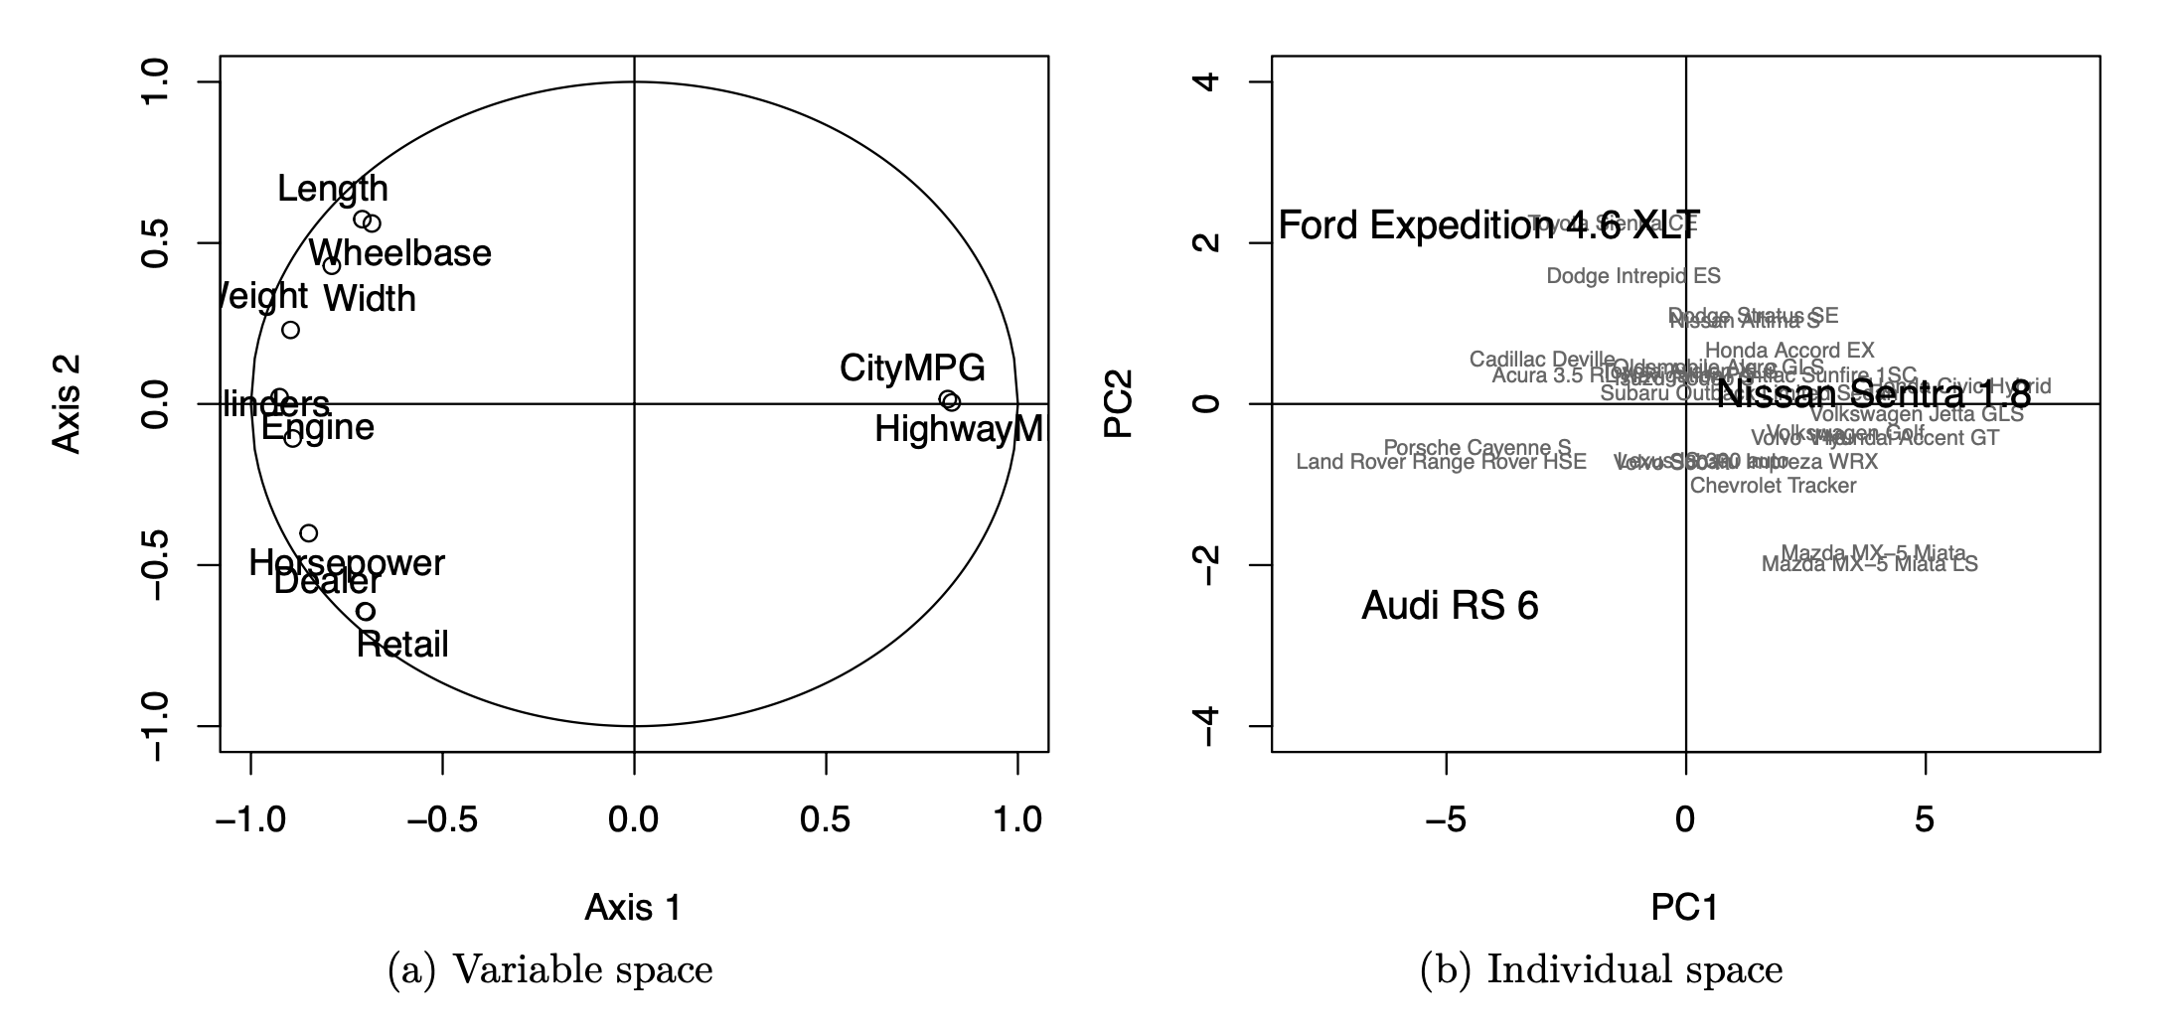
Exercise 5
Notes:
The r

