Slide 1
Introduction to Statistical Learning with Applications
CM7: Decision trees and random forests
Pedro L. C. Rodrigues

Slide 2
Discriminative approaches
There are many strategies for approximating the Bayes classifier.
We have seen so far:
K-nearest neighbours (kNN)
Discriminative approaches
Logistic regression
Linear and quadratic discriminant analysis
Generative approaches
Naïve Bayes classifier
In the following lectures, we will see
Random forests
Ensembling approaches
Gradient boosted trees

Slide 3
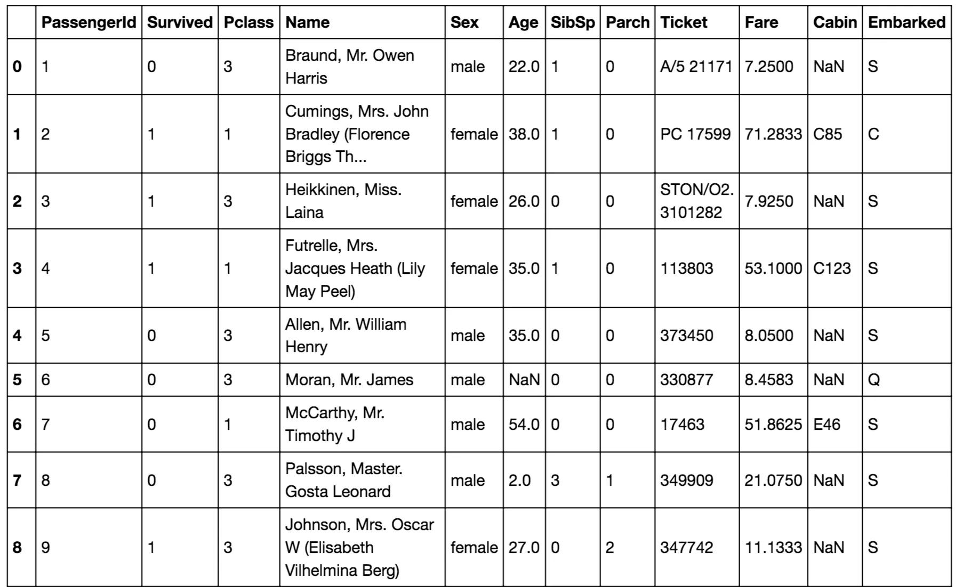

Discriminative approaches
There are many strategies for approximating the Bayes classifier.
Random forests
Ensembling approaches
Gradient boosted trees
Both rely on decision trees and can be used for regression and classification
Example: The Titanic survival dataset

Slide 4
Discriminative approaches
There are many strategies for approximating the Bayes classifier.
Random forests
Ensembling approaches
Gradient boosted trees
Both rely on decision trees and can be used for regression and classification
Example: The Titanic survival dataset
Gender
male
female
Age
SURVIVED
<= 9.5
> 9.5
SURVIVED
DIED

Slide 5
Discriminative approaches
But first, we will talk again about K-nearest neighbours (kNN)
In kNN we approximate i.e. the set of K nearest neighbours of

Slide 6
Discriminative approaches
But first, we will talk again about K-nearest neighbours (kNN)
In kNN we approximate i.e. the set of K nearest neighbours of
kNN is a nonparametric classifier: it makes no assumptions about the data
It can be very flexible but may not be optimal when we know something about the data
It works well in low dimensions, but suffers from the curse of dimensionality
The hyper-parameter K usually chosen via cross-validation

Slide 7
Discriminative approaches
But first, we will talk again about K-nearest neighbours (kNN)

Slide 8
Discriminative approaches
But first, we will talk again about K-nearest neighbours (kNN)
Q: How exactly do we classify a point?

Slide 9
Discriminative approaches
But first, we will talk again about K-nearest neighbours (kNN)
Q: How exactly do we classify a point?
(1) For each data point find its K nearest neighbours
(2) Assign to it the class with most representatives

Slide 10
Discriminative approaches
But first, we will talk again about K-nearest neighbours (kNN)
Q: How exactly do we classify a point?
(1) For each data point find its K nearest neighbours
(2) Assign to it the class with most representatives
For N samples, do N(N-1) operations so

Slide 11
Discriminative approaches
But first, we will talk again about K-nearest neighbours (kNN)
Split the population in half
Q: How exactly do we classify a point?
(1) For each data point find its K nearest neighbours
(2) Assign to it the class with most representatives
For N samples, do N(N-1) operations so
Can we do better? Yes, with
Using KD-Trees (aka binary trees)!

Slide 12
Discriminative approaches
But first, we will talk again about K-nearest neighbours (kNN)
Split the population in half
Can we do better? Yes, with
Using KD-Trees (aka binary trees)!
(A)
(C)
X₁
(B)
<= 1.25
> 1.25
(D)
X₂
X₂
> 0.8
<= 0.8
> 0.0
<= 0.0
(A)
(B)
(C)
(D)

Slide 13
Discriminative approaches
But first, we will talk again about K-nearest neighbours (kNN)
Split the population in half
Can we do better? Yes, with
Using KD-Trees (aka binary trees)!
(A)
(C)
X₁
(B)
<= 1.25
> 1.25
(D)
X₂
X₂
> 0.8
<= 0.8
> 0.0
<= 0.0
(A)
(B)
(C)
(D)

Slide 14
Discriminative approaches
In decision trees we simply assign the majority label to all points in each region as per
Split the population in half
X₁
(A)
(C)
<= 1.25
> 1.25
X₂
X₂
(B)
> 0.8
<= 0.8
> 0.0
<= 0.0
(D)
👍
This avoids storing the whole training dataset and repeating nearest-neighbour searches
👎
But maybe the splits should be done differently?

Slide 15
Discriminative approaches
In decision trees we simply assign the majority label to all points in each region as per
X₁
(A)
(B)
<= 1.0
> 1.0
X₂
> -0.8
<= -0.8
(C)
What would be a good criterium to split the data?
Each split should be as homogeneous as possible!

