Slide 1
STATISTICAL ANALYSIS AND DOCUMENT MINING
Pedro L. C. Rodrigues
pedro.rodrigues@inria.fr
CM
TP
TD
Romain Rombourg
romain.rombourg@univ-grenoble-alpes.fr
TP
TD
Daria Bystrova
daria.bystrova@inria.fr
OH
Website: chamilo.grenoble-inp.fr/courses/ENSIMAG4MMSADM

Slide 2
STATISTICAL ANALYSIS AND DOCUMENT MINING
TP
R programming language
Groups of three students
Four or five TPs with reports to be uploaded on TEIDE
You should write them in english and using .rmd
Half the average of scores on each TP report
Half the score at final exam
Presence in CM, TD, TP is required and evaluated
Final grade

Slide 3
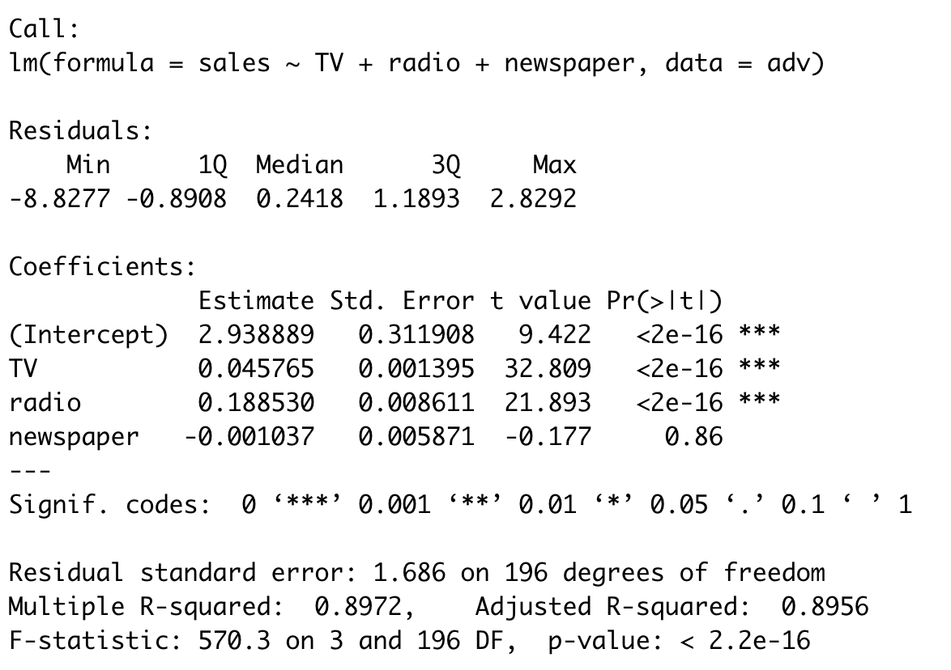

Slide 6
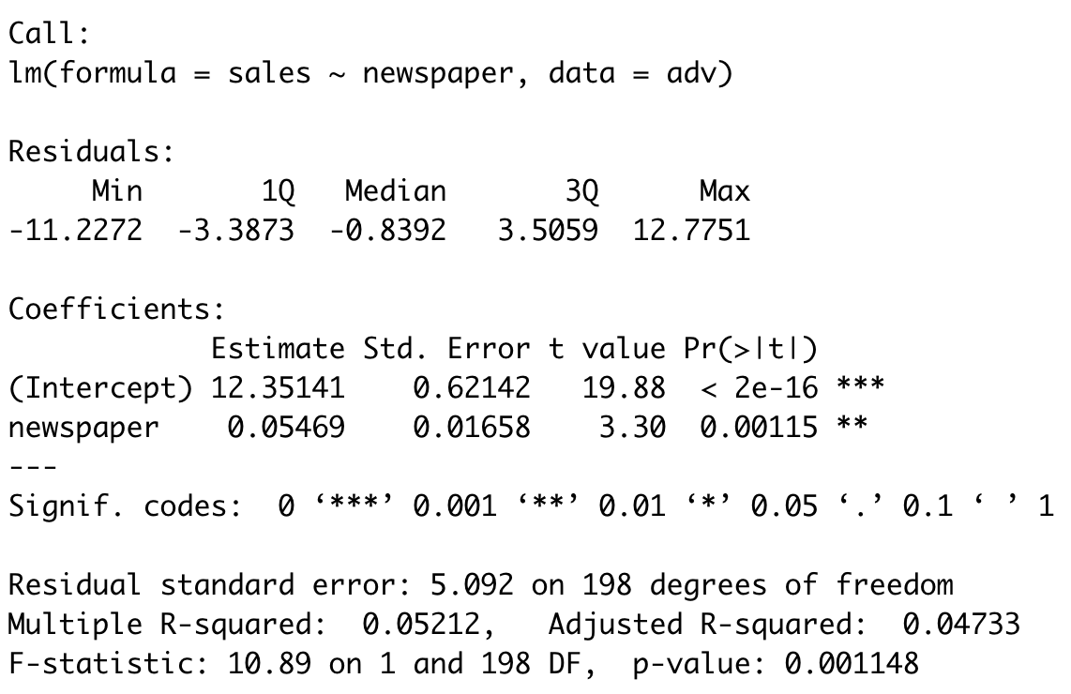

Slide 7
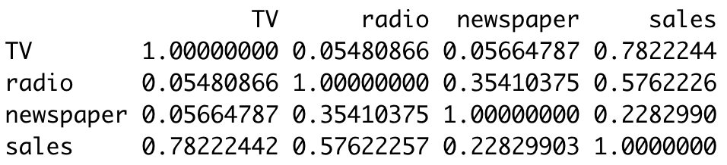

Slide 8
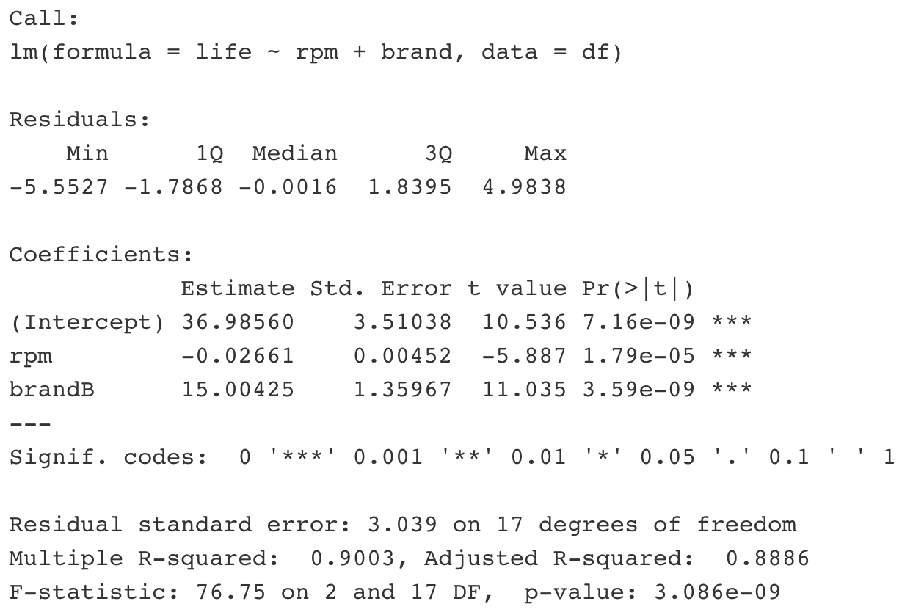

Slide 9
