Slide 1
Introduction to Statistical Learning with Applications
CM7: Decision trees and random forests
Pedro L. C. Rodrigues

Slide 2
Discriminative approaches
There are many strategies for approximating the Bayes classifier.
We have seen so far:
K-nearest neighbours (kNN)
Discriminative approaches
Logistic regression
Linear and quadratic discriminant analysis
Generative approaches
Naïve Bayes classifier
In the following lectures, we will see
Random forests
Ensembling approaches
Gradient boosted trees

Slide 3
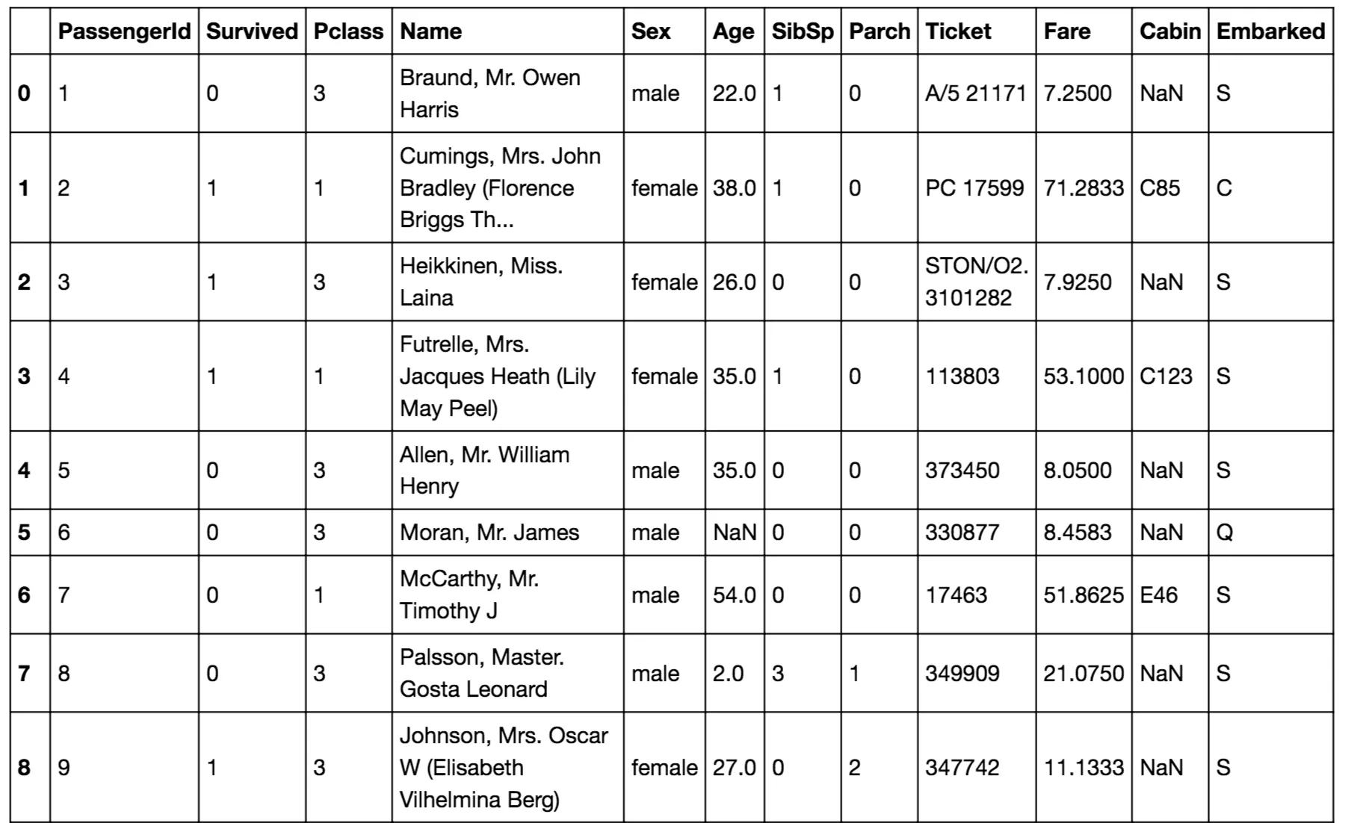

Discriminative approaches
There are many strategies for approximating the Bayes classifier.
Random forests
Ensembling approaches
Gradient boosted trees
Both rely on decision trees and can be used for regression and classification
Example: The Titanic survival dataset

Slide 4
Decision Trees
There are many strategies for approximating the Bayes classifier.
Random forests
Ensembling approaches
Gradient boosted trees
Both rely on decision trees and can be used for regression and classification
Example: The Titanic survival dataset
Gender
male
female
Age
SURVIVED
≤ 9.5
> 9.5
SURVIVED
DIED

Slide 5
Decision Trees
But first, we will talk again about K-nearest neighbours (kNN)
In kNN we approximate i.e. the set of K nearest neighbours of

Slide 6
Decision Trees
But first, we will talk again about K-nearest neighbours (kNN)
In kNN we approximate i.e. the set of K nearest neighbours of
kNN is a nonparametric classifier: it makes no assumptions about the data
It can be very flexible but may not be optimal when we know something about the data
It works well in low dimensions, but suffers from the curse of dimensionality
The hyper-parameter K is usually chosen via cross-validation

Slide 7
Decision Trees
It works well in low dimensions, but suffers from the curse of dimensionality
TODO

Slide 8
Decision Trees
But first, we will talk again about K-nearest neighbours (kNN)

Slide 9
Decision Trees
But first, we will talk again about K-nearest neighbours (kNN)
Q: How exactly do we classify a point?

Slide 10
Decision Trees
But first, we will talk again about K-nearest neighbours (kNN)
Q: How exactly do we classify a point?
(1) For each data point find its K nearest neighbours
(2) Assign to it the class with most representatives

Slide 11
Decision Trees
But first, we will talk again about K-nearest neighbours (kNN)
Split the population in half
Q: How exactly do we classify a point?
(1) For each data point find its K nearest neighbours
(2) Assign to it the class with most representatives
For N samples, do N(N-1) operations so
Can we do better?

Slide 12
Decision Trees
But first, we will talk again about K-nearest neighbours (kNN)
Split the population in half
Q: How exactly do we classify a point?
(1) For each data point find its K nearest neighbours
(2) Assign to it the class with most representatives
For N samples, do N(N-1) operations so
Can we do better? Yes, with
Using KD-Trees (aka binary trees)!

Slide 13
Decision Trees
But first, we will talk again about K-nearest neighbours (kNN)
Split the population in half
Can we do better? Yes, with
Using KD-Trees (aka binary trees)!
(A)
(C)
X₁
(B)
≤ 1.25
> 1.25
(D)
X₂
X₂
> 0.8
≤ 0.8
> 0.0
≤ 0.0
(A)
(B)
(C)
(D)
Run kNN in each smaller group of data points

Slide 14
Decision Trees
In decision trees we simply assign the majority label to all points in each region as per
Split the population in half
X₁
(A)
(C)
≤ 1.25
> 1.25
X₂
X₂
(B)
> 0.8
≤ 0.8
> 0.0
≤ 0.0
(D)
👍
This avoids storing the whole training dataset and repeating nearest-neighbour searches
👎
But maybe the splits should be done differently?

Slide 15
Decision Trees
In decision trees we simply assign the majority label to all points in each region as per
X₁
(A)
(B)
≤ 1.0
> 1.0
X₂
> -0.8
≤ -0.8
(C)
What would be a good criterium to split the data?
Each split should be as homogeneous as possible!

Slide 16
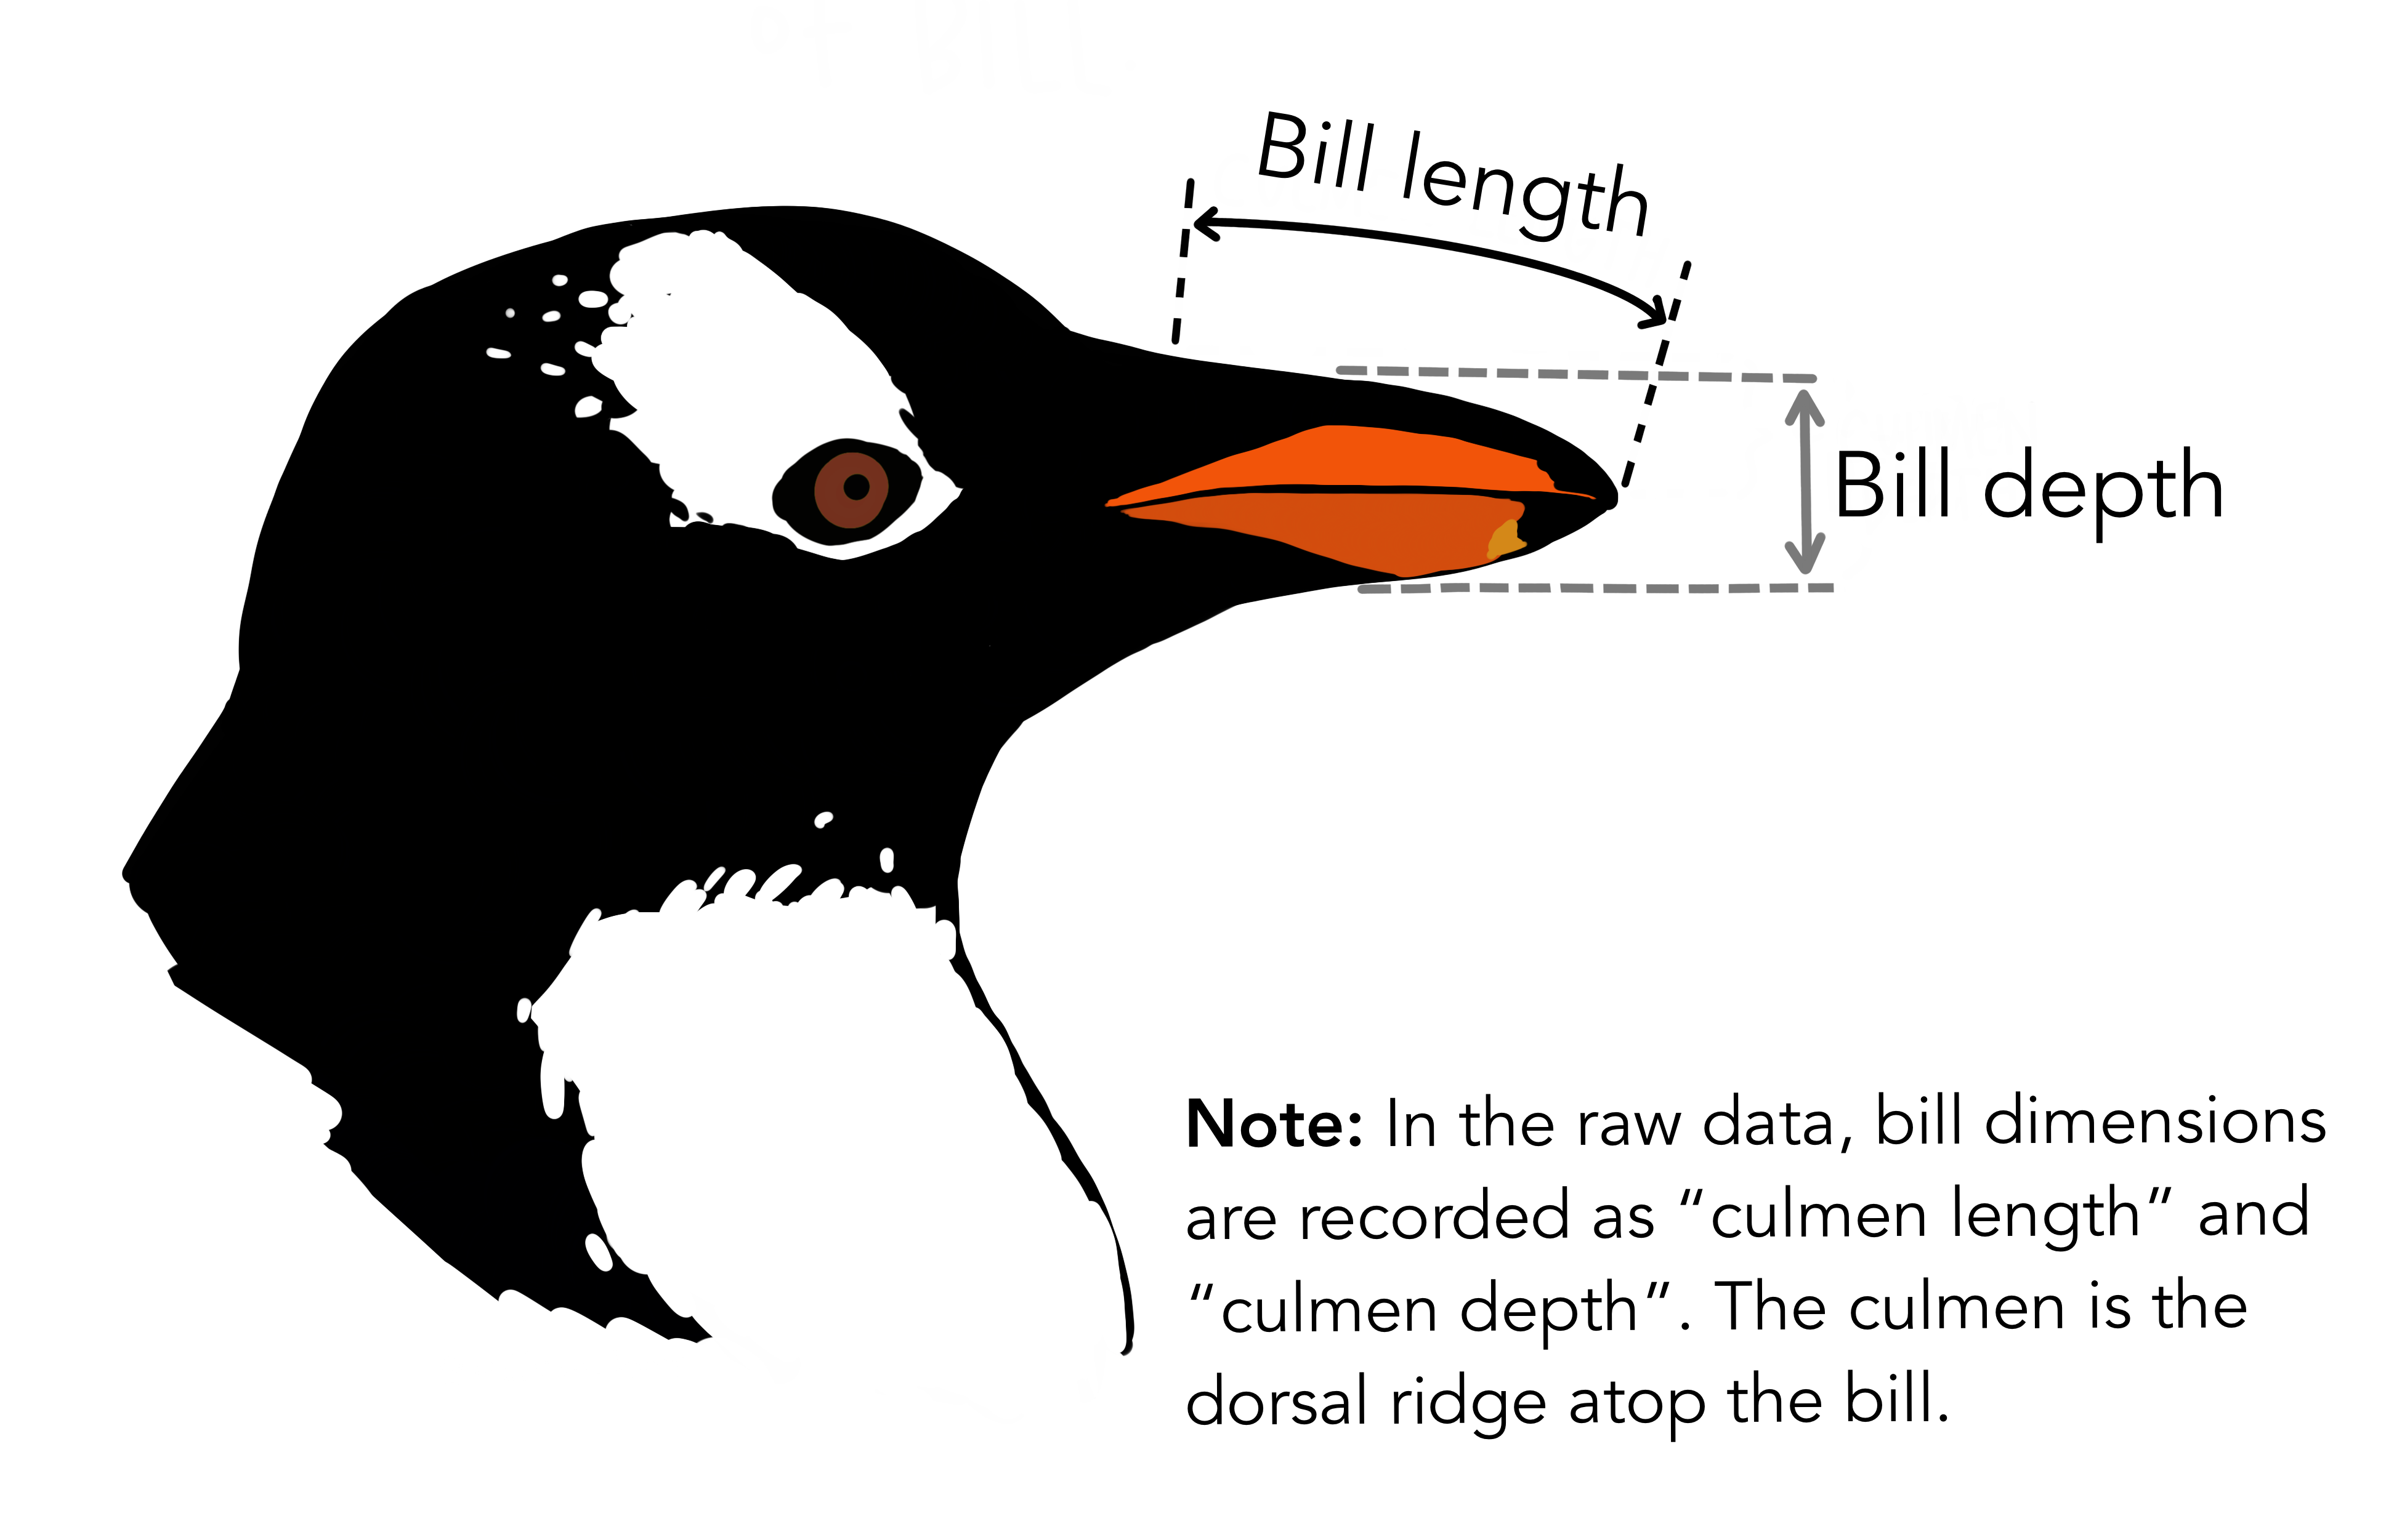
Decision Trees
When choosing a splitting value for a feature, we want the partitions to be homogeneous
Take for example the penguins dataset
We will look for a split in terms of bill depth
Adelie
Gentoo

Slide 17
Decision Trees
When choosing a splitting value for a feature, we want the partitions to be homogeneous
_{BILL DEPTH}
≤ t
> t
0.07
0.95
t = 16.7
0.93
0.05
Adelie
Gentoo

Slide 18
Decision Trees
When choosing a splitting value for a feature, we want the partitions to be homogeneous
_{BILL DEPTH}
≤ t
> t
0.07
0.95
t = 16.7
0.93
0.05
0.00
0.80
t = 15.5
1.00
0.20
Adelie
Gentoo

Slide 19
Decision Trees
When choosing a splitting value for a feature, we want the partitions to be homogeneous
_{BILL DEPTH}
≤ t
> t
0.07
0.95
t = 16.7
0.93
0.05
0.00
0.80
t = 15.5
1.00
0.20
0.47
1.00
t = 19.0
Adelie
0.53
0.00
Gentoo

Slide 20
Decision Trees
When choosing a splitting value for a feature, we want the partitions to be homogeneous
One common way of assessing the homogeneity of a set is via its entropy
For a given dataset with classes and we define:
where is the proportion of data points in of the class
This is a well known measure of disorder used in Physics, Information theory, etc.
The entropy is maximized when the probabilities for each class are the same. Why?
In the case of decision trees we would like to have splits that have minimum entropy.

Slide 21
Decision Trees
When choosing a splitting value for a feature, we want the partitions to be homogeneous
_{BILL DEPTH}
H = 0.68
≤ t
> t
0.07
0.95
H = 0.28
t = 16.7
H = 0.19
0.93
0.05
0.00
0.80
H = 0.00
t = 15.5
H = 0.51
1.00
0.20
0.47
1.00
H = 0.69
t = 19.0
H = 0.00
Adelie
0.53
0.00
Gentoo

Slide 22
Decision Trees
When choosing a splitting value for a feature, we want the partitions to be homogeneous
We can build a single criterium based on entropy called information gain
These terms ensure that the entropies are comparable
where the input argument t is the threshold value that defines how to split the dataset

Slide 23
Decision Trees

Slide 24
Decision Trees

Slide 25
Decision Trees

Slide 26

Decision Trees
The algorithm for growing a tree is therefore:
Start with dataset with N points of P dimensions and K classes
For each feature P_{i} :
For each possible split S_{j} :
Calculate each one of the K probabilities p_{k}
Calculate the entropies of each side
Get the feature P_{i} and split S_{j} that yield maximum information gain
Split the dataset according to these values
Continue recursively (stop criterium can be depth of tree, number of points in each leaf)
The algorithm complexity is
but can be improved

Slide 27
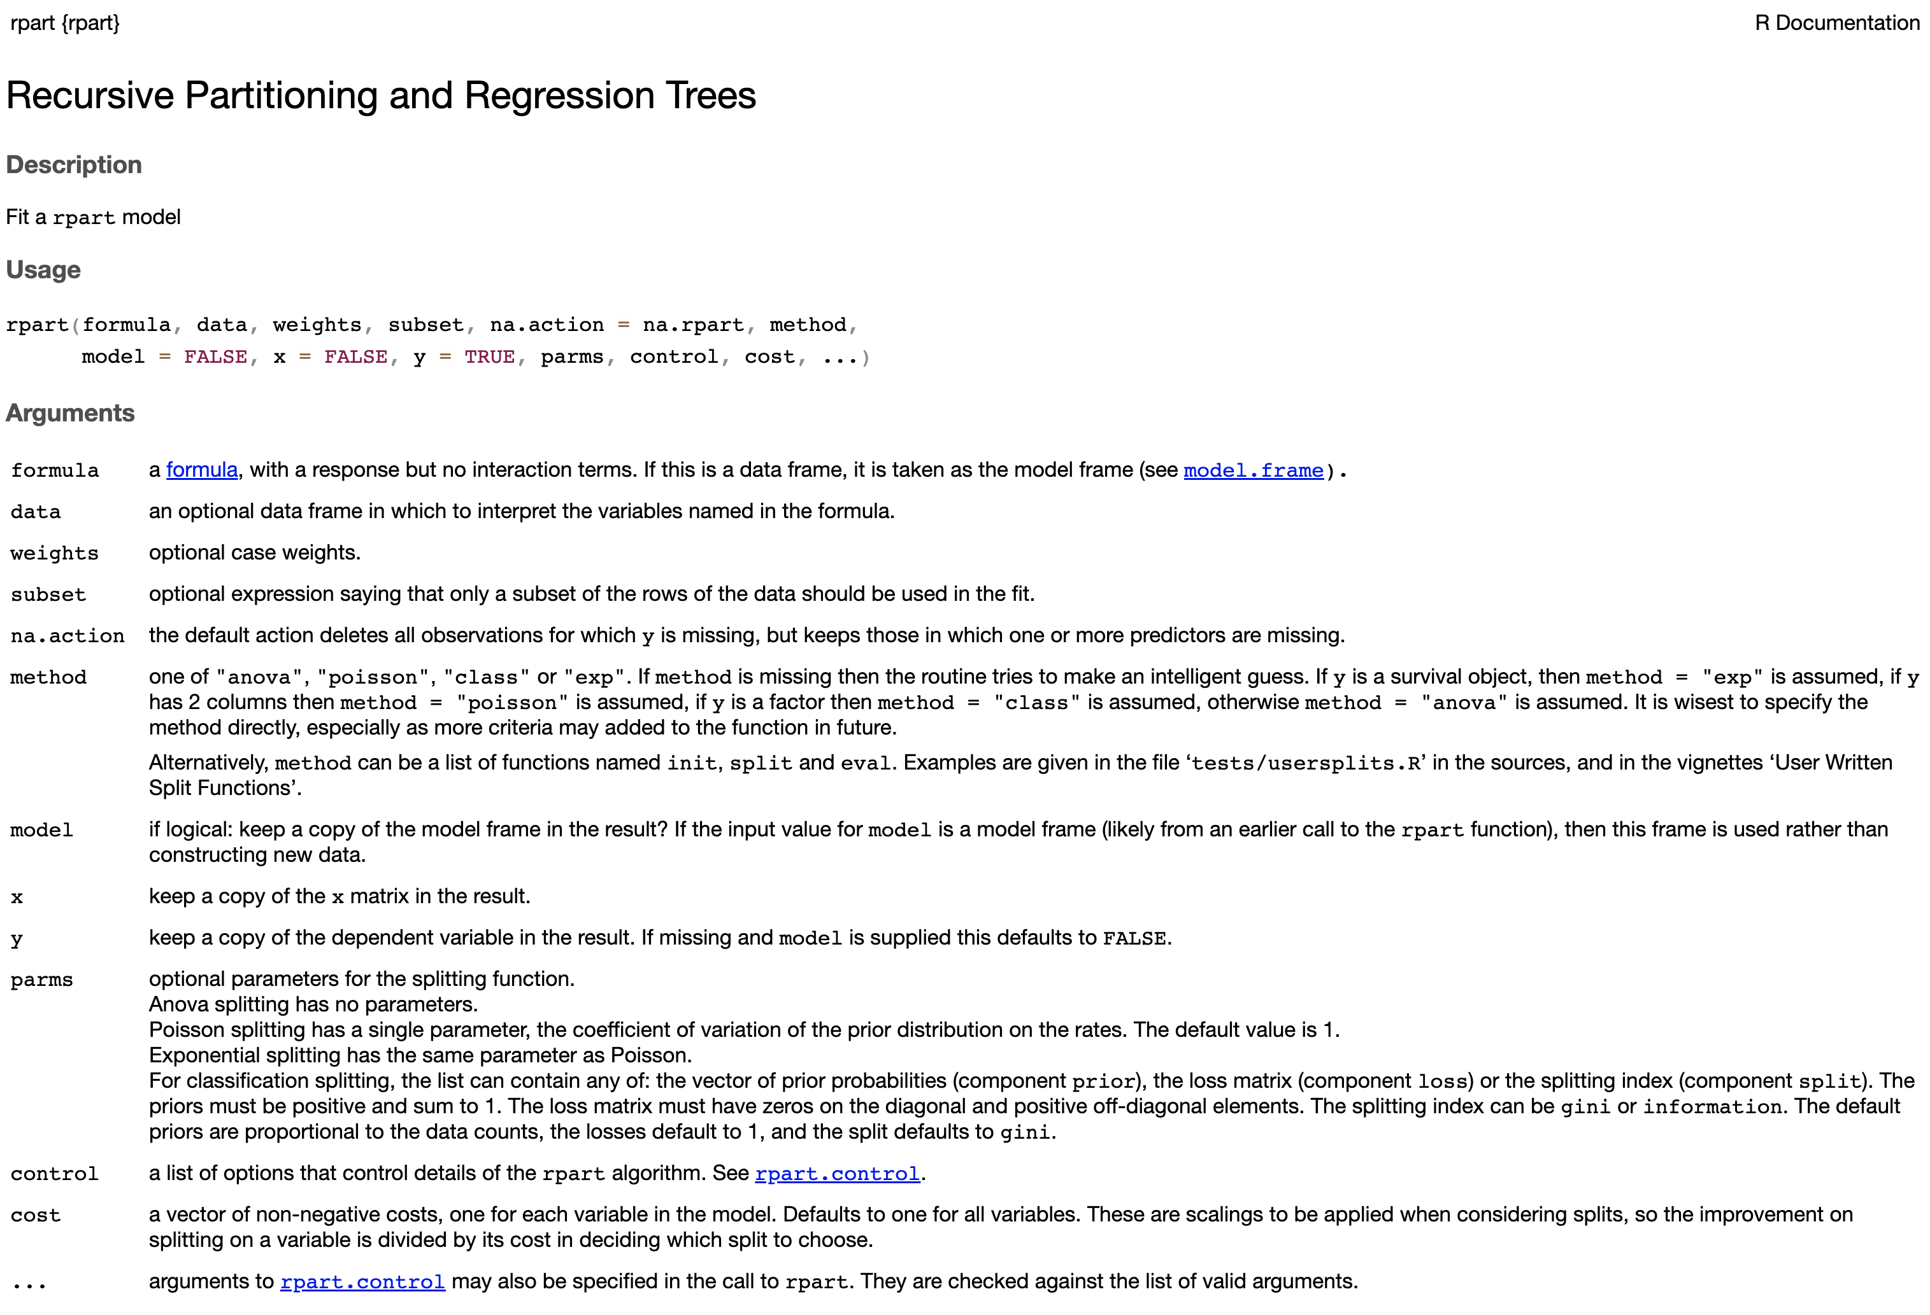
Decision Trees

Slide 28
Decision Trees
Explain the case for Regression
Show the result of a regression tree in 1D
Talk about the choice of impurity function

Slide 29
Decision Trees
How to do all this in R ?

Slide 30
Decision Trees
Talk about the drawbacks of decision trees (bias and variance)
Talk about bagging strategies and what it aims at
Give the gist of the idea of Random Forests
Show one result with it and that’s it

Slide 31

Data science competitions
Regularization techniques
Ensemble methods
Performance metrics

Slide 32
Ensemble methods
Consider the following example taken from Freund and Shapire (1999)
A horse-racing gambler wants to maximize his winnings and creates a computer program that will accurately predict the winner of a horse race based on the usual information (number of races recently won by each horse, betting odds for each horse, etc.)
To create such a program, he asks a highly successful expert gambler to explain his betting strategy. However, the expert is unable to articulate a grand set of rules for selecting a horse.
On the other hand, when presented with the data for a specific set of races, the expert has no trouble coming up with a “rule of thumb” for that set of races (such as, “Bet on the horse that has recently won the most races” or “Bet on the horse with the most favored odds”).
Although such a rule of thumb, by itself, is obviously very rough and inaccurate, it is not unreasonable to expect it to provide predictions that are at least a little bit better than random guessing. Furthermore, by repeatedly asking the expert’s opinion on different collections of races, the gambler is able to extract many rules of thumb.

Slide 33
Ensemble methods
In order to use these rules of thumb, there are two problems faced by the gambler:
First, how should he choose the collections of races presented to the expert so as to extract rules of thumb from the expert that will be the most useful?
Second, once he has collected many rules of thumb, how can they be combined into a single, highly accurate prediction rule?
The answer to these questions is of fundamental importance in machine learning and the category of algorithms that try to address them are called ensemble learning methods.
Some examples of strategies are
VOTING
STACKING
BOOSTING
BAGGING
BLENDING
Etc.
We’re going to talk about these two

Slide 34
Ensemble methods
Remember that the generalization error can be decomposed as
=
+
+
ERROR
NOISE
BIAS
VARIANCE
Ensemble methods try to reduce the values for bias and/or variance using several predictors
Different techniques will have different strategies for choosing the
In general, the predictors are trained on different versions of the training dataset
(chosen wisely but randomly)
In bagging the weights are fixed and for boosting the follow a scheduling strategy

Slide 35
Ensemble methods
Bagging stands for “Bootstrap aggregating” and it reduces the variance of the predictions
Note that we could try to reduce the variance by ensuring that
where the are IID realizations of the distribution generating the dataset
Question:
How can we do this in practice if we have a fixed training dataset?
Splitting the dataset would yield IID sub-datasets, but would not work well
(Why?)
We use bootstrap!

Slide 36
Ensemble methods
We use bootstrap! This consists of generating M datasets by sampling with replacement
datasets of the same size
=
…
=
=
The classifier will reduce the variance, but slower than IID case
(Why?)

