Slide 1
First Course: Hello World
And World Hello
Stack Overflow
XXX
20XX年X月X日

Slide 2
这里是目录(Outline)
Why we all love YanYu Zhang
The Javascript
How to retrofit an interpreter into a moving engine

Slide 3
本小结你将学到
符号列表
123

Slide 4
另一个风格主标题
副标题:仰慕张晓帅师兄

Slide 5
这是一个大标题

Slide 6

点击布局更有多种颜色可选
当然是选择原谅她

Slide 7

今天的第一节课
学习A语言
学习B语言
学习C语言

Slide 8
你好，朋友
格式——>列表——>项目符号列表
可以做到如此分级，使得幻灯片保持美观
可以点击幻灯片，更改母版来适配你的幻灯片

Slide 9
这是使用最频繁的幻灯片，每句话前的点号分级保持美观
The language of the Web
Programs are distributed as source - parsing and compiling must be fast
Untyped: variables and properties do not have types, values do
Prototype-based object model
Functional features with closures
A smattering of interesting features
eval() allows dynamic execution of runtime generated statements within a function
weird scoping rules
default values and implicit type coercion
...

Slide 10
点击布局更有多种颜色可选

Slide 11
这里是代码，使用语法高亮保持美观
function add(a, b) {
return a + b;
}
add(1, 2); // 3
add(1.2, 3.14); // 4.34
add(“hello”, “world”); // “helloworld”
add(1, true); // 2
add(“foo”, true); // “footrue”
var bar = {toString:() => “bar”}; add(“foo”, bar); // “foobar”
Integer addition
Floating point addition
String addition
Type coercion
toString() / valueOf()

Slide 12
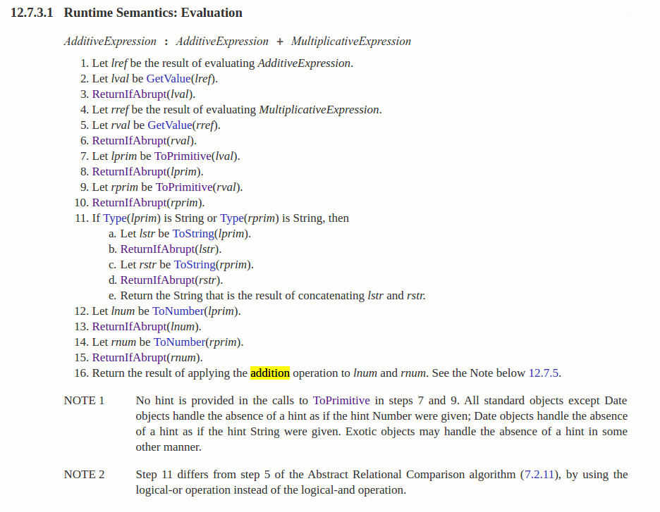
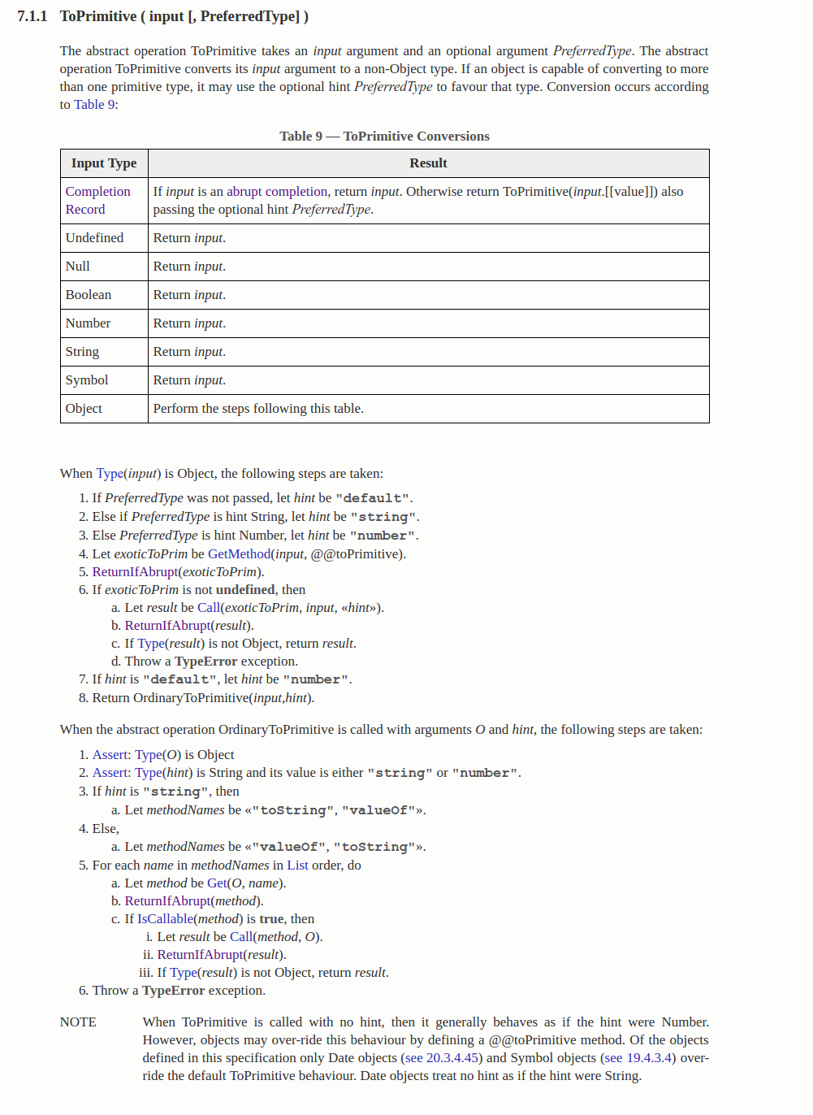
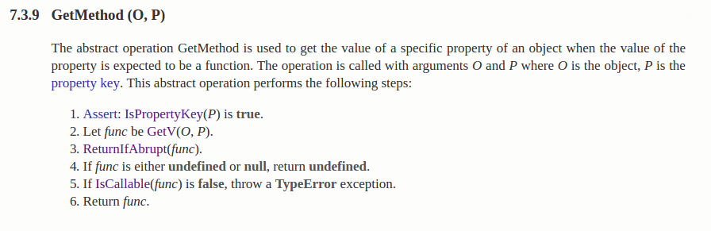
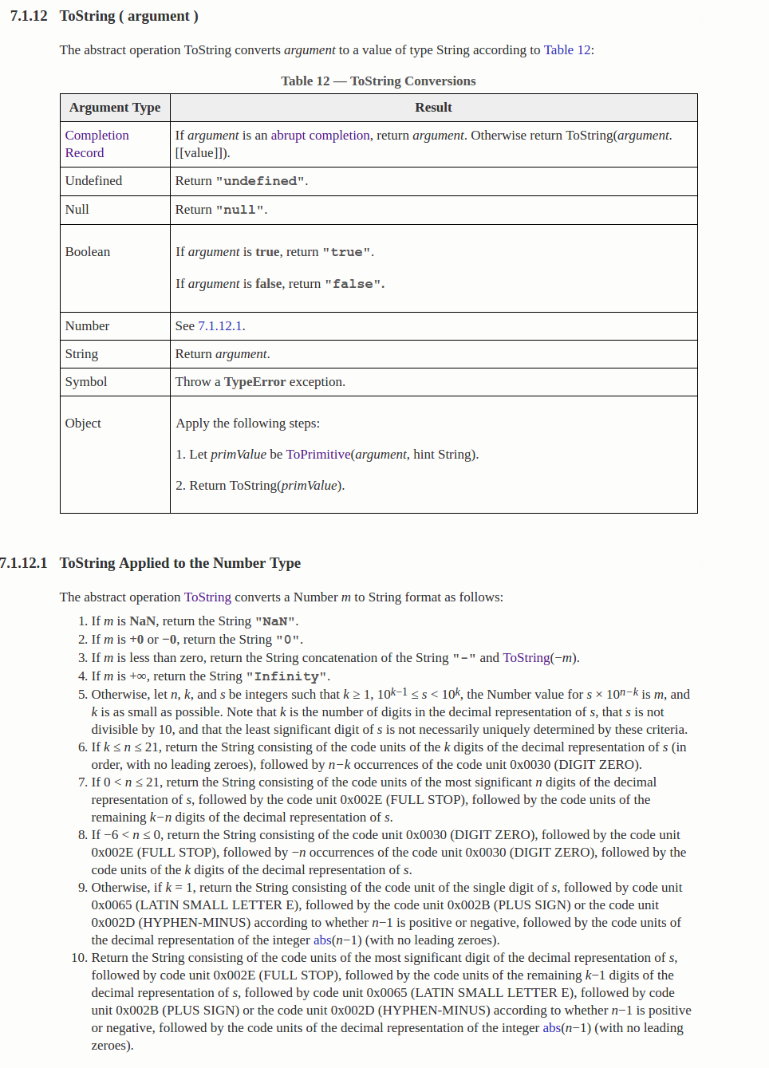
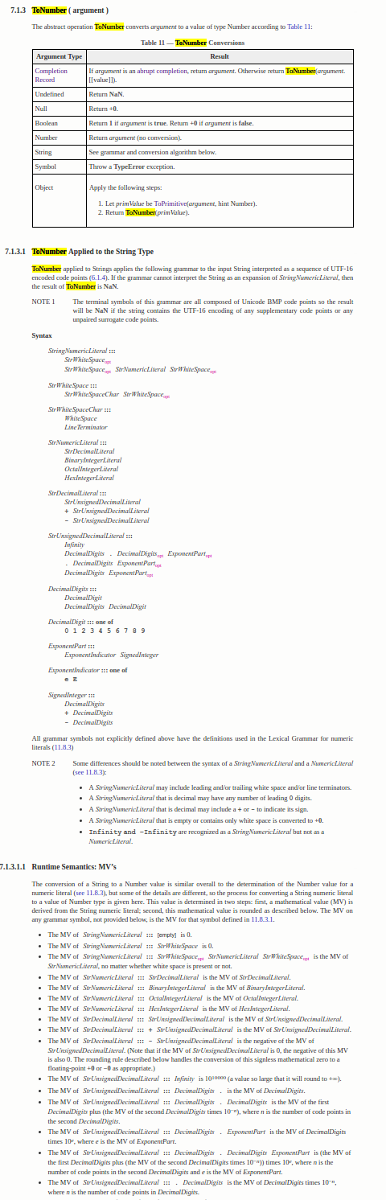
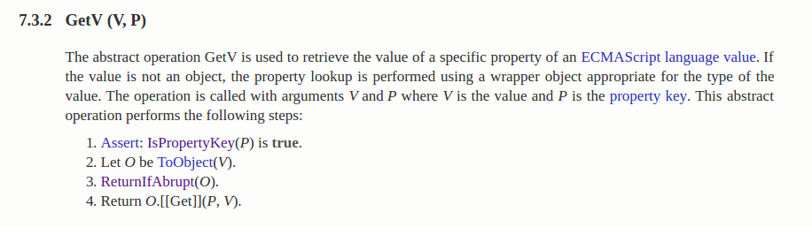
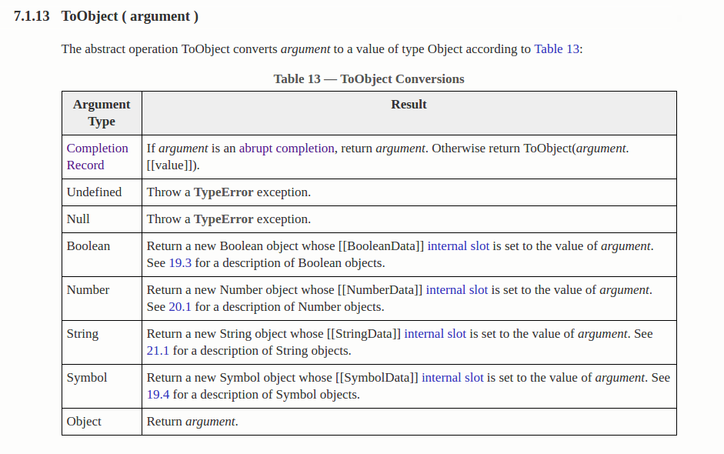
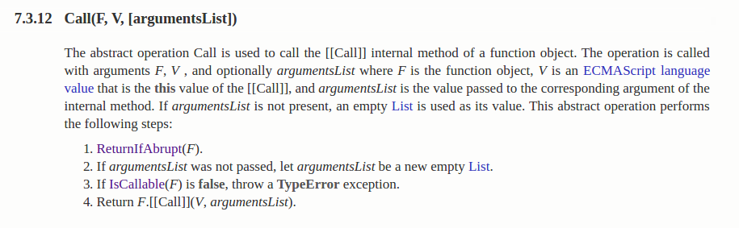
我是图
operator +
ToPrimitive
GetMethod
ToString
ToNumber
GetV
ToObject
Call
Arbitrary Javascript

Slide 13
多种颜色布局
function Person(name) {
this.name = name;
}
Person.prototype.toString = function() { return this.name; }
function Student(name, grade) {
Person.call(this, name);
this.grade = grade;
}
Student.prototype.__proto__ = Person.prototype;
var tom = new Student(“Tom”, 72);
tom.__proto__ = Object.prototype;
print(tom); // “[object Object]”
Which is completely dynamic....

Slide 14
Retrofitting an Interpreter into
a Moving Engine

Slide 15
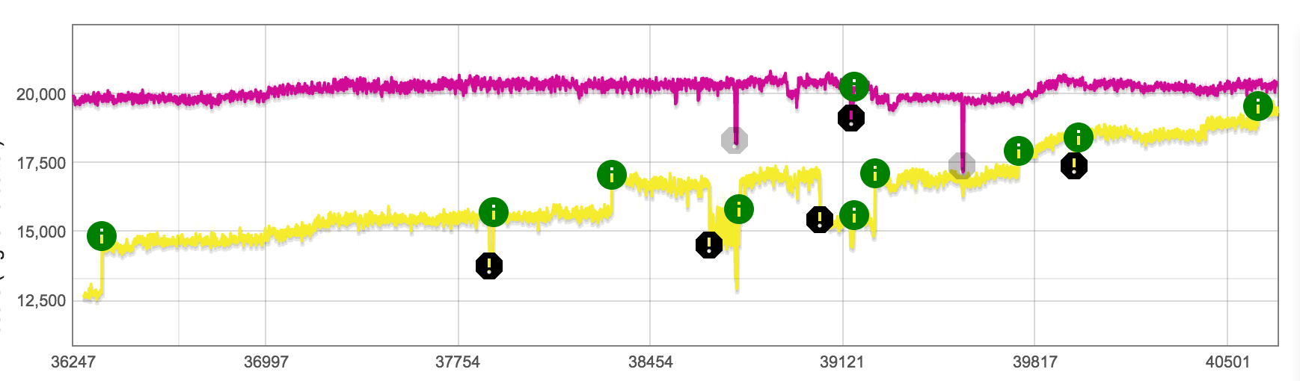
这是一个图表
Tune Tiering up
OSR
BinaryOp Feedback
Score
Octane Score (x64)
5% slower
40% slower

Slide 16
小结
JavaScript is hard
V8 is complex
An interpreter can (sometimes) beat a JIT...

Slide 17
小结
JavaScript is hard
V8 is complex
An interpreter can (sometimes) beat a JIT... but it takes a lot of work!

