Slide 1
ISM 6562
Big Data for Business
Dr. Tim Smith

Slide 2
Guiding Agenda
00-05 - Class Agenda
05-25 - Introductions
25-40 - Review syllabus
40-80 - Introduction to Analytics, Data Mining, and Big Data
Break
95-120 - Introduction to Class CM
120-130 - Get everyone on DataCamp
130-160 - Complete Assessment
160-180 - Class recap, questions, deliverables this week, and preparing for next class01

Slide 3


Meet your professor
Dr. Tim Smith
  PhD in Business Information Systems
Research Interests include technology adoption , organizational routines, health information technology, and application to deep learning models to cryptocurrency and blockchain. Coauthoring a textbook on Business Analytics (Prospect Press).
20+ years of professional experience
  Systems programmer
  Founder, and president of a software development company
  Systems Architect
  Telecom Executive
In my spare time, I like to travel, hike, fly-fish, and play guitar.

Slide 4
Introduce Yourselves
Introduce yourself to the class
Tell them your name, and one interesting thing about yourself:
  i.e., mine was that I played lead guitar in a heavy metal band

Slide 5
Course Introduction

Slide 6
ISM6562 – Big Data for Business
Review Syllabus
Review Academic Integrity Policy (Cheating)
Review Canvas and how to navigate course content

Slide 7
The Rise of Big Data

Slide 8
Learning objectives
Understand what Solow’s Paradox is/was, and how this is changing in today’s data driven world.
Understand big data, and the 6v’s
Situate Data Mining and Data Analytics within the large scope of data science.
Describe the four types of data analytics.
Describe some examples of the use of data analytics in business.

Slide 9

1987….
“You can see the computer age everywhere but in the productivity statistics“.
Robert Solow, 1987

Slide 10

Today…
Since 2002, the top 5% of companies have increased productivity by 40%, while the other 95% of companies have barely increased productivity at all.
Andy Haldane, Chief Economist for the Bank of England

Slide 11
What explains this?
Some companies have found a solution to Solow’s Paradox and are rapidly improving their productivity.
Economists continue to explore what’s behind this trend, but a few things are clear
  The Internet is increasing the rate of consolidation in many industries.
    Differentiation is even more important today!
  Effective use of data analytics and machine learning are being leveraged to improve and automate business processes and decision making.
    Clearly, some companies do a better job at this than others!
    Data, and access to information from this data is driving tremendous competition advantage and growth.

Slide 12
Data is everywhere…
2.5 quintillion bytes of data generated each day
Over the last two years, we’ve generated 90% of all the data that has ever been generated!
  We conduct more than half of our web searches from a mobile phone now.
  More than 3.7 billion humans use the internet (that’s a growth rate of 7.5 percent over 2016).
  On average, Google now processes more than 40,000 searches EVERY second (3.5 billion searches per day)!
See the infographic here (https://web-assets.domo.com/blog/wp-content/uploads/2017/07/17_domo_data-never-sleeps-5-01.png)

Slide 13
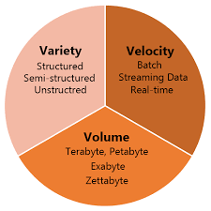
Big Data: The 3vs
Volume: This refers to the amount of data. With the advent of the internet and the rise of cell phone use and IoT, we are seeing exponential growth in data produced.
Variety: The variety of data is expanding – videos, audio, web interactions, geographic location, images, emails, etc.
Velocity: The speed of data production is increasing.
In 2022, 333.2 billion emails are sent every day.
In 2021, people created 2.5 quintillion bytes of data every day.
In 2022, users sent around 650 million Tweets per day.
In 2021, people created 2.5 quintillion bytes of data every day.

Slide 14
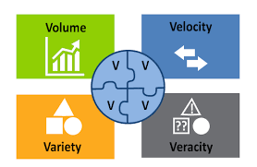
Other Systems: Big Data – 3Vs and 4Vs
Veracity: Refers to the quality of the data; where the data has been collected from, how it was collected, and how it will be analyzed.
The veracity of a users data, dictates how reliable and significant the data really is.

Slide 15
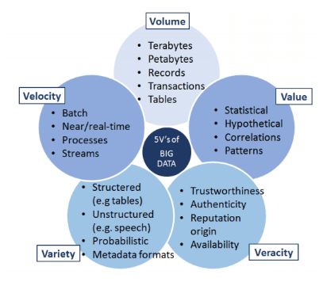
Other Systems: Big Data – 5 Vs

Slide 16
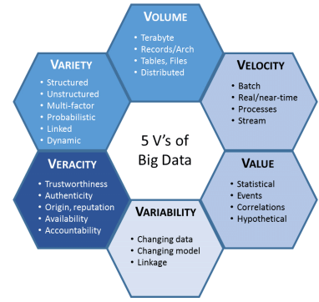
Other Systems: Big Data – 6 Vs
6 V’s of Big Data
Note: Some experts have kept adding new V’s (i.e., 17!) – but beyond 6 is probably not necessary or valuable.

Slide 17
History of Big Data
The term was coined in the 90s
  typically credited to John Mashey from Silicon Graphics
But, we have been dealing with ‘big data’ challenges since ancient times:
  300 BC: Attempt to capture all existing ‘data’ in the Alexandria library
  Roman Empire analyzed data to determine optimal distribution of their armies

Slide 18
Big Data Phase 1 | Big Data Phase 2 | Big Data Phase 3
Period: 1970-2000 | Period: 2000-2010 | Period: 2010-present
RDBMS Based structured content: RDBMS and Data Warehousing | Web-based Unstructured content: Information retrieval and extraction | Mobile and Sensor Based Content Entity-centered analysis (i.e., person)

Slide 19
From a business perspective
How do you store and process the data in a specific use-case scenario?
Will a single computer suffice?
  Can we utilize a single system, or ‘scale up’ the capacity of a single system to handle the job?

Slide 20
Vertical vs Horizontal Scaling
Big Data systems make distributing storage and processing across multiple nodes easier to accomplish
  What was extremely technically challenging and costly to do has become much easier and less costly.

Slide 21
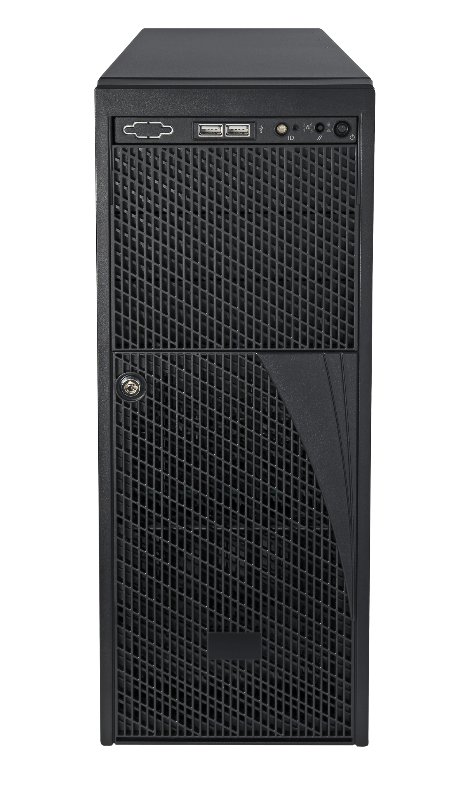
Vertical Scaling
Increase the number of CPU cores
Increase the amount of RAM
Increase the storage disk space

Slide 22
Horizontal Scaling
Increase the number of systems
Utilize systems/software technologies that distribute storage and processing across multiple computers

Slide 23

How much performance does the use case require?
Multi-Node
Performance
Single Node
Cost

Slide 24
Discussion
What’s an RDBMS?
What are they good for? What contexts are they possibly not the best solution?

Slide 25
Scaling – Incorporating Big Data Systems
Horizontal Scaling
Performance
With big data tools and technologies
Horizontal Scaling
Vertical Scaling
Modern RDBMs can scale horizontally, but not as well as big data systems.
Cost

Slide 26
Data Lakes and Data Warehouses

Slide 27
What’s a Data Lake?
A data lake is a large storage repository that holds a vast amount of raw data in its native format until it is needed. It is designed to store structured, semi-structured, and unstructured data. Data lakes are highly flexible and can handle the scale and diversity of big data, making them ideal for storing everything from text and images to log files and sensor data.
Nature of Data: A data lake stores raw, unstructured, semi-structured, and structured data. It keeps data in its native format without a defined schema.
Purpose and Flexibility: Designed for storing vast amounts of data in its raw form, a data lake is highly flexible and can accommodate data that does not fit neatly into a traditional relational database.
Processing: Data lakes allow for the storage of data with no immediate purpose, providing a playground for discovery, profiling, and analytics. The processing (transforming and structuring) of data happens at the time of analysis.
Users: Typically, data scientists and analysts use data lakes because they require access to raw data for advanced analytics, machine learning models, and data discovery tasks.
Technology: Often built on Hadoop (HDFS), but also on cloud-based storage like Amazon S3 or Azure Data Lake Storage.

Slide 28
What’s a Data Lake?
A data warehouse, in contrast, is a system used for reporting and analyzing structured data. It is optimized for SQL queries and is structured in a way that makes it easy to produce actionable insights. Data warehouses store processed and refined data and are typically used for generating reports and performing analysis that drives business decisions.
Nature of Data: A data warehouse stores structured, processed data. Data is cleaned, enriched, transformed, and loaded into a defined schema (often a star or snowflake schema).
Purpose and Efficiency: Primarily used for reporting and analysis. Data warehouses are optimized for fast query performance, making them ideal for business intelligence and decision-making processes.
Processing: Data in a warehouse is processed before it is stored. This means it's ready for analysis and reporting by the time it reaches the warehouse.
Users: Business professionals, managers, and data analysts commonly use data warehouses for routine business queries, reporting, and dashboarding.
Technology: Traditional databases like IBM DB2, Oracle Database, or cloud-based solutions like Amazon Redshift, Google BigQuery, and Snowflake.

Slide 29
Moving Data from a Lake to a Warehouse
Moving data from a data lake to a data warehouse involves identifying the relevant data, transforming it into a structured format, and then loading it into the warehouse. This process turns raw, unstructured data into valuable insights that can drive informed business decisions.
The process of moving data from a data lake to a data warehouse involves several key steps:
  Data Identification and Extraction: Data stored in a data lake is raw and unstructured. The first step is identifying the relevant data needed for specific analytical purposes.
  Data Transformation: This identified data is then processed and transformed. This step, often referred to as ETL (Extract, Transform, Load) or ELT (Extract, Load, Transform), involves cleaning the data, converting it into a structured format, and applying any business logic or rules necessary for the analysis.
  Data Loading: Once the data is transformed into a structured format, it is loaded into the data warehouse. This data now adheres to a schema that makes it suitable for efficient querying and analysis.
  Integration Tools and Technologies: Tools like Apache Spark, Talend, or Informatica are often used in this process. They help in the transformation of data and facilitate the efficient transfer of processed data from the data lake to the data warehouse.
  Use of Intermediate Staging Areas: Sometimes, an intermediate staging area is used, where data is temporarily held and further refined before being loaded into the warehouse.
  Regular Updates: The process is often automated to regularly update the data warehouse with fresh data from the data lake, ensuring that the warehouse contains the most current and relevant data for analysis.

Slide 30
DataCamp

Slide 31
Data Camp
Accept invitation and create account using USF email

Slide 32
Summary

Slide 33
Summary
We have reviewed the syllabus, canvas, and DataCamp.
You are now subscribed to DataCamp and can begin working on the assigned courses.
You understand some of the challenges of big data analytics
You know the 3+ V’s of big data
You understand the benefits and costs of vertical versus horizontal scaling

Slide 34
Next Week
Setup development environment.
Review development environment navigation and tools for this class.
Create your GitHub repo
We will write our first programs for this class
Focus your week on complete assigned courses

Slide 35
Assigned Courses:
Work on the assigned courses in the following sequence:
  By Feb 11th, 11:59pm:
    Introduction to Shell (DataCamp): <3hrs
    Git Essential Training (LinkedIn Learning): <2hrs
    Learning Docker (LinkedIn Learning): <2hrs
  By Feb 18th, 11:59pm:
    Introduction to SQL (DataCamp): <2hrs
    Intermediate SQL (DataCamp): <3hrs
    Creating Postgres Databases: <4hrs

Slide 36
Happy Learning!

