Slide 1
MapReduce

Slide 2
STDIN,STDOUT,STDERR
STDIN(Standard Input): Receives input data from programs, default is keyboard input.
STDOUT(Standard Output): Where programs output data default is terminal display.
STDERR(Standard Error): Dedicated stream for error message, separate from STDOUT.
Pipes( | ): Directly feed the output of one program as the input to another, facilitating the chaining of commands.

Slide 3
Understanding chmod and file permissions in UNIX
Purpose of chmod: Changes the access permissions of files and directories.
Permission Types:
Read (r): Permission to read the file or directory contents.
Write (w): Permission to modify (or delete) the file or directory.
Execute (x): Permission to execute a file or search a directory.
Numeric Permission Representation:
Each permission is represented by a numeric value: read=4, write=2, execute=1.
Permissions are summed up for each category (owner, group, others) to form a 3-digit number (e.g., 755).
Common chmod Settings:
chmod 644: Standard file permission (read/write for owner, read-only for others).
chmod 755: Standard permission for executables or directories (full for owner, read/execute for others).
chmod 777: Open permissions (read/write/execute for everyone), used cautiously.

Slide 4
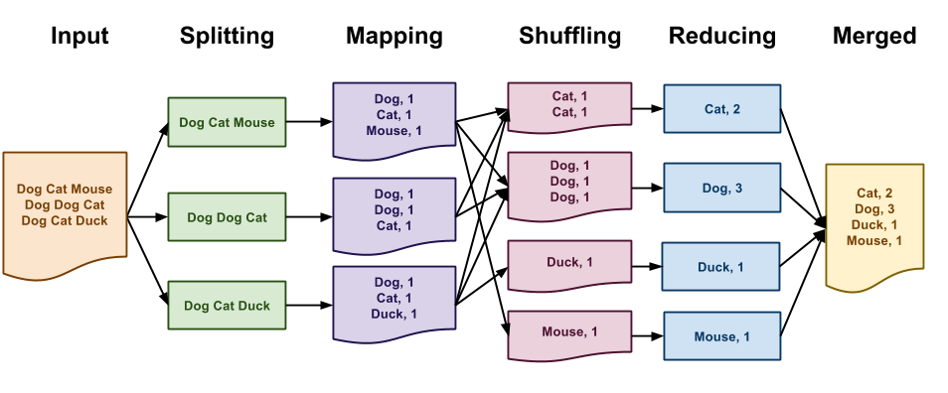
Flow of MapReduce

