Slide 1
ISM6562 – Big Data for Business Applications
C07: Map reduce

Slide 2
Agenda
This week, you will work through the material in Module 2, Mapreduce distributed programming.
This class will focus on the creation of a mapreduce program using Python.

Slide 3
Stdin, stdout, stderr
First, we need to understand something about streaming data in unix based system.
Any program in unix (i.e. Linux) has access to any data that may be been streamed into it. This is accessed through what is called stdin.
Any program that outputs data via print, is sending this data to stdout.
When your program generates system errors when run, it sends output to a third stream called stderr.

Slide 4
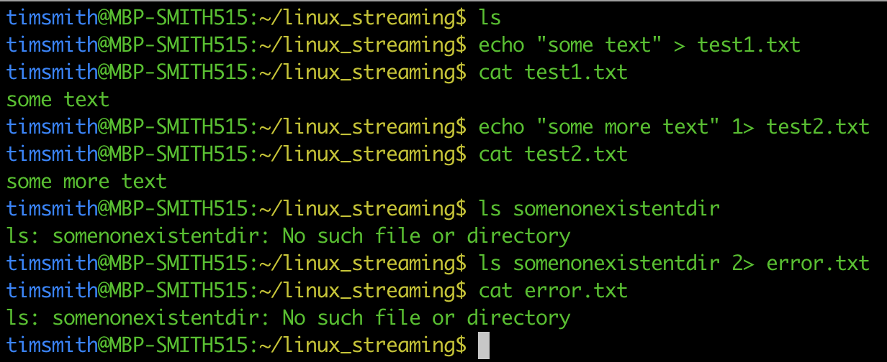
We can redirect STDOUT and STDERROR to files:

Slide 5
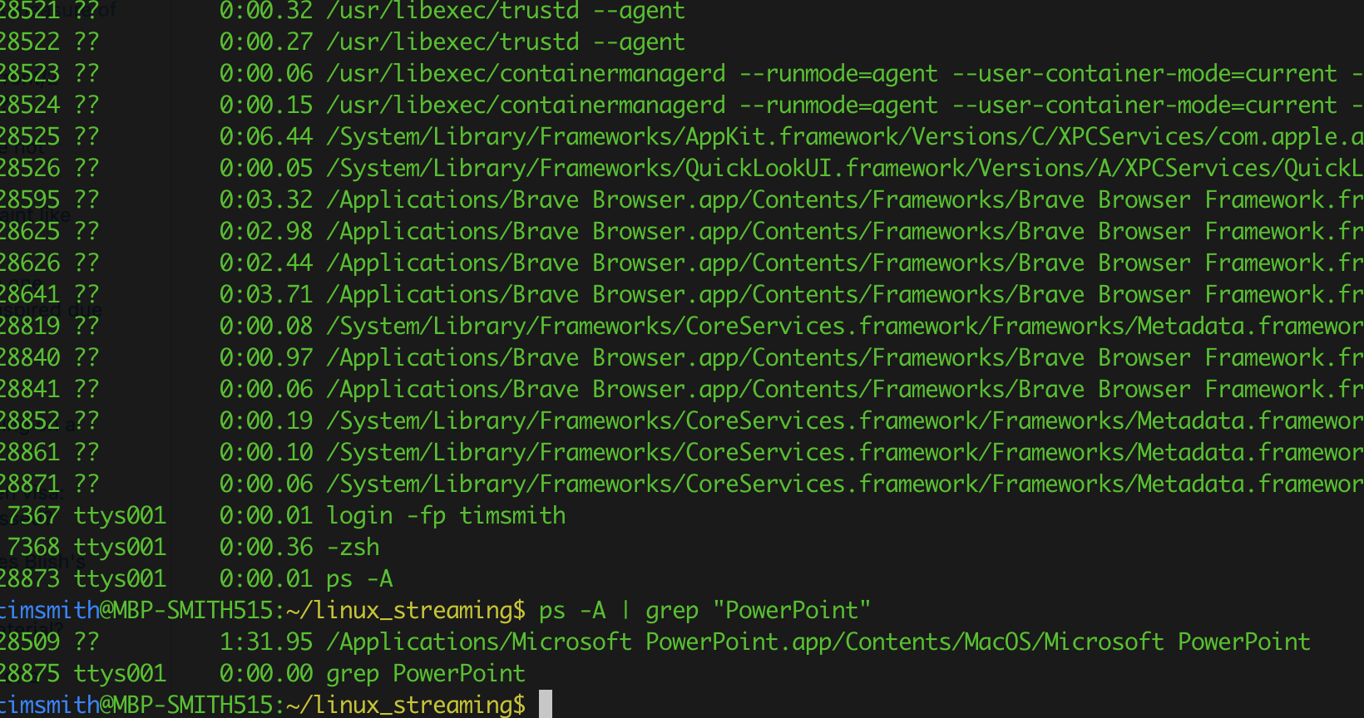
Or, we can pipe STDOUT from one program to STDIN of another:

Slide 6
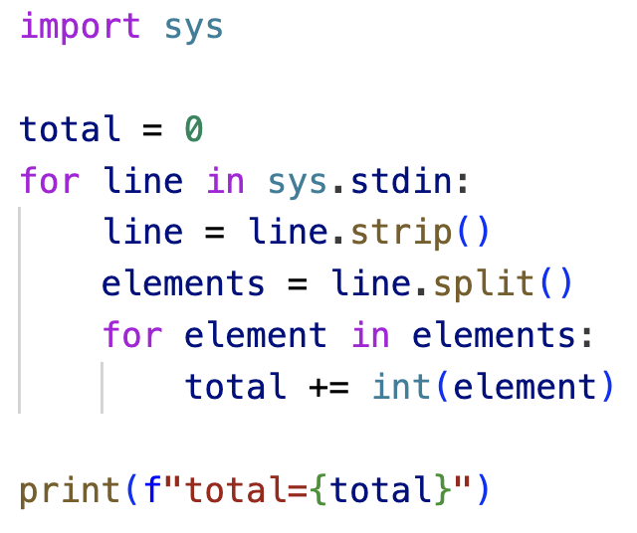
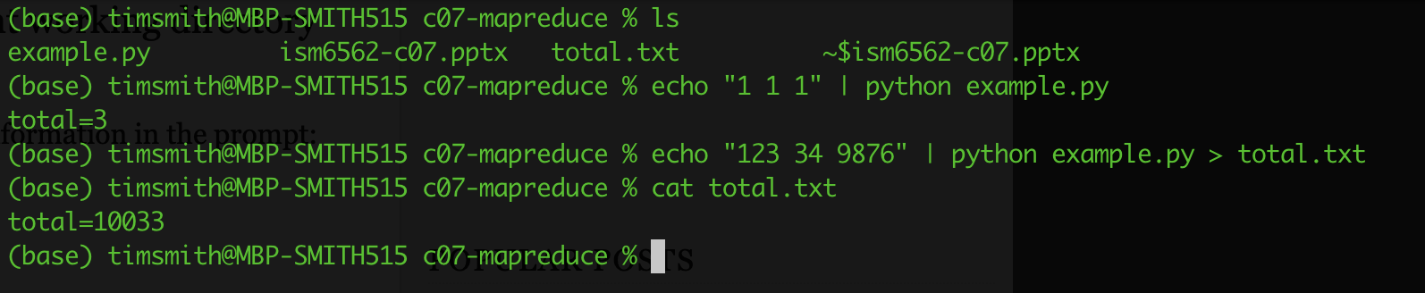
Writing a python program that reads STDIN

Slide 7
Hadoop Streaming
Input file being processed is stored in hdfs; therefore split into blocks and distributed across multiple nodes
Input
Mapper Stream
Reducer Stream
Output
Input
Sort by keys
Output
Input
Output
Input
Output
Input
<key,value> pairs sorted
<key,value> pairs aggregated
Output
Lines of text
<key,value> pairs
STDIN
STDOUT
STDIN
STDOUT
mapper.py
reducer.py
mapper.py
reducer.py
Mapper.py is run on each node and processes the hdfs file blocks for that local node
mapper.py
mapper.py
reducer.py
mapper.py
reducer.py
mapper.py
reducer.py

Slide 8
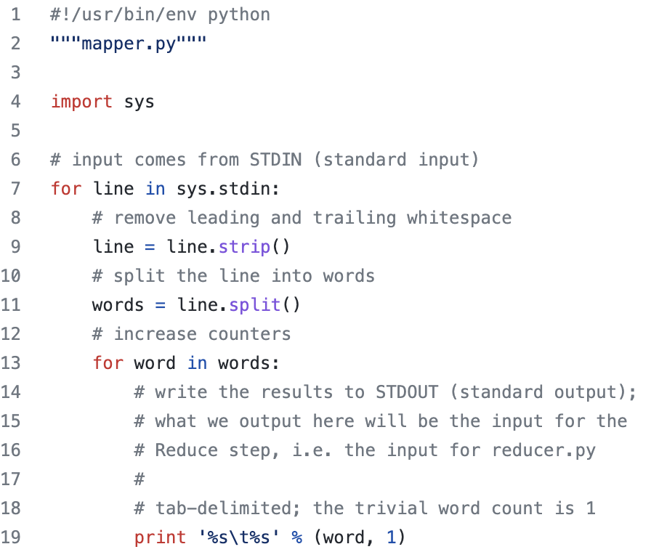
Mapper.py

Slide 9
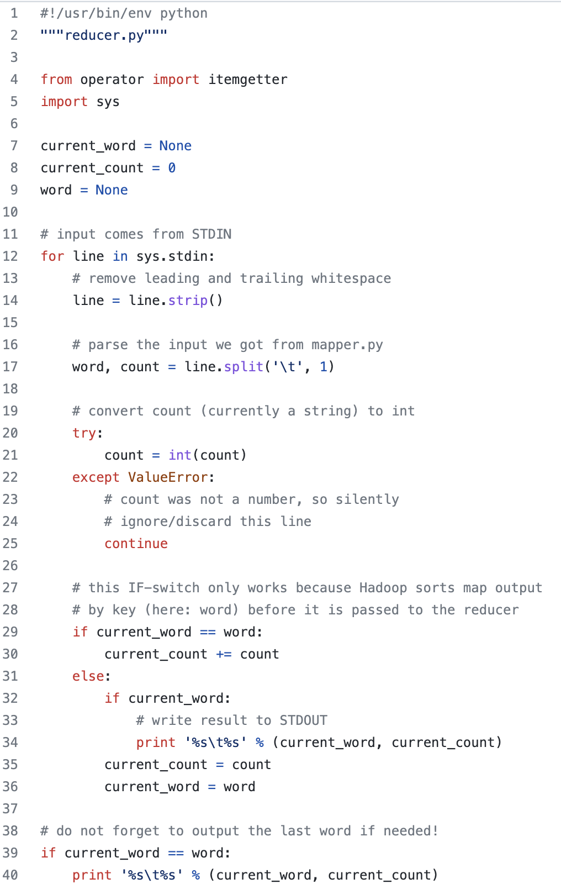
reducer.py

Slide 10
Steps
Create your mapper.py and reducers.py on your local machine
Load your input file into the hdfs
hdfs dfs –copyFromLocal somefile.txt /user/cloudera/somefile.txt
Run the Hadoop-streamer
See next slide
Investigate results
These will be found on your hdfs file location as set in step #3

Slide 11
Running Hadoop streamer

Slide 12
Weekly Programming Exercise
Create a test.txt file that contains multiple lines of integers separated by a space. Write a mapreduce job using python that calculates the total of all the integers found in the file.
For example…
123 24 34 45
34 1 34 55 65
23 2 3 4 2 87
Etc.

Slide 13
This week
Work through the videos (take notes!).
Complete the programming exercise.
Prepare for next week’s in-class quiz.
Propose team members for the final project:
To propose a team, you MUST have 3 to 4 members.
You need to email me your proposed team by 11:59 pm April 2nd.
Anyone not on a proposed team will be randomly partitioned into teams.
I will review the team rosters and project details during next week’s class.

