Slide 1
ISM 6136
Big Data
Dr. Tim Smith

Slide 2
Agenda
Quickly revisit MapReduce and HDFS
Introduce Hive
Demonstrate Hive using our Cloudera Container
Introduce Spark
Discuss final project

Slide 3
MapRedcue and HDFS

Slide 4
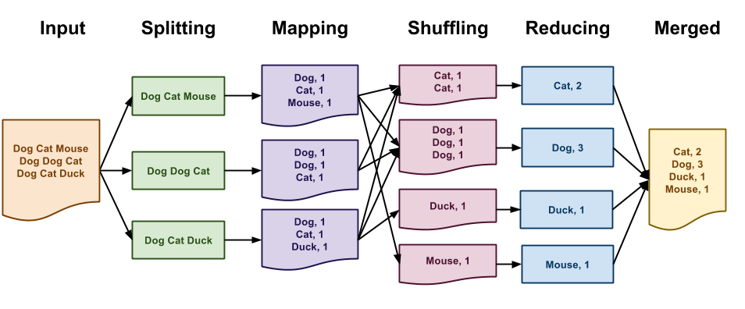
Flow of a MapReduce Job

Slide 5
stdout, stdin, stderr
Any program in Unix (e.g., Linux) has access to any data that may be streamed into it. This data is accessed through what is called stdin.
Any program that outputs data via print, is sending this data to stdout.
When your program generates system errors when run, it sends output to a third stream called stderr.
Hadoop streaming uses this to communicate/transfer data with mappers and reducers.
This allows us to use Languages other than Java to create MR jobs

Slide 6
Hadoop Streaming
Output is stored in hdfs; as often output can also be ‘big data’
Input file being processed is stored in hdfs; therefore split into blocks and distributed across multiple nodes
Input
Mapper Stream
Reducer Stream
Output
Input
Sort by keys
Input
Input
Input
Input
Input
Input
<key,value> pairs sorted
<key,value> pairs aggregated
Input
Lines of text
<key,value> pairs
STDIN
STDOUT
STDIN
STDOUT
mapper.py
reduce.py
mapper.py
mapper.py
mapper.py
Mapper.py is run on each node and processes the hdfs file blocks for that local node
mapper.py
Reducer.py is run on multiple nodes in the Hadoop Cluster
mapper.py
mapper.py
mapper.py
mapper.py
mapper.py
mapper.py

Slide 7
Mapper
Reducer
#!/usr/bin/env python
import sys
for line in sys.stdin:
line = line.strip()
line = line.lower()
words = line.split()
for word in words:
if len(word) == 0:
print '%s\t%s' % ("UNKOWN", 1)
else:
print '%s\t%s' % (word, 1)
#!/usr/bin/env python
import sys
current_word = None
current_count = 0
word = None
for line in sys.stdin:
line = line.strip()
word, count = line.split('\t')
count = int(count)
if current_word != word and current_word != None:
print '%s\t%s' % (current_word, current_count)
current_count = 0
current_word = word
current_count += count
print '%s\t%s' % (current_word, current_count)

Slide 8
Running a MapReduce job
#!/usr/bin/env bash
mkdir /mapreduce
chmod 777 /mapreduce
cp mapper.py /mapreduce
cp reducer.py /mapreduce
hdfs dfs -mkdir /mapreduce
hdfs dfs -copyFromLocal test.txt /mapreduce
cd /mapreduce
/usr/bin/hadoop jar /usr/lib/hadoop-mapreduce/hadoop-streaming.jar \
-files mapper.py,reducer.py \
-input /mapreduce/test.txt \
-output /mapreduce/output01 \
-mapper mapper.py \
-reducer reducer.py

Slide 9

Supplemental: Permissions in Unix (and HDFS)
Filesystem Objects in Linux and HDFS have Permissions:
Permission Types:
Read (r): Permission to read the file or directory contents.
Write (w): Permission to modify (or delete) the file or directory.
Execute (x): Permission to execute a file or search a directory.
Purpose of chmod: Changes the access permissions of files and directories.
Numeric Permission Representation:
Each permission is represented by a numeric value: read=4, write=2, execute=1.
Permissions are summed up for each category (owner, group, others) to form a 3-digit number (e.g., 755).
Common chmod Settings:
chmod 644: Standard file permission (read/write for owner, read-only for others).
chmod 755: Standard permission for executables or directories (full for owner, read/execute for others).
chmod 777: Open permissions (read/write/execute for everyone), used cautiously.

Slide 10
Summary
MapReduce allows for the processing (not just storing) of very large datasets.
It requires very specialized skillsets that can be difficult to acquire.
Other solutions have emerged to provide an abstraction over MapReduce to allow non-programmers to work with MapReduce

Slide 11
Introduction to Hive

Slide 12
Recall: MapReduce
MapReduce provides distributed computing of large datasets.
It’s robust, works well, and can process enormous datasets
But, it requires very specialized skills and significant development time

Slide 13
Hive
Hive provides a traditional Data Warehouse interface for MapReduce programming.
With Hive you can write SQL queries to process the data, and the Hive compiler will convert these queries into MapReduce jobs that can be run on a Hadoop cluster.
Hive allows users to read, write, and manage petabytes of data using SQL.
A hive data warehouse provides a central store of information that can easily be analyzed to make informed, data driven decisions.

Slide 14
Hive
Created by Facebook
Launched as an Apache project in 2012
Hive was created to allow non-programmers familiar with with petabytes of data.
RDBMS’s are designed for interactive queries on small to medium datasets and (as we have seen) do not process huge datasets well.
Hive uses batch processing to work quickly across very large distributed databases.
It queries data stored in Hadoop Distributed File Systems.

Slide 15
Application and Uses
Hive is primarily used for:
Batch processing
Large scale ETL (Extract, Transform, Load) jobs
data warehousing tasks with an emphasis on analytics, reports, and Business Intelligence (BI).
Typical usage scenarios include:
Log processing and analysis
Data warehousing optimization
Large-scale machine learning
Multi-dimensional analysis

Slide 16
Limitations
While Hive is powerful for data warehousing tasks, it is not suited for real-time queries and transaction processing.
The latency is generally high due to its reliance on MapReduce, which makes it less ideal for operational databases that require quick response times.
HiveQL does not fully support all SQL features, such as complex subqueries and full joins, which might be a limitation for users requiring complete SQL compliance.

Slide 17
Hive/Cassandra
Hive is built on Hadoop MapReduce
Hadoop MapReduce excels at batch oriented analytical solutions
Cassandra has taken a different path than Hadoop
Cassandra excels at high-volume real-time transaction processing
You can find both being used:
Hive/Hadoop as a data warehouse
Cassandra as a real-time transaction processing support engine

Slide 18
Where Hive Excels Over Cassandra
Complex Queries: Hive is better suited for complex queries that require aggregations, joins, and analytical functions over large datasets. It uses Hadoop as its execution engine for these operations, making it powerful for deep data analysis.
Integration with Hadoop Ecosystem: Hive works seamlessly with other technologies in the Hadoop ecosystem, including Pig, Mahout, and others, which are often used together in big data processing pipelines.
SQL Interface: Hive provides an SQL-like interface to Hadoop, which is familiar to those with a background in traditional relational databases. This makes it easier to adopt in environments where teams already have SQL skills.
Batch Processing: Hive is optimized for batch processing, making it suitable for scenarios where data can be accumulated and processed periodically rather than needing real-time analysis.

Slide 19
Where Cassandra Excel Over Hive
Write Throughput: Cassandra offers superior write throughput with low latency, making it ideal for write-intensive applications such as real-time data collection systems.
Scalability and Availability: Cassandra’s masterless architecture allows it to scale horizontally easily and efficiently. It is designed to handle large amounts of data spread across many commodity servers without a single point of failure.
Replication and Multi-Datacenter Distribution: Cassandra provides more robust and flexible options for data replication and distribution across multiple data centers, which is critical for high availability and disaster recovery.
Operational Simplicity: Cassandra’s masterless design simplifies the operational complexity. Adding more nodes to a cluster is straightforward, without needing to reconfigure or rebalance data manually.

Slide 20

Hadoop Ecosystem
Source: https://tunetotech.com/Post.aspx?post=7

Slide 21
Hue and Hive
Let’s demonstrate the use of these tools in our Cloudera container…
NOTE: We will use data found in a repo located here: https://github.com/prof-tcsmith/data

Slide 22
Introduction to Spark

Slide 23
History
Spark was developed by the UC Berkeley
Matei Zaharai PhD Thesis 2009
DataBricks, co-founded by Matei in 2013
You can use on-prem or cloud (DataBricks, Azure, AWS, etc.)

Slide 24
Spark
Spark SQL
Spark Streaming
Spark ML
Graphx
Spark Unifies
Batch Processing
Real-time Processing
Stream Analytics
Machine Learning
Interactive SQL
Spark Core Engine
YARN
Mesos
Standalone
Kubernetes

Slide 25
What is Spark
Distributed computing framework very similar to Hadoop Map-Reduce
In Hadoop, we store data using hdfs
In Spark, data is stored as RDDs (Resilient Data Structures)
Early versions of spark were essentially a collection of API’s to process RDDs.
Later, the DataFrame API was released as an abstraction on top of RDD

Slide 26
What is an RDD?
An immutable distributed collection of elements
Distributed across nodes in a cluster
Can be operated on in parallel using transformations and actions
Spark uses its own map-reduce framework to distribute computation across multiple nodes.

Slide 27
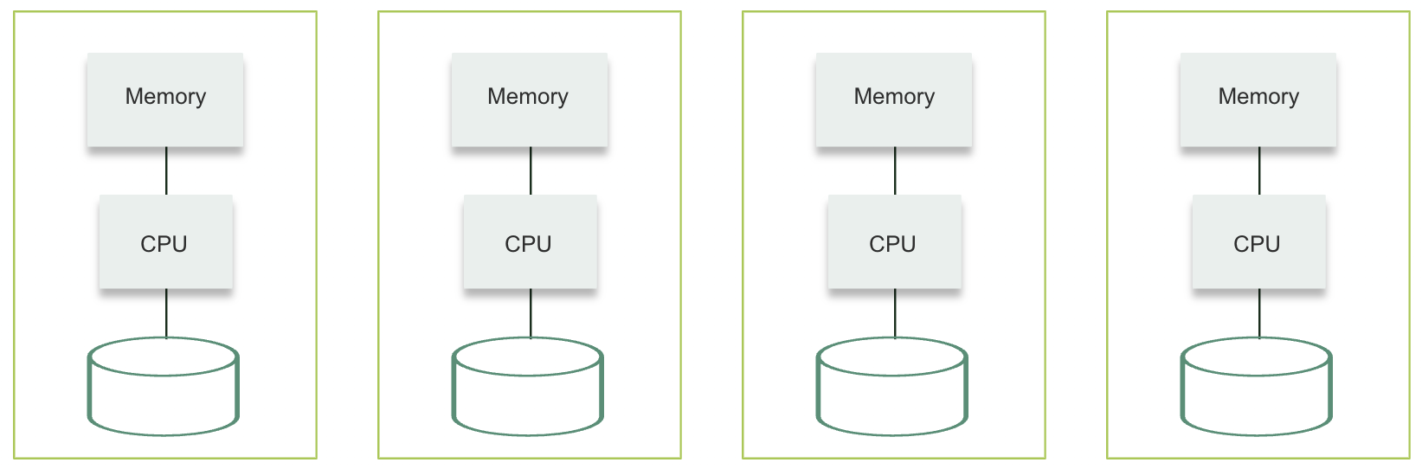
Spark Architecture

Slide 28
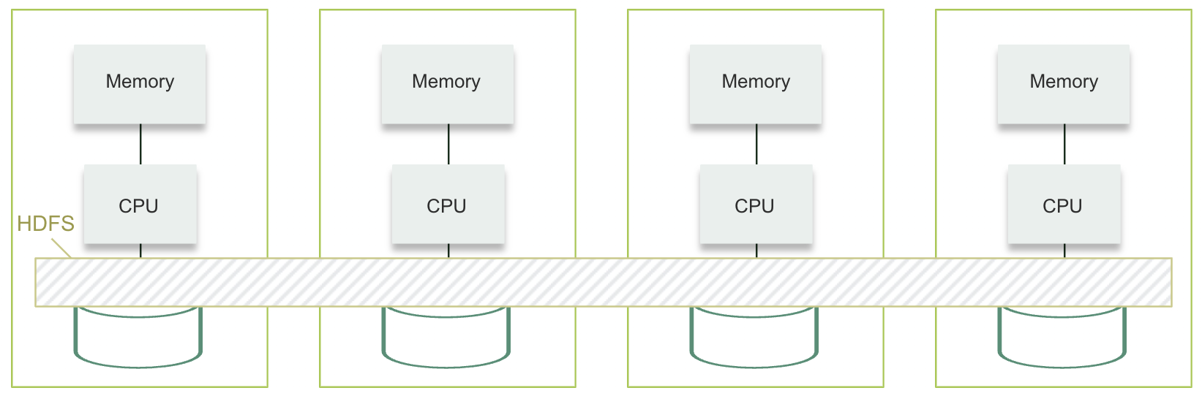
Spark Architecture

Slide 29
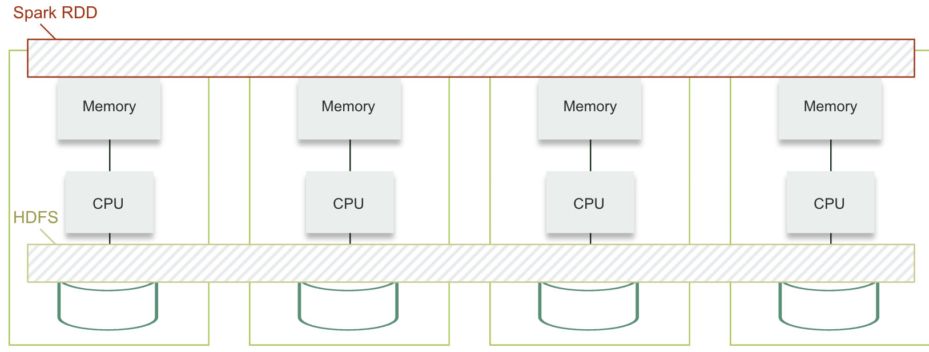
Spark Architecture

Slide 30
Spark RDD
Distributed memory on top of physical memory split across multiple machines
Collections (such as array, map, list) stored in RDD can be equally accessed from any machine
Allows you to store arrays/maps/lists that may cross the boundary of physical memory on one machine

Slide 31
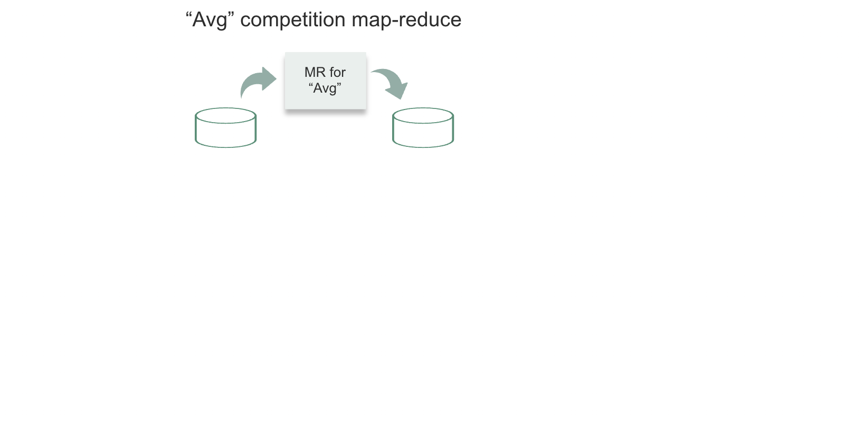
Spark vs. HDFS

Slide 32
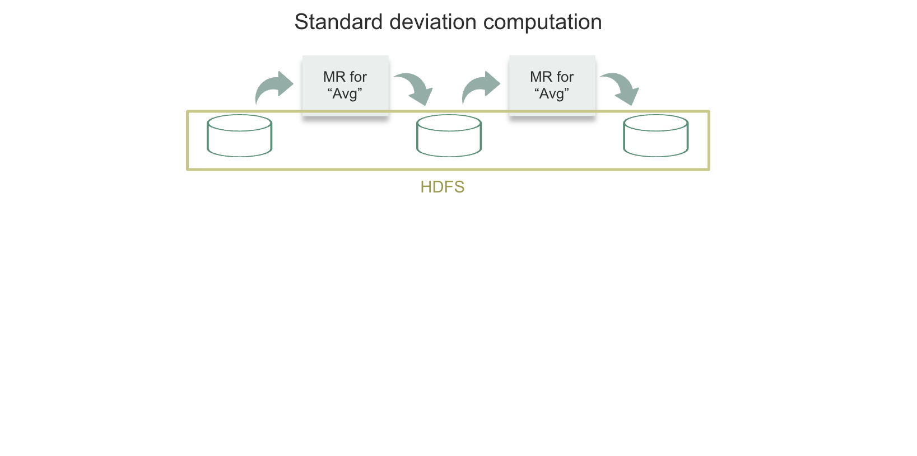
Spark vs. HDFS

Slide 33
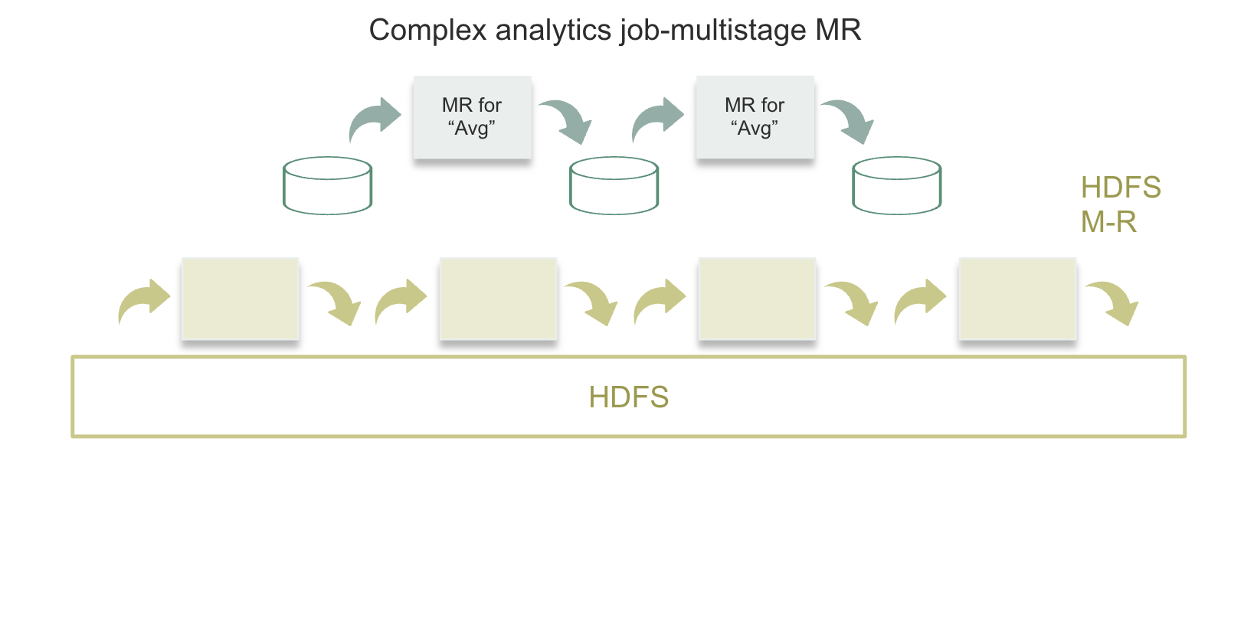
Spark vs. HDFS

Slide 34
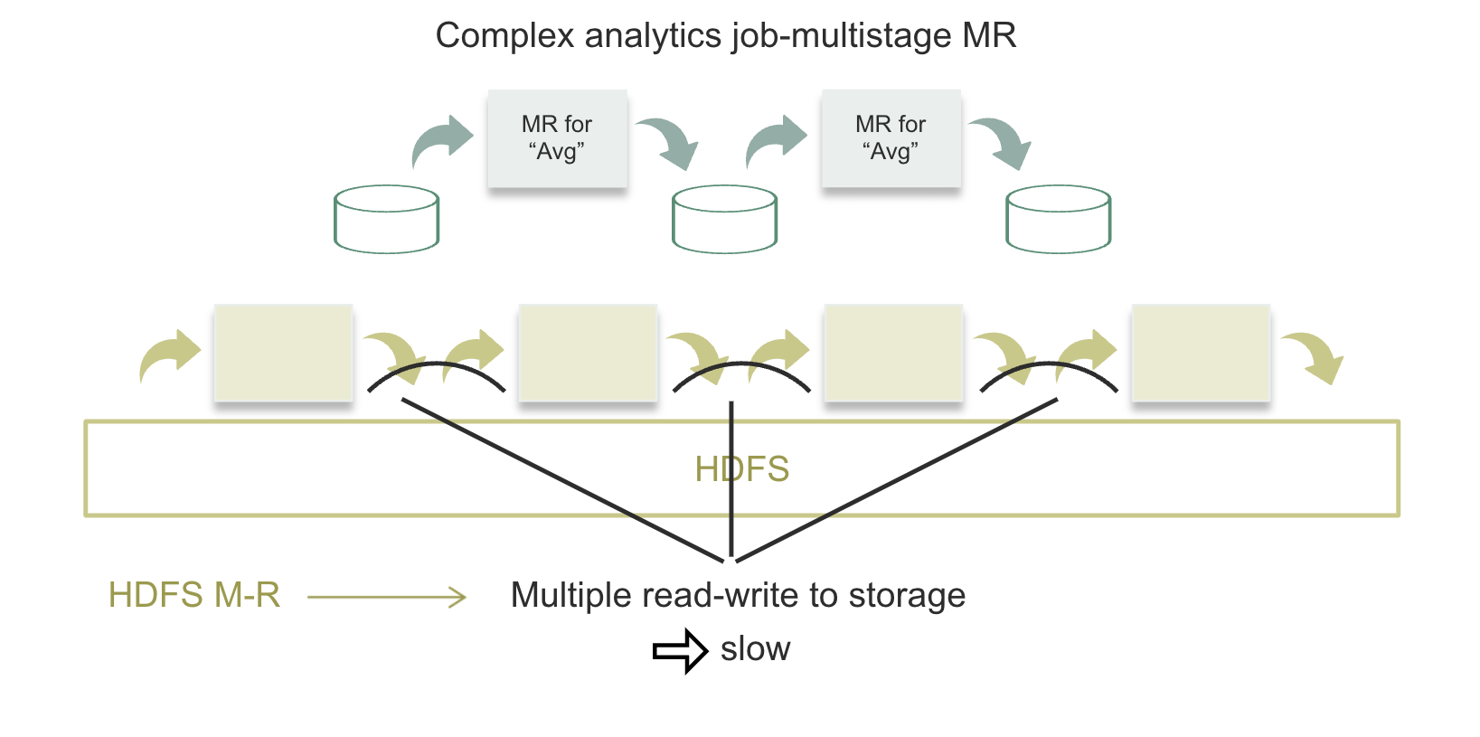
Spark vs. HDFS

Slide 35
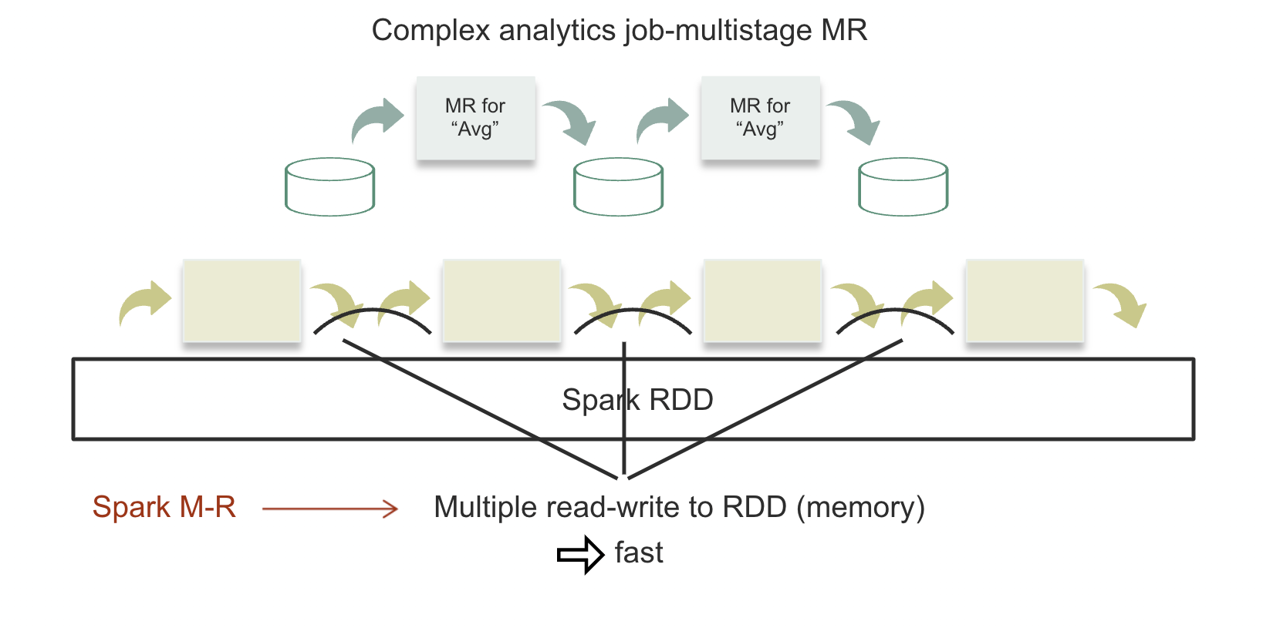
Spark vs. HDFS

Slide 36
Spark Architecture
Master Node
Worker Node
Split job into smaller tasks
Worker Node
Driver Program
Request Resources
Distribute Tasks across nodes
Executor
Cluster Manager
Worker Node
Task
Task
Task
Executor
Spark Context
Task
Task
Task
Task
Executor
Task
Task
Task
Task
Task
Task
Task
Task
Task
Task
Task
Once allocated by the cluster manager, the drive controls the execution of tasks
Notes:
https://www.interviewbit.com/blog/apache-spark-architecture/

Slide 37
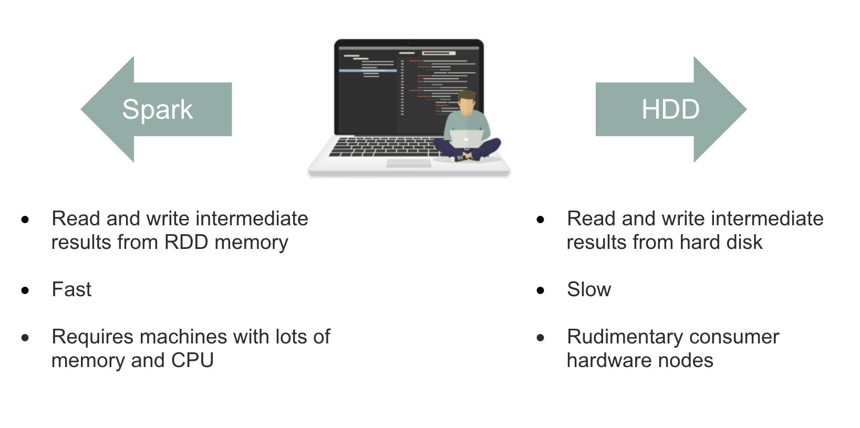
Spark versus Hadoop
Spark
Hadoop

Slide 38
Spark API
The underlying language for Spark in Scala
Scala is a superset of Java and requires the Java Virtual Machine to run
We will use Python interface of Spark – pySpark
pySpark is popular, but Scala is more performance efficient
Spark lower-level API
Based on RDD
Have to use Map-Reduce on RDD
Useful when working with raw, unstructured, uncleaned data

Slide 39
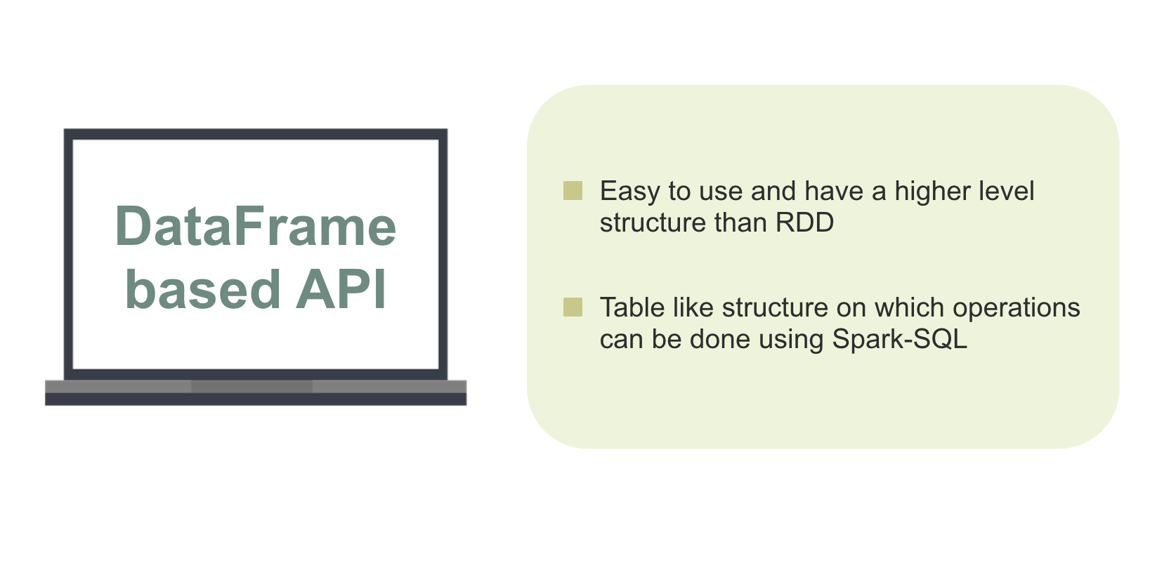
Spark API

Slide 40
Final Project

Slide 41
Final Project
Details are posted in Canvas
Due May 5th by midnight – no late submissions will be accepted; so plan to submit well before this deadline.
Peer review is due May5th by midnight:
Evaluate team member contributions and performance on a scale of 1 through 10.
If you do not submit an evaluation; your personal evaluation will automatically become 8
Final project mark is the team’s mark multiplied by your peer evaluation percentage score. (i.e. If you get 8/10 on peer eval, then you receive 80% of the teams grade)

Slide 42
Happy Learning!

