Slide 1
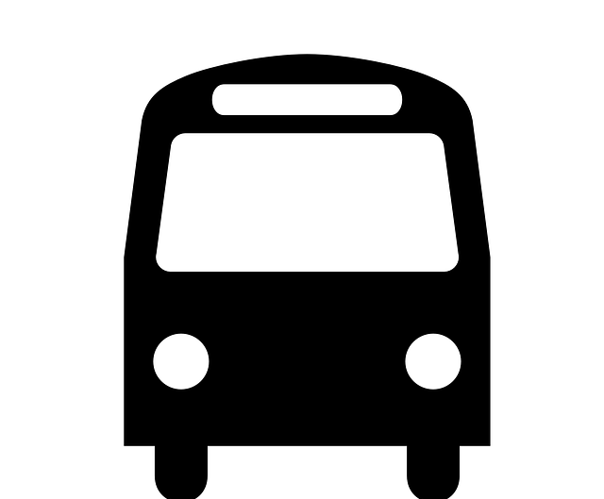
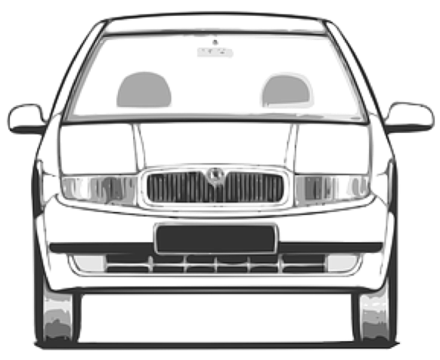
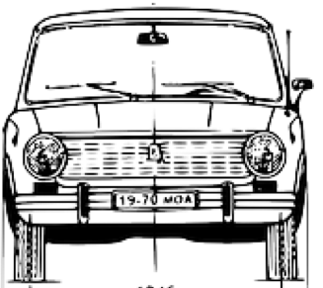
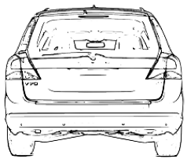
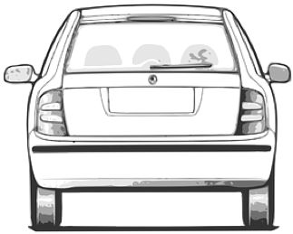

road reservation
driving space (jointly)
Driving space is the composite of all travelled ways in the cross-section plus any hard/soft shoulders and hardstanding
roadside
carriageway
carriageway
carriageway
unpaved
paved
traffic
lane
traffic
lane
reserved
lane
(also a traffic lane)
traffic
lane
traffic
lane
soft shoulder
roadside
Jersey barrier
hard shoulder
central reservation
verge
travelled
way
travelled
way
travelled
way
Does travelled way include foot paths and cycle paths?

Slide 2
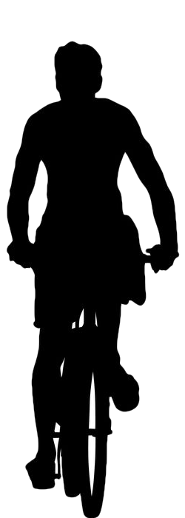
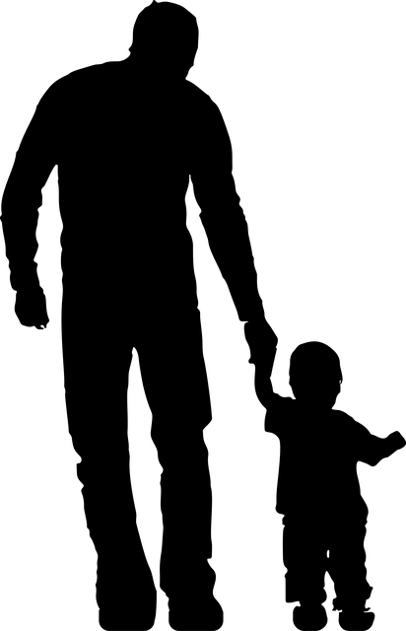
road reservation
roadside
single carriageway
roadside
soft shoulder
traffic
lane
traffic
lane
roadside
footway
cycle lane
cycle lane
cycle lane
cycleway
verge
travelled
way

Slide 3
roadside
carriageway
surface
pavement
Subsurface or roadbed
soft shoulder
travel
lane
travel
lane
footway
buffer lane
travelled
way

Slide 4
roadside
carriageway
Kerb
kerbside
surface
pavement
Subsurface or roadbed
soft shoulder
travel
lane
travel
lane
footway
buffer lane
travelled
way

Slide 5
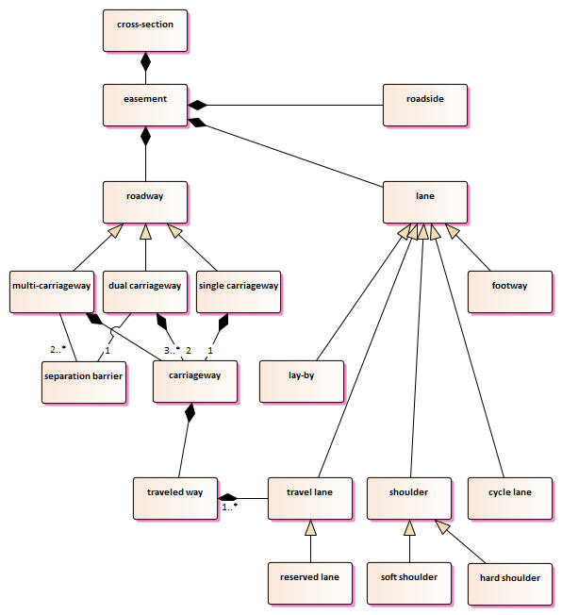
‘traffic’ or ‘driving’?

Slide 6
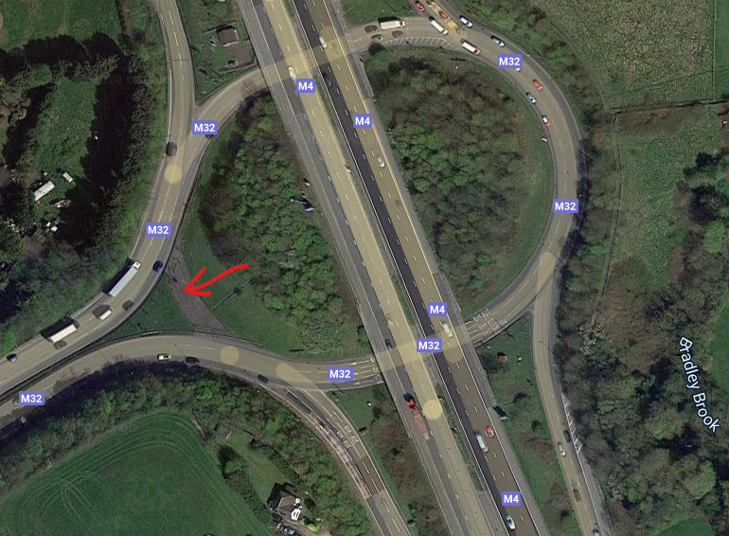
hardstanding

