Slide 1



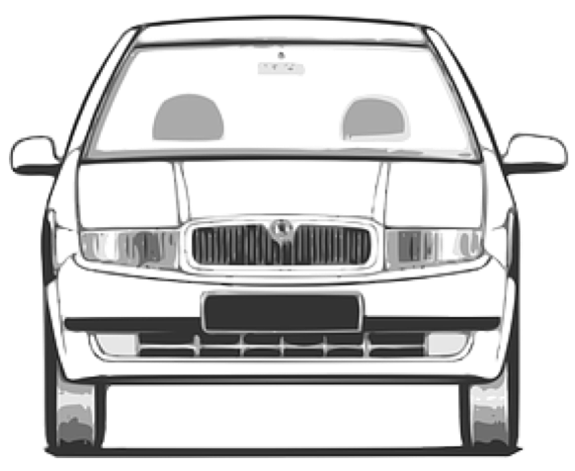
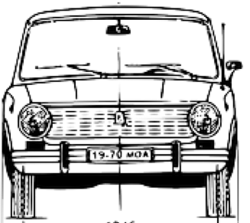
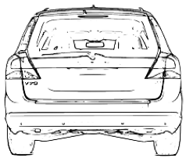
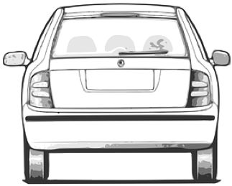

easement
roadway (jointly)
roadside
carriageway
carriageway
carriageway
travel
lane
travel
lane
reserved
lane
(also a travel lane)
travel
lane
travel
lane
soft shoulder
roadside
footway
cycle lane
hard shoulder
cycle lane
buffer lane
separation barrier
separation barrier
roadside
travelled
way
travelled
way
travelled
way

