Slide 1


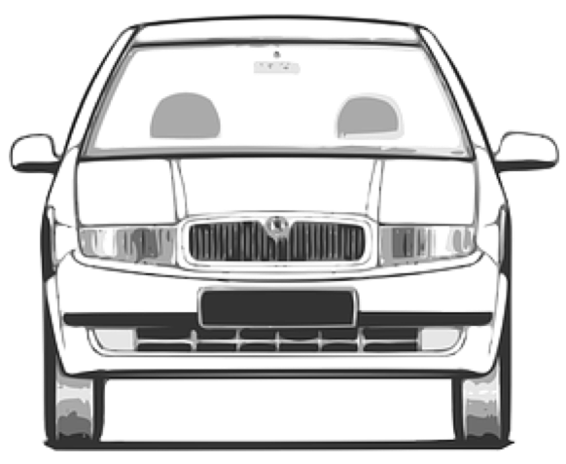
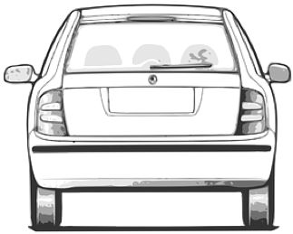

road reservation
roadside
single carriageway
roadside
traffic
lane
traffic
lane
soft shoulder
roadside
cycle lane
cycle lane
cycle lane
footway / sidewalk
usable width
cycleway
verge
roadway
travelled way (jointly)

