Slide 1

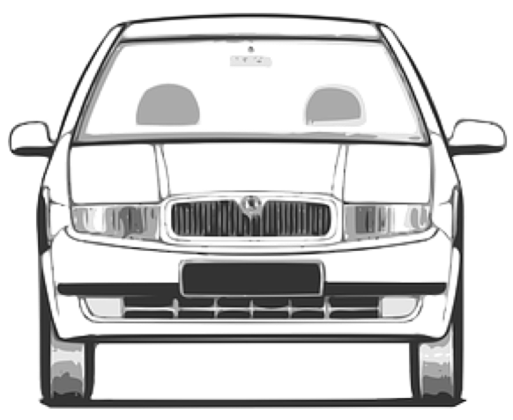
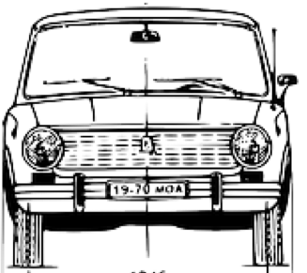
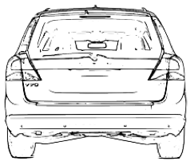
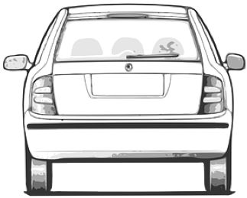

road reservation
driving space (jointly)
roadside
unpaved
paved
traffic
lane
traffic
lane
reserved
lane
(also a traffic lane)
traffic
lane
traffic
lane
soft shoulder
Jersey barrier
roadside
usable width
hard shoulder
central reservation
carriageway
carriageway
carriageway
verge
roadway (jointly)

