Slide 1

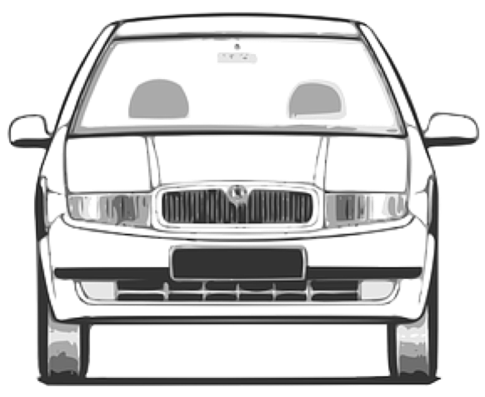
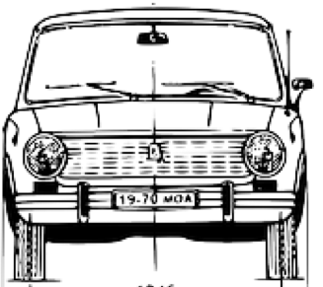
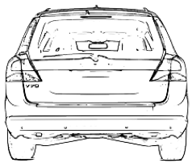
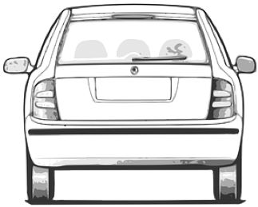

road reservation
driving space (jointly)
roadside
unpaved
paved
traffic
lane
traffic
lane
reserved
lane
(also a traffic lane)
traffic
lane
traffic
lane
soft shoulder
Jersey barrier
roadside
usable width
hard shoulder
central reservation
carriageway
carriageway
carriageway
verge
roadway (jointly)

Slide 2


road reservation
roadside
single carriageway
roadside
traffic
lane
traffic
lane
soft shoulder
roadside
cycle lane
cycle lane
cycle lane
footway / sidewalk
usable width
cycleway
verge
roadway
travelled way (jointly)

Slide 3
roadside
carriageway
surface
pavement
Subsurface or roadbed
soft shoulder
travel
lane
travel
lane
footway
buffer lane
travelled
way

Slide 4
roadside
carriageway
Kerb
kerbside
surface
pavement
Subsurface or roadbed
soft shoulder
travel
lane
travel
lane
footway
buffer lane
travelled
way

Slide 5
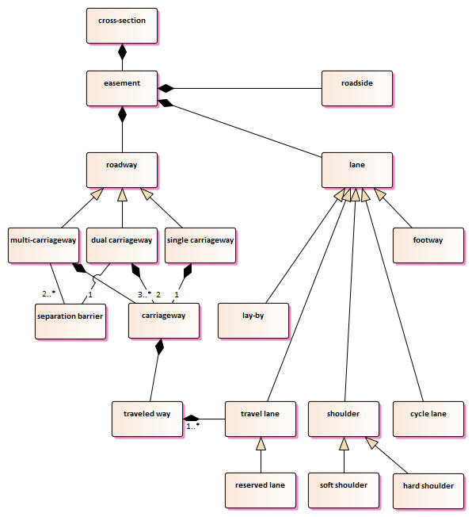
‘traffic’ or ‘driving’?

Slide 6
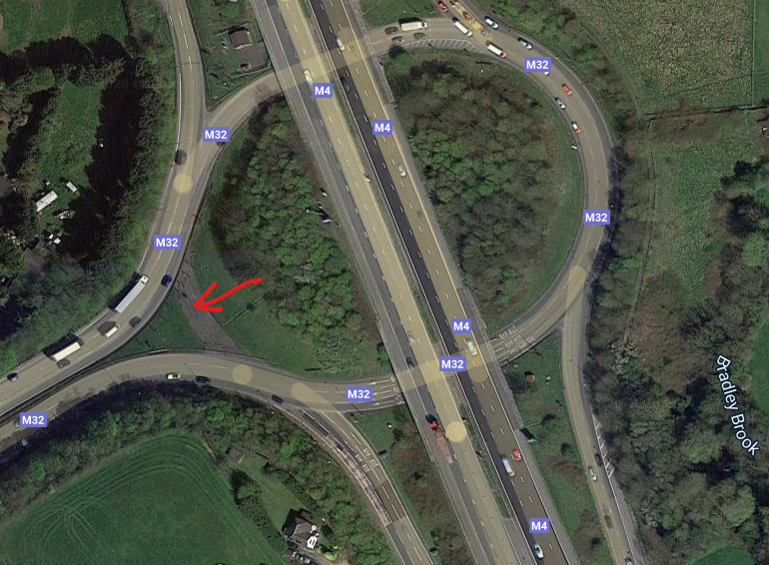
hardstanding

