Slide 1



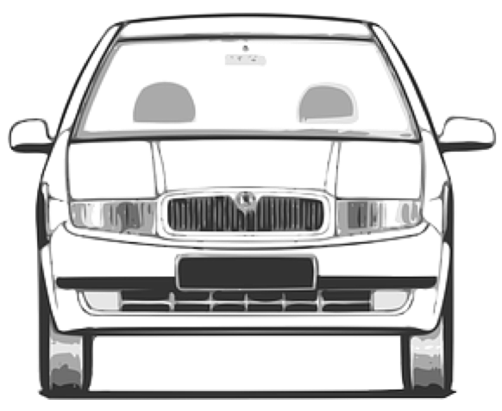
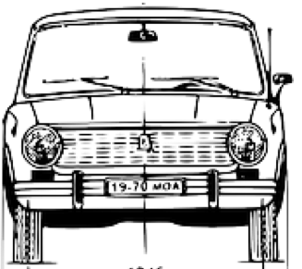
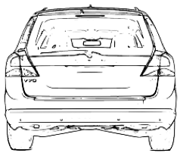
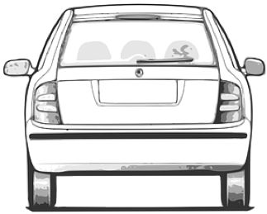

road reservation
driving space (jointly)
Driving space always includes hard shoulder & hard strips travelled way only includes hard shoulder/strips if they are in use
Does travelled way include foot paths and cycle paths?
Travelled way
roadside
boundary zone
carriageway
carriageway
carriageway
?
unpaved
paved
traffic
lane
traffic
lane
reserved
lane
(also a traffic lane)
traffic
lane
traffic
lane
soft shoulder
roadside
footway
cycle lane
hard shoulder
cycle lane
separation barrier
separation barrier
separation barrier
Cycle track
travelled
way
travelled
way
travelled
way
roadside
verge
Add picture with a ditch

Slide 2
roadside
carriageway
surface
pavement
Subsurface or roadbed
soft shoulder
travel
lane
travel
lane
footway
buffer lane
travelled
way

Slide 3
roadside
carriageway
Kerb
kerbside
surface
pavement
Subsurface or roadbed
soft shoulder
travel
lane
travel
lane
footway
buffer lane
travelled
way

Slide 4
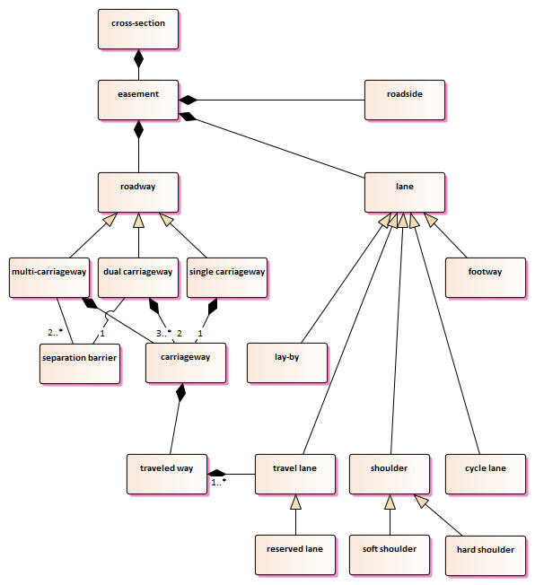
‘traffic’ or ‘driving’?

