Slide 1

Harmonized Model Maintenance Group
Dr. John R. Herring, USA
Mr. Knut Jetlund, Norway
Convenors

Slide 2
Agenda
Roll Call and Introductions
Changes in the procedures for editing the Harmonized Model
Issues from any other *MG, Projects or Members
Ontology compatibility
Repeated classes (editor’s error and fixable)
Unnamed association roles (not fixable – inconsistency with standard)
New business

Slide 3
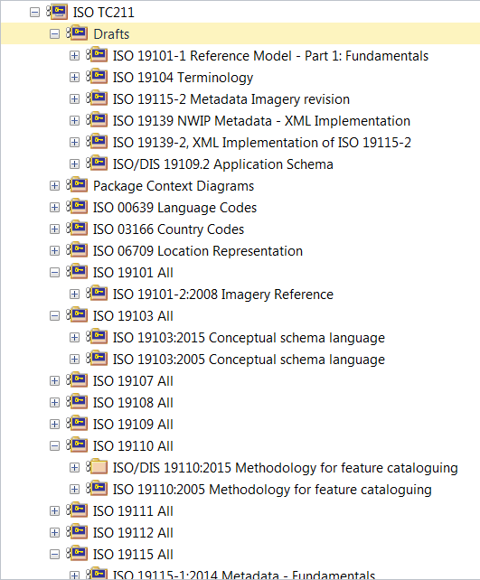
Changes in the procedures for editing the Harmonized Model
Change of procedures
Phase out of Drafts package; convenor will create an empty package and give write privilege to editor; moving a package from Draft to permanent position loses history
All UML models should be created in the repository.

Slide 4
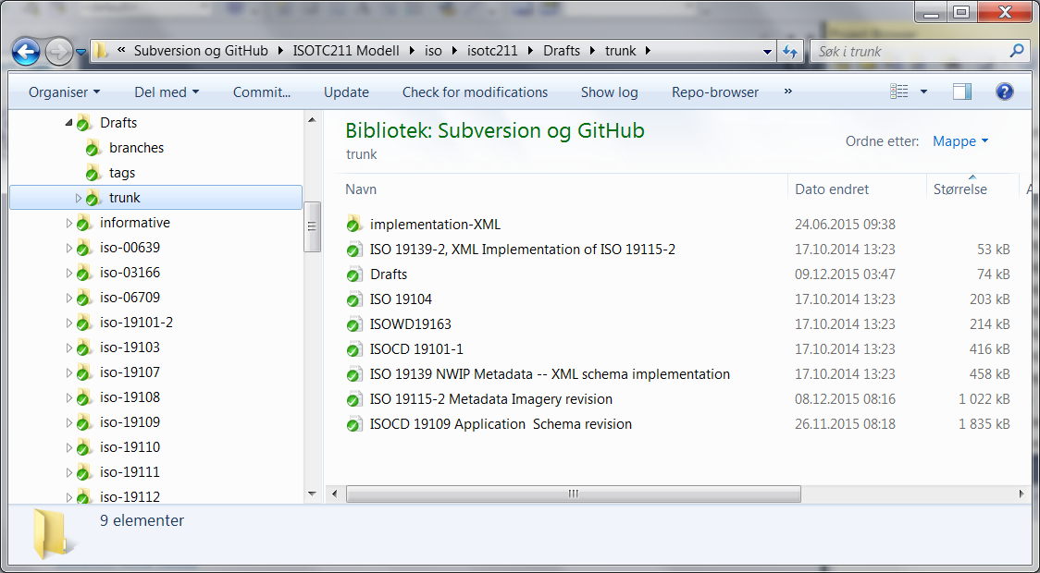
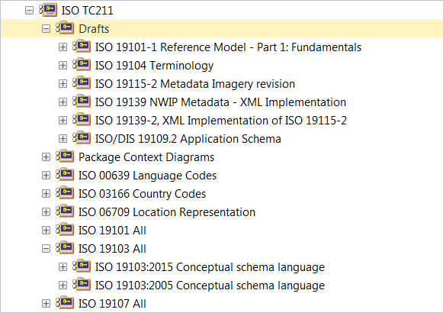
Drafts – files and packages in svn and in EA

Slide 5
Quality control of models
GOM (Jean Brodeur) has offered to use UML to Ontology generator to check models for inconsistencies (should be done before votes)
Also: Scripts from the best practices work

Slide 6
New Business ?
Need for separate editors for model and document (different skills)

