Slide 1

PRoject Set's
Made by team Sossila

Slide 2
Who are we?
Name | Role
Ivelin Bachvarov - IPBachvarov18@codingburgas.bg | Scrum Trainer
Emil Ribarev - eiribarev18@codingburgas.bg | Developer
Atanas Valchanov – AAValchanov18@codingburgas.bg | Developer
Petаr Dyakov – PMDyakov18@codingburgas.bg | Code Checker
Ivan Parashkevov - ISParashkevov18@codingburgas.bg | Front end

Slide 3
About the project and Functions
Our project is a set of operations.
1. Тhe first function finds the union
2. Тhe second function finds the cross section
3. The third function finds the difference
4. The fourth function finds the symmetric difference

Slide 4
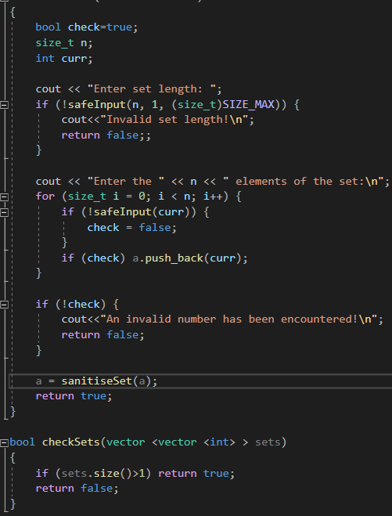
Features
Storing multiple sets
Input validity checks

Slide 5


Used technologies

Slide 6

Thank you for your attention!

Slide 7
Video

