Slide 1
Introduction to MATLAB
These notes were originated from Dr. KongFatt Wong-Lin’s notes from his
Programming for Engineering module at Ulster University, and, with permission
from Dr. Wong-Lin, edited by Farajollah Tahernezhadjavazm, Przemyslaw Cichy
and Dr. KongFatt Wong-Lin for the ISRC-CN³ Autumn School.
Attendees, especially those who are not too familiar with programming or
MATLAB, should go through these notes before attending the Autumn School
– the lab session on Day 1 will discuss only selected parts of the materials.

Slide 2
Aims
To understand and manipulate introductory features and functions to program in MATLAB
Appreciate the differences and similarities with other languages (e.g. Python)

Slide 3

What?
MATrix LABoratory program (MATLAB), a high-level programming language and environment, initially written for scientists and engineers (in industry and academia) with interactive access to numerical computation libraries, and use matrix based techniques to solve problems without having to write programs in traditional languages e.g. C and Fortran.
Now, MATLAB is a commercial (needs license) software package that operates as an interactive programming environment with graphical output, including creation of user interfaces. Used in Windows, UNIX, OSX, etc environments, and interfacing with C, C++, C#, Fortran, Java, Python, etc.
MATLAB is primarily for numerical computing, and assumes almost every data object to be an array (ie. a matrix). But MuPAD allows symbolic computing, and Simulink allows graphical multi-domain simulation and model-based design for dynamic and embedded systems.
https://uk.mathworks.com/
https://en.wikipedia.org/wiki/MATLAB

Slide 4
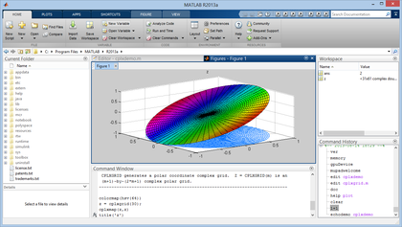
Why?
Built-in operations to handle arrays/matrices. E.g. 2 arrays together needs only 1 command cf. a for or while loop (as in C)
Easy to prototype! Much lesser lines of codes!
Graphical output optimized for interaction – very user friendly
Additional toolboxes could be included e.g. Statistics Toolbox for more specialized statistical manipulation of data (Anova, data fitting, etc)

Slide 5
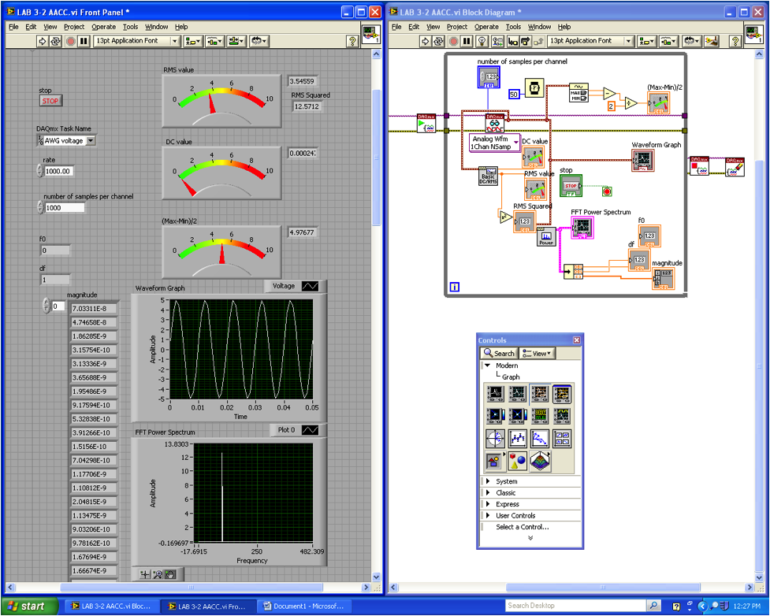
E.g. screen shot of MATLAB Simulink with graphical user interface created by user

Slide 6

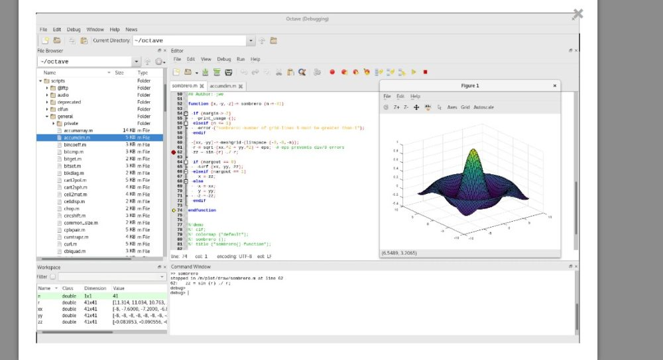
Disadvantages or Limitations
Uses lots of memory and hard to use with slow computers
Real-time computing an issue
Expensive license
A free alternative, compatible with MATLAB – Octave
https://www.gnu.org/software/octave/

Slide 7
Accessing MATLAB:
Professional and student versions. Student version limited in matrix size
If in School’s computer lab, open MATLAB by clicking the MATLAB icon
This can also be accessed through remote desktop access (please consult School’s IT staff)
Online MATLAB access (through the cloud) without downloading it locally: matlab.mathworks.com
To download locally, follow the instructions in Lab notes 10
30-day free trial version
Online help and support + community [Or Google it]
E.g. https://uk.mathworks.com/matlabcentral/answers/20670-how-to-measure-running-time-of-a-code-using-matlab
Or type “help”or “helpdesk” in the Command window. E.g. >> help sin
To quit MATLAB, either type “quit” at the prompt in command window, or choose File, then Exit MATLAB from the menu

Slide 8

Downloading MATLAB
1: Log in to the portal using student email address and password. https://portal.ulster.ac.uk/dashboard/home
2: Select ISD software Downloads (Circled in Black)

Slide 9
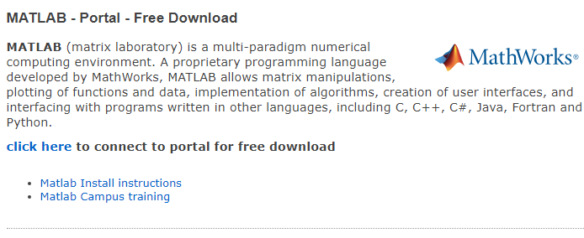
Downloading MATLAB
3: Scroll down to Matlab section

Slide 10
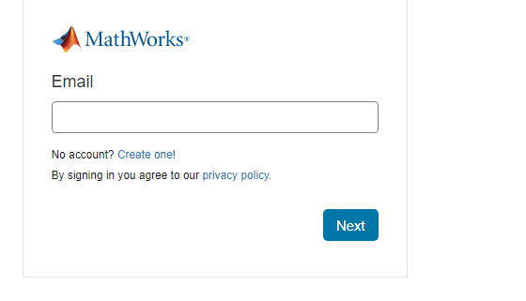
Downloading MATLAB
4: Sign in by creating an account with your University email account
Installation instructions are provided on the Matlab site if required.

Slide 11
MATLAB programming (Part 1)

Slide 12
MATLAB Basics

Slide 13
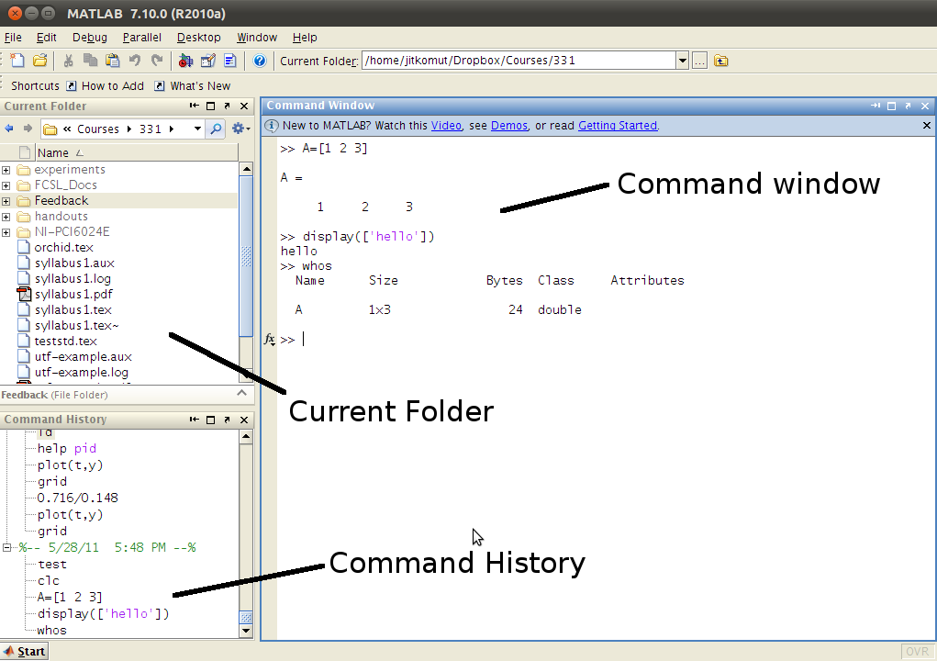
Default layout

Slide 14
Variable and variable arithmetic
Assigning values to variables. E.g.
>> x = 3; y=4; z=5 % define and initialize variable x, y and z
But there are special variable names and numbers, and built-in functions in MATLAB. E.g.
ans – value computed in an expression not stored in a variable name, to keep track of last output
eps – floating point precision for computer being used (2.2204 e-16)
“i” and “j” – imaginary unit in a complex number
pi – 3.141…
NaN – Not a number, e.g. in undefined expressions (division by zero) and in matrix elements where data is missing
inf – infinity, typically due to a division by zero or an arithmetic overflow
clock – current time
date – current date
flops – floating point operations count
sin – trigonometrical sine function, while asin compute arcsine
exp – exponential function, while log and log10 compute natural and base 10 log
abs – absolute value
sign - sign (step) functionfix, floor, ceil, round, rem, etc for rounding off numbers
Type “help elfun” in Command Window for a list of elementary math functions.

Slide 15
E.g. arithmetic expressions:
2^3 = 2*2*2 = 8
2/3 = 0.6667
2\3 = 3/2 = 1.5
2 + 3 = 5
2 – 3 = –1
Precedence of operators:
“()” → “^” → “*” or “/” → “\” → “+” or “–”
E.g. by typing in the command window the line
>> 4.0*sin (pi/4 + pi/4)
MATLAB took the below computational steps procedurally:
4*sin (pi/4 + pi/4)
4*sin (0.7854 + pi/4)
4*sin (0.7854 + 0.7854)
4*sin(1.5708)
4*1.0
4.0
If we type
>> 4.0*sin (pi/4 + pi/4);
>> flops
ans =
5
>>

Slide 16
E.g. by typing in the command window the line
>> mynum = 4 + 2 % acting as an interacting calculator
mynum =
6
>> mynum = mynum + 1 % incrementing by 1
mynum =
7
>> who
Your variables are:
ans mynum
>> clear mynum % clearing the value of the variable mynum
>> who
Your variables are:
ans

Slide 17
Format and type
>> format long % double precision output
>> 2*sin (1.4)
ans =
1.970899459976920 % 15 decimal places
>> pi
ans =
3.141592653589793
>> format short
>> 2*sin (1.4)
ans =
1.9709
>> pi
ans =
3.1416
For long expressions, use ellipsis. E.g.
>> 3 + 55 – 62 _4 – 5 …
+ 22 – 1
ans =
16
format compact just instructs MATLAB to abbreviate its output by removing all blank lines

Slide 18
Integer types: int8, int16, int32, int 64
E.g. int8 uses eight bits altogether to store the integer and its sign; sign takes up one bit. Since each bit stores the number in binary (1’s and 0’s), then the largest number that can be stored is 2^7 – 1 = 127. And hence the range of values that can be stored in int is from -128 to 127. Mainly use int32.
By default, MATLAB stores numbers as double (not single).
E.g.
>> val = 6 + 3;
>> val2 = int32(val); % convert from double to int32 but not changing its value
>> whos
Name Size Bytes Class Attributes
val 1x1 8 double
val2 1x1 4 int32
char is used to store either single characters e.g. “x” or strings e.g. “cat”.
E.g.
>> char(97)
ans =
a
>> double(‘abcd’)
ans =
97 98 99 100
>> char(‘abcd”+1)
ans =
bcde

Slide 19
Random numbers
There are built in functions to generate (pseudo) random numbers.
Idea: Process starts with one number called a seed, either predetermined value or it is obtained from the built-in clock in the computer. Based on this seed, a process determines the next random number, using it as the seed for generating the next number, etc. They are not truly random as there is a process that determines the next value each time.
>> rand
ans =
0.9501
>> rand
ans =
0.2311
The seed for the rand function will always be the same each time MATLAB is started, unless the state is changed. E.g. rand(‘state’, sum(100*clock))
which uses current date and time that are returned from the built-in clock function to set the seed.
To generate a random number within a range. E.g.
>> low = 3; high = 5;
>> rand*(high – low)+low
would generate a random real number in the range from 3 to 5.

Slide 20
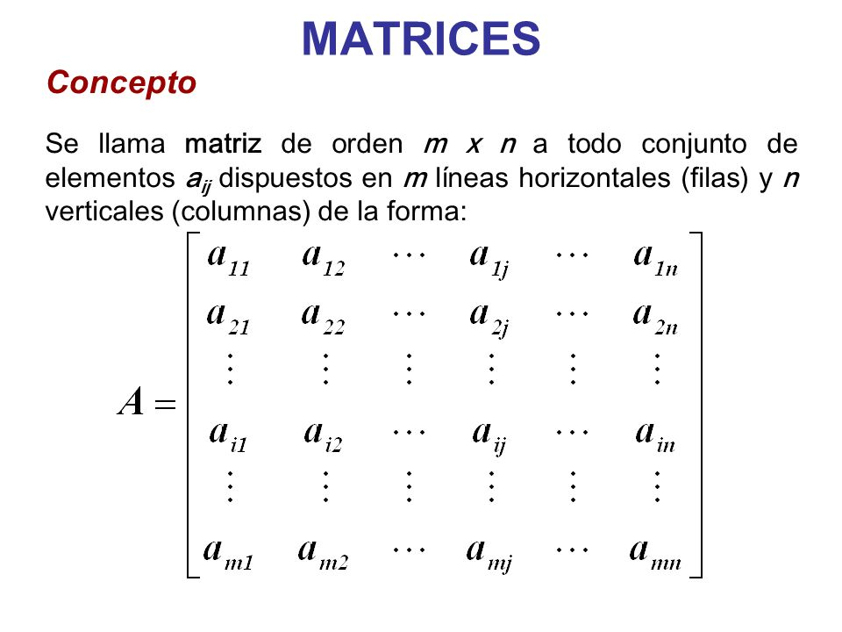
Vectors and matrices
A matrix (or array) of order m by n is simply a set of numbers arranged in a rectangular block of m horizontal rows and n vertical columns. E.g. A below is a m-by-n matrix

Slide 21
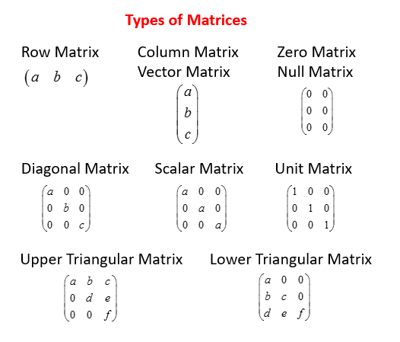
Types of matrices

Slide 22
Creating row vectors:
>> v = [1 2 3 4]
v =
1 2 3 4
>> v = [1, 2, 3, 4]
v =
1 2 3 4
>> vec = 1:5 % iterate in steps of 1
vec =
1 2 3 4 5
Note: brackets [] are not necessary to define the vector
>> nv = 1:2:9 % in steps of 2
nv =
1 3 5 7 9
Or type linspace(x,y,n), creating a linearly spaced vector
>> nv = linspace(1, 9, 5)
Concatenate vectors
>> newvec = [nv v]
newvec =
1 3 5 7 9 1 2 3 4

Slide 23
Referring to and modifying vector elements:
>> newvec(5)
ans =
9
>> b = newvec(4:6)
b =
7 9 1
>> newvec ([1 5 9])
ans =
1 9 4
Note: The vector [1 5 9] is an index vector, specifying the indices in the original vector
>> b(2) = 11
b =
7 11 1
>> b(4) = 2
b =
7 11 1 2
>> b(6) = 10
b =
7 11 1 2 0 10

Slide 24
Creating column vectors:
Very similar to that for row vectors. E.g.
>> c = [1; 2; 3; 4] % Use semicolon to move the element down a row
c =
1
2
3
4
We can also transpose (using prime) a row vector to become a column vector (and vice versa). E.g.
>> r = 1:4;
>> c = r’
c =
1
2
3
4

Slide 25
Creating matrix variables:
>> mat = [1 2 3; 4 5 6]
mat =
1 2 3
4 5 6
Or
>> mat = [1 2 3
4 5 6]
mat =
1 2 3
4 5 6
Note: Make sure the number of elements in rows must be the same; so is for columns. E.g.
>> mat = [1 2 3; 4 5]
will lead to error
>> randint(2, 4, [10, 30])
ans =
29 22 28 19
14 20 26 10
This generates a 2-by-4 matrix with random numbers generated within the range (10, 30)

Slide 26
>> rand(2)
ans =
0.2311 0.4860
0.6068 0.8913
>> rand(1,3)
ans =
0.7621 0.4565 0.0185
The zeros function can create a matrix of all zeros. E.g.
>> zeros(3)
ans =
0 0 0
0 0 0
0 0 0
>>zeros(2,4)
0 0 0 0
0 0 0 0

Slide 27
>> eye (3,4) % built-in function to create an identity matrix with % diagonal of 1’s and the rest 0’s
ans =
1 0 0 0
0 1 0 0
0 0 1 0
0 0 0 1
>> eye (3) % or eye(3,3) create an identity matrix of zeros
ans =
1 0 0
0 1 0
0 0 1

Slide 28
A = [1 2 3; 4 5 6; 7 8 9];
>> U = triu (3,4) % built-in function to create an upper triangular matrix
U =
1 2 3
0 5 6
0 0 9
>> L = tril (3,4) % built-in function to create a lower triangular matrix
L =
1 0 0
4 5 0
7 8 9

Slide 29
Referring to and modifying matrix elements:
>> mat = [1 2 3; 4 5 6]
mat =
1 2 3
4 5 6
>> mat(2,3)
ans =
6
To refer to a subset of the matrix (submatrix), e.g.
>> mat(1:2;2:3)
2 3
5 6
Using a colon for the row (column) index means all rows (columns), regardless of how many. E.g.
>> mat(1,:)
ans =
1 2 3
>> mat(:,2)
ans =
2
5

Slide 30
>> intmat = randint(2,2,[0 100])
intmat=
100 77
28 14
>> intmat(1)
ans =
100
>> intmat(2)
ans =
28 % “linear indexing”
>> intmat(3)
ans =
77
>> mat = [2:4; 3:5];
>> mat(1, 2) = 11 % modified specific element
mat =
2 11 4
3 4 5
>> mat(2,:) = 5:7 % a whole column in row is modified
ans =
2 11 4
5 6 7

Slide 31
Add new row or column. E.g.
>> mat = [2:4; 3:5];
>> mat(:,4) = [9 2]’ % add a new 4th column
mat =
2 3 4 9
3 4 5 2
>> mat(4,:) = 2:2:8 % add 4th row, MATLAB will fill in gaps with zeros
ans =
2 3 4 9
3 4 5 2
0 0 0 0
2 4 6 8
>> mat(end,1) % built-in expression end referring to last row
ans =
2
>> mat(2,end) % built-in expression end referring to last column
ans =
2

Slide 32
Dimensions of matrices
>> mat = [1:3; 5:7];
mat =
1 5
2 6
3 7
>> size(mat) % checking the size/dimension of the matrix
ans =
3 2 % A 3-by-2 matrix
>> length(mat) % checking the length of the matrix/vector
ans =
3
>> [r c] = size(mat) % Capturing the storing the row and column numbers!
r =
3
c =
2
Hence, MATLAB has the ability to have vector of variables on the left-hand side of an assignment – an important and unique concept

Slide 33
>> vec = 9:-2:1
vec =
9 7 5 3 1
>> numel (vec) % returning total number of elements in an array (vector/matrix)
ans =
5
>> mat = randint(2,3,[1, 10])
mat =
7 9 8
4 6 5
>> numel (mat)
ans =
6
>> reshape(mat,1,6)
mat=
7 4 9 6 8 5
>> mat(:,1:2)’ % Transpose – exchanging rows with columns (“mirror at diagonal”)
ans =
7 4
9 6

Slide 34
>> mat = randint(2,3,[1, 10])
mat=
7 9 8
4 6 5
>> fliplr (mat) % flip matrix left to right
mat =
8 9 7
5 6 4
>> flipup (mat) % flip matrix up to down
mat =
4 6 5
7 9 8
>> rot90 (mat) % rotate matrix 90 degrees counterclockwise
mat =
5 8
6 9
4 7

Slide 35
>> intmat = randint(2,2,[1, 10])
intmat =
7 9
4 6
>> repmat(intmat,3,2) % replicate the matrix six times as a 3 by 2 matrix of the
% variable intmat, 3 times on rows and 2 times columns
ans =
7 9 7 9
4 6 4 6
7 9 7 9
4 6 4 6
7 9 7 9
4 6 4 6
Or
>> intmat = [intmat intmat; intmat intmat; intmat intmat];

Slide 36
Using functions with vectors and matrices
>> vec = =3:4
vec =
-3 -2 -1 0 1 2 3 4
>> abs (vec) % all elements in vector/matrix will drop their negative signs
ans =
3 2 1 0 1 2 3 4
>> evec = [ ] % Creating an empty vector with unknown/adaptable size
evec =
[ ]
>> length (evec)
ans =
0
>> evec = [evec 4] % concatenate
ans =
4
>> evec = [evec 11; 3 2]
ans =
4 11
3 2

Slide 37
>> vec =
4 11
>> vec (1,2) = [ ] % Removing element from a vector
vec =
4
Note: However, individual elements cannot be removed from matrices, since matrices always have to have the same number of elements in every row. An error message will appear. That said, entire rows or columns could be removed from a matrix. E.g.
>> evec
ans =
4 11
3 2
>> evec(:,2)=[ ]
4
3

Slide 38
Arithmetic with matrices
>> A = [4 11; 3 2]; B = [1 1; 2 2]
A =
4 11
3 2
B =
1 1
2 2
>> C = A + B % Similarly for subtraction
C =
5 12
5 4
>> D = A*B
D =
26 26
7 7
>> E = [2 2];
>> A*E’
ans =
30
10

Slide 39
>> A = [4 11; 3 2]; B = [1 1; 2 2];
>> 2*A % scalar multiplication
ans =
8 22
6 4
>> A/2
ans =
2 5.5
1.5 1
>> 2/A
ans =
0.5 0.1818
0.6667 1

Slide 40
Introduction to MATLAB programming
In MATLAB, the scripts are written in *.m (cf. e.g. *.c in C programming)
These are scripts, not programs, and read by an interpreter (unlike in e.g. C where they are compiled). But documentation in MATLAB refers to scripts as programs. So we’ll follow that.
To create a script, click File, then New, then M-file. A new window will appear called the Editor. To create a new script, simply type the sequence of statements and click Run (or F5).
Save the file using File → Save. Make sure the extension is in *.m format. Rules for filenames are the same as for variable (must start with a letter, and after that there can be letters, digits or underscore, etc). Once saved and closed, the file can be reopened by clicking File → Open and then select the name of the file.

Slide 41
E.g. Create a script called compute_area.m
% The compute_area program calculates the area of a circle
% First the radius is assigned
radius = 5
% The area is calculated based on the radius
area = pi*(radius^2)

Slide 42
Simple input and output
Input of variables from keyboard. E.g.
A = input(‘Please type the value of coefficient A :’);
will print the message
Please type the value of coefficient A :
>> rad = input(‘Enter the radius: ‘)
Enter the radius: 5
rad =
5
>> letter = input(‘Enter a char: ‘,’s’)
Enter a char: go
letter =
go
>> length(letter)
ans =
6
Hence if blank spaces are entered before other characters, they are included in the string.
>> mychar = input(‘Enter a character: ‘,’s’)
Enter a character:
mychar =
‘ ‘
Hence, if user enters only spaces or tabs before pressing Enter key, they are ignored and an empty string is stored in the variable.

Slide 43
Output of variables. E.g.
>> fprintf(‘Volume of sphere = %f\n’, 3.4)
Volume of sphere =
3.400000
>> fprintf(‘The value is %d, for sure!\n’, 4^3)
The value is 64, for sure!
>> disp(‘Hello’)
Hello
>> disp(4^3)
64
%d – integers (it actually stands for decimal integers)
%f – floats
%c – single characters
%s – strings
Don’t confuse % in these “placeholders” (which specify where the value of the expression) with the symbol used to designate a comment.

Slide 44
Also, e.g. %6.2f means a field width of 6 (including the decimal point and decimal places) with two decimal places.
>> x = input(‘Enter the \nx coordinate: ‘);
Enter the
x coordinate: 4
>> fprintf(‘The int is %3d and the float is %6.2f\n’, 5, 4.9)
The int is 5 and the float is 4.90
Note: field width is wider than necessary, leading blanks are printed, and if more decimal places are specified than necessary, trailing zeros are printed.
>> fprintf(‘%3.2f\n’, 1234.5678)
1234.57
>> fprintf(‘%d\n’, 1234567.89)
1.234568e+006
>> fprintf(‘The string is %s or %.4s\n’, ‘truncate’, …
‘truncate’)
The string is truncate or trun

Slide 45
>> vec = 2:5;
>> fprintf(‘%d\n’, vec)
2
3
4
5
Note: this was a row vector. A column vector would print the same way.
>> fprintf(‘%d’, vec)
2345>>
So without the newline character \n, it would print in a row but the next prompt would appear on the same line.
But in a script, named printvec.m, a separate newline character could be printed to avoid this issue.
% This demonstrates printing a vector
vec = 2:5;
fprintf(‘%d’, vec)
fprintf(‘\n’)
The output will be
>> printvec
2345
>>

Slide 46
>> mat = randint(2,3,[1,10])
mat =
5 9 8
4 1 10
>> fprintf(‘%d\n’, mat)
5
4
9
1
8
10
>> fprintf(‘%d %d %d\n’, mat)
5 4 9
1 8 10
So the order has been changed. A transpose of the matrix will return its order to the original form
>> fprintf(‘%d %d %d\n’, mat’)
5 9 8
4 1 10

Slide 47
script2.m
% This script calculates the area of a circle
% It prompts the user for the radius
% Prompt the use for the radius and calculate
% the are based on that radius
radius = input(‘Please enter the radius: ‘);
area = pi*(radius^2);
% Print all variables in a sentence format
fprintf(‘For a circle with a radius of %.2f,’ , radius)
fprintf(‘the area is %.2f\n’, area)
The output will be:
>> script2
Please enter the radius: 3.9
For a circle with a radius of 3.90, the area is 47.78
Modify the script to calculate the volume of a sphere

Slide 48
Scripts for simple plots
plotonepoint.m
% This is a really simple plot of just one point!
% Create coordinate variables and plot a red ‘*’
x=11;
y=48;
plot(x,y,’r*’)
%Change the axes and label them
axis([9 12 35 55])
xlabel(‘Time’)
ylabel(‘Temperature’)
% Put a title on the plot
title(‘Time and Temperature’)
Modify the script to prompt the user for the time and temperature, and set the axes based on these values

Slide 49
Scripts for simple plots
x=1:6;
y=[1 5 3 9 11 8];
plot(x,y)
Now try
plot(y)
It should give the same plot as the x values are from 1 to 6 anyway
What if x=2:7?
What if x=2:6?

Slide 50
Customizing a plot: colour, line types, marker types
Possible colours are:
b – blue (which is also the default colour of the graph)
c – cyan
g – green
k – black (which is also the default colour of the axes)
m – magenta
r – red
y – yellow
The plot symbols or markers can be:
o – circle
d – diamond
h – hexagram
p – pentagram
+ – plus
. – point
s – square
* – star
v – down triangle
^ – up triangle
< – left triangle
> – right triangle
x – mark
Line types
-- dashed
-. dashed-dot
.. dotted
- solid (also the default)

Slide 51
plot2figs.m
% This creates 2 different plots, in 2 different
% Figure Windows, to demonstrate some plot features
clf
x=1:5; % Not necessary, actually
y1=[2 11 6 9 3];
y2=[4 5 8 6 2];
% Put a bar chart in Figure 1
figure(1)
bar(x,y1)
% Put plots using different y values on one plot
% with a legend
figure(2)
plot(x,y1,’k’);
hold on;
plot(x,y2,’ko’)
grid on
legend(‘y1’,’y2’)

Slide 52
sinncos.m
% This script plots sin(x) and cos(x) in the same Fig.
% Window for values of x ranging from 0 to 2*pi
clf
x=0:2*pi/40:2*pi;
y=sin(x);
plot(x,y,’ro’)
hold on
y=cos(x);
plot(x,y,’b+’)
legend(‘sin’,’cos’)
title(‘sin ans cos on one graph’)
To save plots, just go to File and save the figure. The raw figure is in *.fig format. But you may also save it in other formats, e.g. *.png. *.tif, *.jpg
Try playing with the figure edits panel instead of using a script or Command Window to control the figure

Slide 53
Introduction to file input/output (load and save)
Saving and restoring variables. E.g. to save variable to a plain text file, type
>> save filename matrixvariablename –ascii
The “ascii” is used when creating a text or data file.
To save variables in reloadable format, e.g. type
>> save filename.dat matrixvariablename –ascii
E.g.
>> mymat = rand(2,3)
mymat =
0.4565 0.8214 0.6154
0.0185 0.4447 0.7919
>> save testfile.dat mymat –ascii
This creates a file called testfile.dat that stores the numbers
0.4565 0.8214 0.6154
0.0185 0.4447 0.7919
The type command could be used to display the contents of the file.
>> type testfile.dat
4.5646767e-001 8.2140716e-001 6.1543235e-001
1.8503643e-002 4.4470336e-001 7.9193704e-001
Note: In scientific notation.

Slide 54
Data can be appended even after saving. To append data to a data file
>> mymat = rand(3,3)
0.9218 0.4057 0.4103
0.7382 0.9355 0.8936
0.1763 0.9169 0.0579
>> save testfile.dat mymat –ascii –append
This results in the file testfile.dat containing
0.4565 0.8214 0.6154
0.0185 0.4447 0.7919
0.9218 0.4057 0.4103
0.7382 0.9355 0.8936
0.1763 0.9169 0.0579
Once a file has been created, it can be read into a matrix variable. If file is data file, the load function will read from the file filename.ext (e.g. the extension might be *.dat) and create a matrix with the same name as the file. E.g.
>> clear
>> load testfile.dat
>> who
Your variables are:
testfile
>> testfile
testfile =
0.4565 0.8214 0.6154
0.0185 0.4447 0.7919
0.9218 0.4057 0.4103
0.7382 0.9355 0.8936
0.1763 0.9169 0.0579

Slide 55
To save all variables in a file named e.g. mysession.mat in reloadable format, use
>> save mysession
To restore the session, type
>> load mysession
Or use File menu for saving and retrieving data
E.g. load from a file and plot the data.
First creates the data, with the first line as times of day, and second line as temperatures at those times, and save as timetemp.dat
>> timetemp =
[0 3 6 9 12 15 18 21 ;
55.5 52.4 52.6 55.7 75.6 77.7 70.3 66.6];
>> save timetemp.dat timetemp –ascii
Then create a timetempprob.m script to plot the data. (see next page)

Slide 56
timetempprob.m
% This reads time and temperature data for an afternoon
% from a file and plots the data
load timetemp.dat
% The times are in the first row, and temps in the second row
time = timetemp(1,:);
temp=timetemp(2,:);
% Plot the data and label the plot
plot(time,temp,’k+’)
xlabel(‘Time’)
ylabel(‘Temperature (degree Fahrenheit’)
title(‘Temperatures in one afternoon’)

Slide 57
Sometimes files are not in the desirable format. E.g. suppose we have in expresults.dat,
55.2
51.9
49.5
53.4
44.3
50.0
55.5
Use flipud function to flip the matrix up-to-down and then save the matrix to a new file.
>> load expresults.dat
>> correctorder = flipud(expresults)
correctorder =
1.000 55.5000
2.000 50.0000
3.000 44.3000
4.000 53.4000
5.000 49.5000
6.000 51.9000
7.000 55.2000
>> save neworder.dat correctorder -ascii

Slide 58
User-defined functions that return a single value
A function in MATLAB that returns a single result consists of
The function header (the first line); this has:
The reserved word function
Since the function returns a result, the name of the output argument followed by the assignment operator =
The name of the function (this should be the same as the name of the M-file in which this function is stored in order to avoid confusion)
The input arguments in parentheses (these correspond to the arguments that are passed to the function in the function call)
A comment that describes what the function does (printed if help is used)
The body of the function, which includes all statements and eventually must assign a value to the output argument

Slide 59
General form of a function definition for a function that calculates and returns one value looks like:
functionname.m
function outputargument = function(input arguments)
% Comment describing the function
Statements here: these must include assigning a value to the output argument
E.g. The function calcarea, which calculates and returns the area of a circle, is stored in a file called calcarea.m
calcarea.m
function area = calcarea(rad)
% This function calculates the area of a circle
area = pi*rad*rad;
Function details can be displayed in the Command Window using
>> type calcarea
Radius value passed to function to the input argument in the header
Function calculates area and stores it in output argument

Slide 60
Various ways to call a function:
>> calcarea(4)
ans =
50.2655
>> area = calcarea(5)
area =
78.5398
>> myarea = calcarea(6)
myarea =
113.0973
>> disp(calcarea(4))
50.2655
>> fprintf(‘The area is %.1f\n’, calcarea(4))
The area is 50.3
Using help, it can display the contiguous block of comments under the function header
>> help calcarea
This function calculates the area of a circle

Slide 61
One can also call a function from a script. E.g.
script3.m
% This script calculates the area of a circle
% It prompts the user for the radius
radius = input(‘Please enter the radius: ‘);
% It then calls our previously created function to calculate the
% area and then prints the result
area = calcarea(radius);
fprintf(‘For a circle with a radius of %.2f,’,radius)
fprintf(‘the area is %.2f\n’,area)
Running this script will produce the following output:
>> script3
Please enter the radius: 5
For a circle with a radius of 5.00, the area is 78.54

Slide 62
Passing multiple arguments
E.g. To calculate the volume of a cone
conevol.m
function outarg = conevol(radius, height)
% Calculates the volume of a cone
outarg = (pi/3)*radius*radius*height;
To call this function, e.g. type in Command Window
>> conevol(4, 6.1)
ans =
102.2065

Slide 63
E.g. To calculate the total material cost to cover a cylinder – requires calculation of total surface area of a cylinder, and calculation of total cost
cylcost.m
function outcost = cylcost(radius, height, cost_psf)
% Calculates the cost of constructing a closed cylinder
% The radius and height are in inches
% The cost is per square foot
% Calculates surface area in square inches
surf_area = (2*pi*radius*height)+(2*pi*radius^2);
% Convert surface area in square feet and round up
surf_areasf = ceil(surf_area/144);
% Calculate cost
outcost = surf_areasf*cost_psf;
To call this function, e.g. type in Command Window
>> cylcost(32, 73, 4.50)
ans =
661.5000
Or
>> fprintf(‘The cost would be $%.2f\n’, cylcost(32, 73, 4.50))
The cost would be $661.50
Notes:
9 lab exercises from lecture notes

Slide 64
References
MATLAB: A Practical Introduction to Programming and Problem Solving, by Stormy Attaway, 2009, Elsevier. Chapers 1-2.
Engineering Programming C, MATLAB, JAVA, by Mark Austin, David Chancogne, 1999, John Wiley & Sons. Chapter 13.

Slide 65
Key points and summary
Introduction to operating and programming in MATLAB
Operating and manipulating variables, matrices
Built-in functions
Scripting, plotting and using user-defined functions

Slide 66
MATLAB programming (Part 2)

Slide 67
Control Structures & Programs

Slide 68
Aims
To use selection statements and loops to control the flow
To learn about the various ways of designing MATLAB programs

Slide 69
Selection statements

Slide 70
Relational expressions
Relational operators:
> (greater) < (smaller) >= (greater or equals) <= (smaller or equals) == (equal) ~= (not equal)
E.g.
>> 3 < 5
ans =
1
>> 5 > 7
ans =
0
>> ‘a’ < ‘c’
ans =
1
Logical operators:
|| (or, for scalars) && (and, for scalars) ~ (not) xor (exclusive or) & (and) | (or)
E.g.
>> ~(3<5)
ans =
0
>> xor(3<5, ‘a’<‘c’)
ans =
0
>> A = [1 2; 3 0]; B = [6 7; 8 9];
>> A < B
ans =
1 1
1 1
>> A & B
ans =
1 1
1 0
>> 2 || 0 % has to be scalar
ans =
1
>> [2 0 ] | [0 0]
ans =
1 0
>> [2 0 ] & [0 0]
ans =
0 0

Slide 71
Logical functions:
any(x) (for vector arguments x, returning 1 if any of the elements of x are nonzero, but 0 otherwise)
all(x) (for vector arguments x, returning 1 if all elements of x are nonzero, but 0 otherwise)
find(x) (finds indices of nonzero elements of x; can be combined with logical and relational expressions)
isnan(x) (returns elements of x that are NaNs to be 1s, otherwise 0s)
isempty(x) (In MATLAB, an empty matrix has zero size in at least one dimension, hence this returns 1 if x is an empty matrix
or otherwise 0)
E.g.
>> isnan([0 1 NaN 2])
ans =
0 0 1 0
>> isempty([0 0])
ans =
0
>>isempty([ ])
ans =
1
>> xx = [0 1 0 2];
>> find(xx)
ans =
2 4

Slide 72
if Statement
E.g.
>> num = -4;
>> if num < 0 % note: not semicolon
num = abs(num)
end
num =
4
createvec.m
function outvec = createvec(mymin,mymax)
% Create a vector that iterates from mymin to mymax
% If minimum isn’t smaller than the maximum
% exchange the values using a temporary variable
if mymin > mymax
temp = mymin;
mymin = mymax;
mymax = temp;
end
% Use colon operator to create the vector
outvec = mymin:mymax;
>> createvec(4,6)
ans =
4 5 6
>> createvec(7,4)
ans =
4 5 6 7

Slide 73
if-else Statement
E.g.
>> if rand < 0.5
disp(‘It was less than .5’)
else
disp(‘It was not less than .5’)
end
if condition
action1
else
action2
end
checkradius.m
% This script calculates the area of a circle
% It error-checks the user's radius
radius = input('Please enter the radius: ');
if radius <= 0
fprintf('Sorry; %.2f is not a valid radius\n',radius)
else
area = calcarea(radius);
fprintf('For a circle with a radius of %.2f,',radius)
fprintf(' the area is %.2f\n',area)
end
>> checkradius
Please enter the radius: -4
Sorry: -4.00 is not a valid radius
>> checkradius
Please enter the radius: 5.5
For a circle with a radius of 5.50, the area is 95.03

Slide 74
Nested if-else Statements
E.g.
if condition1
action1
else
if condition2
action2a
else
action2b
end
end
E.g. creating a discontinuous function y=f(x)
if x<-1
y=1;
else
% If we are here, x must be >=-1
% Use an if-else statement to choose
% between the two remaining ranges
if x>=-1 && x<=2
y=x^2;
else
% No need to check
% If we are here, x must be > 2
y=4;
end
end

Slide 75
elseif in if Statements
E.g. Same discontinuous function as previously
calcy.m
function y = calcy(x)
% calcy calculates y as a function of x
% Format of call: calcy(x)
% y = 1 if x < -1
% y = x^2 if -1 <= x <= 2
% y = 4 if x > 2
if x < -1
y = 1;
elseif x <= 2
y = x.^2;
else
y = 4;
end
end
E.g.
if condition1
action1
elseif condition2
action2
elseif condition3
action3
% etc: there can be many of these
% And for the rest …
else
actionN % the Nth action
end

Slide 76
switch Statement
% First, error-check
if quiz < 0 || quiz > 10
grade = 'X’;
else
% If here, it is valid so figure out the
% corresponding letter grade using a
% switch
switch quiz
case 10
grade = 'A’;
case 9
grade = 'A’;
case 8
grade = 'B’;
case 7
grade = 'C’;
case 6
grade = 'D’;
otherwise
grade = 'F’;
end
end
end
switch switch_expression
case caseexp1
action1
case caseexp2
action2
case caseexp3
action3
% etc: there can be many of these
% And for the rest …
otherwise
actionN % the Nth action
end
E.g. function returns a letter grade based on numerical marks, e.g. 9 or 10 is ‘A’, and ‘X’ if invalid
function grade = switchletgrade(quiz)
% switchletgrade returns the letter grade corresponding to % the integer quiz grade argument using switch
% Format of call: switchletgrade(integerQuiz)
% Returns a character

Slide 77
>> quiz=8;
>> lettergrade = switchletgrade(quiz)
lettergrade =
B
>> quiz=4;
>> lettergrade = switchletgrade (quiz)
lettergrade =
F
>> quiz=22;
>> lettergrade = switchletgrade (quiz)
lettergrade =
X

Slide 78
menu function
Menu function will display a Figure Window with push buttons for the choices. The first string passed to the function is the heading, and the rest are labels that appear on the push buttons.
pickpizza.m
% Script asks user for a type of pizza & prints
mypick=menu(‘Pick a pizza’,’Cheese’,’Shroom’,’Sausage’);
switch mypick
case 1
disp(‘Order a cheese pizza’)
case 2
disp(‘Order a mushroom pizza’)
case 3
disp(‘Order a sausage pizza’)
otherwise
disp(‘No pizza for us today’)
end
Notes:
Create your own script

Slide 79
Looping

Slide 80
for loop
E.g.
>> for i=1:4
fprintf(‘%d\n’,i)
end
>>
1
2
3
4
E.g.
>> for i=0:50:200
fprintf(‘%3d\n’,i)
end
>>
0
50
100
150
200
Note: Can also do it for strings
E.g. function that sums
function runsum=sum_1_to_n(n)
%This function returns the sum of
% integers from 1 to n
runsum=0;
for i=1:n
runsum=runsum+1;
end
>> sum_1_to_n(5)
ans =
15
Can you create a function that sums from m to n with both as inputs?
E.g. sum_m_to_n(4,7)
MATLAB has a built in function ”sum”.
E.g. “sum([1:5])” would give the same answer of 15.

Slide 81
MATLAB has other built functions that circumvent creating a for loop.
E.g. “prod” where “prod([5 9 4])” would give the answer “180”.
E.g. “cumsum” where “cumsum([5 9 4])” would give the answer “5 14 18”.
E.g. Combining for loop and if statement to find minimum value in a vector
myminvec.m
function outmin = myminvec(vec)
% myminvec returns the minimum value in a vector
% Format: myminvec(vector)
outmin = vec(1);
for i = 2:length(vec)
if vec(i) < outmin
outmin = vec(i);
end
end
end
MATLAB has a built in function ”min”.
E.g. “min([3 8 99 -1])” would give the same answer of “-1”.
There is another function “max” such that
E.g. “max([3 8 99 -1])” would give the answer of “99”.
>> vec = [3 8 99 -1];
>> myminvec(vec)
ans =
-1

Slide 82
E.g. Nested for loop in which the outer loop is over the columns.
matcolsum.m
function outsum = matcolsum(mat)
% matcolsum finds the sum of every column in a matrix
% Returns a vector of the column sums
% Format: matcolsum(matrix)
[r, c] = size(mat);
% Preallocate the vector to the number of columns
outsum = zeros(1,c);
% Every column is being summed so the outer loop
% has to be over the columns
for col = 1:c
% Initialize the running sum to 0 for every column
runsum = 0;
for row = 1:r
runsum = runsum + mat(row,col);
end
outsum(col) = runsum;
end
end
>> mat = [3:5; 2 5 7];
mat =
3 4 5
2 5 7
>> matcolsum(mat)
ans =
5 9 12
Note: MATLAB’s built-in function “sum” can sum each column. E.g.
sum(mat)
ans =
5 9 12
But sum(mat’)
ans =
12 14
How would you use nested for loop to transpose a matrix?

Slide 83
Vectorizing
Vectorizing in MATLAB can circumvent loops. Vectorizing in MATLAB is for rewriting code using loops in a traditional programming language to matrix operations in MATLAB.
E.g. instead of
>> for i=1;length(v)
v(i) = v(i)*3;
end
>> v
v =
9 21 6 3
we could have written
>> v=v*3
v =
9 21 6 3
Similarly for matrices.
E.g. have to be careful with ^
>> v^2
??? Error using ==> mpower
Matrix must be square
But if instead
>> v.^2
ans =
9 49 4 1
This is because ^ for a matrix or vector means multiplying by itself (by the dimensions have to match appropriately). Similarly for * and / with inappropriate matrix dimensions

Slide 84
E.g. logical vectors.
testvecgtn.m
function outvec = testvecgtn(vec,n)
% testvecgtn tests whether elements in vector
% are greater than n or not
% Format: testvecgtn(vector, n)
% Preallocate the vector to logical false
outvec = false(size(vec));
for i = 1:length(vec)
% If an element is > n, change to true
if vec(i) > n
outvec(i) = true;
end
end
end
>> vec = [5 9 3 4 6 11];
>> notlog = testvecg(vec,5)
notlog =
0 1 0 0 1 1
Note: MATLAB could easily compute this using
>> isg = vec > 5
isg =
0 1 0 0 1 1

Slide 85
while loop
As discussed for C programming, the while will execute action(s) as long as the condition is satisfied. The condition must eventually become false to avoid an infinite loop (if this happens, Ctrl-C will exit the loop). Generally,
while condition
action
end
E.g. factorial function to find the first factorial above a defined value
factgthigh.m
function facgt = factgthigh(high)
% factgthigh returns the first factorial > input
% Format: factgthigh(inputInteger)
i=0;
fac=1;
while fac <= high
i=i+1;
fac = fac * I;
end
facgt = fac;
end
>> factgthigh(5000)
ans =
5040

Slide 86
E.g. reading from a file in a while loop
The file has data 3.1 11 5.2 8.9 -99 4.4 62
findvalwhile.m
% Reads data from a file, but only
% plots the numbers up to a flag of -99.
load experd.dat
i = 1;
while experd(i) ~= -99 %plot up to before -99
newvec(i) = experd(i);
i = i + 1;
end
plot(newvec,'ko’)
xlabel('Reading #’)
ylabel('Weight(pounds)’)
title('First Data Set')

Slide 87
E.g. a more efficient code
findval.m
% Reads data from a file, but only
% plots the numbers up to a flag of -99.
% uses find and colon operator
load experd.dat
where = find(experd==-99)
newvec = experd(1:where-1);
plot(newvec,’ko’)
xlabel('Reading #’)
ylabel('Weight(pounds)’)
title('First Data Set')

Slide 88
E.g. using while loop for error checking user input
readonenum.m
% Loop until the user enters a positive number
inputnum=input('Enter a positive number: ');
while inputnum < 0
inputnum = input('Invalid! Enter a positive number: ');
end
fprintf('Thanks, you entered a %.1f \n',inputnum)
>> readonenum
Enter an integer: -5
Invalid! Enter a positive integer: -2.2
Invalid! Enter a positive integer: c
??? Error using ==> input
Undefined function or variable ‘c’
Invalid! Enter a positive number: 44
Thanks, you entered a 44.0

Slide 89
Programs

Slide 90
Focus on:
Combination of MATLAB scripts and user-defined functions
Interactions of variables in M-files and the Command Window
Debugging – finding and fixing mistakes in programs

Slide 91
Functions that return more than one value
Generally,
functionname.m
function [outputs arguments] = functionname(input arguments)
% Comment describing the function
Statements here; there must include assigning values to all of the output arguments listed in the header
E.g. calculating the area and circumference of a circle given a radius
calcareacirc.m
% This script prompts the user for the radius of a circle,
% calls a function to calculate and return both the area
% and the circumference, and prints the results
% It ignores units and error-checking for simplicity
radius = input('Please enter the radius of the circle: ');
[area, circ] = areacirc(radius);
fprintf('For a circle with a radius of %.1f,\n', radius)
fprintf('the area is %.1f and the circumference is %.1f\n',…
area, circ)
>> calcareacirc
Please enter the radius of the circle: 5.2
For a circle with a radius of 5.2,
the area is 84.9 and the circumference is 32.7

Slide 92
Functions that accomplish a task without returning values
Generally,
functionname.m
function functioname(input arguments)
% Comment describing the function
Statements here
E.g. function just prints the number arguments passed to it in a sentence format.
printem.m
function printem(a,b)
% printem prints two numbers in a sentence format
% Format: printem(num1, num2)
fprintf('The first number is %.1f and the second is %.1f\n',a,b)
end
>> printem(3.3, 2)
The first number is 3.3 and the second is 2.0
>> x=printem(3.3, 2)
??? Error using ==> printem
Too many output arguments.
Cannot be called using assignment since it’s not returning any value

Slide 93
Functions that return values versus printing
A function that calculates and returns values (through the output arguments) does not normally also print them; that is left the calling script or function.
If a function just prints a value, rather than returning it, the value cannot be used later on in other calculations.
E.g. a function that just prints the circumference of a circle.
calccircum1.m
function calccircum1(radius)
% display the circumference of a circle but does not
% return the value
disp(2*pi*radius)
>> calccircum1(3.3)
20.7345
>> c = calcccircum1(3.3)
??? Error using ==> calcircum1
Too many output arguments.

Slide 94
Passing arguments to functions
So far, we have at least argument passed in the function call to be the value(s) of the corresponding input argument(s) in the function header – call-by-value method. However, sometimes it is not necessary to pass any arguments to the function – i.e. void.
E.g. a function that simply prints a random real number with 2 decimal places.
printrand.m
function printrand( )
% This function prints one random number
fprintf(‘The random # is %.2f\n’, rand)
>> printrand( )
The random # is 0.94
Since nothing is passed, there are no arguments in the parentheses in the function call, and none in the function header, either. In fact, the parentheses are not even needed in either function or the function call:
function printrandnp
fprintf(‘The random # is %.2f\n’, rand)

Slide 95
Modular programming
We discussed about modular programming earlier in C programming, essentially breaking down a program (or problem) into modules, and each is implemented as a function. The script is typically called the main program (as in our C programming).
E.g. one M-file script and three M-file functions
calcandprintarea.m
% This is the main script to calculate the
% area of a circle
% It calls 3 functions to accomplish this
radius = readradius;
area = calcarea(radius);
printarea(radius,area)
readradius.m
function radius = readradius
% readradius prompts the user and reads the radius
% Format: readradius or readradius()
disp('When prompted, please enter the radius in inches.’)
radius = input('Enter the radius: ');
end

Slide 96
The following steps occur:
script calcandprintarea begins executing
calcandprintarea calls readradius function,
which executes and returns the radius
calcandprintarea resumes executing and calls calcarea function,
passing radius to it
calcarea executes and returns the area
calcandprintarea resumes executing and calls the printarea function,
passing both the radius and area to it
printarea executes and prints
calcarea.m
function area = calcarea(rad)
% calcarea returns the area of a circle
% Format: calcarea(radius)
area = pi * rad .* rad;
end
printarea.m
function printarea(rad,area)
% printarea prints the radius and area
% Format: printarea(radius, area)
fprintf('For a circle with a radius of %.2f inches,\n',rad)
fprintf('the area is %.2f inches squared.\n',area)
end
>> calcandprintarea
When prompted, please enter the radius in inches.
Enter the radius: 5.3
For a circle with a radius of 5.30 inches,
the area is 88.25 inches squared.
Note: It is possible to have multiple functions within one M-file

Slide 97
Variable scope
If a variable us defined in an function it is a local variable to that function, which means that it is know and used only within that function. When the function is finished executing, the local variables are cleared. Unlike in C, MATLAB discourages global variables e.g. “seen” by other functions.
However, sometimes there are persistent variables declared such that when the value is not cleared so that the next time the function is called, the variable still exists and retains it former value. E.g.
persistex.m
% This script demonstrates persistent variables
% The first function has a variable "count”
fprintf('This is what happens with a "normal" variable:\n’)
func1
func1
% The second function has a persistent variable "count”
fprintf('\nThis is what happens with a persistent variable:\n’)
func2
func2

Slide 98
func1.m
function func1
% func1 increments a normal variable "count”
count = 0;
count = count + 1;
fprintf('The value of count is %d\n',count)
end
func2.m
function func2
% func2 increments a persistent variable "count”
% Format func2 or func2()
persistent count % Declare the variable
if isempty(count)
count = 0;
end
count = count + 1;
fprintf('The value of count is %d\n',count)
end
>> persistex
This is what happens with a normal variable:
The value of count is 1
The value of count is 1
This is what happens with a persistent variable:
The value of count is 1
The value of count is 2
>> func1
The value of count is 1
>> func2
The value of count is 3

Slide 99
Debugging techniques
Bug: error in a computer program
Types of errors:
syntax errors – mistakes in using the language. E.g. missing a comma, quotation mark, misspelling (e.g. variable name valu instead of value), …
run-time errors – errors when script/function is executing. E.g. dividing by zero, or referring to an element in an array that does not exist (e.g. vec(4) when length(vec)=3)
logical errors – mistakes in reasoning by programmer but not the programming language, and produce no error message. E.g. dividing instead of multiplying two variables.

Slide 100
Tracing
To know exactly which statements have been executed when program is not running properly.
Use the echo function, which will display every statement as it is executed as well as results from the code. For scripts, just type echo. But for functions, name of function must be specified, e.g. echo function on/off.
E.g. testifelse.m
function testifelse(x)
% testifelse will test the debugger
% Format: testifelse(Number)
if (x>3) && (x<6)
disp('In middle of range’)
else
disp('Out of range’)
end
end
>> testifelse
Not enough input arguments.
Error in testifelse (line 5)
if (x>3) && (x<6)
>> echo testifelse on
>> testifelse(5)
function testifelse(x)
% testifelse will test the debugger
% Format: testifelse(Number)
if (x>3) && (x<6)
disp('In middle of range')
In middle of range
end
end

Slide 101
Editor/Debugger
Type “help debug” in Command Window to show some debugging functions.
In Help Browser, click Search tab and type “debugging” will display basic information about the debugging processes.
Debugging can also be done using MATLAB’s Editor/Debugger. We can set breakpoints in a file (script/function) so that the variables or expressions can be examined (within the Editor/Debugger or Command Window).
E.g. the following dbstop command will set a breakpoint in the 5th line of the previous testifelse function – which allows us to type variable names and/or expressions to examine their values at that point in the execution. The function dbcont can be used to continue the execution, and dbquit to quit the debug mode.

Slide 102
>> dbstop testifelse 5 % red dot will appear on line 5 in Editor
>> testifelse(-2)
6 if (x>3) && (x<6)
K>> x
x =
-2
K>> 3 < x
ans =
0
K>> dbcont
In middle of range
>>
By typing the expressions 3 < x and then 3 < x < 6, we can determine that the expression 3 < x will return either 0 or 1. Both 0 and 1 are less than 6, so the expression will always be true, regardless of the value of x!
Note: prompt becomes K>> in debug mode. Typing and entering dbquit will return the normal prompt. (The red dot in Editor can be removed by clicking.)
Notes:
22 lecture examples!

Slide 103
Function stubs
When a program has a script (main program) that calls many functions, use function stub, which is a placeholder so that the script will work even though that particular function has not been written yet.
E.g. a programmer might start with a script main program that consists of calls to three functions that accomplish all the tasks.
mainmfile.m
% This program gets values for x and y, and
% calculates and prints z
[x, y] = getvals;
z = calcz(x, y);
printall(x, y, z)
getvals.m
function [x, y] = calc(x, y)
x = 33;
y = 11;
calcz.m
function z = calcz(x, y)
z = 2.2;
printall.m
function printall(x, y, z)
disp(‘Something’)
The 3 functions have not yet been written, so function stubs are put in place so that the script can be executed and tested.
The function stubs consist of the proper function headers, following by a simulation of what the function will eventually do (e.g. it puts arbitrary values in for the output arguments).
The functions can be written and debugged one at a time, hence much easier to write a working program than attempting to write everything at once.
When error occurs, it is also easier to identify the problem.

Slide 104
Key points and summary
Relational and logical operators/functions.
Selection statements - if and while statements.
Looping – for and while loops. How coding in matrices in MATLAB save writing long codes with loops.
Different types of functions.
Different errors and debugging techniques (important to experience many types of errors and debugging)

Slide 105
References
MATLAB: A Practical Introduction to Programming and Problem Solving, by Stormy Attaway, 2009, Elsevier. Chapters 3, 4, 5, and (bits from) 10 and 11.
Engineering Programming C, MATLAB, JAVA, by Mark Austin, David Chancogne, 1999, John Wiley & Sons. Chapter 13 and (bits from) 14 and 15.

Slide 106
MATLAB programming (Part 3)

Slide 107
Some Applications

Slide 108
Aims
To use MATLAB for statistics, curve fitting, calculus and numerical integration

Slide 109
Basic statistics, sorting, and searching

Slide 110
Built-in functions
In some languages, e.g. C programming, when calculating basic statistics, e.g. mean, median, mode, we have to deal with the individual indices of a vector of data using (e.g. for) loops. This can also be done in MATLAB.
E.g. the mymean function calculates the mean
mymean.m
function outv = mymean(vec)
% Calculates and returns the mean of a vector
mysum = 0;
for i=1:length(vec)
mysum = mysum + vec(i);
end
outv = mysum/length(vec);
>> x = [9 10 10 9 8 7 3 10 9 8 5 10];
>> mymean (x)
ans =
8.1667
But MATLAB’s built-in function can short cut this:
>> mean(x)
mean(x) =
8.1667

Slide 111
Highly useful built-in functions for statistics, with x and y as two vectors:
mean(x) Mean of x
var(x) Variance of x
std(x) Standard deviation of x (square root of variance of x)
mode(x) Mode of x
median(x) Median of x
union(x,y) Union of 2 vectors x and y to give a vector that
contains all the values from the 2 without repeating any
intersect(x,y) Intersect returns all values that can be found in both vectors
setdiff(x,y) Returns all values contained in x but not y
setxor(x,y) Returns a union of all values from the 2 vectors that are not in
the intersection
unique(x) Returns all unique values (i.e. repeating values are shown once
ismember(x,y) Gives 1 if an element in x is also found in y, but 0 otherwise
issorted(x) Is 1 if elements in x are sorted in ascending order, but 0
otherwise

Slide 112
In some languages, e.g. C programming, we have to use for loops (or nested for loops) to sort and search for data. Although we can do the same in MATLAB, we can make use of the more efficient built-in functions.
E.g. suppose
>> vec = [85 70 100 95 80 91];
Then
>> sort(vec)
vec =
70 80 85 91 95 100
Now, if
>> mat = [4 6 2;
8 3 7;
9 7 1];
>> sort(mat) % sorts by column
ans =
4 3 1
8 6 2
9 7 7
>> sort(vec,’descend’)
ans =
100 95 91 85 80 70
>> sort(mat,2) % sorts by row
ans =
2 4 6
3 7 8
1 7 9
Searching means looking for a value (a key) in a list of in a vector. MATLAB already has a built-in function, find, that will return the indices in an array that meet a criterion (we have previously seen this).

Slide 113
Fitting curves to data

Slide 114
Engineers and scientists are often faced with having to model complex processes and phenomena that are not fully understood, e.g. overwhelming size of system, or missing information about system. In many applications, (discrete or continuous) data is sampled and simplified model of the system is estimated to better understand the system. Curve fitting is one technique.
Curve fitting is finding the curve that best fits the data.
MATLAB has several curve-fitting functions. E.g. polyfit.
Polynomial fits:
First let us recall what a polynomial is.
A polynomial generally has the form a₀ + a₁ x + a₂ x² + a₃ x³ + a₄ x⁴ …
where the a’s are coefficients (real numbers - can be zero value)
E.g.
A straight line is a first order (or degree 1) polynomial
a₀ + a₁ x
A quadratic is a second order (or degree 2) polynomial
a₀ + a₁ x + a₂ x²
A cubic (degree 3) is of the form
a₀ + a₁ x + a₂ x² + a₃ x³

Slide 115
The built-in function polyfit has the general form: polyfit(x,y,n)
where x and y are vectors of data and n the degree of the polynomial to be fitted. polyfit will find the coefficients of the polynomial of the specified degree that best fits the data using a least squares algorithm.
E.g. Suppose we have the set of data
>> x = 2:6;
>> y = [65 67 72 71 63];
>> coefs = polyfit(x,y,2)
-1.8571 14.8571 41.6000
>> plot(x, y, ’o’); hold on;
This means that the coefficient values a₀=41.6, a₁=14.8571, and a₂=-1.8571 give the best fit for a quadratic (degree 2) polynomial given the set of data provided. Note: Sometimes, the coefficient could be zero. E.g. if a₂ in this data set is zero or a very small number, that may mean that degree 2 is not necessary, and either degree 1 (or higher degree) may be used for fitting (see 2 slides below).
Now, use function polyval to evaluate the above polynomial at every value in the x vector:
>> curve = polyval(coefs,x)
curve =
63.8857 69.4571 71.3143 69.4571 63.8857

Slide 116
If we plot curve (together with x) on the same graph as the data point, it will graphically show the fitted curve on the graph:
E.g.
>> plot(x,curve,’--’)
>> legend(‘data’,’polyfit’);
>> xlabel(‘x’); ylabel(‘y’);
Note: The graph is quite “crooked” because of a lack of data points.
To interpolate and estimate what is the value of y given x (e.g. x=2.5, even if the data is not immediately available),
>> polyval(coefs,2.5)
ans =
67.1357
To extrapolate for y at say, x=1 (which is outside the recorded range of x),
>> polyval(coefs,1)
54.6000

Slide 117
The below subplots show the different polynomial fits for the same set of data:
>> figure
>> subplot(1,3,1) % first subplot – linear fit
>> plot(x,y,'o'); hold on;
>> coefs_linear = polyfit(x,y,1)
coefs_linear =
0 67.6000 % almost constant! No dependence on x?? Maybe not!
>> curve_linear = polyval(coefs_linear,x)
curve_linear =
67.6000 67.6000 67.6000 67.6000 67.6000>> coefs_linear = polyfit(x,y,1)
coefs_linear =
0 67.6000
>> plot(x,curve_linear,'--'); legend('data','polyfit (deg 2)');
>> subplot(1,3,2) % second subplot – quadratic fit, as before
>> plot(x,y,'o'); hold on;
>> plot(x,curve,'--');
>> coefs_cubic = polyfit(x,y,3)
coefs_cubic =
-0.8333 8.1429 -22.3095 83.6000
>> curve_cubic = polyval(coefs_cubic,x)
curve_cubic =
64.8857 67.4571 71.3143 71.4571 62.8857
>> subplot(1,3,3) % third subplot – cubic fit
>> plot(x,y,'o'); hold on;
>> plot(x,curve_cubic,'--'); legend('data','polyfit (deg 3)')

Slide 119
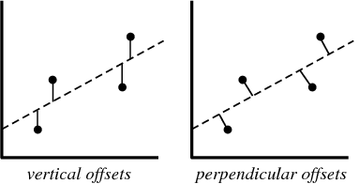
Stepping back, the concept of the least squares algorithm (under regression analysis) is to minimize the errors between the fitted curve and the data. In general, suppose the polynomial is:
p(x) = a₀ + a₁ x + a₂ x² + a₃ x³ + a₄ x⁴ …
and the data point y_{i} depends on x_{i}, we can then define the error e_{i} for each data point to be:
e_{i} = y_{i} – p(x_{i}) = y_{i} – ( a₀ + a₁ x_{i} + a₂ x_{i}² + a₃ x_{i}³ + a₄ x_{i}⁴ … )
To account for all the N data points, we can the sum up the squares of all the errors is:
Σ_{i} e_{i} ² = Σ_{i} ( y_{i} – p(x_{i}) )² = S({a_{i}})
where the summation is for i=1 to N.
The square is to not distinguish the signs
(and for derivatives).
This fits the vertical points (can be perpendicular
too, but more complex).
The key is to minimize the function S using calculus.
Beware of “overfitting”.
https://www.khanacademy.org/math/ap-statistics/bivariate-data-ap/least-squares-regression/v/introduction-to-residuals-and-least-squares-regression
http://mathworld.wolfram.com/LeastSquaresFitting.html

Slide 120
Numerical integration in calculus and ordinary differential equations (ODEs)

Slide 121
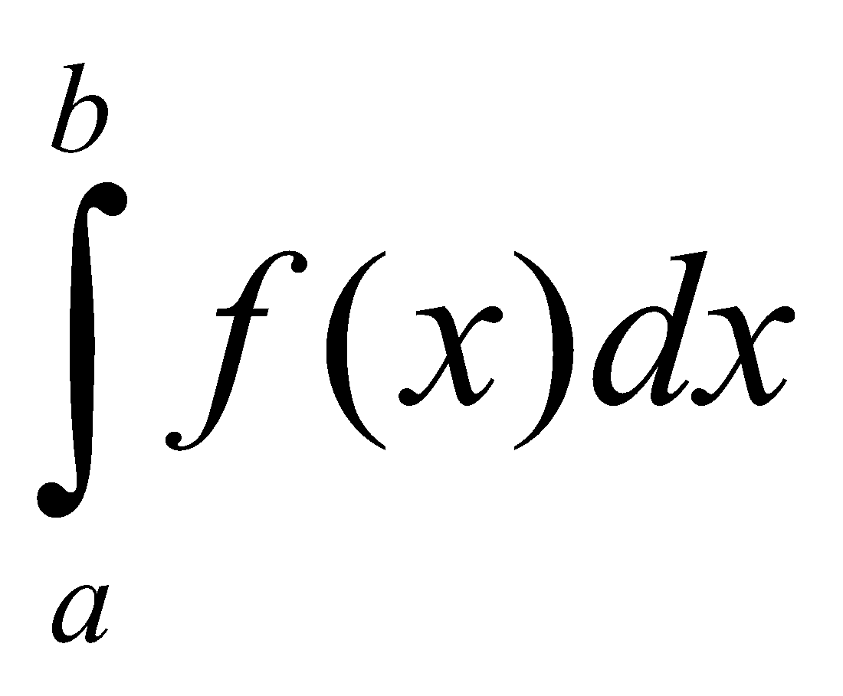
Calculus: Integration
In basic calculus, the (definite) integral of a function f(x) between the limits given by x=a and x=b is written as
Quite often in practice, the function f(x) is non-trivial, and the integration is difficult to solve (or not even analytically solvable!). ➔ Solve it numerically.
The trick is to understand that the above integration is essentially estimating the area under the f(x) curve from x=a to x=b. The simplest way is to use a bunch of narrow rectangles, and summed their areas all up. But it may lead to errors if f(x) varies a lot.
So if we can find some method to (intelligently) estimate the rectangles to fit the curve better, the total area estimation will be more accurate.

Slide 122
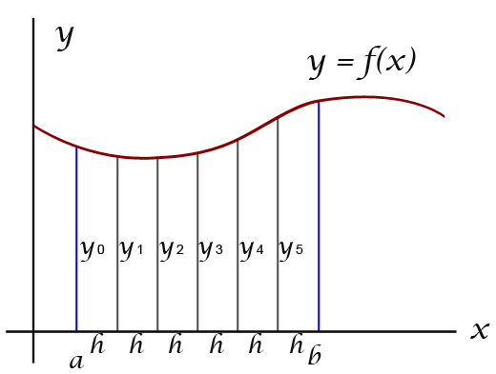
One of the most often used numerical methods (there are many others!) is the trapezoidal rule. With uniform partitioning of the trapezoids (simplest method), we have the total area to be Σ_{n} ( (h/2)* (y_{n} + y_{n+1}) )
where n goes from 0 to N, and N is the total number of trapezoids. The summation is from n=0 to n=N – 1. h=(b – a)/N is the horizontal width of the trapezoid.
MATLAB has built-in function trapz that circumvents using for loop to sum all the areas. Instead of linear (y_{n} + y_{n+1}) , we can also used polynomials → Simpson’s method, which MATLAB uses the built-in function quad to implement it.
https://www.khanacademy.org/math/ap-calculus-ab/ab-accumulation-riemann-sums/ab-midpoint-trapezoid/v/trapezoidal-approximation-of-area-under-curve

Slide 123
One of the most often used numerical methods (there are many others!) is the trapezoidal rule. With uniform partitioning of the trapezoids (simplest method), we have the total area to be Σ_{n} ( (h/2)* (y_{n} + y_{n+1}) )
where n goes from 0 to N, and N is the total number of trapezoids. The summation is from n=0 to n=N – 1. h=(b – a)/N is the horizontal width of the trapezoid.
MATLAB has built-in function trapz that circumvents using for loop to sum all the areas. Instead of linear (y_{n} + y_{n+1}) , we can also used polynomials → Simpson’s method, which MATLAB uses the built-in function quad to implement it.
https://www.khanacademy.org/math/ap-calculus-ab/ab-accumulation-riemann-sums/ab-midpoint-trapezoid/v/trapezoidal-approximation-of-area-under-curve

Slide 124
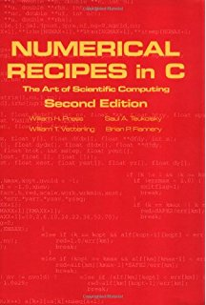
E.g.
>> x = 2:10
>> f = 3.*x.^2 - 1;
>> trapz(x,f)
ans =
988
How about the integral of the below f2 function from x2=2 to 10?
>> x2 = 2:10
>> f2 = 3.*x2.^2 - log(x2.*exp(-2.*x2));
>> trapz(x2,f2)
ans =
1.0784e+03
One can also incorporate more advanced features, e.g. with
adaptive width depending on the curvature of the graph
(steeper the gradient, the smaller the width). For more
information, check out the classic book “Numerical Recipes in C”,
by Press et al.

Slide 125
Ordinary differential equations (ODEs)
Many physical processes, both natural and engineered, are best described by ordinary differential equations (ODEs), which relate time derivatives of particular quantities to each other.
Most mathematics course would focus on developing techniques to solve ODEs analytically. But computers offer the option of solving ODEs numerically for some fixed initial values.
Solving an ODE numerically is sometimes called “simulating” it. So numerical methods can be seen as a methodology for programming simulations of physical processes. Sometimes it is even called in silico experiments.

Slide 126
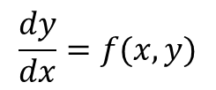
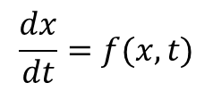
Refresher
A differential equation with respect to time (dynamical system) can be expressed in a general form:
$$\frac{dx}{dt}=f(x,t)$$
Essentially describing a rate of change of a quantity x with respect to time.
E.g. Kinematics: ds/dt = u – g t
E.g. Force and acceleration: F = m dv/dt, or dv/dt = F/m
This is sometimes call a dynamical system.
Very useful in modelling a variety of systems: engineering, physics, biology, chemistry, …
More generally,
$$\frac{dy}{dx}=f(x,y)$$
x: independent variable
y: dependent variable

Slide 127
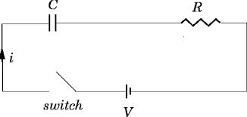
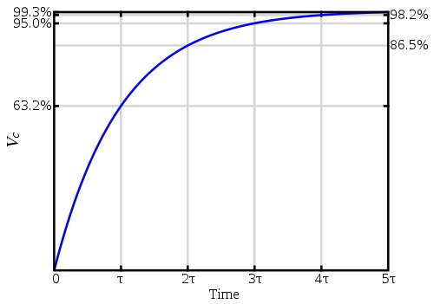

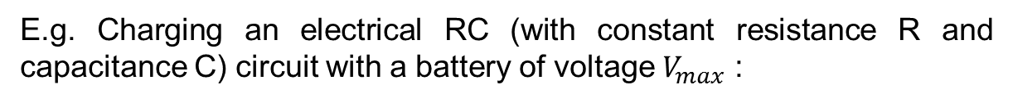
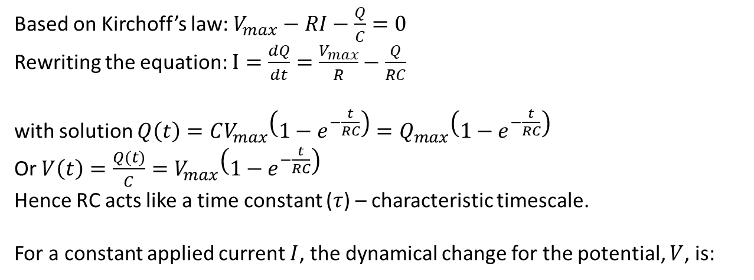
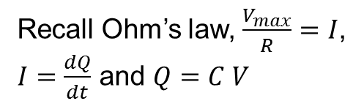
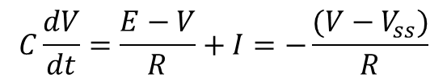

E.g. Charging an electrical RC (with constant resistance R and capacitance C) circuit with a battery of voltage $V_{max}$ :
Recall Ohm’s law, $\frac{V_{max}}{R}=I$,
$I=\frac{dQ}{dt}$ and $Q=C V$
$$V_{max}$$
Based on Kirchoff’s law: $V_{max}−RI−\frac{Q}{C}=0$
Rewriting the equation: $I=\frac{dQ}{dt}=\frac{V_{max}}{R}−\frac{Q}{RC}$
with solution $Q\left(t\right)=CV_{max}\left(1−e^{−\frac{t}{RC}}\right)=Q_{max}\left(1−e^{−\frac{t}{RC}}\right)$
Or $V\left(t\right)=\frac{Q(t)}{C}=V_{max}\left(1−e^{−\frac{t}{RC}}\right)$
Hence RC acts like a time constant ($τ$) – characteristic timescale.
For a constant applied current $I$, the dynamical change for the potential, $V$, is:
$$C\frac{dV}{dt}=\frac{E−V}{R}+I=−\frac{(V−V_{ss})}{R}$$
with solutions
$$V\left(t\right)=V_{ss}−(V_{ss}−V(0))\left(1−e^{−\frac{t}{RC}}\right)$$

Slide 128



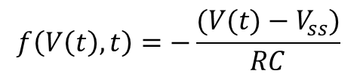
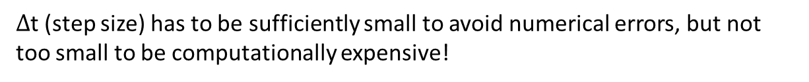
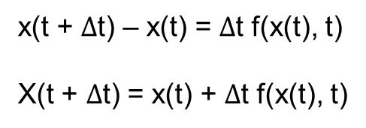
Numerical integration methods to differential equations
(Forward) Euler’s method (iterative numerical scheme):
Finite difference method
dx/dt = f(x, t)
$∆$x/$∆$t $≈$ f(x, t)
$∆$x = x(t + $∆$t) – x(t)
x(t + $∆$t) – x(t) = $∆$t f(x(t), t)
X(t + $∆$t) = x(t) + $∆$t f(x(t), t)
$∆$t (step size) has to be sufficiently small to avoid numerical errors, but not too small to be computationally expensive!
E.g.
$$f\left(V\left(t\right),t\right)=−\frac{(V(t)−V_{ss})}{RC}$$
$$V\left(t+∆t\right)=V\left(t\right)+∆t f(V\left(t\right))$$
Check out more accurate (e.g. with adaptive time step) numerical algorithms:
e.g. Runge-Kutta 2, Runge Kutta 4.

Slide 129
Numerical integration with MATLAB
Euler’s numerical integration method (blue) compared to analytical solutions:
>> Vss=10
Vss =
10
>> tau=20
tau =
20
>> T_total=1000; dt=0.1; V=zeros(1,10*T_total);
>> for t=1:T_total/dt
V(t+1)=V(t)+dt*(-(V(t)-Vss)/tau);
end;
>> plot(V)
>> xlabel('t (units)'); ylabel('V (volts)');
>> figure;
plot([0:dt:T_total],Vss-(Vss-0)*exp(-[0:dt:T_total]/tau),'g');
>> xlabel('t (units)'); ylabel('V (volts)');

Slide 130
The MATLAB function “ode45” implements a (more complex, but more accurate) Runge-Kutta method with a variable/adaptive time step for efficient computation.
First, create a function file and save it as, say, F.m :
function f_V=F(t,V)
f_V=zeros(1,T_total);
f_V=-(V-Vss)/tau;
Then:
>> [t,V]=ode45('F',[0,T_total],0);
>> plot(V,‘r‘)

Slide 131
Key points and summary
MATLAB built-in functions for statistics.
Curve fitting of data using built-in functions polyfit and polyval.
Numerical methods for estimating definite integrals and simulating ODEs especially especially when solutions are not possibly/apparently analytical.

Slide 132
References
MATLAB: A Practical Introduction to Programming and Problem Solving, by Stormy Attaway, 2009, Elsevier. Chapters 12 and (bits of 14).
Engineering Programming C, MATLAB, JAVA, by Mark Austin, David Chancogne, 1999, John Wiley & Sons. Chapter 15.
Programming for Engineers: A Foundational Approach to Learning C and Matlab, Aaron R. Bradley, 2011, Springer-Verlag. Chapters 10 and 11.

Slide 133
We hope this set of notes will cover some of the fundamental aspects of MATLAB programming and give you a good headstart going into the Autumn School! The lab session on Day 1 will cover further relevant applications and examples There are also many other resources online that you can explore on your own, e.g. https://uk.mathworks.com/help/matlab/

