Slide 1

Investigate time series neural data: Experimental design & processing
Day 3 : LAB
Tutors: Mark Butler and Monika Sharma

Slide 2
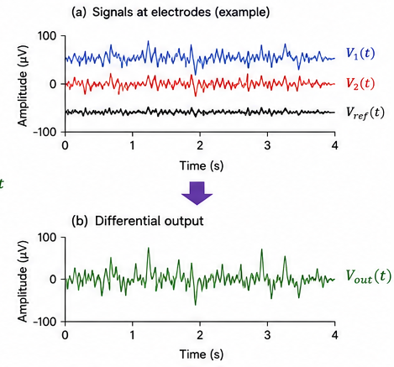
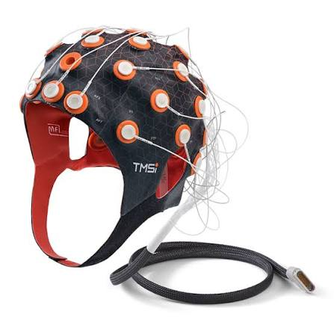
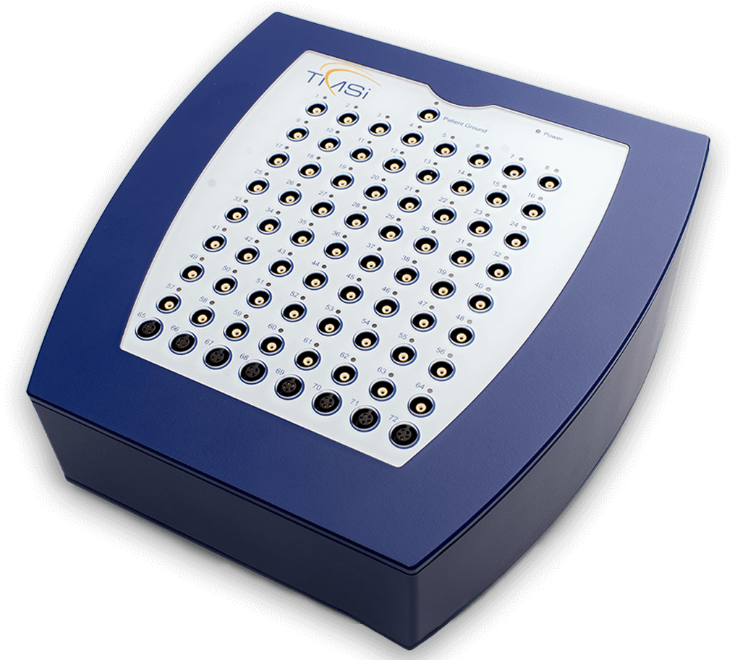
Experiment Description
TMSI Refa8 EEG amplifier
Sampling rate: 256 Hz
17 electrode: fronto-central, central, centro-parietal, and parietal
OpenVIBE software
EEG recording
display of visual cues
Feedback
Online classification

Slide 3
EEG Concept
Concept | Details | Why Important
EEG Channels | Records change in voltage over time | Represents spatial brain activity
Number of Channels | Can vary: • Low-density: 8–16 channels • Medium: 16–32 channels • High-density: 64, 128, 256+ channels | More channels = better spatial resolution
10–20 System | Standard electrode placement system | Ensures consistency across studies
Odd vs Even Electrodes | Odd = Left hemisphere (C3, FC3, CP3) Even = Right hemisphere (C4, FC4, CP4) | Helps distinguish left vs right brain activity
Midline Electrodes | Cz, FCz, CPz (“z” = center) | Represent central brain activity
Sampling Frequency | Number of samples per second; your system: 256 Hz | Determines temporal resolution and ability to capture fast neural activity
EEG Frequency Bands | Alpha (8–13 Hz): relaxed, eyes closed; Beta (13–30 Hz): alert, active thinking | Alpha → baseline/relaxation; Beta → cognition, attention, stress

Slide 4
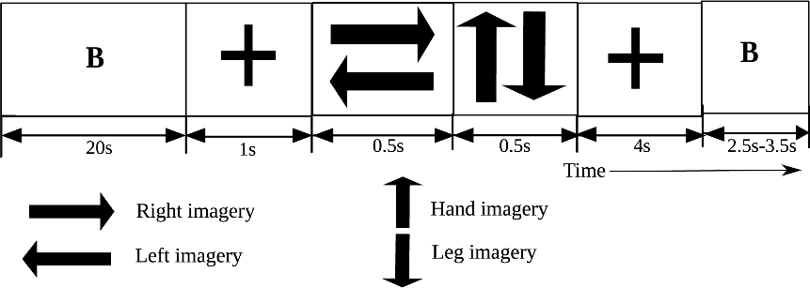
Participants and tasks
Visual or somatosensory feedback
Sixteen naive participants
13 males and three females
mean age = 28 ± 9 years
Tasks
cued motor imagery (They imagined movement based on cues)
left hand, right hand, left foot, and right foot
Each session
24 trials for each motor imagery task

Slide 5
Recorded EEG signal analysis
EEG signal were 5s epoched from 1s before feedback onset
Bandpass filtered [0.5, 40] Hz
re-referenced at Fz
common spatial patterns (CSPs) to extract the feature vectors
linear discriminant analysis (LDA) classifier
selecting a time window around an important event

Slide 6
Exercises
Temporal filter: Apply a low-pass filter of your choice with a cut-off at
6 Hz
32 Hz
Spatial filter: Apply a Laplacian filter for electrodes
FCz, Cz and CPz
Baseline correct the
temporally filtered data
spatially filtered data
Plot the grand averages of the electrodes: Cz, FCz and CPz for the time range [1.5, 3] s
Plot and analyse the time-frequency distribution of the signals using Morlet Wavelet
temporally filtered data
spatially filtered data

