Slide 1
Investigating time series neural data: Experimental design & processing

Slide 2
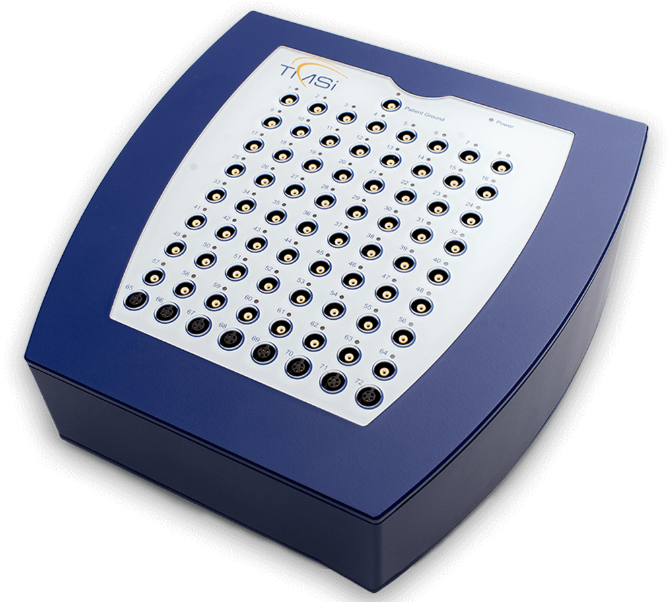
Experiment Description
TMSI Refa8 EEG amplifier
Sampling rate: 256 Hz
17 electrode: fronto-central, central, centro-parietal, and parietal
OpenVIBE software
EEG recording
display of visual cues
Feedback
Online classification

Slide 3
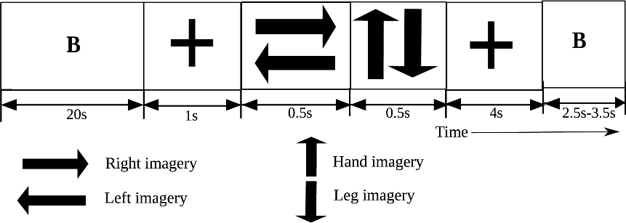
Participants and tasks
Visual or somatosensory feedback
Sixteen naive participants
13 males and three females
mean age = 28 ± 9 years
Tasks
cued motor imagery
left hand, right hand, left foot, and right foot
Each session
24 trials for each motor imagery task

Slide 4
Recorded EEG signal analysis
5s epoched from 1s before feedback onset
Bandpass filtered [0.5, 40] Hz
re-referenced at Fz
common spatial patterns (CSPs) to extract the feature vectors
linear discriminant analysis (LDA) classifier

Slide 5
Exercises
Temporal filter: Apply a low-pass filter of your choice with a cut-off at
6 Hz
32 Hz
2. Spatial filter: Apply a Laplacian filter for electrodes
FCz, Cz and CPz
Baseline correct the
temporally filtered data
spatially filtered data
Plot the grand averages of the electrodes: Cz, FCz and CPz for the time range [1.5, 3] s
Plot and analyse the time-frequency distribution of the signals using Morlet Wavelet
temporally filtered data
spatially filtered data

