Slide 1
Senhui Qiu, PhD Researcher Intelligent Systems Research Centre, School of Computing, Engineering & Intelligent Systems Ulster University, Magee, Derry
Continual Learning

Slide 2
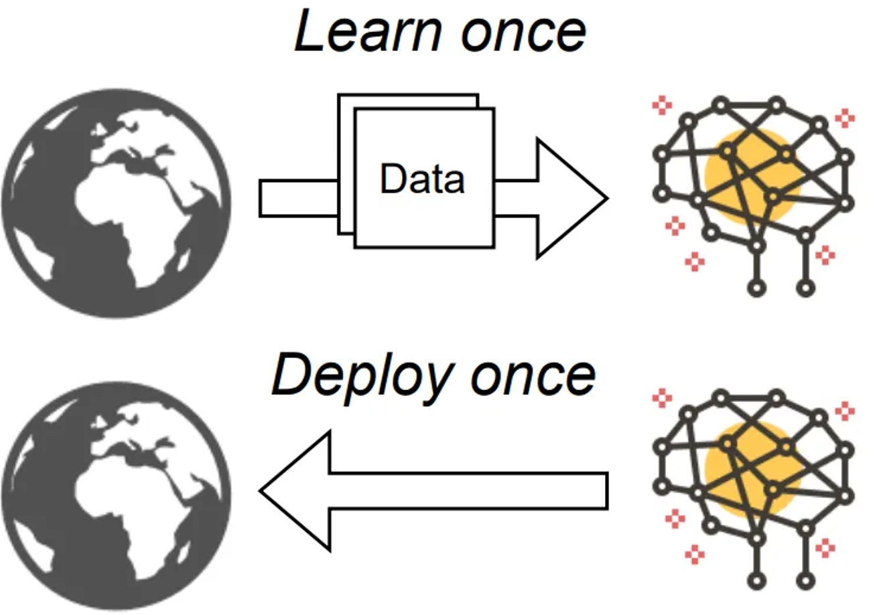
Introduction
The world is not stationary
Animal species can learn continually throughout their lifetime.
Current machine learning (ML) models cannot learn continually by using the same model.
Current static ML method

Slide 3
Questions
Q1: Suppose we use the same model to learn a new classification task. What happens to test accuracy on data from previous tasks after learning a new task?
Classification accuracy on data from previous tasks will decrease significantly. (Catastrophic forgetting)
Q2: How to solve this problem?
Replay method. (Storing data from previous tasks and feed them into new tasks)

Slide 4
Experiment
Q1: Suppose we use the same model to learn a new classification task. What happens to test accuracy on data from previous tasks after learning a new task?
Task 1
data | ‘0’ | ‘1’
label | 0 | 1
Task 2
data | ‘2’ | ‘3’
label | 0 | 1
Task 3
data | ‘4’ | ‘5’
label | 0 | 1
Task 4
data | ‘6’ | ‘7’
label | 0 | 1
Task 5
data | ‘8’ | ‘9’
label | 0 | 1
Train:
Model
Model
Model
Model
Model
Task 1
data | ‘0’ | ‘1’
label | 0 | 1
Task 2
data | ‘0’ ‘2’ | ‘1’ ‘3’
label | 0 | 1
Task 3
data | ‘0’ ‘2’ ‘4’ | ‘1’ ‘3’ ‘5’
label | 0 | 1
Task 4
data | ‘0’ ‘2’ ‘4’ ‘6’ | ‘1’ ‘3’ ‘5’ ‘7’
label | 0 | 1
Task 5
data | ‘0’ ‘2’ ‘4’ ‘6’ ‘8’ | ‘1’ ‘3’ ‘5’ ‘7’ ‘9’
label | 0 | 1
Test:
After training task 2, the test accuracy on ‘0’ and ‘1’ (task 1 data) decreased significantly, leading to catastrophic forgetting.

Slide 5
Experiment
2: How to solve this problem?
Replay method (Storing data from previous tasks and feed them into new tasks)
Storing data
Task 1
data | ‘0’ | ‘1’
label | 0 | 1
Task 2
data | ‘2’ | ‘3’
label | 0 | 1
Data storage
data | ‘0’ | ‘1’
label | 0 | 1
Train:
Replay
Model
Model
……..
Task 1
data | ‘0’ | ‘1’
label | 0 | 1
Task 2
data | ‘0’ ‘2’ | ‘1’ ‘3’
label | 0 | 1
Test:
After training task 2, the test accuracy on ‘0’ and ‘1’ (task 1 data) significantly higher than those without using the replay method.

Slide 6
Directions for further exploration
Q1: How does the proportion of samples saved for replay affect the model's performance?
Q2: Use replay to train the network on more than two tasks. What is the impact of replay on the memory used by your models? Note that replay-based approach requires that you save the replay samples from previous task forever. This implies that the memory required to store samples contributes to your models memory footprint.
Q3: Can we choose replay samples more smartly so that we generate maximal impact while using minimal memory? For instance, can you use the network's prediction on a given task to identify samples stored for replay?

Slide 7
Thank you for listening!
Email: Qiu-S2@ulster.ac.uk

