Slide 1
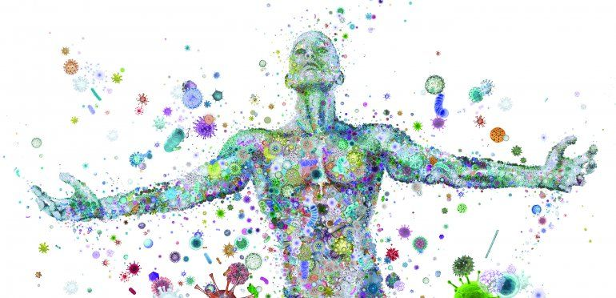


Central regulation of appetite, satiety and metabolism: Do gut microbiota play a role?
Cristina Cuesta Martí
Research MSc student
Supervisor: Dr. Harriët Schellekens
Co-supervisor: Dr. Gerard Clarke
Mentor: Natasha Leeuwendaal
& Gerry Moloney
2020-2021

Slide 2


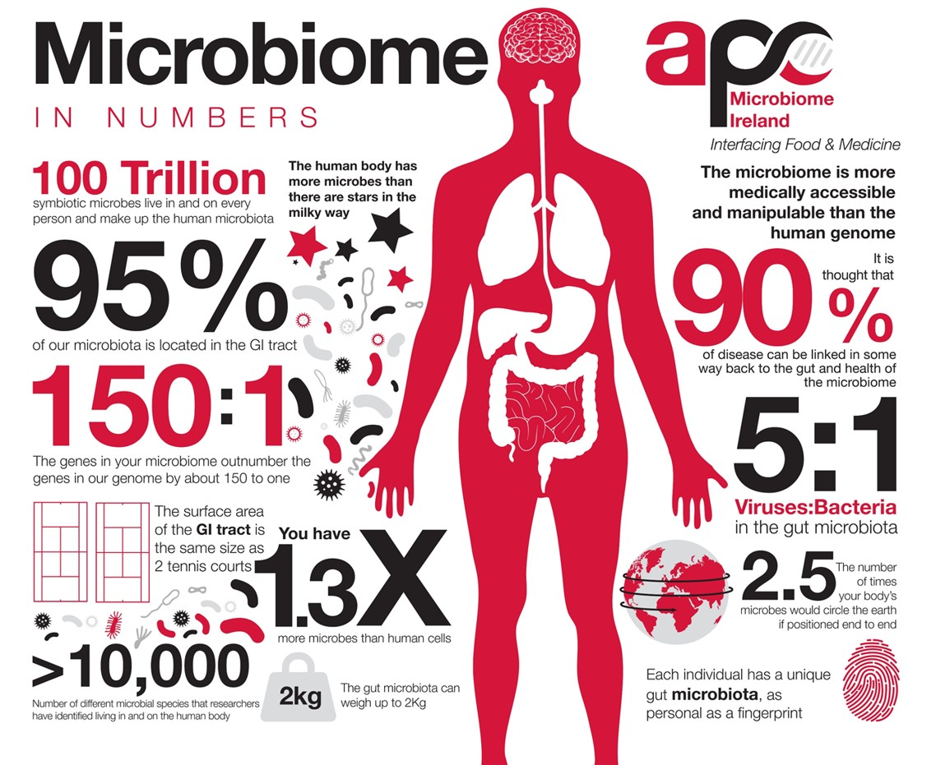

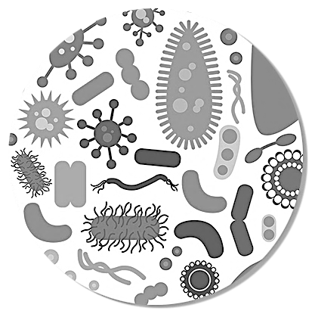
INDEX
01
INTRODUCTION
02
OBJECTIVES OF THE STUDY
03
METHODOLOGY
04
06

Slide 3
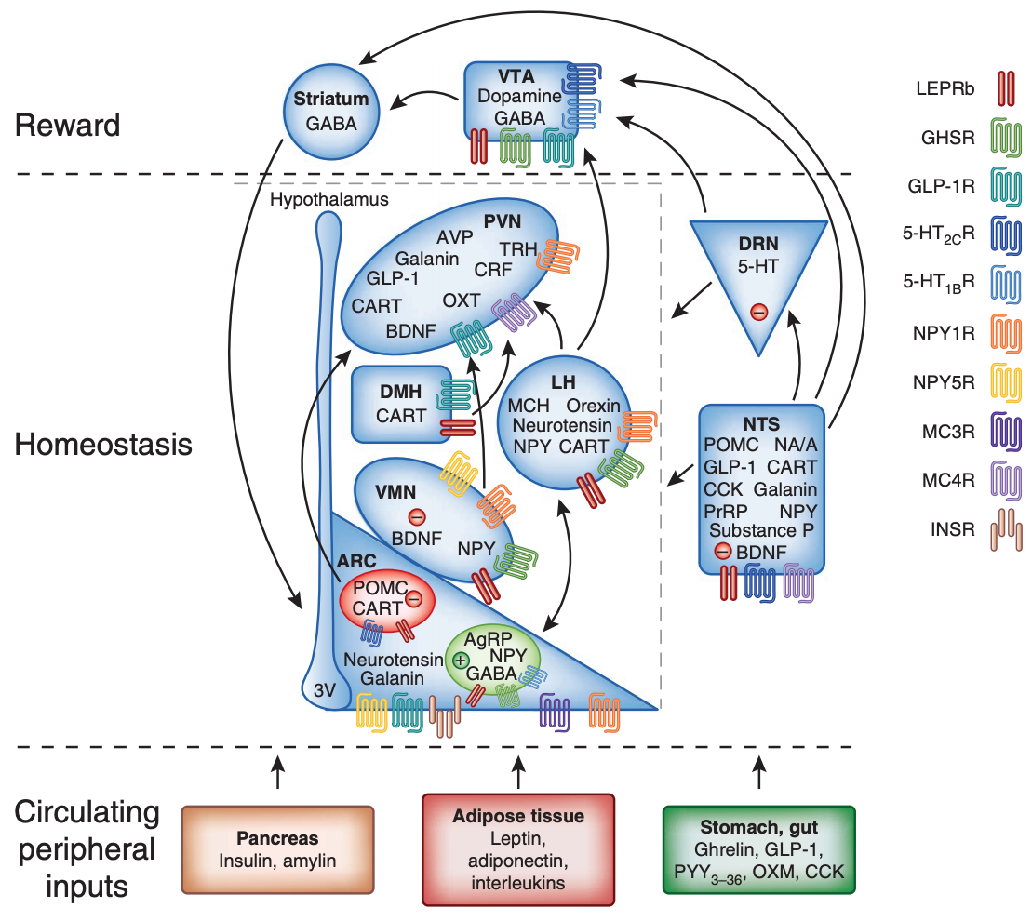
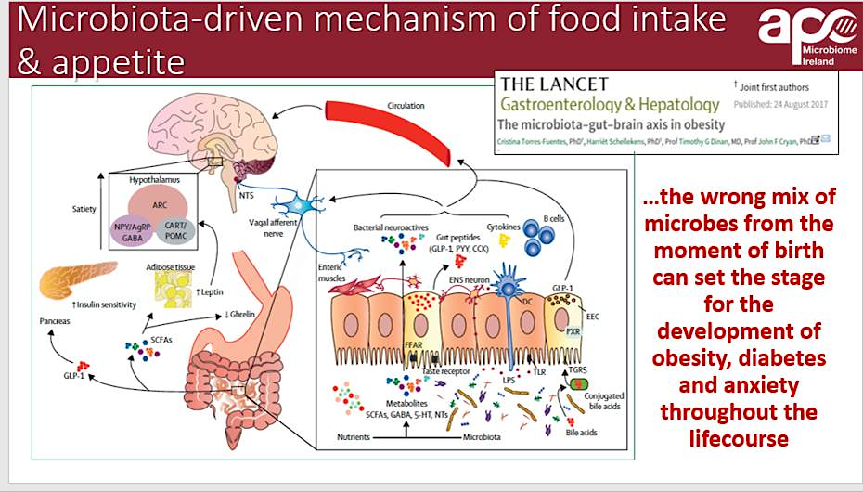
INTRODUCTION | MICROBIOTA-GUT-BRAIN AXIS
Figure 1 | Signaling Pathways and Molecules Involved in the regulation of appetite and metabolism driven by gut microbiota. Extracted from: (Torres-Fuentes et al. 2017).
Figure 2 | Representation of the hypothalamic nuclei and other higher brain regions (Yeo and Heisler 2012).
3

Slide 4

OBJECTIVES
Investigate the potential of Microbiota-Gut-Brain Axis signalling on the regulation of food intake, appetite and satiety via central mechanism. But how specifically?
Study the modulation of hypothalamic gene expression, focusing on the neuropeptides and GPCRs involved in appetite signalling by:
Specific bacterial strain supernatants.
Different concentrations of SCFAs and lactate.
4

Slide 5
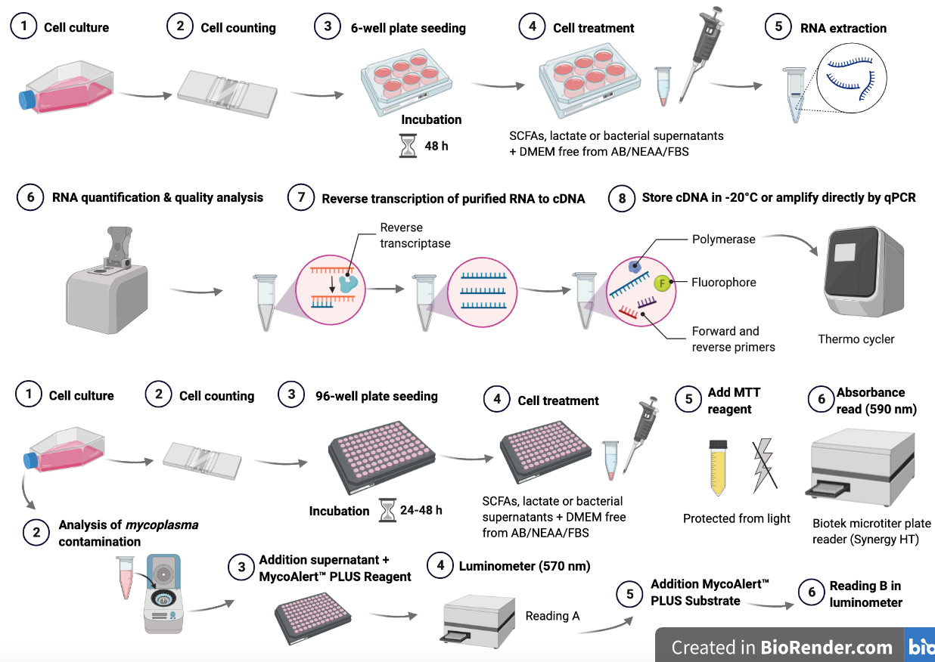
METHODOLOGY | In vitro study
5
Figure 3 | Schematic representation of the experimental procedure performed.

Slide 6
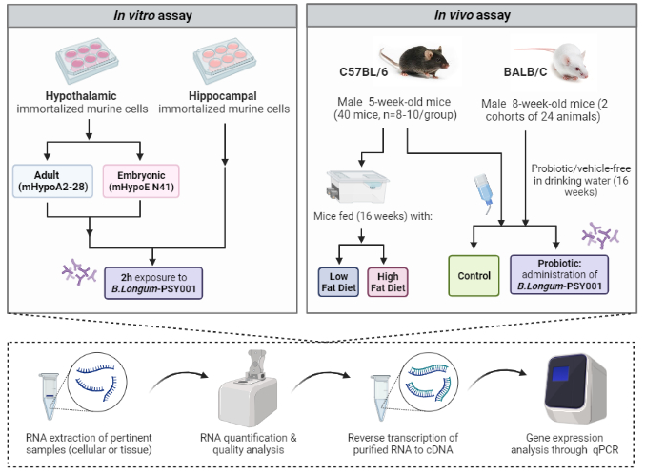
METHODOLOGY | Overview
6
Figure 4 | Summary of the methodology performed in the current study. Figure created with Biorender.

Slide 7

WHAT I EXPECT FROM THE CN₃ AUTUMN SCHOOL?
Learn and apply some of the main learnings and techniques of the course (computational neuroscience, neural data science, neurotechnology and neuro-inspired AI) in my group (Dr. Schellekens group) or microbiota-gut-brain axis (Prof. Dr. Cryan group)
7

Slide 8
Central regulation of appetite, satiety and metabolism: Do gut microbiota play a role?
Cristina Cuesta Martí
Erasmus + Trainee Student
Supervisor: Dr. Harriët Schellekens
Co-supervisor: Dr. Gerard Clarke
Mentor: Natasha Leeuwendaal
& Gerry Moloney
2020-2021

