Slide 1
Digital Notice Board System
Real-time Campus Communication Platform

Slide 2
Problem Statement
Paper notices create clutter and waste
No instant updates for urgent announcements
Students miss important information
No centralized communication

Slide 3
Proposed Solution
Cloud-based digital notice system
Instant updates across devices
Accessible via mobile and displays
Centralized information hub

Slide 4
Key Features
Role-based access (Student/Teacher/Admin)
Real-time updates (WebSockets)
Categorized notices
Multimedia support

Slide 5
System Architecture
Admin creates notice
Server processes data
Database stores notices
Instant push to users

Slide 6
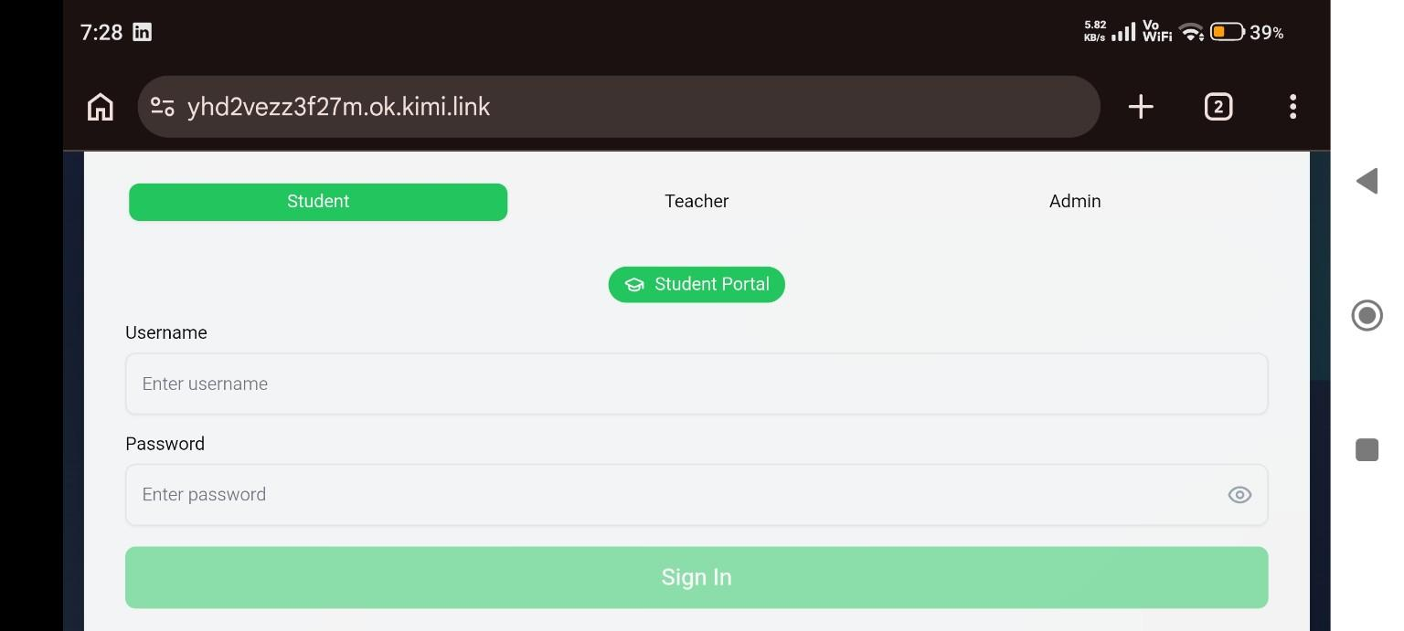
Login System

Slide 7
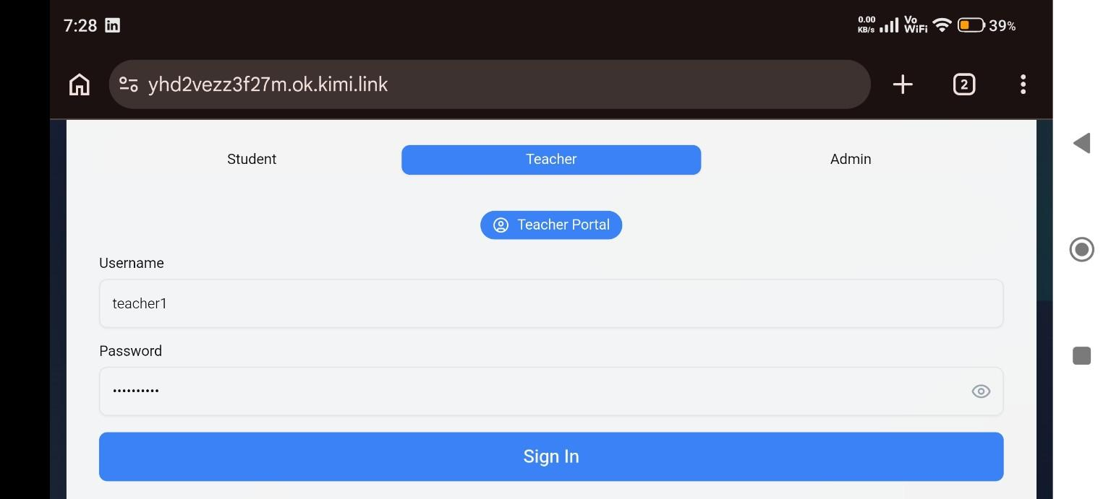
Teacher Portal

Slide 8
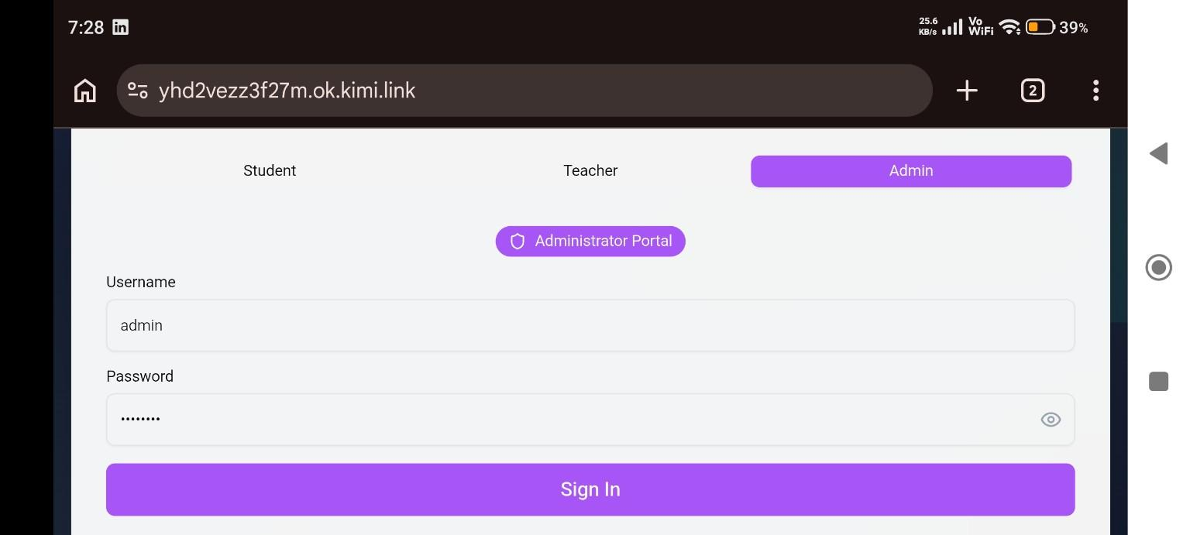
Admin Panel

Slide 9
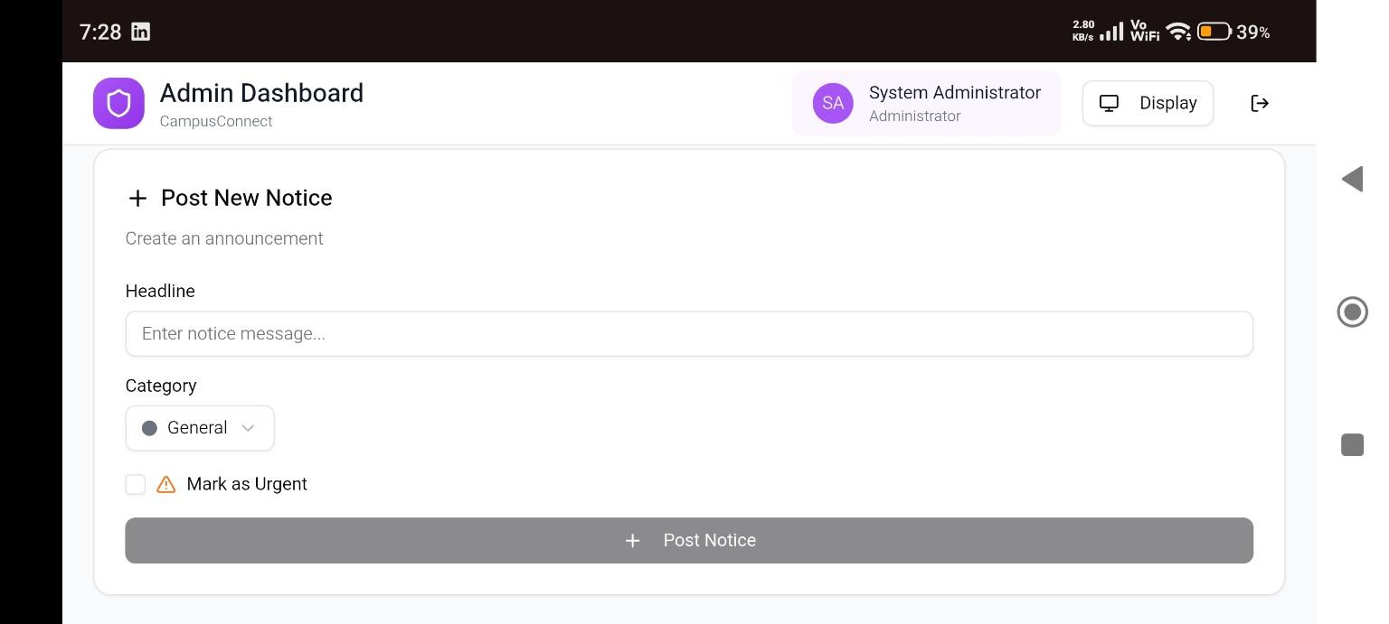
Notice Creation

Slide 10
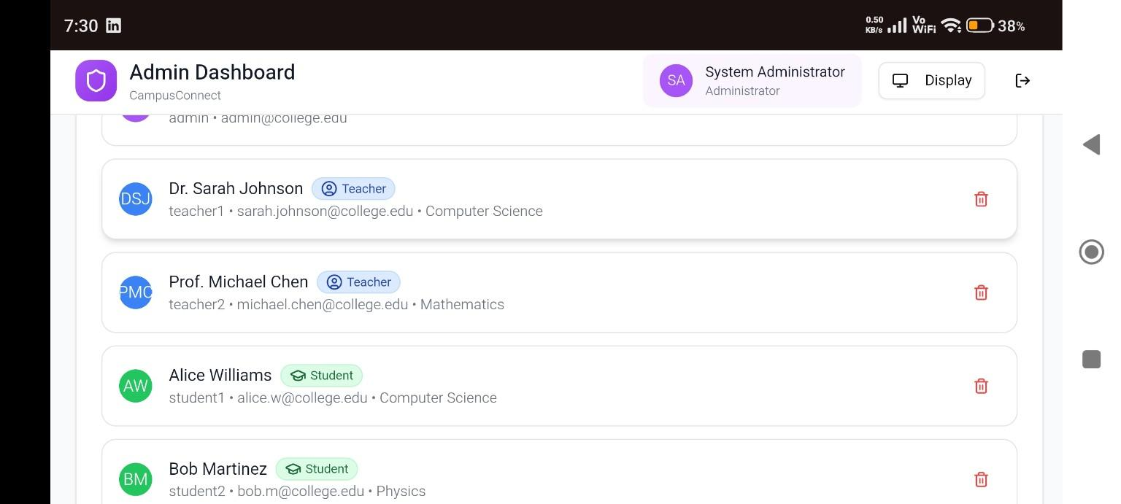
User Management

Slide 11
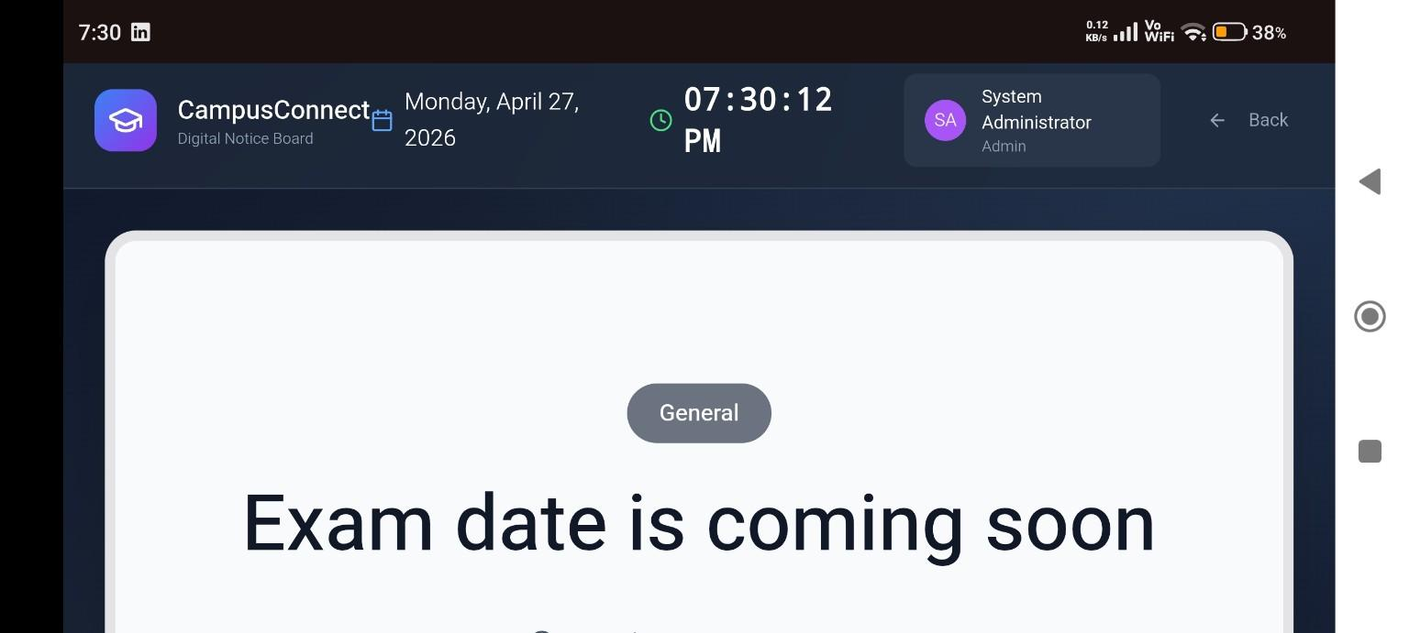
Display Board

Slide 12
Advantages
Eco-friendly
Instant communication
Improved accessibility
Scalable system

Slide 13
Conclusion
Transforms traditional boards
Real-time communication system
Efficient and modern solution

