Slide 1
Vehicle Data Analysis
IST 718
Group12
Matt McDonnell, Ji Ma, Zhongwei Chen

Slide 2
Overview
Problem Statement: How can car shoppers and manufacturers benefit from identifying aspects of cost savings and consumer buying selection process?
Why?
Average Americans spend over $2,000 a year on their vehicles in just gas costs
New government policies are mandating reductions in fuel emissions, thus driving gas costs up
Gas cars are projected to lose significant market share by 2030
Consumers are taking their carbon footprint and fuel costs into account more than ever with the emergence of more prevalent alternative technologies

Slide 3
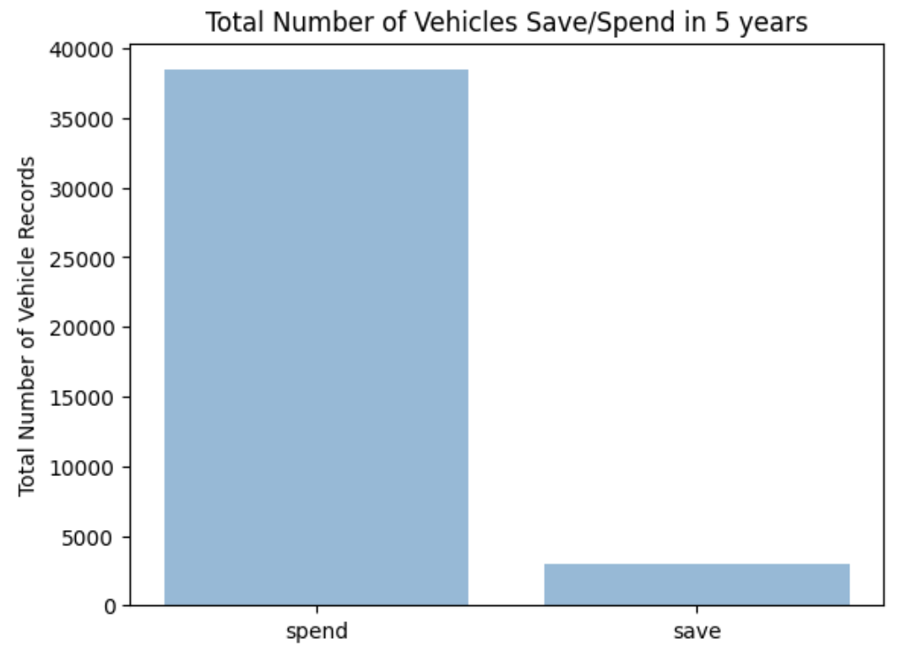
Dataset Introduction
youSaveSpend: save/spend over 5 years compared to an average car, savings are positive
CO2 Tailpipe GPM: tailpipe CO2 in grams/mile
Barrels08: annual petroleum consumption in barrels
Cylinders: number of engine cylinders
Make: vehicle manufacturer
Model: vehicle model name
Displ: engine displacement in liters
Trany: transmission gear box

Slide 4
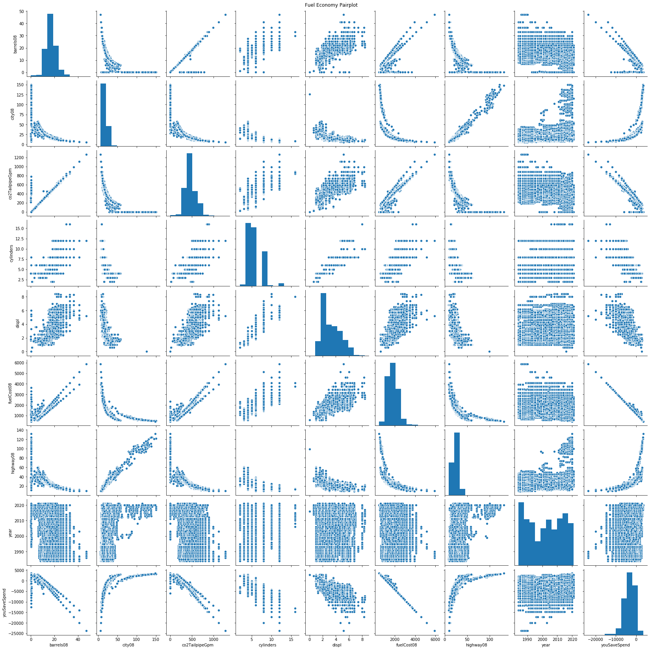
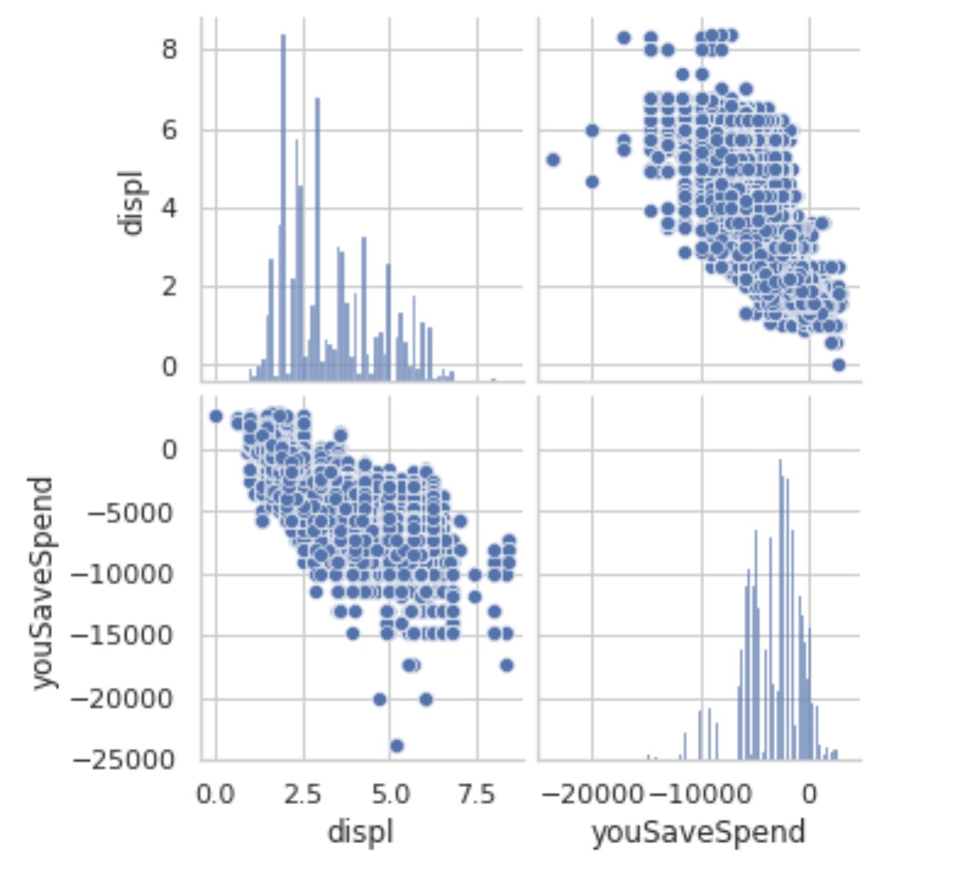
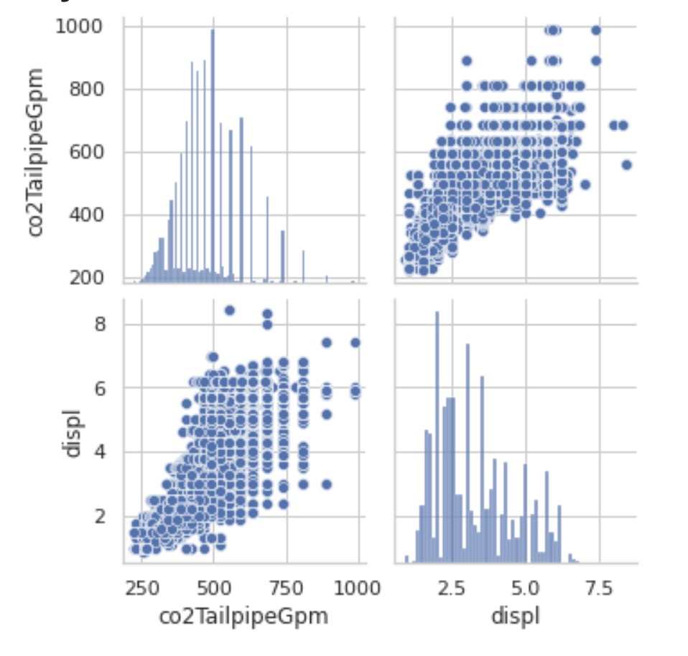
Data exploration
Displacement vs YouSaveSpend
Displacement vs Tailpipe
Notes:
the positive linear relationships seen in the tailpipe emission(co2TailpipeGpm), fuel cost, and annual petroleum consumption (barrels08) variables
the number of cylinders and engine displacement in liters (displ) appear to have the highest potential to affect fuel cost as well as the cost on vehicle in 5 years (youSaveSpend).

Slide 5
Project Goals
Prediction (Cost Savings)
What kind of vehicle features can possibly generate lower costs for customers in 5 years after purchasing the vehicle?
Inference (Cost Savings)
We predict that some of the most likely variables will be displacement, fuel cost, cylinders, and fuel type.

Slide 6
Project Goals
Prediction (CO2 Tailpipe Emissions)
What kind of vehicle features lead to high CO2 Tailpipe emissions?
Inference (CO2 Tailpipe Emissions)
We predict that some of the most likely variables will be consumption barrels, cylinders, and fuel type.

Slide 7
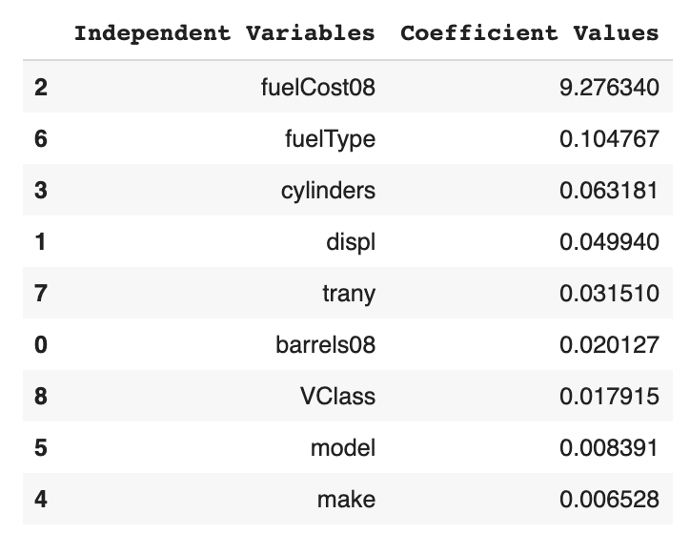
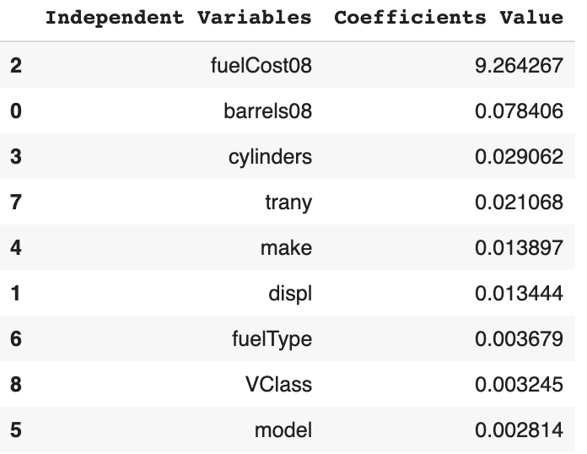
Prediction Outcomes
Results on Save/Spend in 5 years:
  MSE Training: 0.122
  MSE Testing: 0.108
  Weights on independent vehicle features:
Results on CO2 Tailpipe Emission:
  MSE Training: 2447.511
  MSE Testing: 1936.808
  Weights on independent vehicle features:

Slide 8
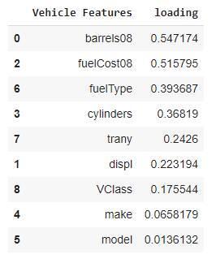
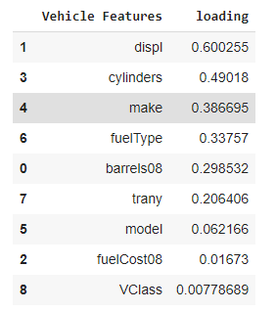
Inference
PC1 and PC2 loading show which vehicle features are important for recommendations.
PC1
PC2

Slide 9
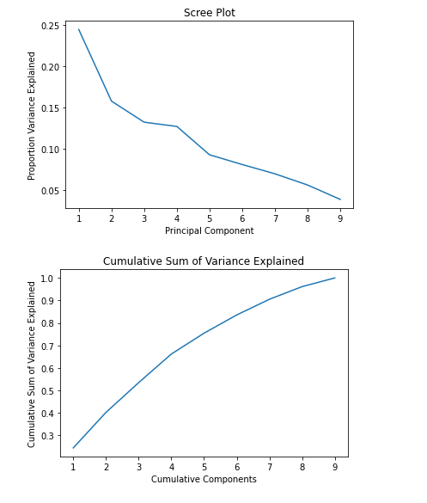
K-Means Cluster Analysis
Cluster Analysis
K | Silhouette Coefficient
3 | 0.281951014
4 | 0.267750277
5 | 0.280944585
6 | 0.267092362
7 | 0.284524183
8 | 0.28272994
String Indexer
Vector Assemble
Standard Scaler
Normalization

Slide 10
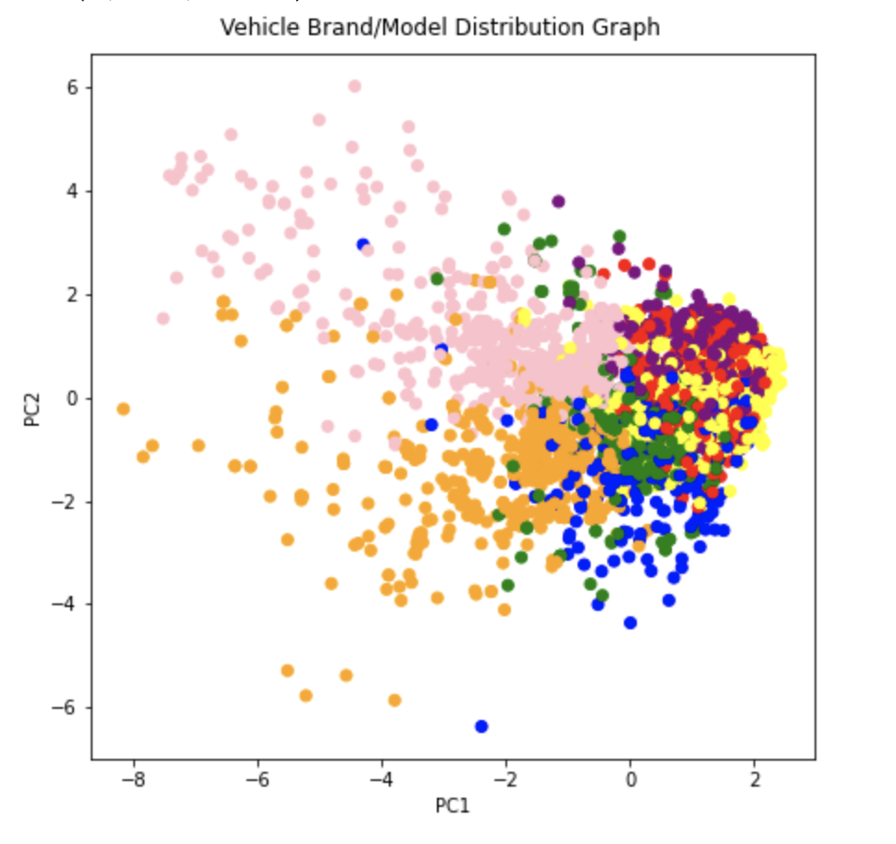
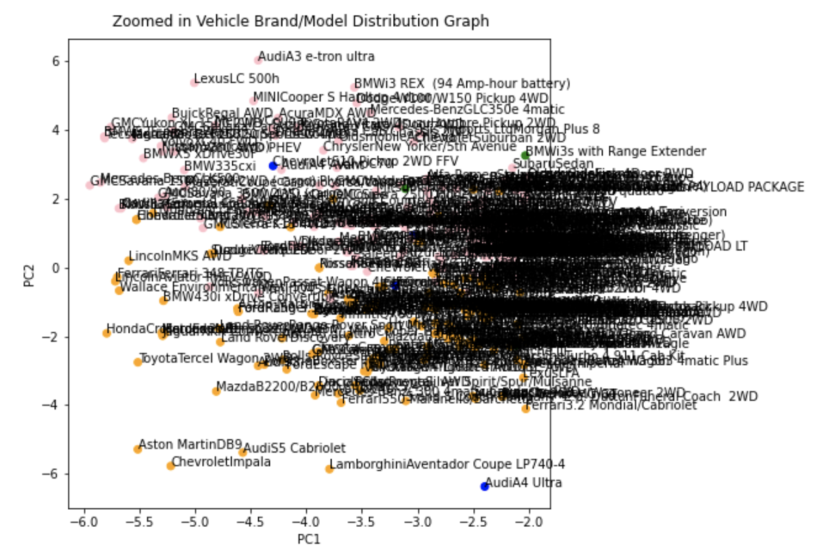
Clustering Visualizations

Slide 11
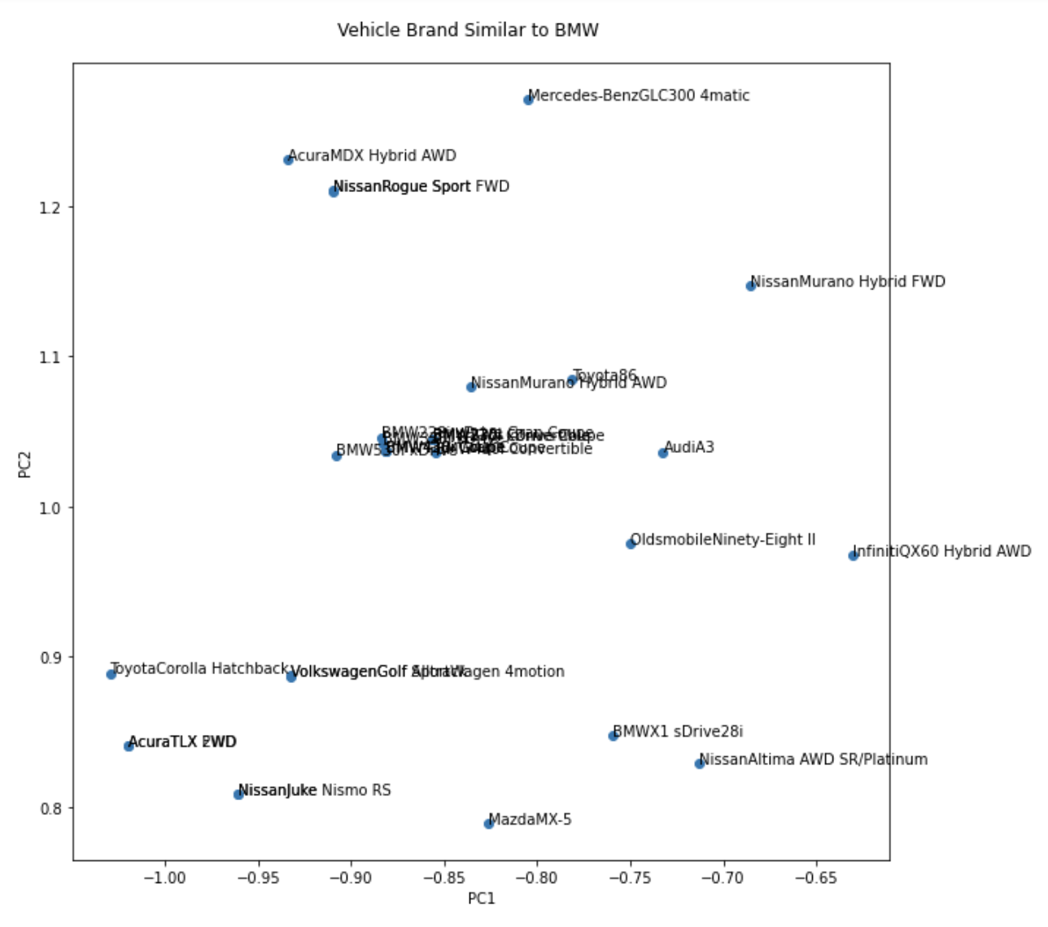
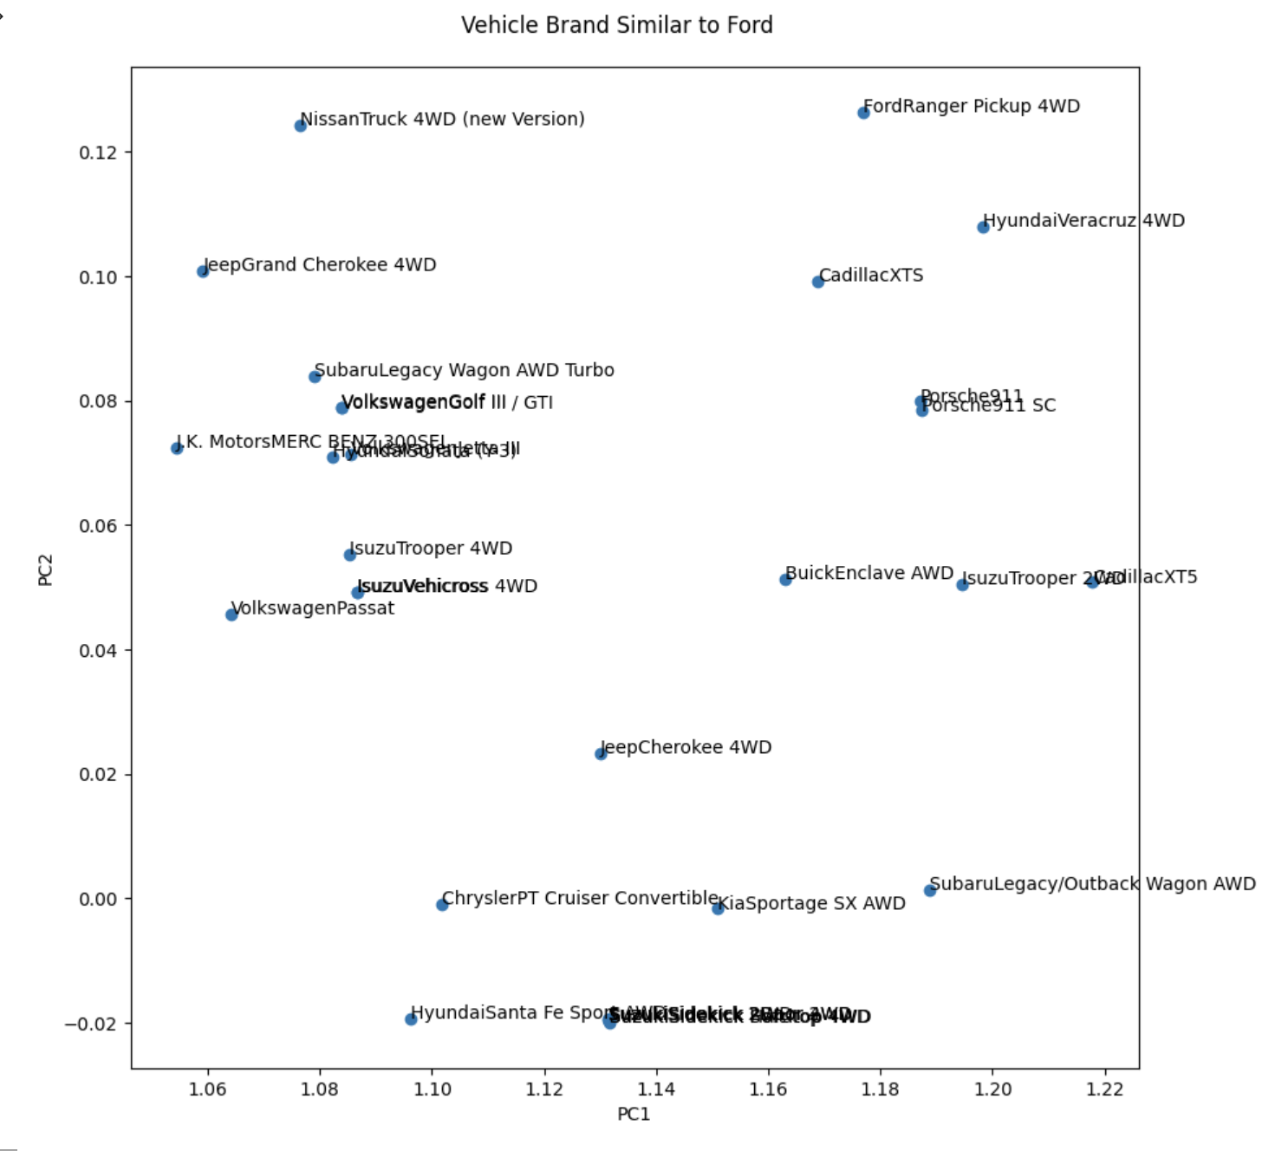
Recommendation System on Vehicle

Slide 12
Problems
1. Clusters Similarity
  Although we separated our dataset into 6 clusters, they are not differentiable enough for us to identify the unique features of each cluster.
2. Duplicates
  Since many vehicle models come from the same manufacturer and encompass the same features, they cannot be deleted. It is also import to continue to track the same make and model in different years due to the time lapse component of our research.

Slide 13
Summary and Work to do
Summary
  Based on the linear prediction model accuracy, we believe we have generated relatively accurate prediction model for Save/Spend. However, we will try to improve the model accuracy on CO2 emission by add cross validation and grid search.
  We have successfully used our models to validate the inference that we made.
Work to do
  Improve the accuracy on predictive model.
  We will add logistic regression model and random forest to improve our results.

Slide 14
Team Member Contribution
Matt: Project Introduction, data exploration, logistic regression and visualization; Prediction/Inference
Ji: Linear Regression model and PCA Weight; Predication/Inference
Zhongwei: Data Visualization, K-Means Analysis and Recommendation system ; Predication/Inference

Slide 15
Thank you!

