Slide 1
MUSIC ANALYSIS FOR GENRE CLASSIFICATION & SONG RECOMMENDATION
IST 718 Big Data Analytics GROUP 8
Aditya Uday Tornekar
Nisha Rangnani
Rishabh Mahesh Upadhye
Shreyas Raghavan Sadagopan

Slide 2
PROJECT OVERVIEW
Innovative companies such as Spotify and Shazam have been able to leverage music data in a clever way to provide amazing services to users!
Automatic genre classification and recommendation algorithms could greatly increase the experience of users
MAJOR PREDICTION & INFERENCE GOALS :
To perform genre classification for various tracks given there musical features
To create a music recommender system and a playlist generator for companies like Spotify and Pandora

Slide 3
Data Assimilation and Understanding
Retrieved the dataset from the UCI Database: EchonestData
Contains multiple datasets with the discographic and technographic details of english musical tracks and albums
Dataset features data of 106,574 music tracks over 27 years
Discographic Features
Name, Artists, Albums, Hits, Duration, Interest, Number of Likes, Number of Tracks per album, Number of lIkes etc
Technographic Features:
Spectral features, tonal features, pitch features(zcr,rmse)
Total x variables deemed relevant: 46
Target variable for classification : Genres

Slide 4
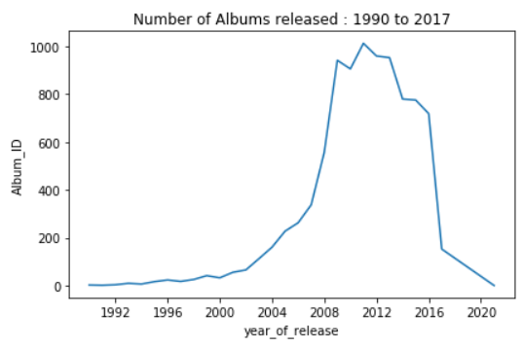
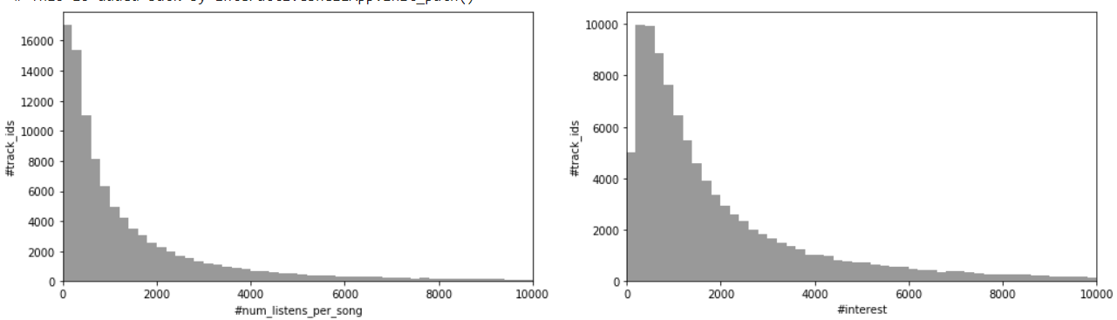
Initial Data Exploration

Slide 5
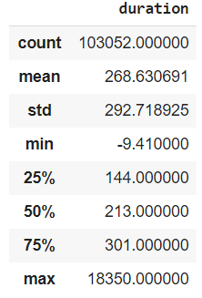
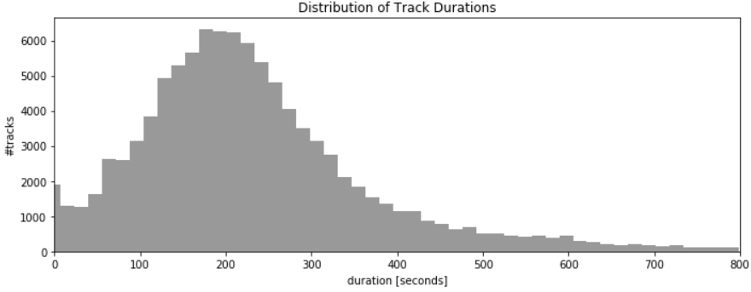
Initial Data Exploration

Slide 6
Data Processing and Manipulation
Dropped the irrelevant features for our business case
Brought the Datasets to a Track Level (Unique at trackid)
Removed IDs, Dates, Titles and other Multilevel categorical features
Missing Duration and Year of Release - Total 17 rows ( Fetched the values from the Internet)
Performed the Univariates Test:
Identified the missing %s in all the variables
Studied the Data Types, Ranges and patterns of the explanatory variables
Skew, Kurtosis and the Quartile distributions were determined
Dropped the Highly correlated variables
Missing value Imputations: Imputed all the continuous NAs by their means and categorical by their modes.
Variable Bucketing: Bucketed the continuous variables using their quartile distributions
5 levels with an equal distribution per level was maintained

Slide 7
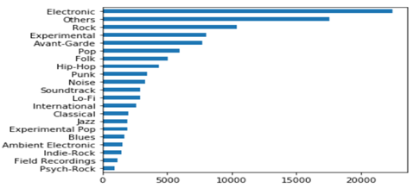
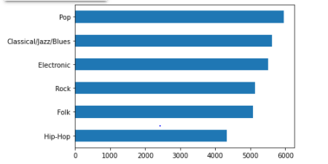
Target Variable Distribution
Initial Y Variable Distribution Distribution After Sampling

Slide 8
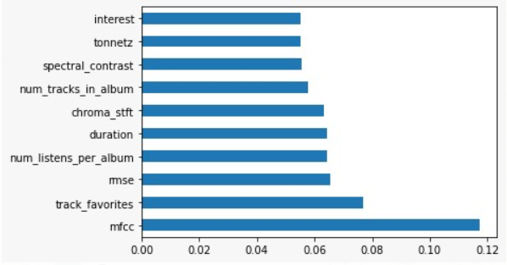
FEATURE SELECTION
Performed Random Forest feature engineering to extract important features below:
Split the dataset into three parts - training set, validation set & testing set

Slide 9
METHODS FOR PROBLEM SOLVING
Engineered the Dataset and the required features
Classification Models -
Built model and tuned the parameters to get the best results
Logistic Regression
Naive Bayes
Neural Networks
Random Forest
Compared the outputs to determine the best algorithm
Created K-means clusters for our song recommendation engine
Shape of Modeling data :
X columns: 9 (Bucketed and Label encoded)
Y variable: 6 Levels

Slide 10
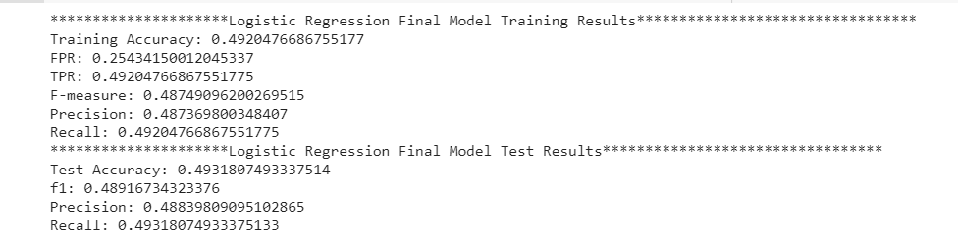
LOGISTIC REGRESSION
Logistic Regression model was used as a base model because of better interpretability
After hyperparameter tuning across values of alpha and lambda, best model had alpha = 1 and lambda = 0.01
The best model after hyperparameter tuning had 49.31% test accuracy in classifying the genre

Slide 11
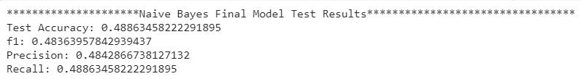
NAIVE BAYES CLASSIFIER
As Naive Bayes assumes features are independent in nature, it took substantially less compute time than other models
Naive Bayes performs better on complex data, and might be the reason for model not performing well as compared to other models

Slide 12
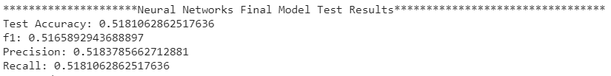
NEURAL NETWORKS(MLP)
Neural Networks (MLP) model performed the second best
As we had 9 important features and 6 target classes, different number of hidden layers and neurons were experimented, with layers [9,18,6,6] giving the best results
Due to Spark not having flexibility in activation function & optimizer, the model did not perform the best, but was the second best in the 4 models that were tried

Slide 13
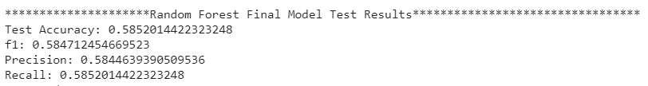
RANDOM FOREST CLASSIFIER
After hyperparameter tuning across number of trees, max depth and max bins; the best model had 25 trees, depth = 15 and bins = 6
The best model gave an test accuracy of 58.5% while classifying genres

Slide 14
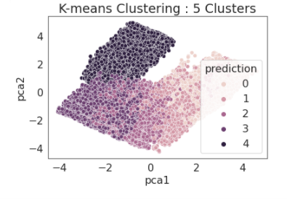
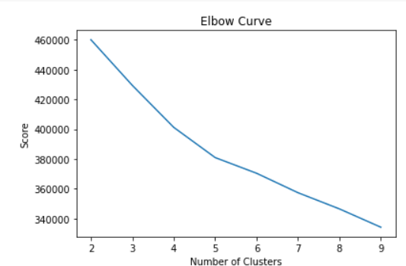
SONG RECOMMENDATION
Initial Approach Collaborative Filtering, Content Based Filtering and Alternating Least Squares.
K-Means:
Optimal Clusters : 5
Silhouette Score : 0.17

Slide 15
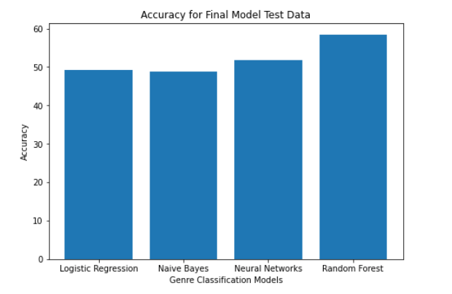
MODEL COMPARISON & RESULTS
The Random Forest model performed the best with 58.52% test accuracy, when compared to Logistic Regression, Naive Bayes & Neural Networks(MLP) models
The AUC scores comparison was done using One Vs All technique as the problem is a multi-class classification problem

Slide 16
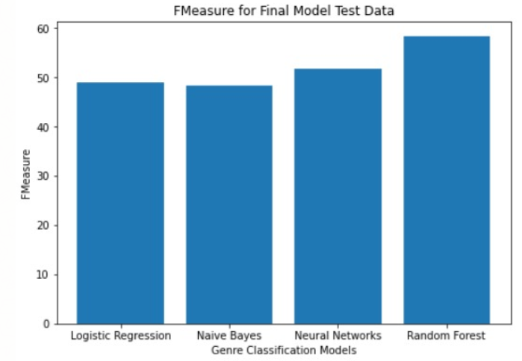
MODEL COMPARISON & RESULTS
The F-Measure was considered the best evaluator for the genre classification problem
The Random Forest performed the best with 58.47 F-1 score

Slide 17
ISSUES ENCOUNTERED
Multiple Datasets- Extensive Preprocessing
Sampling Issues- The Initial Y variable was imbalanced
Neural Network(MLP) has limited options for choosing activation function & optimizers
Gradient Boosting Trees could not be performed as PySpark does not support multi class classification, and supports only binary classification
Multiclass Classification Issues - A great validation score was not achievable
Overlapping Clusters and low silhouette score

Slide 18
ACHIEVING PREDICTION & INFERENCE GOALS
We extracted 9 important features from 40+ features, and performed genre classification task using various models such as Logistic Regression, Naive Bayes, Random Forest and Neural Networks (MLP)
We were able to achieve close to 58.5% accuracy while classifying genres using Random Forest, with MFCC being the most important feature, which makes sense as this feature is generally used for speech recognition system and music information retrieval applications such as genre classification
We were able to successfully recommend songs using inter-cluster arrangements and intra-cluster distances

Slide 19
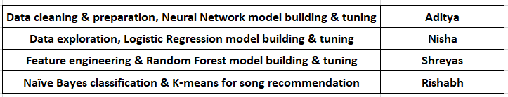
CREDITS

Slide 20
THANK YOU!
-
QUESTIONS?

